Slide 1
Inference in first-order logic
Chapter 9

Slide 2
Outline
Reducing first-order inference to propositional inference
Unification
Generalized Modus Ponens
Forward chaining
Backward chaining
Resolution

Slide 3
Universal instantiation (UI)
Every instantiation of a universally quantified sentence is entailed by it:
∀v α
Subst({v/g}, α)
for any variable v and ground term g
E.g., ∀x King(x) ∧ Greedy(x) ⇒ Evil(x) is equal to:
  King(John) ∧ Greedy(John) ⇒ Evil(John)
  King(Richard) ∧ Greedy(Richard) ⇒ Evil(Richard)
  King(Father(John)) ∧ Greedy(Father(John)) ⇒ Evil(Father(John))
  .
  .
  .

Slide 4
Existential instantiation (EI)
For any sentence α, variable v, and constant symbol k that does not appear elsewhere in the knowledge base:
∃v α
Substitute({v/k}, α)
where v=variable, k=constant
E.g., ∃x Crown(x) ∧ OnHead(x,John) is equivalent to:
Crown(C₁) ∧ OnHead(C₁,John)
provided C₁ is a new constant symbol, called a Skolem constant

Slide 5
Skolem Constant: allows you to remove ∃
Skolem Constant
There exists a good teacher
  ∃x Teacher(x) ∧ Good(x)
  <==> Teacher(C) ∧ Good (C)
Everyone has a mother
  ∀x Person(x) → ∃y Mother(y,x)
  Introduce Skolem Function: m(x)
    Person(x) → Mother (m(x), x))

Slide 6
Reduction to propositional logic
Theorem: Herbrand (1930). If a sentence α is entailed by an FOL KB, it is entailed by a finite subset of the propositionalized KB
(thus, you don’t need to search too far for the subset → it always exists in finite size…)
Idea: For n = 0 to ∞ do
  create a propositional KB by instantiating with depth-$n$ terms
  see if α is entailed by this KB
Problem: works if α is entailed, loops if α is not entailed
Theorem: Turing (1936), Church (1936) Entailment for FOL is
semidecidable (algorithms exist that say yes to every entailed sentence, but no algorithm exists that also says no to every nonentailed sentence.)

Slide 7
Problems with propositionalization
Propositionalization seems to generate lots of irrelevant sentences.
E.g., from:
  ∀x King(x) ∧ Greedy(x) ⇒ Evil(x)
  King(John)
  ∀y Greedy(y)
  Brother(Richard,John)
it seems obvious that Evil(John), but propositionalization produces lots of facts such as Greedy(Richard) that are irrelevant
With p k-ary predicates and n constants, there are p·n^{k} instantiations.
Therefore, we need to find another way to prove things…
➔ not efficient

Slide 8
Unification
We can get the inference immediately if we can find a substitution θ such that King(x) and Greedy(x) match King(John) and Greedy(y)
θ = {x/John,y/John} works
Unify(α,β) = θ if αθ = βθ
α β θ
Knows(John,x) Knows(John,Jane)
Knows(John,x) Knows(y,OJ)
Knows(John,x) Knows(y,Mother(y))
Knows(John,x) Knows(x,OJ)
Standardizing apart eliminates overlap of variables, e.g., Knows(z₁₇,OJ)

Slide 9
Unification
We can get the inference immediately if we can find a substitution θ such that King(x) and Greedy(x) match King(John) and Greedy(y)
θ = {x/John,y/John} works
Unify(α,β) = θ if αθ = βθ
α β θ
Knows(John,x) Knows(John,Jane) {x/Jane}}
Knows(John,x) Knows(y,OJ)
Knows(John,x) Knows(y,Mother(y))
Knows(John,x) Knows(x,OJ)
Standardizing apart eliminates overlap of variables, e.g., Knows(z₁₇,OJ)

Slide 10
Unification
We can get the inference immediately if we can find a substitution θ such that King(x) and Greedy(x) match King(John) and Greedy(y)
θ = {x/John,y/John} works
Unify(α,β) = θ if αθ = βθ
α β θ
Knows(John,x) Knows(John,Jane) {x/Jane}}
Knows(John,x) Knows(y,OJ) {x/OJ,y/John}}
Knows(John,x) Knows(y,Mother(y))
Knows(John,x) Knows(x,OJ)
Standardizing apart eliminates overlap of variables, e.g., Knows(z₁₇,OJ)

Slide 11
Unification
We can get the inference immediately if we can find a substitution θ such that King(x) and Greedy(x) match King(John) and Greedy(y)
θ = {x/John,y/John} works
Unify(α,β) = θ if αθ = βθ
p q θ
Knows(John,x) Knows(John,Jane) {x/Jane}}
Knows(John,x) Knows(y,OJ) {x/OJ,y/John}}
Knows(John,x) Knows(y,Mother(y)) {y/John,x/Mother(John)}}
Knows(John,x) Knows(x,OJ)
Standardizing apart eliminates overlap of variables, e.g., Knows(z₁₇,OJ)

Slide 12
Unification
We can get the inference immediately if we can find a substitution θ such that King(x) and Greedy(x) match King(John) and Greedy(y)
θ = {x/John,y/John} works
Unify(α,β) = θ if αθ = βθ
α β θ
Knows(John,x) Knows(John,Jane) {x/Jane}}
Knows(John,x) Knows(y,OJ) {x/OJ,y/John}}
Knows(John,x) Knows(y,Mother(y)) {y/John,x/Mother(John)}}
Knows(John,x) Knows(x,OJ) {fail}

Slide 13
Unification
To unify Knows(John,x) and Knows(y,z),
θ = {y/John, x/z } or θ = {y/John, x/John, z/John}
The first unifier is more general than the second.
There is a single most general unifier (MGU) that is unique up to renaming of variables.
  MGU = { y/John, x/z }
  Dfn of MGU: theta is a MGU of alpha and beta, if you cannot find a gamma, such that …

Slide 14
Unify these
{P(x,z,y), P(w,u,w), P(A,u,u)}
{P(f(A),x), P(x,A)}

Slide 15
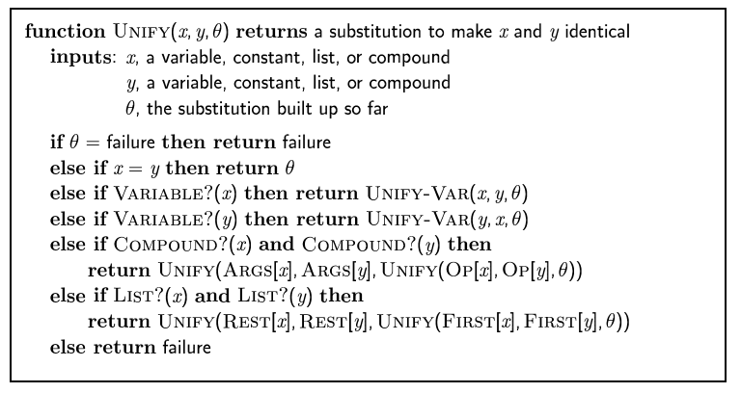
The unification algorithm

Slide 16
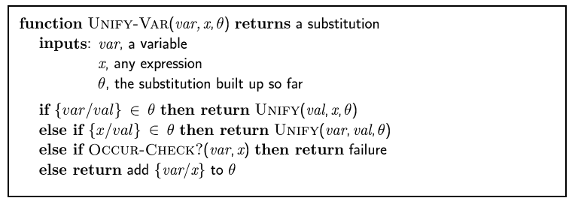
The unification algorithm

Slide 17
Resolution: FOL version
Full first-order version:
l₁ ∨ ··· ∨ l_{k}, m₁ ∨ ··· ∨ m_{n}
(l₁ ∨ ··· ∨ l_{i-1} ∨ l_{i+1} ∨ ··· ∨ l_{k} ∨ m₁ ∨ ··· ∨ m_{j-1} ∨ m_{j+1} ∨ ··· ∨ m_{n})θ
where Unify(l_{i}, ¬m_{j}) = θ.
The two clauses are assumed to be standardized apart so that they share no variables.
For example,
¬Rich(x) ∨ Unhappy(x)
Rich(Ken)
Unhappy(Ken)
with θ = {x/Ken}
Resolution Refutation:
  Apply resolution steps to CNF(KB ∧ ¬α) and infer contradiction (empty clause)
  complete for FOL

Slide 18
Convert to CNF: conjunctive normal form
Also known as clausal form
All quantifiers are eliminated
All implications are eliminated
Clausal form:
  each clause is a set of literals
  Each literal is an atom (proposition) or negated atom
  All clauses are univresally quantified by default
  All existentials are replaced by skolems
Steps…

Slide 19
Steps to Clausal Form
Eliminate implications
Reduce scope of negations
Standardize variables apart
  {P(x,y), Q(x,C)}, {P(x,u), G(y)}
    → {P(x1,y1), Q(x1,C)}, {P(x2,u), G(y2)}
Eliminate existential quantifiers using skolems
Move all quantifiers to the left
Drop the prefix (foralls)
Distribute AND and OR’s using De Morgan’s law
Split Conjunctions into clauses

Slide 20
Try these
Everyone who loves all animals is loved by someone:
Cats are the only animals
Nobody loves John
Prove that
  John does not like some cat (well, what if no cats exist? So, cannot prove this strong statement…)
  John likes no cat (!)

Slide 21
Conversion to CNF
Everyone who loves all animals is loved by someone:
  ∀x [∀y Animal(y) ⇒ Loves(x,y)] ⇒ [∃y Loves(y,x)]
1. Eliminate biconditionals and implications
  ∀x [¬∀y ¬Animal(y) ∨ Loves(x,y)] ∨ [∃y Loves(y,x)]
2. Move ¬ inwards: ¬∀x p ≡ ∃x ¬p, ¬ ∃x p ≡ ∀x ¬p
  ∀x [∃y ¬(¬Animal(y) ∨ Loves(x,y))] ∨ [∃y Loves(y,x)]
  ∀x [∃y ¬¬Animal(y) ∧ ¬Loves(x,y)] ∨ [∃y Loves(y,x)]
  ∀x [∃y Animal(y) ∧ ¬Loves(x,y)] ∨ [∃y Loves(y,x)]

Slide 22
Conversion to CNF contd.
Standardize variables: each quantifier should use a different one
  ∀x [∃y Animal(y) ∧ ¬Loves(x,y)] ∨ [∃z Loves(z,x)]
Skolemize: a more general form of existential instantiation.
  Each existential variable is replaced by a Skolem function of the enclosing universally quantified variables:
  ∀x [Animal(F(x)) ∧ ¬Loves(x,F(x))] ∨ Loves(G(x),x)
Drop universal quantifiers:
  [Animal(F(x)) ∧ ¬Loves(x,F(x))] ∨ Loves(G(x),x)
Distribute ∨ over ∧ :
  [Animal(F(x)) ∨ Loves(G(x),x)] ∧ [¬Loves(x,F(x)) ∨ Loves(G(x),x)]

Slide 23
An example from textbook (page 280, bottom of page)
English: The law says that it is a crime for an American to sell weapons to hostile nations. Nono, an enemy of America, has some missiles, and all of its missiles were sold to it by Colonel West, who is an American.
A(x) and W(y) and Sells(x,y,z) and H(z) ➔ C(x)
A(West)
M(x) ➔ W(x)
M(M1)
M(x) and O(Nono,x) ➔ Sells(W,x, Nono)
Owns(Nono,M1)
E(x,America) ➔ H(x)
E(Nono,,America)
This is known as a datalog since there is no function symbols.
Definite Clause: A1 and A2 and … An → B, where all A1, A2 .. B are positive terms (page 217)
Prove that
West is a criminal
  C(West)

Slide 24
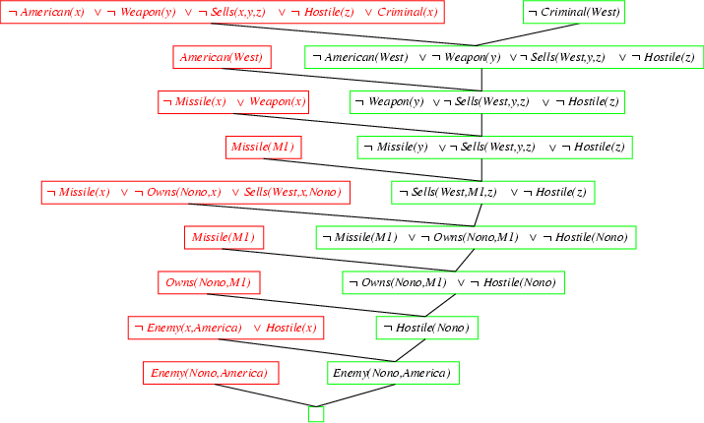
Resolution proof: definite clauses

Slide 25
Example
Assuming the following facts
Steve likes all easy courses.
Science courses are hard.
All the courses in the AI department are easy
Use Resolution Theorem Proving, show:
Steve likes some courses in AI department
  What is wrong? AI department may be empty!
Try this: Steve likes all courses in AI department.

Slide 26
Another Example (page 298)
Jack owns a dog. Every dog owner is an animal lover. No animal lover kills an animal. Either Jack or Curiosity killed the cat, who is named Tuna. Did Curiosity kill the cat?
(solution: http://www.indiana.edu/~gasser/Q351/rtp_example.html)

Slide 27
Finding Answers in resolution theorem proving
Students who take a course like that course
John is a student
John is taking comp221
Finding answer: who likes comp221?
¬ ∃ x. (Likes (x, comp221) ∧ Answer (x))

Slide 28
Finding Answers
Animals can outrun any animals that they eat
Carnivores eat other animals
Outrunning is transitive: if x outruns y, and y outruns z, then x can outrun z.
Lions eat zebras
Zebras can outrun dogs
Dogs are carnivores
Use resolution to find three animals that lions can outrun

Slide 29
Logic programming: Prolog
Algorithm = Logic + Control
Basis: backward chaining with Horn clauses + bells & whistles
  Horn clause: a clause where at most one terms is positive
Widely used in Europe, Japan (basis of 5th Generation project)
Program = set of clauses = head :- literal₁, … literal_{n}.
criminal(X) :- american(X), weapon(Y), sells(X,Y,Z), hostile(Z).
Same as (criminal(X) ← american(X), weapon(Y), sells(X,Y,Z), hostile(Z) )
Depth-first, left-to-right backward chaining
Built-in predicates for arithmetic etc., e.g., X is Y*Z+3
Built-in predicates that have side effects (e.g., input and output
predicates, assert/retract predicates)
Closed-world assumption ("negation as failure")
  e.g., given alive(X) :- not dead(X).
  alive(joe) succeeds if dead(joe) fails

Slide 30
Negation as Failure (page 357)
If you cannot prove that P holds, then “not P” is true
  Called ("negation as failure")
  a jump to a new conclusion
  Closed-world assumption (the world consists of finite true facts; all others are false)
  e.g., given alive(X) :- not dead(X).
  alive(joe) succeeds if dead(joe) fails
Example
  John is a student
  John takes the AI course
  John takes the database course
  Prove that John does not take the English course

Slide 31
Prolog
Appending two lists to produce a third:
append([],Y,Y).
append([X|L],Y,[X|Z]) :- append(L,Y,Z).
query: append(A,B,[1,2]) ?
answers: A=[] B=[1,2]
A=[1] B=[2]
A=[1,2] B=[]

