Slide 1
COMP 361 – “Networks I” Fall 2003
Instructor: Mordecai Golin www.cs.ust.hk/~golin
http://course.cs.ust.hk/comp361/fall2003/html/comp361.html (or via instructor’s web site) contains all notes, announcements, etc. Check it regularly!
Class meets Tuesday/Thursday 9:10:20 Rm 2407
Labs: Friday 12-12:50 and 17:17:50 Rm 4214 No Labs Sept 5 and Sept 12

Slide 2
Textbook: James Kurose and Keith Ross
Computer Networks: A Top Down Approach Featuring The Internet, 2nd ed., Addison Wesley, 2002
Course material is based on lecture notes and chapters in the textbook. You are responsible to read the corresponding book chapters.
There is one project (to be announced at start of Oct. Will take one month)
Labs are actually tutorials to review material and time to work on project. You will be given homework questions to practice on but they will not be marked
Class Grading Scheme:
Midterm Examination 30 points
Final Examination 45 points
Course Project 25 points

Slide 3
Other Stuff
You must have a CS department UG UNIX account (not a windows account) in order to work on the project.
The project will have to be written in Java. Please see the notes section of the web site http://course.cs.ust.hk/comp361/spr2003/html/spr03sch.html
under Lab notes (week 1) for a tutorial (re)introduction to Java.
The textbook has a an accompanying web site http://wps.aw.com/aw_kurose_network_2/
with useful resource material, e.g., illustrative applets.
Protected section of the site also has self-study quizzes.

Slide 4
Copyright Notice
Material that follows is substantially based on powerpoint slides developed and copyrighted by J.F. Kurose and K.W. Ross, 1996-2002.

Slide 5
Philosophical Quandary: Top Down or Bottom Up?
Two ways to teach
Bottom Up: Start with Physical (e.g., wires) layer and move up to Application (e.g., mail, web browsers) layer explaining how known resources can be used to implement requested services
Top Down : Start with Application layer and move down to Physical layer, explaining how required applications can be implemented
We teach top down!
application
transport
network
link
physical

Slide 6
Chapter 1: Computer Networks and the Internet
Chapter goal:
get context, overview, “feel” of networking
more depth, detail later in course
approach:
  descriptive
  use Internet as example
Overview:
1.1 what’s the Internet?
1.2 what’s a protocol?
1.3 network edge – end devices
1.4 network core – circuit, packet, and message switching
1.5 access networks & physical media
1.6 performance: loss, delay
1.7 protocol layers & service models
1.8 Internet backbones, NAPs, ISPs
1.9 history

Slide 7





What’s the Internet: “nuts and bolts” view
Internet: “network of networks”
  loosely hierarchical: company networks, access networks, local ISPs (Internet Service Providers), regional ISPs
  millions of connected computing devices: hosts, end-systems
  pc’s workstations, servers
  PDA’s phones, toasters
  running network applications
communication links made up of different physical media:
  fiber, copper, radio, satellite
routers: forward packets (chunks) of data thru network
router
workstation
server
mobile
local ISP
To backbone
provider
Access Network
regional ISP
company
network

Slide 8
1.1 What’s the Internet: “nuts and bolts” view
protocols control the sending and receiving of information (messages) within the Internet
  e.g., TCP, IP, HTTP, FTP, PPP
Internet standards
  IETF, the Internet Engineering Task Force, is where much of “standards” in used in the Internet today were discussed and created. IETF is a forum that is open to any interested individuals. The standards it created are contained in documents known as RFC, Request for comments.
  Important websites:
    Internet Engineering Task Force (IETF) – www.ietf.org
    Internet Society – www.isoc.org
    The World Wide Web Consortium (W3C) – www.w3.org/Consortium
    and others listed in section 1.1.3 of the text.

Slide 9
What’s the Internet: a service view
communication infrastructure enables distributed applications:
  WWW, email, games, e-commerce, database, voting,
  more?
communication services provided:
  Connectionless
    Vs.
  Connection-oriented
  The dichotomy of connectionless/connection-oriented service can be applied to different communication layers. We will return later to the concept of layering.

Slide 10
Chapter 1: Computer Networks and the Internet
1.1 what’s the Internet?
1.2 what’s a protocol?
1.3 network edge – end devices
1.4 network core – circuit, packet, and message switching
1.5 access networks & physical media
1.6 performance: loss, delay
1.7 protocol layers & service models
1.8 Internet backbones, NAPs, ISPs
1.9 history

Slide 11
1.2 What’s a protocol?
protocols define format, order of messages sent and received among network entities, and actions taken on msg transmission, receipt
… specific msgs (messages) sent
… specific actions taken when msgs received, or other events
network protocols:
machines rather than humans
all communication activity in Internet governed by protocols
human protocols:
“what’s the time?”
“I have a question”
introductions
An important concept is that Communication protocols are structured in layers. Each protocol layer makes uses of the services provided by the layer below and provides a service to the layer above.

Slide 12


What’s a protocol?
a human protocol and a computer network protocol:
Hi
TCP connection
req.
Hi
TCP connection
reply.
Got the
time?
Get http://gaia.cs.umass.edu/index.htm
2:00
<file>
time
Q: Other human protocol?

Slide 13
A closer look at network structure:
network edge: applications and hosts
network core:
  routers
  network of networks
access networks, physical media: communication links

Slide 14
Chapter 1: Computer Networks and the Internet
1.1 what’s the Internet?
1.2 what’s a protocol?
1.3 network edge – end devices
1.4 network core – circuit, packet, and message switching
1.5 access networks & physical media
1.6 performance: loss, delay
1.7 protocol layers & service models
1.8 Internet backbones, NAPs, ISPs
1.9 history

Slide 15
1.3 The network edge:
end systems (hosts):
  run application programs
  e.g., WWW, email
  at “edge of network”
client/server model
  client initiates requests to and receives service from server
  e.g., WWW client (browser)/ server; email client/server
peer-peer model:
  host interaction is symmetric
  e.g.: teleconferencing

Slide 16
Network edge: connection-oriented service
Goal: data transfer between end sys.
handshaking: setup (prepare for) data transfer ahead of time
  Hello, hello back human protocol
  set up “state” in two communicating hosts
TCP - Transmission Control Protocol
  Internet’s connection-oriented service
TCP service [RFC 793]
reliable, in-order byte-stream data transfer
  loss: acknowledgements and retransmissions
flow control:
  sender won’t overwhelm receiver
congestion control:
  senders “slow down sending rate” when network congested

Slide 17
Network edge: connectionless service
Goal: data transfer between end systems
  same as before!
UDP - User Datagram Protocol [RFC 768]: Internet’s connectionless service
  unreliable data transfer
  no flow control
  no congestion control
  but faster!
App’s using TCP:
HTTP (WWW), FTP (file transfer), Telnet (remote login), SMTP (email)
App’s using UDP:
streaming media, teleconferencing, Internet telephony

Slide 18
Chapter 1: Computer Networks and the Internet
1.1 what’s the Internet?
1.2 what’s a protocol?
1.3 network edge – end devices
1.4 network core – circuit, packet, and message switching
1.5 access networks & physical media
1.6 performance: loss, delay
1.7 protocol layers & service models
1.8 Internet backbones, NAPs, ISPs
1.9 history

Slide 19
1.4 Network Core
Circuit Switching vs. Packet Switching
the fundamental question: how is data transferred through net?
  Circuit switching: dedicated circuit per call: telephone net
  Packet switching: data sent thru net in discrete “chunks”
  In circuit switching, a channel of fixed rate (bandwidth) is provided between the communicating end-points. In packet switching, packets are exchanged only as needed.
  In circuit switching, identity of the data being transferred is provided implicitly by its time slot or frequency assignment. In packet switching, identity of data must be explicitly specified by a header.
  Circuit switching must be connection-oriented. Packet switching can be connectionless (datagram), or connection-oriented (virtual circuit).
Modern computer communication is based on packet switching

Slide 20
Clarification
Transport Layer
TCP and UDP are Transport Layer protocols that provide connection-oriented and connectionless services to Application Layer clients
Switching Paradigm
Circuit Switching vs Packet Switching (or Message Switching) occurs at the physical switching layer. Circuit Switching is the system usually used by telephone networks but is not used in the Internet (except, e.g., when you dial up to an ISP using a modem).
Network Layer (Assuming Packet Switching)
Datagram and Virtual Circuits are network service models at the Network Layer. Current Internet architecture only provides a Datagram service.
.

Slide 21
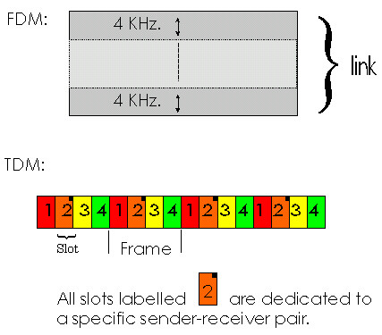
Network Core - Circuit Switching
Circuit Switching
call setup (and tear-down) required
split bandwidth into “pieces” by
  frequency division or
  time division
Bandwidth and switch resources reserved for the duration of a call
dedicated resources: no sharing
circuit-like (guaranteed) performance
Ex: telephone network

Slide 22
Network Core: Packet Switching
each end-end data stream divided into packets
user A, B packets share network resources
each packet transmitted at full link bandwidth
resources used as needed,
resource contention:
aggregate resource demand can exceed amount available
congestion: packets queue, wait for link use
store and forward: packets move one hop at a time
  transmit over link
  wait turn at next link
Bandwidth division into “pieces”
Dedicated allocation
Resource reservation

Slide 23
Network Core: Packet Switching
10 Mbs
Ethernet
A
C
statistical multiplexing
1.5 Mbs
B
queue of packets
waiting for output
link
45 Mbs
D
E
Packet-switching versus circuit switching: human restaurant analogy

Slide 24
Packet switching versus circuit switching
Packet switching allows more users to use network!
1 Mbit link
each user:
  100Kbps when “active”
  active 10% of time
circuit-switching:
  10 users
packet switching:
  with 35 users, the probability that more than 10 users are active in a given time is less than .004. When it happens, excess packets are queued up and suffer additional delays.
N users
1 Mbps link

Slide 25
Packet switching versus circuit switching
Is packet switching a “slam dunk winner?”
Great for bursty data
  resource sharing
  no call setup
Excessive congestion: packet delay and loss
  protocols needed for reliable data transfer, congestion control
Q: How to provide circuit-like behavior?
  bandwidth guarantees needed for audio/video apps
  still an unsolved problem (chapter 6)

Slide 26
Packet-switching: store-and-forward
L
R
R
R
Takes L/R seconds to transmit (push out) packet of L bits on to link or R bps
Entire packet must arrive at router before it can be transmitted on next link: store and forward
delay = 3L/R
Example:
L = 7.5 Mbits
R = 1.5 Mbps
delay = 15 sec

Slide 27
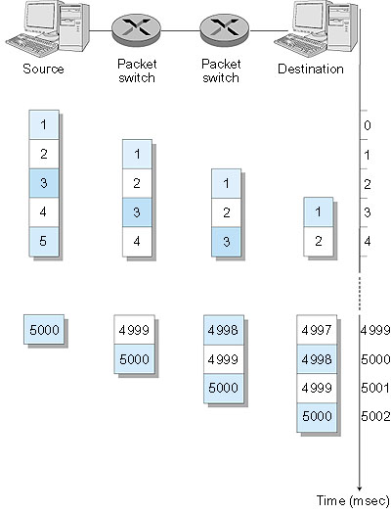
Packet Switching: Message Segmenting
Now break up the message into 5000 packets
Each packet 1,500 bits
1 msec to transmit packet on one link
pipelining: each link works in parallel
Delay reduced from 15 sec to 5.002 sec

Slide 28
Packet-switched networks: routing
Goal: move packets among routers from source to destination
  we’ll study several path selection algorithms (chapter 4)
datagram network:
  destination address determines next hop
  routes may change during session
  analogy: driving, asking directions
virtual circuit network:
  each packet carries tag (virtual circuit ID), tag determines next hop
  fixed path determined at call setup time, remains fixed thru call
  routers maintain per-call state

Slide 29
Clarification
Transport Layer
TCP and UDP are Transport Layer protocols that provide connection-oriented and connectionless services to Application Layer clients
Switching Paradigm
Circuit Switching vs Packet Switching (or Message Switching) occurs at the physical switching layer. Circuit Switching is the system usually used by telephone networks but is not used in the Internet (except, e.g., when you dial up to an ISP using a modem).
Network Layer (Assuming Packet Switching)
Datagram and Virtual Circuits are network service models at the Network Layer. Current Internet architecture only provides a Datagram service.
.

Slide 30
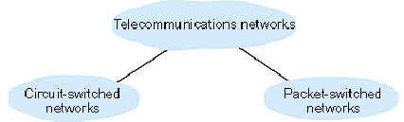

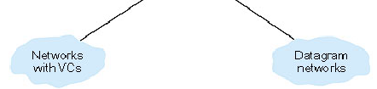
Core Network - Summary

Slide 31
Chapter 1: Computer Networks and the Internet
1.1 what’s the Internet?
1.2 what’s a protocol?
1.3 network edge – end devices
1.4 network core – circuit, packet, and message switching
1.5 access networks & physical media
1.6 performance: loss, delay
1.7 protocol layers & service models
1.8 Internet backbones, NAPs, ISPs
1.9 history

Slide 32
1.5 Access networks and physical media
Q: How to connect end systems to edge router?
residential access nets
institutional access networks (school, company)
mobile access networks
Keep in mind:
bandwidth (bits per second) of access network?
shared or dedicated?

Slide 33
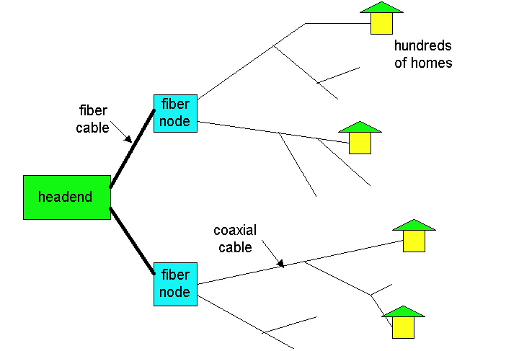
Residential access
Cable Modem
HFC: hybrid fiber coax
  asymmetric: up to 10Mbps upstream, 1 Mbps downstream
network of cable and fiber attaches homes to ISP router
  shared access to router among homes
  issues: congestion, dimensioning
deployment: available via cable companies
Point-to-point
Dialup via modem
  up to 56Kbps direct access to router (conceptually)
ISDN: integrated services digital network: 128Kbps all-digital connect to router
ADSL: asymmetric digital subscriber line
  up to 1 Mbps home-to-router
  up to 8 Mbps router-to-home

Slide 34
Institutional access: local area networks
company/univ local area network (LAN) connects end system to edge router
Ethernet:
  shared or dedicated cable connects end system and router
  10 Mbs, 100Mbps, Gigabit Ethernet
deployment: institutions, home LANs soon
LANs: chapter 5

Slide 35
Wireless access networks
shared wireless access network connects end system to router
wireless LANs:
  radio spectrum replaces wire
  e.g., Lucent Wavelan 10 Mbps
wider-area wireless access
  CDPD: wireless access to ISP router via cellular network
router
base
station
mobile
hosts

Slide 36
Physical Media
Twisted Pair (TP)
two insulated copper wires
  Category 3: traditional phone wires, 10 Mbps Ethernet
  Category 5 TP: 100Mbps Ethernet
physical link: transmitted data bit propagates across link
guided media:
  signals propagate in solid media: copper, fiber
unguided media:
  signals propagate freely, e.g., radio

Slide 37


Physical Media: coax, fiber
Coaxial cable:
wire (signal carrier) within a concentric shield
  Baseband (50 ohm): single channel on cable. ~1cm thick, popular in old 10 Mbs Ethernet
  Broadband (75 ohm): multiple channels on cable, each channel shifted to a different frequency band. Thick and stiffer, common in cable TV systems.
bidirectional
Fiber optic cable:
glass fiber carrying light pulses
high-speed operation:
  100Mbps Ethernet
  high-speed point-to-point transmission (e.g., 10 Gps)
low error rate

Slide 38
Physical media: radio
signal carried in electromagnetic spectrum
no physical “wire”
bidirectional
propagation environment effects:
  reflection
  obstruction by objects
  interference
Radio link types:
microwave
  e.g. up to 45 Mbps channels
LAN (e.g., waveLAN)
  2Mbps, 11Mbps
wide-area (e.g., cellular)
  e.g. CDPD, 10’s Kbps
satellite
  up to 50Mbps channel (or multiple smaller channels)
  270 Msec end-end delay
  geosynchronous versus LEOS

Slide 39
Chapter 1: Computer Networks and the Internet
1.1 what’s the Internet?
1.2 what’s a protocol?
1.3 network edge – end devices
1.4 network core – circuit, packet, and message switching
1.5 access networks & physical media
1.6 performance: loss, delay
1.7 protocol layers & service models
1.8 Internet backbones, NAPs, ISPs
1.9 history

Slide 40
1.6 Delay & Loss in packet-switched networks
packets queue in router buffers
packet arrival rate to link exceeds output link capacity
packets queue, wait for turn
packet being transmitted (delay)
A
B
packets queuing (delay)
free (available) buffers: arriving packets
dropped (loss) if no free buffers

Slide 41
Delay in packet-switched networks
packets experience delay on end-to-end path
four sources of delay at each hop
1. nodal processing:
  check bit errors
  determine output link
2. queuing:
  time waiting at output link for transmission
  depends on congestion level of router
transmission
A
propagation
B
nodal
processing
queuing

Slide 42
Delay in packet-switched networks
3. transmission delay:
R=link bandwidth (bps)
L=packet length (bits)
time to send bits into link = L/R
4. propagation delay:
d = length of physical link
s = propagation speed in medium (~2x10⁸ m/sec)
propagation delay = d/s
Note: s and R are very different quantities!
transmission
A
propagation
B
nodal
processing
queuing

Slide 43
Caravan analogy
100 km
100 km
ten-car
caravan
toll
booth
toll
booth
Cars “propagate” at
100 km/hr
Toll booth takes 12 sec to service a car (transmission time)
car~bit; caravan ~ packet
Q: How long until caravan is lined up before 2nd toll booth?
Time to “push” entire caravan through toll booth onto highway = 12*10 = 120 sec
Time for last car to propagate from 1st to 2nd toll both: 100km/(100km/hr)= 1 hr
A: 62 minutes

Slide 44
Caravan analogy (more)
100 km
100 km
ten-car
caravan
toll
booth
toll
booth
Yes! After 7 min, 1st car at 2nd booth and 3 cars still at 1st booth.
1st bit of packet can arrive at 2nd router before packet is fully transmitted at 1st router!
  See Ethernet applet at AWL Web site
Cars now “propagate” at
1000 km/hr
Toll booth now takes 1 min to service a car
Q: Will cars arrive to 2nd booth before all cars serviced at 1st booth?

Slide 45

Queuing delay (revisited)
R=link bandwidth (bps)
L=packet length (bits)
a=average packet arrival rate
traffic intensity = La/R
La/R ~ 0: average queuing delay small
La/R -> 1: delays become large
La/R > 1: more “work” arriving than can be serviced, average delay infinite!

Slide 46
“Real” Internet delays and routes
What do “real” Internet delay & loss look like?
Traceroute program: provides delay measurement from source to router along end-end Internet path towards destination. For all i:
  sends three packets that will reach router i on path towards destination
  router i will return packets to sender
  sender times interval between transmission and reply.
3 probes
3 probes
3 probes

Slide 47
traceroute www.weather.org.hk
traceroute to www.weather.org.hk (202.72.0.62), 30 hops max, 40 byte packets
1 betamach (143.89.43.201) 1.141 ms 0.727 ms 0.648 ms
2 202.40.138.120 (202.40.138.120) 1.204 ms 0.709 ms 0.652 ms
3 c7603.ust.hk (202.40.138.254) 1.709 ms 1.735 ms 1.769 ms
4 202.40.217.65 (202.40.217.65) 2.480 ms 10.606 ms 11.267 ms
5 * * *
6 J-4-0-0Z30.wc-core2.noc.cpcnet-hk.com (202.76.9.57) 5.270 ms 9.637 ms 9.987 ms
7 C-0-1.wc-qb1.noc.cpcnet-hk.com (210.184.16.218) 10.554 ms 10.694 ms 11.474 ms
8 C-0-0.qb-fm1.noc.cpcnet-hk.com (202.76.120.10) 10.873 ms 12.380 ms 11.008 ms
9 202.72.30.2 (202.72.30.2) 53.747 ms * 48.373 ms
10 202.72.0.62 (202.72.0.62) 11.893 ms 7.637 ms 10.137 ms

Slide 48
traceroute www.cs.princeton.edu
traceroute to www.cs.princeton.edu (128.112.136.35), 30 hops max, 40 byte packets
1 betamach (143.89.43.201) 1.231 ms 0.703 ms 0.640 ms
2 fcdscr3.ust.hk (202.40.138.121) 0.796 ms 0.938 ms 0.786 ms
3 * * *
4 * * *
5 192.245.196.82 (192.245.196.82) 2.767 ms 3.081 ms 3.723 ms
6 192.245.196.110 (192.245.196.110) 235.428 ms 234.831 ms 234.870 ms
7 chinng-iplsng.abilene.ucaid.edu (198.32.8.76) 244.737 ms 238.280 ms 238.537 ms
8 nycmng-chinng.abilene.ucaid.edu (198.32.8.83) 259.712 ms 258.783 ms 258.455 ms
9 washng-nycmng.abilene.ucaid.edu (198.32.8.85) 263.580 ms 263.689 ms 268.510 ms
10 local1.abilene.magpi.net (198.32.42.209) 265.515 ms 267.031 ms 265.328 ms
11 remote.princeton.magpi.net (198.32.42.66) 267.300 ms 268.220 ms 266.764 ms
12 gigagate1.Princeton.EDU (128.112.12.21) 266.824 ms 267.111 ms 267.585 ms
13 csgate.Princeton.EDU (128.112.128.144) 269.710 ms 267.470 ms 266.836 ms
14 targe.CS.Princeton.EDU (128.112.139.194) 268.235 ms 268.071 ms 267.733 ms
15 ignition.CS.Princeton.EDU (128.112.138.1) 268.132 ms 268.364 ms 267.561 ms
16 web0.CS.Princeton.EDU (128.112.136.35) 268.589 ms 268.695 ms 268.591 ms

Slide 49
Packet loss
queue (aka buffer) preceding link in buffer has finite capacity
when packet arrives to full queue, packet is dropped (aka lost)
lost packet may be retransmitted by previous node, by source end system, or not retransmitted at all

Slide 50
Chapter 1: Computer Networks and the Internet
1.1 what’s the Internet?
1.2 what’s a protocol?
1.3 network edge – end devices
1.4 network core – circuit, packet, and message switching
1.5 access networks & physical media
1.6 performance: loss, delay
1.7 protocol layers & service models
1.8 Internet backbones, NAPs, ISPs
1.9 history

Slide 51
1.7 - Protocol “Layers”
Networks are complex!
many “pieces”:
  hosts
  routers
  links of various media
  applications
  protocols
  hardware, software
Question:
Is there any hope of organizing structure of network?
Or at least our discussion of networks?
Layering breaks a complex problem into smaller pieces with clear relationships
explicit structure allows identification, relationship of complex system’s pieces
  Provide a reference model for discussion
modularization eases maintenance, updating of system
  Allow changes in implementation of a layer without affecting the rest of the system

Slide 52
Protocol Layering and Data
Each protocol layer:
Contains “entities” implementing layer functions at each node, which may include: Error Control, Flow Control, Segmentation and Reassembly, Multiplexing, and Connection Setups.
entities perform actions and exchange messages known as Protocol Data Units (PDU) with peers. Layer n entities would exchange n-PDU using the service of layer n-1.
Each layer takes data from above
  adds layer header information to create new data unit
  passes new data unit to layer below
source
destination
M
Layer 5
Layer 4
Layer 3
Layer 2
Layer 1
Layer 5
Layer 4
Layer 3
Layer 2
Layer 1
M
5-PDU
H
4
M
H
4
M
4-PDU
H
H
H
H
M
3-PDU
3
4
M
3
4
H
H
H
H
H
H
M
2-PDU
2
3
4
M
2
3
4

Slide 53
Internet protocol stack
application: supporting network applications
  ftp, smtp, http
transport: host-host data transfer
  tcp, udp
network: routing of datagrams from source to destination
  ip, routing protocols
link: data transfer between neighboring network elements
  ppp, ethernet
physical: bits “on the wire”, modulation scheme, line-coding format, electrical & physical specifications, etc.
Routers in the network operate only up to the Network Layer
application
transport
network
link
physical
Host
Router

Slide 54
Example of Layering: logical communication
E.g.: transport
take data from app
add addressing, reliability check info to form “datagram”
send datagram to peer using service provided by the Network Layer
wait for peer to acknowledge receipt
data
application
transport
network
link
physical
transport
ack
network
link
physical
application
transport
network
link
physical
data
data
application
transport
network
link
physical
application
transport
network
link
physical
transport

Slide 55
Layering: physical communication
data
application
transport
network
link
physical
network
link
physical
application
transport
network
link
physical
data
application
transport
network
link
physical
application
transport
network
link
physical

Slide 56
Chapter 1: Computer Networks and the Internet
1.1 what’s the Internet?
1.2 what’s a protocol?
1.3 network edge – end devices
1.4 network core – circuit, packet, and message switching
1.5 access networks & physical media
1.6 performance: loss, delay
1.7 protocol layers & service models
1.8 Internet backbones, NAPs, ISPs
1.9 history

Slide 57
1.8 Internet structure: network of networks
roughly hierarchical
national/international backbone providers (NBPs)
  e.g. BBN/GTE, Sprint, AT&T, IBM, UUNet
  interconnect (peer) with each other privately, or at public Network Access Point (NAPs)
regional ISPs
  connect into NBPs
local ISP, company
  connect into regional ISPs
local
ISP
regional ISP
NBP B
NAP
NAP
NBP A
regional ISP
local
ISP

Slide 58
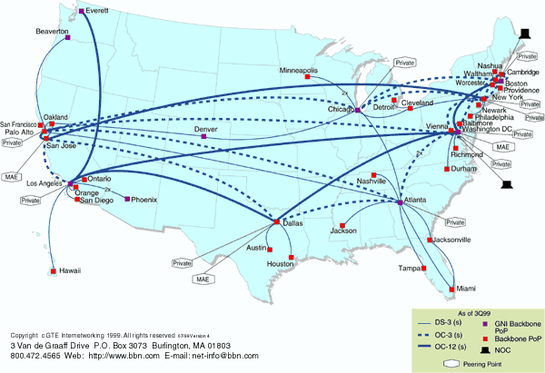
National Backbone Provider
e.g. BBN/GTE US backbone network

Slide 59
Chapter 1: Computer Networks and the Internet
1.1 what’s the Internet?
1.2 what’s a protocol?
1.3 network edge – end devices
1.4 network core – circuit, packet, and message switching
1.5 access networks & physical media
1.6 performance: loss, delay
1.7 protocol layers & service models
1.8 Internet backbones, NAPs, ISPs
1.9 history

Slide 60
1.9 Internet History
1961-1972: Early packet-switching principles
1961: Kleinrock - queueing theory shows effectiveness of packet-switching
1964: Baran - packet-switching in military nets
1967: ARPAnet conceived by Advanced Research Projects Agency
1969: first ARPAnet node operational
1972:
  ARPAnet demonstrated publicly
  NCP (Network Control Protocol) first host-host protocol
  first e-mail program
  ARPAnet has 15 nodes

Slide 61
Internet History
1972-1980: Internetworking, new and proprietary nets
1970: ALOHAnet satellite network in Hawaii
1973: Metcalfe’s PhD thesis proposes Ethernet
1974: Cerf and Kahn - architecture for interconnecting networks
late70’s: proprietary architectures: DECnet, SNA, XNA
late 70’s: switching fixed length packets (ATM precursor)
1979: ARPAnet has 200 nodes
Cerf and Kahn’s internetworking principles:
  minimalism, autonomy - no internal changes required to interconnect networks
  best effort service model
  stateless routers
  decentralized control
define today’s Internet architecture

Slide 62
Internet History
1980-1990: new protocols, a proliferation of networks
1983: deployment of TCP/IP
1982: smtp e-mail protocol defined
1983: DNS defined for name-to-IP-address translation
1985: ftp protocol defined
1988: TCP congestion control
new national networks: Csnet, BITnet, NSFnet, Minitel
100,000 hosts connected to confederation of networks

Slide 63
Internet History
1990’s: commercialization, the WWW
Early 1990’s: ARPAnet decommissioned
1991: NSF lifts restrictions on commercial use of NSFnet (decommissioned, 1995)
early 1990s: WWW
  hypertext [Bush 1945, Nelson 1960’s]
  HTML, http: Berners-Lee
  1994: Mosaic, later Netscape
  late 1990’s: commercialization of the WWW
Late 1990’s & 2000’s:
est. 50 million computers on Internet
est. 100 million+ users
backbone links running at 1 Gbps
Chapter 1: Summary
You now hopefully have:
context, overview, “feel” of networking
more depth, detail later in course

Slide 64
Chapter 1: Summary
Covered a “ton” of material!
Internet overview
what’s a protocol?
network edge, core, access network
performance: loss, delay
layering and service models
backbones, NAPs, ISPs
history
ATM network
You now hopefully have:
context, overview, “feel” of networking
more depth, detail later in course

