Slide 1
Chapter 3: Transport Layer last updated 11/10/03
Chapter goals:
understand principles behind transport layer services:
  multiplexing/demultiplexing
  reliable data transfer
  flow control
  congestion control
instantiation and implementation in the Internet
Chapter Overview:
transport layer services
multiplexing/demultiplexing
connectionless transport: UDP
principles of reliable data transfer
connection-oriented transport: TCP
  reliable transfer
  flow control
  connection management
principles of congestion control
TCP congestion control

Slide 2
Chapter 3 outline
3.1 Transport-layer services
3.2 Multiplexing and demultiplexing
3.3 Connectionless transport: UDP
3.4 Principles of reliable data transfer
3.5 Connection-oriented transport: TCP
  segment structure
  reliable data transfer
  flow control
  connection management
3.6 Principles of congestion control
3.7 TCP congestion control

Slide 3





Transport services and protocols
provide logical communication between app processes running on different hosts
transport protocols run in end systems
  send side: breaks app messages into segments, passes to network layer
  rcv side: reassembles segments into messages, passes to app layer
more than one transport protocol available to apps
  Internet: TCP and UDP
application
transport
network
data link
physical
network
data link
physical
network
data link
physical
network
data link
physical
logical end-end transport
network
data link
physical
network
data link
physical
application
transport
network
data link
physical

Slide 4
Transport vs. network layer
network layer: logical communication between hosts
transport layer: logical communication between processes
  relies on, enhances, network layer services
Household analogy:
12 kids sending letters to 12 kids
processes = kids
app messages = letters in envelopes
hosts = houses
transport protocol = Ann and Bill
network-layer protocol = postal service

Slide 5
Transport-layer protocols
Internet transport services:
reliable, in-order unicast delivery (TCP)
  congestion
  flow control
  connection setup
unreliable (“best-effort”), unordered unicast or multicast delivery: UDP
services not available:
  real-time
  bandwidth guarantees
  reliable multicast
application
transport
network
data link
physical
network
data link
physical
network
data link
physical
network
data link
physical
logical end-end transport
network
data link
physical
network
data link
physical
application
transport
network
data link
physical

Slide 6
Chapter 3 outline
3.1 Transport-layer services
3.2 Multiplexing and demultiplexing
3.3 Connectionless transport: UDP
3.4 Principles of reliable data transfer
3.5 Connection-oriented transport: TCP
  segment structure
  reliable data transfer
  flow control
  connection management
3.6 Principles of congestion control
3.7 TCP congestion control

Slide 7
Multiplexing/demultiplexing
Demultiplexing at rcv host:
Multiplexing at send host:
delivering received segments
to correct socket
gathering data from multiple
sockets, enveloping data with
header (later used for
demultiplexing)
= socket
= process
application
application
application
P4
P3
P1
P2
P1
transport
transport
transport
network
network
network
link
link
link
physical
physical
physical
host 1
host 2
host 3

Slide 8
Multiplexing/demultiplexing
segment - unit of data exchanged between transport layer entities
  aka TPDU: transport protocol data unit
Demultiplexing: delivering
received segments to
correct app layer processes
receiver
P3
P4
application-layer
data
M
M
application
transport
network
segment
header
P1
P2
M
M
application
transport
network
application
transport
network
segment
H
t
M
H
segment
n

Slide 9
How demultiplexing works
host receives IP datagrams
  each datagram has source IP address, destination IP address
  each datagram carries 1 transport-layer segment
  each segment has source, destination port number
  (recall: well-known port numbers for specific applications)
host uses IP addresses & port numbers to direct segment to appropriate socket
32 bits
source port #
dest port #
other header fields
application
data
(message)
TCP/UDP segment format

Slide 10
Connectionless demultiplexing
When host receives UDP segment:
  checks destination port number in segment
  directs UDP segment to socket with that port number
IP datagrams with different source IP addresses and/or source port numbers directed to same socket
Create sockets with port numbers:
DatagramSocket mySocket1 = new DatagramSocket(99111);
DatagramSocket mySocket2 = new DatagramSocket(99222);
UDP socket identified by two-tuple:
(dest IP address, dest port number)

Slide 11
Connectionless demux (cont)
DatagramSocket serverSocket = new DatagramSocket(6428);
P3
P1
P3
P1
SP: 6428
SP: 6428
DP: 9157
DP: 5775
SP: 9157
SP: 5775
client
IP: A
DP: 6428
server
IP: C
DP: 6428
Client
IP:B
SP provides “return address”

Slide 12
Connection-oriented demux
TCP socket identified by 4-tuple:
  source IP address
  source port number
  dest IP address
  dest port number
recv host uses all four values to direct segment to appropriate socket
Server host may support many simultaneous TCP sockets:
  each socket identified by its own 4-tuple
Web servers have different sockets for each connecting client
  non-persistent HTTP will have different socket for each request

Slide 13
Connection-oriented demux (cont)
P3
P3
P4
P1
P1
SP: 80
SP: 80
DP: 9157
DP: 5775
SP: 9157
SP: 5775
client
IP: A
DP: 80
server
IP: C
DP: 80
Client
IP:B

Slide 14
Chapter 3 outline
3.1 Transport-layer services
3.2 Multiplexing and demultiplexing
3.3 Connectionless transport: UDP
3.4 Principles of reliable data transfer
3.5 Connection-oriented transport: TCP
  segment structure
  reliable data transfer
  flow control
  connection management
3.6 Principles of congestion control
3.7 TCP congestion control

Slide 15
UDP: User Datagram Protocol [RFC 768]
“no frills,” “bare bones” Internet transport protocol
“best effort” service, UDP segments may be:
  lost
  delivered out of order to app
connectionless:
  no handshaking between UDP sender, receiver
  each UDP segment handled independently of others
Why is there a UDP?
no connection establishment (which can add delay)
simple: no connection state at sender, receiver
small segment header (8 Bytes)
no congestion control: UDP can blast away as fast as desired

Slide 16
UDP: more
often used for streaming multimedia apps
  loss tolerant
  rate sensitive
other UDP uses (why?):
  DNS: small delay
  SNMP: stressful cond.
reliable transfer over UDP: add reliability at application layer
  application-specific error recover!
32 bits
Length, in
bytes of UDP
segment,
including
header
source port #
dest port #
length
checksum
Application
data
(message)
UDP segment format

Slide 17
UDP checksum
Goal: detect “errors” (e.g.,flipped bits) in transmitted segment
Receiver:
compute checksum of received segment
check if computed checksum equals checksum field value:
  NO - error detected
  YES - no error detected. But maybe errors nonetheless? More later ..
Receiver may choose to discard segment or send a warning to app in case error
Sender:
treat segment contents as sequence of 16-bit integers
checksum: addition (1’ s complement sum) of segment contents
sender puts checksum value into UDP checksum field

Slide 18
Chapter 3 outline
3.1 Transport-layer services
3.2 Multiplexing and demultiplexing
3.3 Connectionless transport: UDP
3.4 Principles of reliable data transfer
3.5 Connection-oriented transport: TCP
  segment structure
  reliable data transfer
  flow control
  connection management
3.6 Principles of congestion control
3.7 TCP congestion control

Slide 19

Principles of Reliable data transfer
important in app., transport, link layers
top-10 list of important networking topics!
characteristics of unreliable channel will determine complexity of reliable data transfer protocol (rdt)

Slide 20

Reliable data transfer: getting started
rdt_send(): called from above, (e.g., by app.). Passed data to
deliver to receiver upper layer
deliver_data(): called by rdt to deliver data to upper
send
side
receive
side
udt_send(): called by rdt,
to transfer packet over
unreliable channel to receiver
rdt_rcv(): called when packet arrives on rcv-side of channel

Slide 21
Reliable data transfer: getting started
We’ll:
incrementally develop sender, receiver sides of reliable data transfer protocol (rdt)
consider only unidirectional data transfer
  but control info will flow on both directions!
use finite state machines (FSM) to specify sender, receiver
event causing state transition
actions taken on state transition
state: when in this “state” next state uniquely determined by next event
state
1
state
2
event
actions

Slide 22
Incremental Improvements
rdt1.0: assumes every packet sent arrives, and no errors introduced in transmission
rdt2.0: assumes every packet sent arrives, but some errors (bit flips) can occur within a packet. Introduces concept of ACK and NAK
rdt2.1: deals with corrupted ACKS/NAKS
rdt2.2: like rdt2.1 but does not need NAKs
Rdt3.0: Allows packets to be lost

Slide 23
Rdt1.0: reliable transfer over a reliable channel
underlying channel perfectly reliable
  no bit errors
  no loss of packets
separate FSMs for sender, receiver:
  sender sends data into underlying channel
  receiver read data from underlying channel
Wait for call from above
rdt_send(data)
Wait for call from below
rdt_rcv(packet)
extract (packet,data)
deliver_data(data)
packet = make_pkt(data)
udt_send(packet)
sender
receiver

Slide 24
Rdt2.0: channel with bit errors
underlying channel may flip bits in packet
  recall: UDP checksum to detect bit errors
the question: how to recover from errors:
  acknowledgements (ACKs): receiver explicitly tells sender that pkt received OK
  negative acknowledgements (NAKs): receiver explicitly tells sender that pkt had errors
  sender retransmits pkt on receipt of NAK
  human scenarios using ACKs, NAKs?
new mechanisms in rdt2.0 (beyond rdt1.0):
  error detection
  receiver feedback: control msgs (ACK,NAK) rcvr->sender

Slide 25
rdt2.0: FSM specification
rdt_send(data)
snkpkt = make_pkt(data, checksum)
udt_send(sndpkt)
receiver
rdt_rcv(rcvpkt) &&
isNAK(rcvpkt)
Wait for call from above
Wait for ACK or NAK
rdt_rcv(rcvpkt) &&
corrupt(rcvpkt)
udt_send(sndpkt)
udt_send(NAK)
rdt_rcv(rcvpkt) && isACK(rcvpkt)
Λ
Wait for call from below
sender
rdt_rcv(rcvpkt) &&
notcorrupt(rcvpkt)
extract(rcvpkt,data)
deliver_data(data)
udt_send(ACK)

Slide 26
rdt2.0: operation with no errors
rdt_send(data)
snkpkt = make_pkt(data, checksum)
udt_send(sndpkt)
rdt_rcv(rcvpkt) &&
isNAK(rcvpkt)
Wait for call from above
Wait for ACK or NAK
rdt_rcv(rcvpkt) &&
corrupt(rcvpkt)
udt_send(sndpkt)
udt_send(NAK)
rdt_rcv(rcvpkt) && isACK(rcvpkt)
Wait for call from below
Λ
rdt_rcv(rcvpkt) &&
notcorrupt(rcvpkt)
extract(rcvpkt,data)
deliver_data(data)
udt_send(ACK)

Slide 27
rdt2.0: error scenario
rdt_send(data)
snkpkt = make_pkt(data, checksum)
udt_send(sndpkt)
rdt_rcv(rcvpkt) &&
isNAK(rcvpkt)
Wait for call from above
Wait for ACK or NAK
rdt_rcv(rcvpkt) &&
corrupt(rcvpkt)
udt_send(sndpkt)
udt_send(NAK)
rdt_rcv(rcvpkt) && isACK(rcvpkt)
Wait for call from below
Λ
rdt_rcv(rcvpkt) &&
notcorrupt(rcvpkt)
extract(rcvpkt,data)
deliver_data(data)
udt_send(ACK)

Slide 28
rdt2.0 has a fatal flaw!
What happens if ACK/NAK corrupted?
sender doesn’t know what happened at receiver!
can’t just retransmit: possible duplicate. But receiver waiting!
What to do?
sender ACKs/NAKs receiver’s ACK/NAK? What if sender ACK/NAK corrupted?
retransmit, but this might cause retransmission of correctly received pkt!
Receiver won’t know about duplication!
Handling duplicates:
sender adds sequence number (0/1) to each pkt
sender retransmits current pkt if ACK/NAK garbled
receiver discards (doesn’t deliver up) duplicate pkt
Duplicate packet is one with same sequence # as previous packet
stop and wait
Sender sends one packet,
then waits for receiver
response

Slide 29
Sender: whenever sender receives control message it sends a packet to receiver.
  A valid ACK: Sends next packet (if exists) with new sequence #
  A NAK or corrupt response: resends old packet
Receiver: sends ACK/NAK to sender
  If received packet is corrupt: send NAK
  If received packet is valid and has different sequence # as prev packet: send ACK and deliver new data up.
  If received packet is valid and has same sequence # as prev packet, i.e., is a retransmission of duplicate: send ACK
Note: ACK/NAK do not contain sequence #.

Slide 30
rdt2.1: sender, handles garbled ACK/NAKs
rdt_send(data)
sndpkt = make_pkt(0, data, checksum)
udt_send(sndpkt)
rdt_rcv(rcvpkt) &&
( corrupt(rcvpkt) ||
isNAK(rcvpkt) )
Wait for call 0 from above
Wait for ACK or NAK 0
udt_send(sndpkt)
rdt_rcv(rcvpkt)
&& notcorrupt(rcvpkt)
&& isACK(rcvpkt)
rdt_rcv(rcvpkt)
&& notcorrupt(rcvpkt)
&& isACK(rcvpkt)
Λ
Λ
Wait for ACK or NAK 1
Wait for
call 1 from above
rdt_rcv(rcvpkt) &&
( corrupt(rcvpkt) ||
isNAK(rcvpkt) )
rdt_send(data)
udt_send(sndpkt)
sndpkt = make_pkt(1, data, checksum)
udt_send(sndpkt)

Slide 31
rdt2.1: receiver, handles garbled ACK/NAKs
rdt_rcv(rcvpkt) && notcorrupt(rcvpkt)
&& has_seq0(rcvpkt)
extract(rcvpkt,data)
deliver_data(data)
sndpkt = make_pkt(ACK, chksum)
udt_send(sndpkt)
rdt_rcv(rcvpkt) && (corrupt(rcvpkt)
rdt_rcv(rcvpkt) && (corrupt(rcvpkt)
sndpkt = make_pkt(NAK, chksum)
udt_send(sndpkt)
sndpkt = make_pkt(NAK, chksum)
udt_send(sndpkt)
Wait for
0 from below
Wait for
1 from below
rdt_rcv(rcvpkt) &&
not corrupt(rcvpkt) &&
has_seq1(rcvpkt)
rdt_rcv(rcvpkt) &&
not corrupt(rcvpkt) &&
has_seq0(rcvpkt)
sndpkt = make_pkt(ACK, chksum)
udt_send(sndpkt)
sndpkt = make_pkt(ACK, chksum)
udt_send(sndpkt)
rdt_rcv(rcvpkt) && notcorrupt(rcvpkt)
&& has_seq1(rcvpkt)
extract(rcvpkt,data)
deliver_data(data)
sndpkt = make_pkt(ACK, chksum)
udt_send(sndpkt)

Slide 32
rdt2.1: discussion
Sender:
seq # added to pkt
two seq. #’s (0,1) will suffice. Why?
must check if received ACK/NAK corrupted
twice as many states
  state must “remember” whether “current” pkt has 0 or 1 seq. #
Receiver:
must check if received packet is duplicate
  state indicates whether 0 or 1 is expected pkt seq #
note: receiver can not know if its last ACK/NAK received OK at sender

Slide 33
rdt2.2: a NAK-free protocol
same functionality as rdt2.1, using NAKs only
instead of NAK, receiver sends ACK for last pkt received OK
  receiver must explicitly include seq # of pkt being ACKed
duplicate ACK at sender results in same action as NAK: retransmit current pkt

Slide 34
rdt2.2: sender, receiver fragments
rdt_send(data)
sndpkt = make_pkt(0, data, checksum)
udt_send(sndpkt)
rdt_rcv(rcvpkt) &&
( corrupt(rcvpkt) ||
isACK(rcvpkt,1) )
Wait for call 0 from above
Wait for ACK
0
udt_send(sndpkt)
sender FSM
fragment
rdt_rcv(rcvpkt)
&& notcorrupt(rcvpkt)
&& isACK(rcvpkt,0)
rdt_rcv(rcvpkt) &&
(corrupt(rcvpkt) ||
has_seq1(rcvpkt))
Λ
Wait for
0 from below
receiver FSM
fragment
udt_send(sndpkt)
rdt_rcv(rcvpkt) && notcorrupt(rcvpkt)
&& has_seq1(rcvpkt)
extract(rcvpkt,data)
deliver_data(data)
sndpkt = make_pkt(ACK1, chksum)
udt_send(sndpkt)

Slide 35
rdt3.0: channels with errors and loss
New assumption: underlying channel can also lose packets (data or ACKs)
  checksum, seq. #, ACKs, retransmissions will be of help, but not enough
Q: how to deal with loss?
  sender waits until certain data or ACK lost, then retransmits
  yuck: drawbacks?
Approach: sender waits “reasonable” amount of time for ACK
retransmits if no ACK received in this time
if pkt (or ACK) just delayed (not lost):
  retransmission will be duplicate, but use of seq. #’s already handles this
  receiver must specify seq # of pkt being ACKed
requires countdown timer

Slide 36
rdt3.0 sender
rdt_send(data)
rdt_rcv(rcvpkt) &&
( corrupt(rcvpkt) ||
isACK(rcvpkt,1) )
sndpkt = make_pkt(0, data, checksum)
udt_send(sndpkt)
start_timer
rdt_rcv(rcvpkt)
Λ
Λ
Wait for
call 0from above
Wait for ACK0
timeout
udt_send(sndpkt)
start_timer
rdt_rcv(rcvpkt)
&& notcorrupt(rcvpkt)
&& isACK(rcvpkt,1)
rdt_rcv(rcvpkt)
&& notcorrupt(rcvpkt)
&& isACK(rcvpkt,0)
stop_timer
stop_timer
Wait for ACK1
Wait for
call 1 from above
timeout
udt_send(sndpkt)
start_timer
rdt_rcv(rcvpkt)
rdt_send(data)
Λ
rdt_rcv(rcvpkt) &&
( corrupt(rcvpkt) ||
isACK(rcvpkt,0) )
sndpkt = make_pkt(1, data, checksum)
udt_send(sndpkt)
start_timer
Λ

Slide 37

rdt3.0 in action

Slide 38

rdt3.0 in action

Slide 39

Performance of rdt3.0
rdt3.0 works, but performance stinks
example: 1 Gbps link, 15 ms e-e prop. delay, 1KB packet:
T
=
L (packet length in bits)
8kb/pkt
transmit
=
= 8 microsec
R (transmission rate, bps)
10**9 b/sec
  U _{sender}: utilization – fraction of time sender busy sending
  1KB pkt every 30 msec -> 33kB/sec thruput over 1 Gbps link
  network protocol limits use of physical resources!

Slide 40
rdt3.0: stop-and-wait operation
sender
receiver
first packet bit transmitted, t = 0
last packet bit transmitted, t = L / R
first packet bit arrives
RTT
last packet bit arrives, send ACK
ACK arrives, send next
packet, t = RTT + L / R

Slide 41

Pipelined protocols
Pipelining: sender allows multiple, “in-flight”, yet-to-be-acknowledged pkts
  range of sequence numbers must be increased
  buffering at sender and/or receiver

Slide 42
Pipelined protocols
Advantage: much better bandwidth utilization than stop-and-wait
Disadvantage: More complicated to deal with reliability issues, e.g., corrupted, lost, out of order data.
  Two generic approaches to solving this
    go-Back-N protocols
    selective repeat protocols
Note: TCP is not exactly either

Slide 43

Pipelining: increased utilization
sender
receiver
first packet bit transmitted, t = 0
last bit transmitted, t = L / R
first packet bit arrives
RTT
last packet bit arrives, send ACK
last bit of 2nd packet arrives, send ACK
last bit of 3rd packet arrives, send ACK
ACK arrives, send next
packet, t = RTT + L / R
Increase utilization
by a factor of 3!

Slide 44

Go-Back-N
Sender:
k-bit seq # in pkt header
“window” of up to N, consecutive unack’ed pkts allowed
ACK(n): ACKs all pkts up to, including seq # n - “cumulative ACK”
  may receive duplicate ACKs (see receiver)
Only one timer: for oldest unacknowledged pkt
timeout(n): retransmit pkt n and all higher seq # pkts in window
Called a sliding-window protocol

Slide 45
GBN: Sender
rdt_Send() called: checks to see if window is full.
  No: send out packet
  Yes: return data to application level
Receipt of ACK(n): cumulative acknowledgement that all packets up to and including n have been received. Updates window accordingly.
Timeout: resends ALL packets that have been sent but not yet acknowledged.

Slide 46
GBN: sender extended FSM
rdt_send(data)
if (nextseqnum < base+N) {
sndpkt[nextseqnum] = make_pkt(nextseqnum,data,chksum)
udt_send(sndpkt[nextseqnum])
if (base == nextseqnum)
start_timer
nextseqnum++
}
else
refuse_data(data)
Λ
base=1
nextseqnum=1
timeout
Wait
start_timer
udt_send(sndpkt[base])
udt_send(sndpkt[base+1])
…
udt_send(sndpkt[nextseqnum-1])
rdt_rcv(rcvpkt)
&& corrupt(rcvpkt)
rdt_rcv(rcvpkt) &&
notcorrupt(rcvpkt)
base = getacknum(rcvpkt)+1
If (base == nextseqnum)
stop_timer
else
start_timer

Slide 47
GBN: receiver extended FSM
default
udt_send(sndpkt)
rdt_rcv(rcvpkt)
&& notcurrupt(rcvpkt)
&& hasseqnum(rcvpkt,expectedseqnum)
Λ
Wait
extract(rcvpkt,data)
deliver_data(data)
sndpkt = make_pkt(expectedseqnum,ACK,chksum)
udt_send(sndpkt)
expectedseqnum++
expectedseqnum=1
sndpkt =
make_pkt(expectedseqnum,ACK,chksum)
If expected packet received:
  Send ACK and deliver packet packet upstairs
If out-of-order packet received:
  discard (don’t buffer) -> no receiver buffering!
  Re-ACK pkt with highest in-order seq #
  may generate duplicate ACKs

Slide 48
More on receiver
The receiver always sends ACK for last correctly received packet with highest in-order seq #
Receiver only sends ACKS (no NAKs)
Can generate duplicate ACKs
need only remember expectedseqnum

Slide 49

GBN in action

Slide 50
GBN is easy to code but might have performance problems.
In particular, if many packets are in pipeline at one time (bandwidth-delay product large) then one error can force retransmission of huge amounts of data!
Selective Repeat protocol allows receiver to buffer data and only forces retransmission of required packets.

Slide 51
Selective Repeat
receiver individually acknowledges all correctly received pkts
  buffers pkts, as needed, for eventual in-order delivery to upper layer
sender only resends pkts for which ACK not received
  sender timer for each unACKed pkt
  Compare to GBN which only had timer for base packet
sender window
  N consecutive seq #’s
  again limits seq #s of sent, unACKed pkts
  Important: Window size < seq # range

Slide 52

Selective repeat: sender, receiver windows

Slide 53
Selective repeat
sender
receiver
data from above :
if next available seq # in window, send pkt
timeout(n):
resend pkt n, restart timer
ACK(n) in [sendbase,sendbase+N]:
mark pkt n as received
if n smallest unACKed pkt, advance window base to next unACKed seq #
pkt n in [rcvbase, rcvbase+N-1]
send ACK(n)
out-of-order: buffer
in-order: deliver (also deliver buffered, in-order pkts), advance window to next not-yet-received pkt
pkt n in [rcvbase-N,rcvbase-1]
ACK(n) (note this is a reACK)
otherwise:
ignore

Slide 54

Selective repeat in action

Slide 55

Selective repeat: dilemma
Example:
seq #’s: 0, 1, 2, 3
window size=3
receiver sees no difference in two scenarios!
incorrectly passes duplicate data as new in (a)
Q: what is relationship between seq # size and window size?

Slide 56
Chapter 3 outline
3.1 Transport-layer services
3.2 Multiplexing and demultiplexing
3.3 Connectionless transport: UDP
3.4 Principles of reliable data transfer
3.5 Connection-oriented transport: TCP
  segment structure
  reliable data transfer
  flow control
  connection management
3.6 Principles of congestion control
3.7 TCP congestion control

Slide 57

TCP: Overview RFCs: 793, 1122, 1323, 2018, 2581
point-to-point:
  one sender, one receiver
reliable, in-order byte steam:
  no “message boundaries”
pipelined:
  TCP congestion and flow control set window size
send & receive buffers
full duplex data:
  bi-directional data flow in same connection
  MSS: maximum segment size
connection-oriented:
  handshaking (exchange of control msgs) init’s sender, receiver state before data exchange
flow controlled:
  sender will not overwhelm receiver

Slide 58
More TCP Details
Maximum Segment Size (MSS)
  Depends upon implementation (can often be set)
  The Max amount of application-layer data in segment
Application Data + TCP Header = TCP Segment
Three way Handshake
  Client sends special TCP segment to server requesting connection. No payload (Application data) in this segment.
  Server responds with second special TCP segment
    (again no payload)
  Client responds with third special segment
    This can contain payload

Slide 59
Even More TCP Details
A TCP connection between client and server creates, in both client and server
  (i) buffers
  (ii) variables and
  (iii) a socket connection to process.
TCP only exists in the two end machines.
    No buffers and variables allocated to the connection in any of the network elements between the host and server.

Slide 60
TCP segment structure
32 bits
URG: urgent data
(generally not used)
counting
by bytes
of data
(not segments!)
source port #
dest port #
sequence number
ACK: ACK #
valid
acknowledgement number
head
len
not
used
U
Receive window
A
PSH: push data now
(generally not used)
P
R
S
F
# bytes
rcvr willing
to accept
checksum
Urg data pnter
RST, SYN, FIN:
connection estab
(setup, teardown
commands)
Options (variable length)
application
data
(variable length)
Internet
checksum
(as in UDP)

Slide 61
TCP seq. #’s and ACKs
Seq. #’s:
  byte stream “number” of first byte in segment’s data
ACKs:
  seq # of next byte expected from other side
  cumulative ACK
Q: how receiver handles out-of-order segments
  A: TCP spec doesn’t say, - up to implementer
Host A
Host B
User
types
‘C’
Seq=42, ACK=79, data = ‘C’
host ACKs
receipt of
‘C’, echoes
back ‘C’
Seq=79, ACK=43, data = ‘C’
host ACKs
receipt
of echoed
‘C’
Seq=43, ACK=80
time
simple telnet scenario

Slide 62
TCP Round Trip Time and Timeout
Q: how to set TCP timeout value?
longer than RTT
  but RTT varies
too short: premature timeout
  unnecessary retransmissions
too long: slow reaction to segment loss
Q: how to estimate RTT?
SampleRTT: measured time from segment transmission until ACK receipt
  ignore retransmissions
SampleRTT will vary, want estimated RTT “smoother”
  average several recent measurements, not just current SampleRTT

Slide 63
TCP Round Trip Time and Timeout
EstimatedRTT = (1- α)*EstimatedRTT + α*SampleRTT
Exponential weighted moving average
influence of past sample decreases exponentially fast
typical value: α = 0.125

Slide 64

Example RTT estimation:

Slide 65
TCP Round Trip Time and Timeout
Setting the timeout
EstimtedRTT plus “safety margin”
  large variation in EstimatedRTT -> larger safety margin
first estimate of how much SampleRTT deviates from EstimatedRTT:
DevRTT = (1-β)*DevRTT +
β*|SampleRTT-EstimatedRTT|
(typically, β = 0.25)
Then set timeout interval:
TimeoutInterval = EstimatedRTT + 4*DevRTT

Slide 66
Chapter 3 outline
3.1 Transport-layer services
3.2 Multiplexing and demultiplexing
3.3 Connectionless transport: UDP
3.4 Principles of reliable data transfer
3.5 Connection-oriented transport: TCP
  segment structure
  reliable data transfer
  flow control
  connection management
3.6 Principles of congestion control
3.7 TCP congestion control

Slide 67
TCP reliable data transfer
TCP creates rdt service on top of IP’s unreliable service
Pipelined segments
Cumulative acks
TCP uses single retransmission timer
Retransmissions are triggered by:
  timeout events
  duplicate acks
Initially consider simplified TCP sender:
  ignore duplicate acks
  ignore flow control, congestion control

Slide 68
TCP sender events:
data rcvd from app:
Create segment with seq #
seq # is byte-stream number of first data byte in segment
start timer if not already running (think of timer as for oldest unacked segment)
expiration interval: TimeOutInterval
timeout:
retransmit segment that caused timeout
restart timer
Ack rcvd:
If acknowledges previously unacked segments
  update what is known to be acked
  start timer if there are outstanding segments

Slide 69
TCP sender
(simplified)
NextSeqNum = InitialSeqNum
SendBase = InitialSeqNum
loop (forever) {
switch(event)
event: data received from application above
create TCP segment with sequence number NextSeqNum
if (timer currently not running)
start timer
pass segment to IP
NextSeqNum = NextSeqNum + length(data)
event: timer timeout
retransmit not-yet-acknowledged segment with
smallest sequence number
start timer
event: ACK received, with ACK field value of y
if (y > SendBase) {
SendBase = y
if (there are currently not-yet-acknowledged segments)
start timer
}
} /* end of loop forever */
Comment:
SendBase-1: last
cumulatively
ack’ed byte
Example:
SendBase-1 = 71;
y= 73, so the rcvr
wants 73+ ;
y > SendBase, so
that new data is
acked

Slide 70
TCP: retransmission scenarios
Host A
Host B
Host A
Host B
Seq=92, 8 bytes data
Seq=92, 8 bytes data
Seq=100, 20 bytes data
timeout
ACK=100
Seq=92 timeout
X
ACK=100
loss
ACK=120
Seq=92, 8 bytes data
Sendbase
= 100
Seq=92, 8 bytes data
SendBase
= 120
Seq=92 timeout
ACK=120
ACK=100
SendBase
= 100
SendBase
= 120
premature timeout
time
time
lost ACK scenario

Slide 71
TCP retransmission scenarios (more)
Host A
Host B
Seq=92, 8 bytes data
ACK=100
timeout
Seq=100, 20 bytes data
X
loss
SendBase
= 120
ACK=120
time
Cumulative ACK scenario

Slide 72
TCP ACK generation [RFC 1122, RFC 2581]
Event at Receiver
Arrival of in-order segment with
expected seq #. All data up to
expected seq # already ACKed
Arrival of in-order segment with
expected seq #. One other
segment has ACK pending
Arrival of out-of-order segment
higher-than-expect seq. # .
Gap detected
Arrival of segment that
partially or completely fills gap
TCP Receiver action
Delayed ACK. Wait up to 500ms
for next segment. If no next segment,
send ACK
Immediately send single cumulative
ACK, ACKing both in-order segments
Immediately send duplicate ACK,
indicating seq. # of next expected byte
Immediate send ACK, provided that
segment starts at lower end of gap

Slide 73
More on Sender Policies
Doubling the Timeout Interval
  Used by most TCP implementations
  If timeout occurs then, after retransmisison, Timeout Interval is doubled
  Intervals grow exponentially with each consecutive timeout
  When Timer restarted because of (i) new data from above or (ii) ACK received, then Timeout Interval is reset as described previously using Estimated RTT and DevRTT.
  Limited form of Congestion Control

Slide 74
Fast Retransmit
Time-out period often relatively long:
  long delay before resending lost packet
Detect lost segments via duplicate ACKs.
  Sender often sends many segments back-to-back
  If segment is lost, there will likely be many duplicate ACKs.
If sender receives 3 ACKs for the same data, it supposes that segment after ACKed data was lost:
  fast retransmit: resend segment before timer expires

Slide 75
Fast retransmit algorithm:
event: ACK received, with ACK field value of y
if (y > SendBase) {
SendBase = y
if (there are currently not-yet-acknowledged segments)
start timer
}
else {
increment count of dup ACKs received for y
if (count of dup ACKs received for y = 3) {
resend segment with sequence number y
}
a duplicate ACK for
already ACKed segment
fast retransmit

Slide 76
TCP: GBN or Selective Repeat?
Basic TCP looks a lot like GBN
Many TCP implementations will buffer received out-of-order segments and then ACK them all after filling in the range
  This looks a lot like Selective Repeat
TCP is a hybrid

Slide 77
Chapter 3 outline
3.1 Transport-layer services
3.2 Multiplexing and demultiplexing
3.3 Connectionless transport: UDP
3.4 Principles of reliable data transfer
3.5 Connection-oriented transport: TCP
  segment structure
  reliable data transfer
  flow control
  connection management
3.6 Principles of congestion control
3.7 TCP congestion control

Slide 78
TCP Flow Control
Sender should not overwhelm receiver’s capacity to receive data
If necessary, sender should slow down transmission rate to accommodate receiver’s rate.
Different from Congestion Control whose purpose was to handle congestion in network. (But both congestion control and flow control work by slowing down data transmission)

Slide 79

TCP Flow Control
flow control
sender won’t overflow
receiver’s buffer by
transmitting too much,
too fast
receive side of TCP connection has a receive buffer:
speed-matching service: matching the send rate to the receiving app’s drain rate
app process may be slow at reading from buffer

Slide 80
TCP segment structure
32 bits
URG: urgent data
(generally not used)
counting
by bytes
of data
(not segments!)
source port #
dest port #
sequence number
ACK: ACK #
valid
acknowledgement number
head
len
not
used
U
Receive window
A
PSH: push data now
(generally not used)
P
R
S
F
# bytes
rcvr willing
to accept
checksum
Urg data pnter
RST, SYN, FIN:
connection estab
(setup, teardown
commands)
Options (variable length)
application
data
(variable length)
Internet
checksum
(as in UDP)

Slide 81
TCP Flow control: how it works
Rcvr advertises spare room by including value of RcvWindow in segments
Sender limits unACKed data to RcvWindow
  guarantees receive buffer doesn’t overflow
(Suppose TCP receiver discards out-of-order segments)
spare room in buffer
= RcvWindow
= RcvBuffer-[LastByteRcvd - LastByteRead]

Slide 82
Technical Issue
Suppose RcvWindow=0 and that receiver has already ACK’d ALL packets in buffer
Sender does not transmit new packets until it hears RcvWindow>0.
Receiver never sends RcvWindow>0 since it has no new ACKS to send to Sender
DEADLOCK
Solution: TCP specs require sender to continue sending packets with one data byte while RcvWindow=0, just to keep receiving ACKS from B. At some point the receiver’s buffer will empty and RcvWindow>0 will be transmitted back to sender.

Slide 83
Note on UDP
UDP has no flow control!
UDP appends packets to receiving socket’s buffer. If buffer is full then packets are lost!

Slide 84
Chapter 3 outline
3.1 Transport-layer services
3.2 Multiplexing and demultiplexing
3.3 Connectionless transport: UDP
3.4 Principles of reliable data transfer
3.5 Connection-oriented transport: TCP
  segment structure
  reliable data transfer
  flow control
  connection management
3.6 Principles of congestion control
3.7 TCP congestion control

Slide 85
TCP Connection Management
Recall: TCP sender, receiver establish “connection” before exchanging data segments
initialize TCP variables:
  seq. #s
  buffers, flow control info (e.g. RcvWindow)
client: connection initiator
Socket clientSocket = new Socket("hostname","port number");
server: contacted by client
Socket connectionSocket = welcomeSocket.accept();
Three way handshake:
Step 1: client end system sends TCP SYN control segment to server
  specifies client_isn, the initial seq #
  No application data
Step 2: server end system receives SYN, replies with SYNACK control segment
  ACKs received SYN
  allocates buffers
  Replies with client_isn+1 in ACK field to signal synchronization
  Specifies server_isn
  No application data

Slide 86
TCP Connection Management (cont.)
Step 3: client end system receives SYNACK, replies with SYN=0 and server_isn+1
  Allocate buffers
  Alloxates buffers
  Can include application data
SYN=0 signals that connection established
server_isn+1 signals that # is synchronized
client
server
Connection request (SYN=1 seq=client_isn)
Connection granted (SYN=1, server_isn,
ack=client_isn+1)
ACK (SYN=0, seq=client_isn+1)
ack=server_isn+1

Slide 87
TCP Connection Management (cont.)
Closing a connection:
client closes socket: clientSocket.close();
Step 1: client end system sends TCP FIN control segment to server
Step 2: server receives FIN, replies with ACK. Closes connection, sends FIN.
client
server
close
FIN
ACK
close
FIN
ACK
timed wait
closed

Slide 88
TCP Connection Management (cont.)
Step 3: client receives FIN, replies with ACK.
  Enters “timed wait” – during which will respond with ACK to received FINs (that might arrive if ACK gets lost).
  Closes down after timed-wait
Step 4: server, receives ACK. Connection closed.
Note: with small modification, can handle simultaneous FINs.
client
server
closing
FIN
ACK
closing
FIN
ACK
timed wait
closed
closed

Slide 89


TCP Connection Management (cont)
ExampleTCP server
lifecycle
Example TCP client
lifecycle

Slide 90
A few special cases
Have not discussed what happens if both client and server decide to close down connection at same time.
It is possible that first ACK (from server) and second FIN (also from server) are sent in same segment

Slide 91
Chapter 3 outline
3.1 Transport-layer services
3.2 Multiplexing and demultiplexing
3.3 Connectionless transport: UDP
3.4 Principles of reliable data transfer
3.5 Connection-oriented transport: TCP
  segment structure
  reliable data transfer
  flow control
  connection management
3.6 Principles of congestion control
3.7 TCP congestion control

Slide 92
Principles of Congestion Control
Congestion:
informally: “too many sources sending too much data too fast for network to handle”
different from flow control!
manifestations:
  lost packets (buffer overflow at routers)
  long delays (queuing in router buffers)
a top-10 problem!

Slide 93
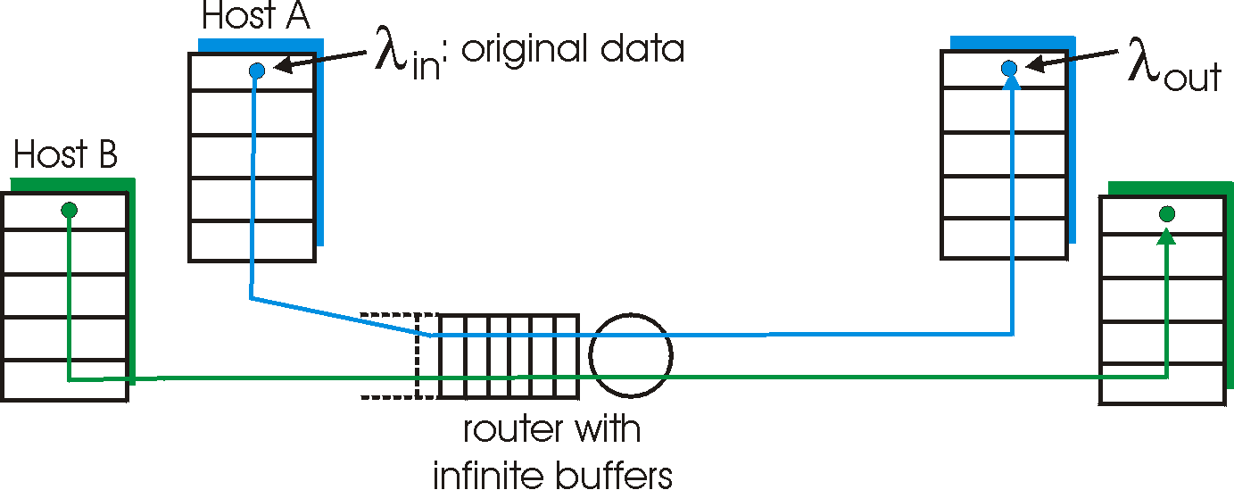

Causes/costs of congestion: scenario 1
two senders, two receivers
one router, infinite buffers
no retransmission
Send rate 0-C/2
large delays when congested
maximum achievable throughput

Slide 94
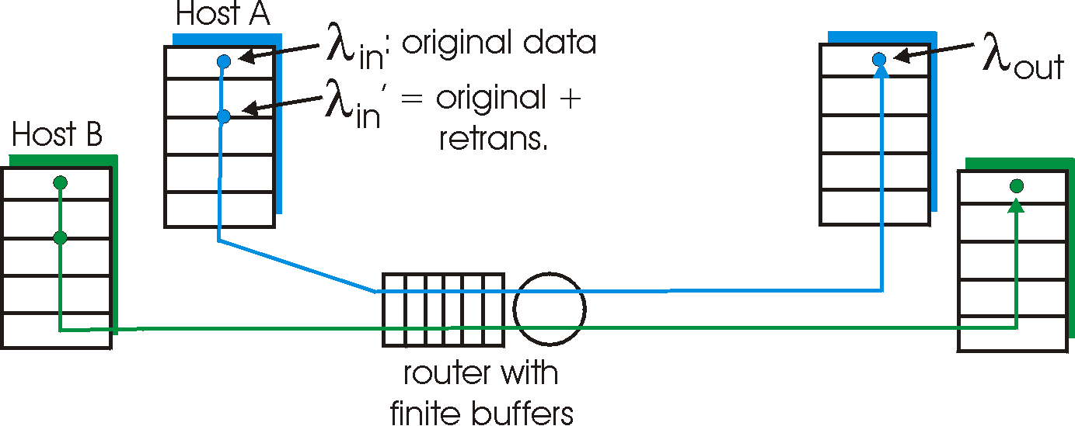
Causes/costs of congestion: scenario 2
one router, finite buffers
sender retransmission of lost packet

Slide 95
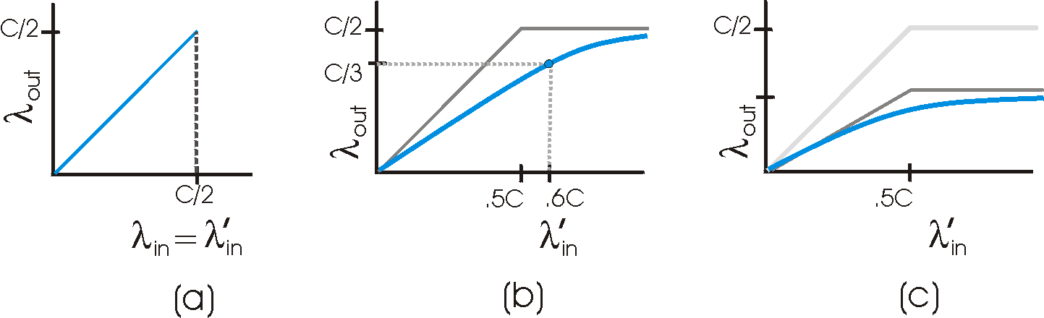
Causes/costs of congestion: scenario 2
λ
=
λ
always: (goodput)
“perfect” retransmission only when loss:
retransmission of delayed (not lost) packet makes larger (than perfect case) for same
in
out
λ
>
λ
in
out
λ
λ
in
out
“costs” of congestion:
more work (retrans) for given “goodput”
unneeded retransmissions: link carries multiple copies of pkt

Slide 96
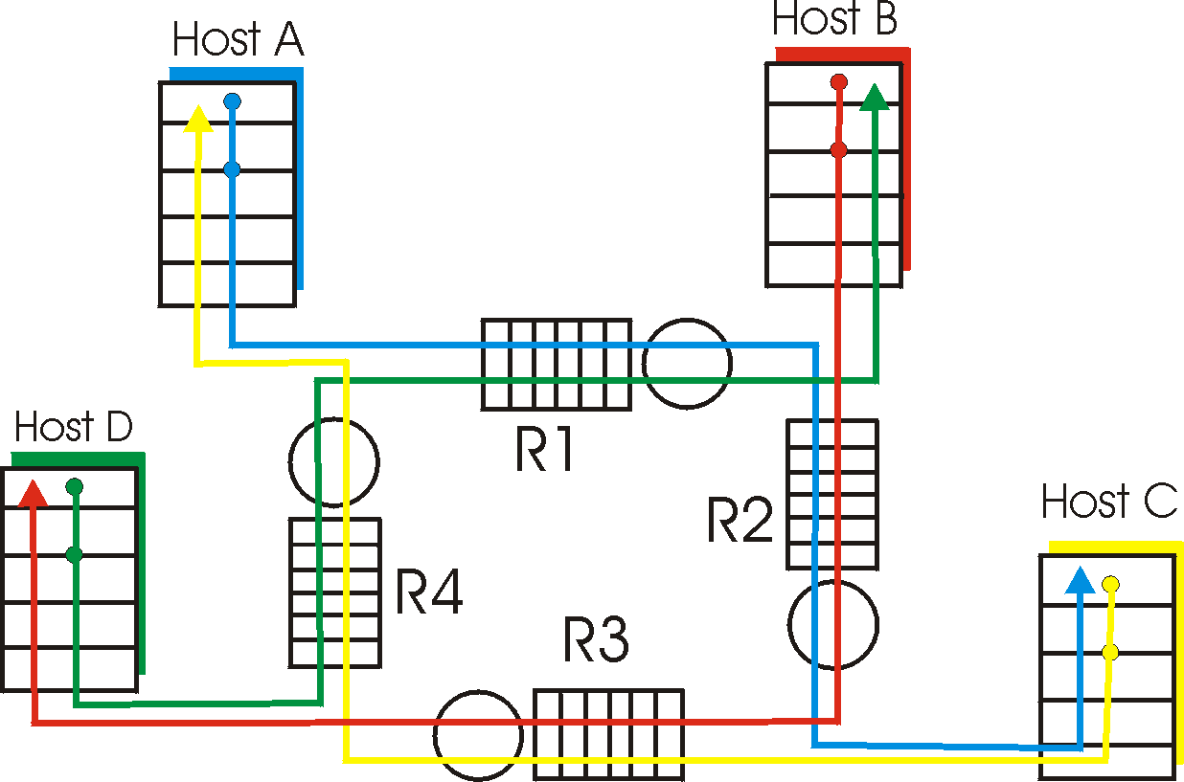
Causes/costs of congestion: scenario 3
λ
four senders
multihop paths
timeout/retransmit
Q: what happens as and increase ?
λ
in
in

Slide 97

Causes/costs of congestion: scenario 3
Another “cost” of congestion:
when packet dropped, any “upstream transmission capacity used for that packet was wasted!

Slide 98
Approaches towards congestion control
Two broad approaches towards congestion control:
End-end congestion control:
no explicit feedback from network
congestion inferred from end-system observed loss, delay
approach taken by TCP
Network-assisted congestion control:
routers provide feedback to end systems
  single bit indicating congestion (SNA, DECbit, TCP/IP ECN, ATM)
  explicit rate sender should send at

Slide 99
Case study: ATM ABR congestion control
ABR: available bit rate:
“elastic service”
if sender’s path “underloaded”:
  sender should use available bandwidth
if sender’s path congested:
  sender throttled to minimum guaranteed rate
RM (resource management) cells:
sent by sender, interspersed with data cells
bits in RM cell set by switches (“network-assisted”)
  NI bit: no increase in rate (mild congestion)
  CI bit: congestion indication
RM cells returned to sender by receiver, with bits intact

Slide 100

Case study: ATM ABR congestion control
two-byte ER (explicit rate) field in RM cell
  congested switch may lower ER value in cell
  sender’ send rate thus minimum supportable rate on path
EFCI bit in data cells: set to 1 in congested switch
  if data cell preceding RM cell has EFCI set, sender sets CI bit in returned RM cell

Slide 101
Chapter 3 outline
3.1 Transport-layer services
3.2 Multiplexing and demultiplexing
3.3 Connectionless transport: UDP
3.4 Principles of reliable data transfer
3.5 Connection-oriented transport: TCP
  segment structure
  reliable data transfer
  flow control
  connection management
3.6 Principles of congestion control
3.7 TCP congestion control

Slide 102
TCP Congestion Control
end-end control (no network assistance)
transmission rate limited by congestion window size, Congwin, over segments. Congwin dynamically modified to reflect perceived congestion.
Congwin
w segments, each with MSS bytes sent in one RTT:
w * MSS
throughput =
Bytes/sec
RTT

Slide 103
To simplify presentation we assume that RcvBuffer is large enough that it will not overflow
Tools are “similar” to flow control. sender limits transmission using:
LastByteSent-LastByteAcked ≤ CongWin
How does sender perceive congestion?
loss event = timeout or 3 duplicate acks
TCP sender reduces rate (CongWin) after loss event
three mechanisms:
  AIMD = Additive Increase Multiplicative Decrease
  slow start = CongWin set to 1 and then grows exponentially
  conservative after timeout events

Slide 104

TCP AIMD
multiplicative decrease: cut CongWin in half after loss event
additive increase: increase CongWin by 1 MSS every RTT in the absence of loss events: probing also known as congestion avoidance
Long-lived TCP connection

Slide 105
TCP Slow Start
When connection begins, increase rate exponentially fast until first loss event
When connection begins, CongWin = 1 MSS
  Example: MSS = 500 bytes & RTT = 200 msec
  initial rate = 20 kbps
available bandwidth may be >> MSS/RTT
  desirable to quickly ramp up to respectable rate

Slide 106
TCP Slow Start (more)
When connection begins, increase rate exponentially until first loss event:
  double CongWin every RTT
  done by incrementing CongWin for every ACK received
Summary: initial rate is slow but ramps up exponentially fast
Host A
Host B
one segment
RTT
two segments
four segments
time

Slide 107
So Far
  Slow-Start: ramps up exponentially
  Followed by AIMD: sawtooth pattern
Reality (TCP Reno)
  Introduce new variable threshold
  threshold initially very large
  Slow-Start exponential growth stops when reaches threshold and then switches to AIMD
  Two different types of loss events
    3 dup ACKS: cut CongWin in half and set threshold=CongWin (now in standard AIMD)
    Timeout: set threshold=CongWin/2, CongWin=1 and switch to Slow-Start

Slide 108
Reason for treating 3 dup ACKS differently than timeout is that 3 dup ACKs indicates network capable of delivering some segments while timeout before 3 dup ACKs is “more alarming”.
Note that older protocol, TCP Tahoe, treated both types of timeout events the same and always goes to slowstart with MSS=1 after a loss event.
TCP Reno’s skipping of the slow start for a 3-DUP-ACK loss event is known as fast-recovery.

Slide 109
Summary: TCP Congestion Control
When CongWin is below Threshold, sender in slow-start phase, window grows exponentially.
When CongWin is above Threshold, sender is in congestion-avoidance phase, window grows linearly.
When a triple duplicate ACK occurs, Threshold set to CongWin/2 and CongWin set to Threshold. (only in TCP Reno)
When timeout occurs, Threshold set to CongWin/2 and CongWin is set to 1 MSS. (TCP Tahoe does this for 3 Dup Acks as well)

Slide 110
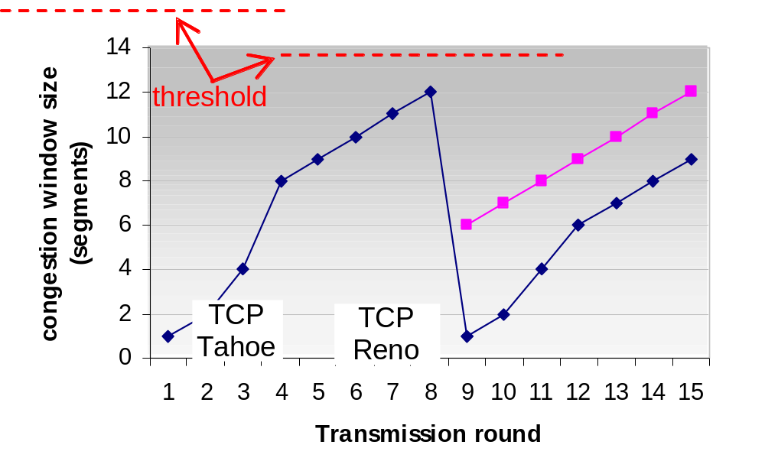
The Big Picture

Slide 111
TCP Fairness
Fairness goal: if K TCP sessions share same bottleneck link of bandwidth R, each should have average rate of R/K
TCP connection 1
TCP
connection 2
bottleneck
router
capacity R

Slide 112
Why is TCP fair?
Two competing sessions:
Additive increase gives slope of 1, as throughout increases
multiplicative decrease decreases throughput proportionally
R
equal bandwidth share
loss: decrease window by factor of 2
congestion avoidance: additive increase
Connection 2 throughput
loss: decrease window by factor of 2
congestion avoidance: additive increase
Connection 1 throughput
R

Slide 113
Fairness (more)
Fairness and UDP
Multimedia apps often do not use TCP
  do not want rate throttled by congestion control
Instead use UDP:
  pump audio/video at constant rate, tolerate packet loss
Current Research area:
  How to keep UDP from congesting the internet.
Fairness and parallel TCP connections
nothing prevents app from opening parallel cnctions between 2 hosts.
Web browsers do this
Example: link of rate R supporting 9 cnctions;
  new app asks for 1 TCP, gets rate R/10
  new app asks for 11 TCPs, gets R/2 !

Slide 114
TCP Latency Modeling
Notation, assumptions:
Assume one link between client and server of rate R
S: MSS (bits)
O: object size (bits)
no retransmissions (no loss, no corruption)
Window size:
First assume: fixed congestion window, W segments
Then dynamic window, modeling slow start
Q: How long does it take to completely receive an object from a Web server after sending a request? This is known as the latency of the (request for the) object.
Ignoring congestion, delay is influenced by:
TCP connection establishment
data transmission delay
slow start

Slide 115
Fixed Congestion Window (W)
Two cases
  WS/R > RTT + S/R:
    ACK for first segment in window returns before window’s worth of data sent
    Latency = 2RTT + O/R
  WS/R < RTT + S/R:
    ACK for first segment in window returns after window’s worth of data sent
    Latency = 2RTT + O/R + (K-1)[S/R + RTT - WS/R]

Slide 116
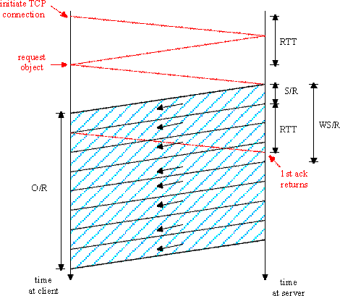
Fixed congestion window (1)
First case:
WS/R > RTT + S/R: ACK for first segment in window returns before window’s worth of data sent
latency = 2RTT + O/R

Slide 117
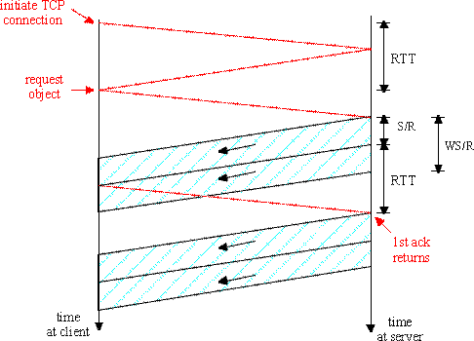
Fixed congestion window (2)
Second case:
WS/R < RTT + S/R: wait for ACK after sending window’s worth of data sent
latency = 2RTT + O/R
+ (K-1)[S/R + RTT - WS/R]

Slide 118
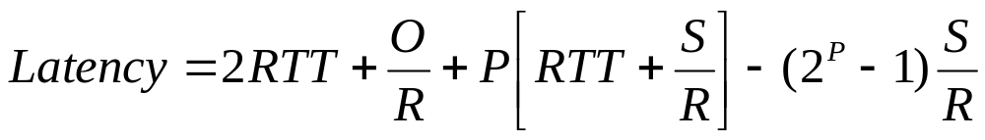

TCP Latency Modeling: Slow Start (1)
Now suppose window grows according to slow start
(with no threshold and no loss events)
Will show that the delay for one object is:
where P is the number of times TCP idles at server:
- where Q is the number of times the server idles
if the object were of infinite size.
- and K is the number of windows that cover the object.

Slide 119
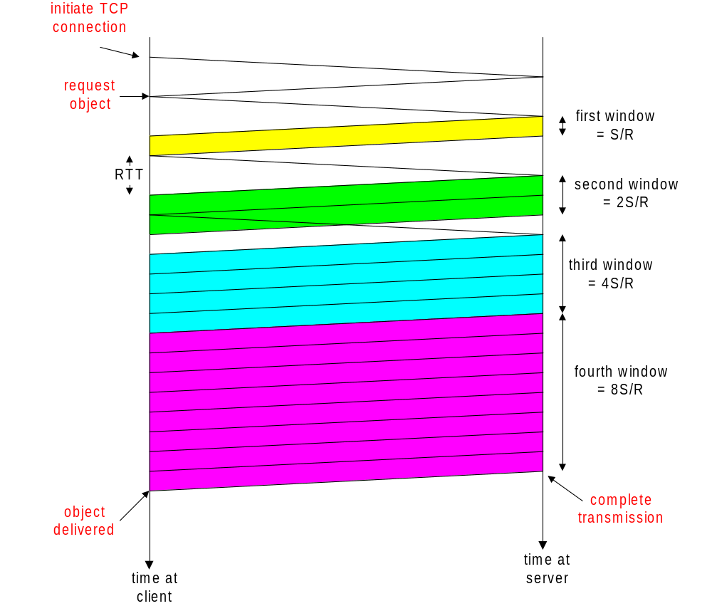
TCP Latency Modeling: Slow Start (2)
Delay components:
2 RTT for connection estab and request
O/R to transmit object
time server idles due to slow start
Server idles:
P = min{K-1,Q} times
Example:
O/S = 15 segments
K = 4 windows
Q = 2
P = min{K-1,Q} = 2
Server idles P=2 times

Slide 120
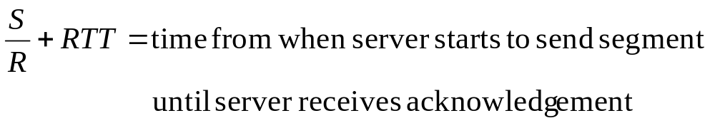
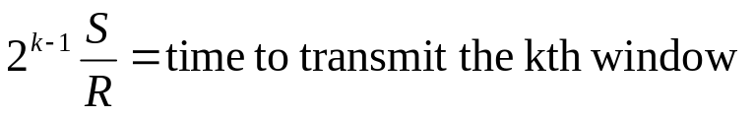
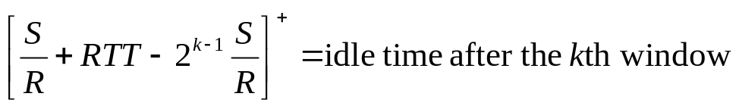
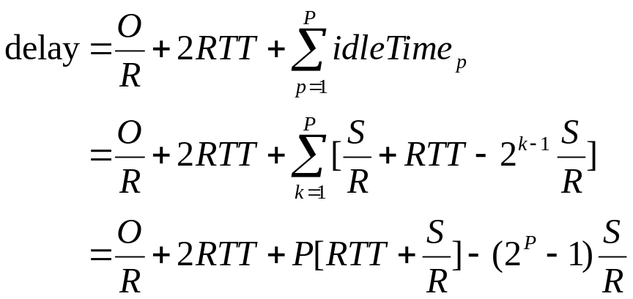
TCP Latency Modeling (3)

Slide 121
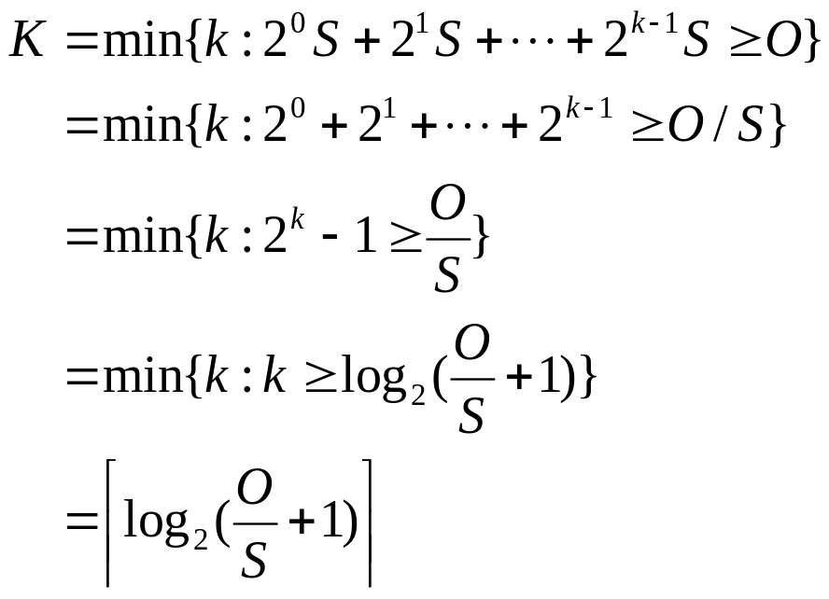
TCP Latency Modeling (4)
Recall K = number of windows that cover object
How do we calculate K ?
Calculation of Q, number of idles for infinite-size object,
is similar.

Slide 122
HTTP Modeling
Assume Web page consists of:
  1 base HTML page (of size O bits)
  M images (each of size O bits)
Non-persistent HTTP:
  M+1 TCP connections in series
  Response time = (M+1)O/R + (M+1)2RTT + sum of idle times
Persistent HTTP:
  2 RTT to request and receive base HTML file
  1 RTT to request and receive M images
  Response time = (M+1)O/R + 3RTT + sum of idle times
Non-persistent HTTP with X parallel connections
  Suppose M/X integer.
  1 TCP connection for base file
  M/X sets of parallel connections for images.
  Response time = (M+1)O/R + (M/X + 1)2RTT + sum of idle times

Slide 123
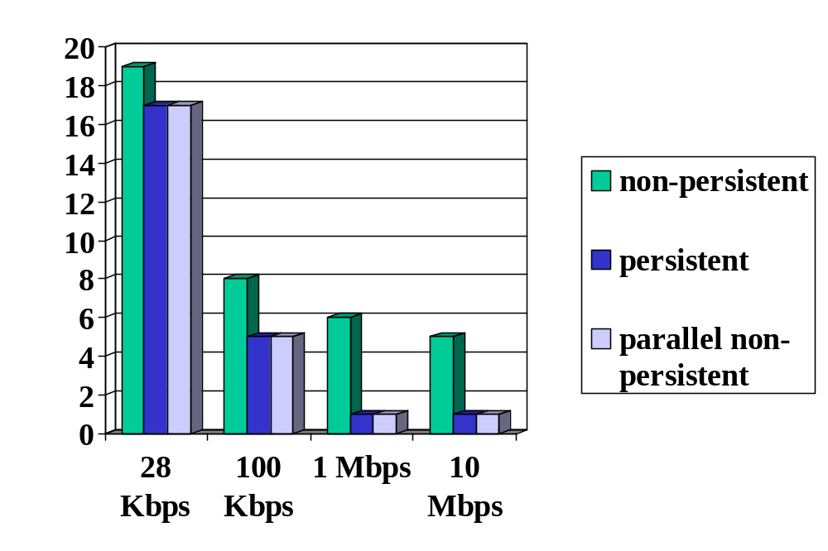
HTTP Response time (in seconds)
RTT = 100 msec, O = 5 Kbytes, M=10 and X=5
For low bandwidth, connection & response time dominated by transmission time.
Persistent connections only give minor improvement over parallel
connections.

Slide 124
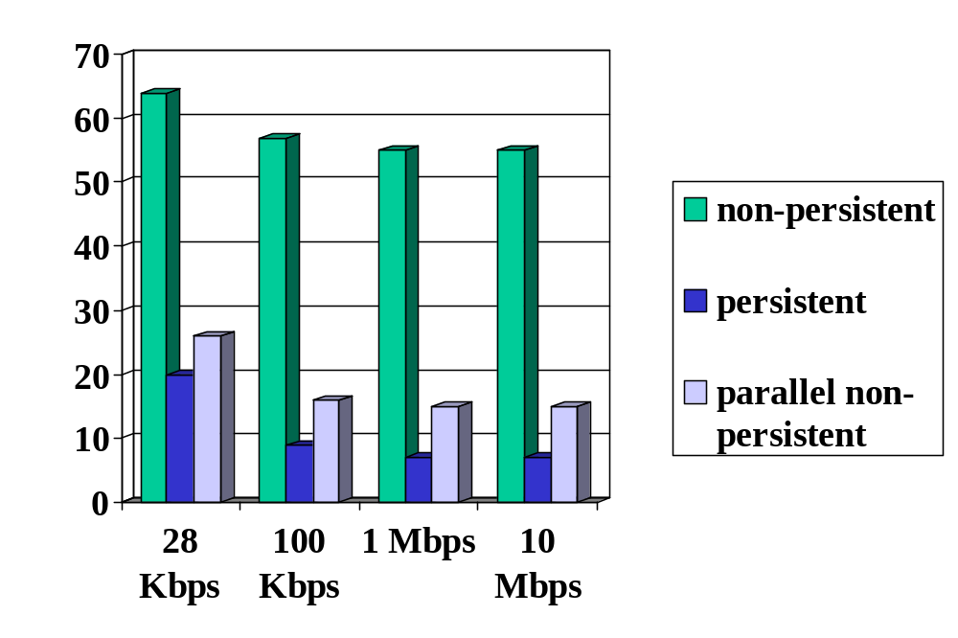
HTTP Response time (in seconds)
RTT =1 sec, O = 5 Kbytes, M=10 and X=5
For larger RTT, response time dominated by TCP establishment
& slow start delays. Persistent connections now give important
improvement: particularly in high delay•bandwidth networks.

Slide 125
Chapter 3: Summary
principles behind transport layer services:
  multiplexing, demultiplexing
  reliable data transfer
  flow control
  congestion control
instantiation and implementation in the Internet
  UDP
  TCP
Next:
leaving the network “edge” (application, transport layers)
into the network “core”

