Slide 1
COMP 171
Data Structures and Algorithms
Tutorial 6
Binary Search Trees

Slide 2
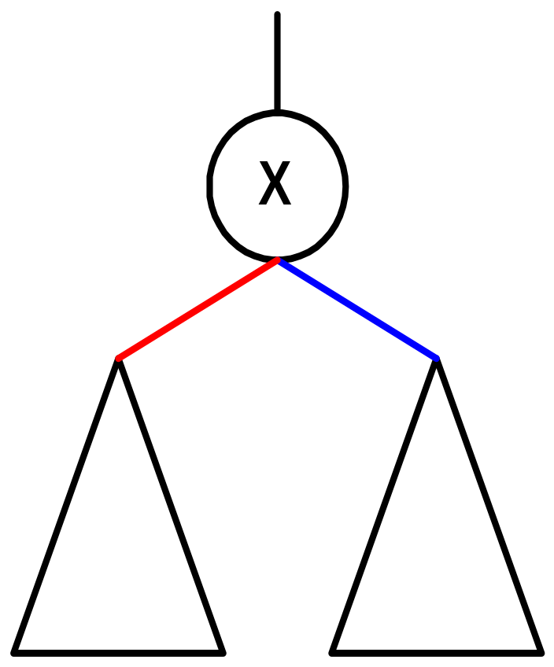
Binary Search Tree
Binary Tree
Node X
  Key values in left subtree ≦ key value of X
  Key values in right subtree ≧ key value of X

Slide 3
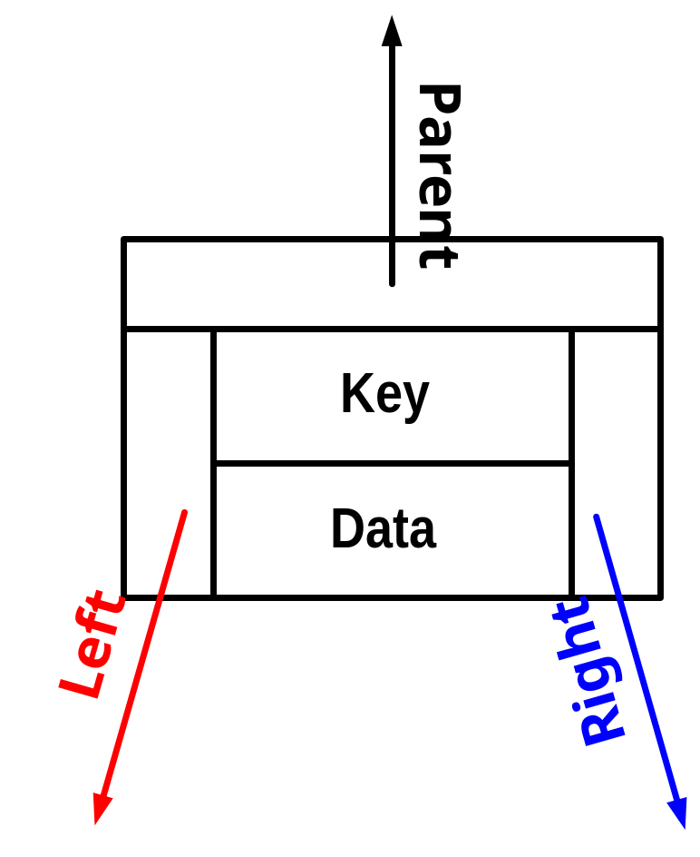
BST Structure
Node
  Key
  Data
  Left (ptr to Node)
  Right (ptr to Node)
  Parent (ptr to Node)

Slide 4
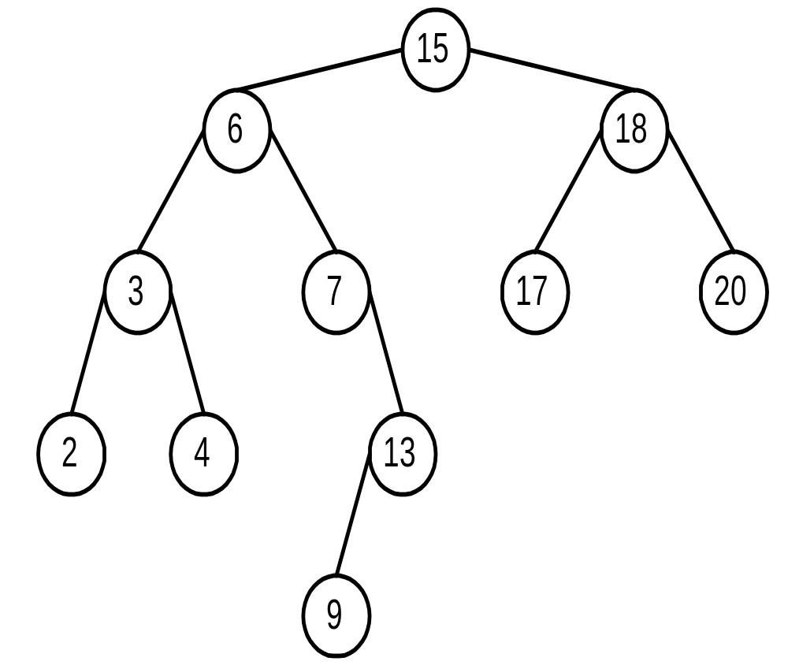
Tree Search
TreeSearch(x, k)
while x≠NIL and k≠key[x]
if k < key[x] then
x ← left[x]
else
x ← right[x]
end if
end while
End TreeSearch

Slide 5
Tree Minimum & Maximum
TreeMinimum(x)
while left(x) ≠NIL
x ← left(x)
end while
return x
End TreeMinimum
TreeMaximum(x)
while right(x) ≠NIL
x ← right(x)
end while
return x
End TreeMaximum

Slide 6
Tree Walk: Inorder
Inorder(x)
if x≠NIL then
Inorder(left(x))
print key(x)
Inorder(right(X))
end if
End Inorder
Θ(n)

Slide 7
Preorder
Preorder(x)
if x≠NIL then
print key(x)
Preorder(left(x))
Preorder(right(X))
end if
End Preorder
Θ(n)

Slide 8
Postorder
Postorder(x)
if x≠NIL then
Postorder(left(x))
Postorder(right(X))
print key(x)
end if
End Postorder
Θ(n)

Slide 9
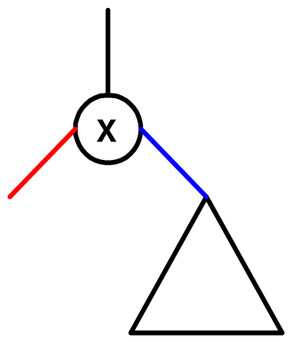
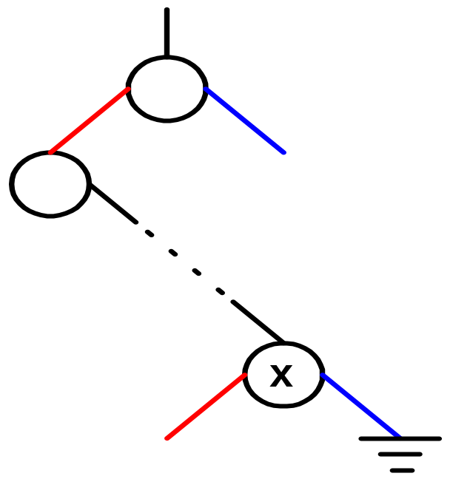
Tree Successor
TreeSuccessor(x)
// -----case I------
if right(x)≠NIL then
return TreeMinimum(right(x))
end if
// -----case II-----
y ← parent(x)
while y≠NIL and x=right(y)
x ← y
y ← parent(y)
end while
End TreeSuccessor

Slide 10
Insertion
TreeInsert(T, z)
// -----Find position-----
y ← NIL
x ← root(T)
while x≠NIL
y ← x
if key(z) < key(x) then
x ← left(x)
else
y ← right(x)
end if
end while
// -----Insert into position-----
Parent(z) ← y
if y = NIL then // T is empty
root[T] = z
else
if key[z] < key[y] then
left[y] ← z
else
right[y] ← z
end if
end if
End TreeInsert

Slide 12
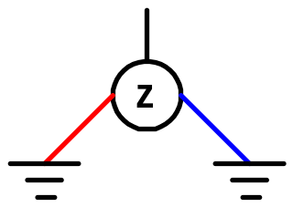
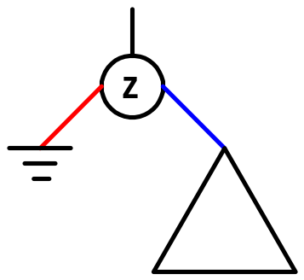
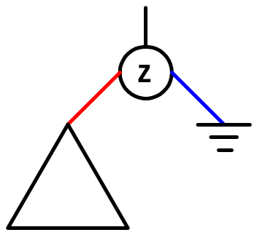
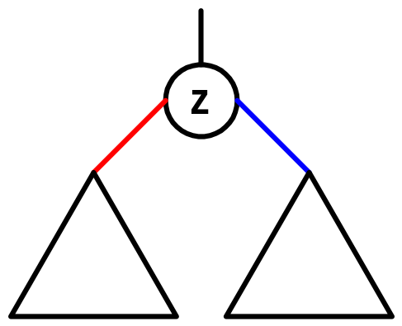
Deletion
TreeDelete(T, z)
if left(z)=NIL or right(z)=NIL
then y ← z
else y ← TreeSuccessor(z)
if left(y)≠NIL
then x ← left(y)
else x ← right(y)
if x≠NIL
then parent(x) ← parent(y)
if parent(y)=NIL
then root(T) ← x
else if y = left(parent(y))
then left(parent(y)) ← x
else right(parent(y)) ← x
if y≠z
then key(z) ← key(y)
return y
End TreeDelete

