Slide 1
COMP 171
Data Structures and Algorithms
Tutorial 9
B-Trees

Slide 2
Node Structure
n[x]
  the number of keys it have
leaf[x]
  return True if x is a leaf, otherwise, return False
x.key[i]
  the value of the i-th key
x.c[i]
  the i-th pointer to the child node

Slide 3
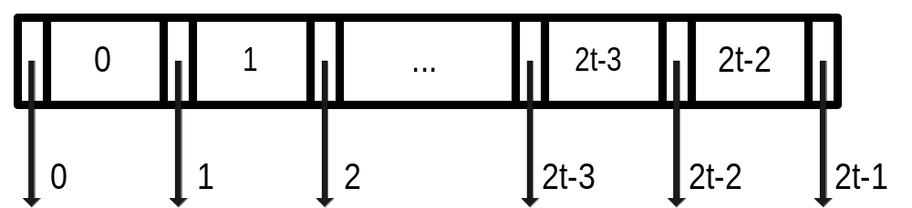
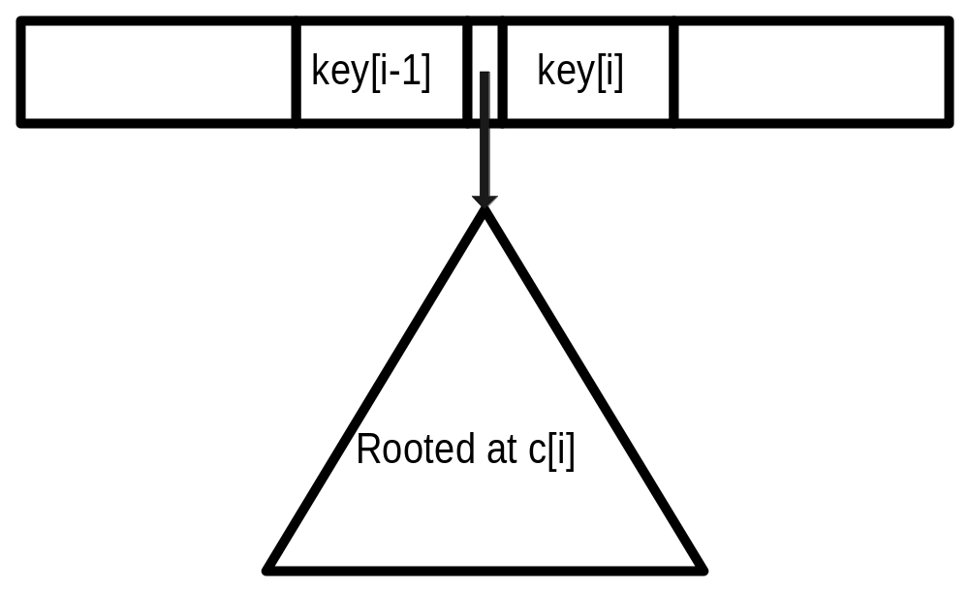

Slide 4
Properties
Minimum degree: t
  t ≧ 2
  n[x] ≧ t-1, except the root
  n[x] ≦ 2t-1
  Node is Full if n[x] = 2t-1
Number of child pointer = n[x] + 1
Keys of x are in non-decreasing order
Keys in the node pointed by x.c[i]
  ≧ x.key[i-1]
  ≦ x.key[i]

Slide 5
All leaves have the same depth, which is the tree’s height h
If n ≧ 1, then for any B-Tree with minimum degree t, its tree height h:
  h ≦ logt((n+1)/2)

Slide 6
Search
BTreeSearch(x, k)
i ← 0
while i<n[x] and k>x.key[i]
i ← i+1
end while
if i<n[x] and k=x.key[i] then
return (x, i)
end if
if leaf[x] then
return NIL
else
BTreeSearch(x.c[i], k)
end if
End BTreeSearch

Slide 7
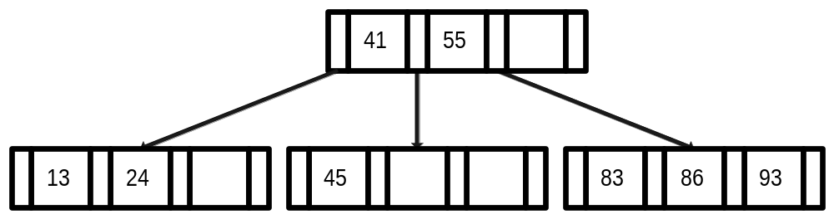
BTreeSearch(root(T), 24)
BTreeSearch(root(T), 86)
BTreeSearch(root(T), 0)
BTreeSearch(root(T), 100)

Slide 8
Insert
BTreeSplitChild(x, i, y)
create new node z
leaf[z] ← leaf[y]
n[z] ← t-1
for j = 0 to t-2 // copy keys
z.key[j] ← y.key[j+t]
if not leaf[y] then // copy pointers
for j = 0 to t-1
z.c[j] ← y.c[j+t]
n[y] ← t-1
for j = n[x] downto i+1 // shift pointers
x.c[j+1] ← x.c[j]
x.c[i+1] ← z // insert pointer
for j = n[x]-1 downto i // shift keys
x.key[j+1] ← x.key[j]
x.key[i] ← y.key[t-1] // insert key
n[x] ← n[x] + 1
End BTreeSplitChild

Slide 9
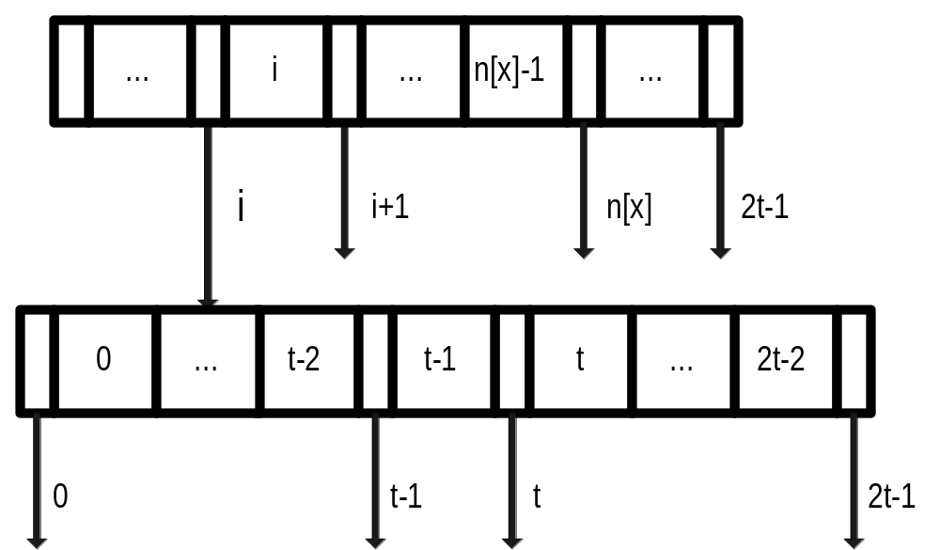
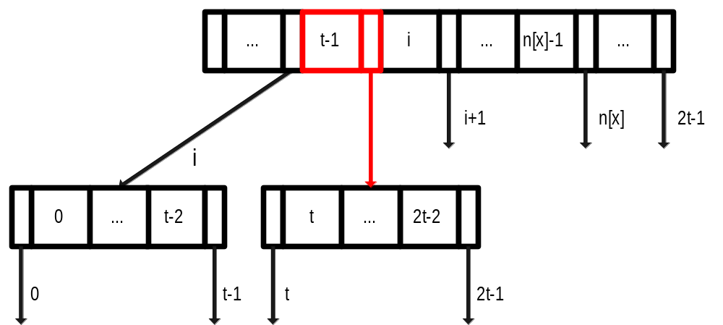

Slide 10
BTreeInsert(T, k)
r ← root(T)
if n[r] = 2t-1 then
create new node s
root[T] ← s
leaf[s] ← False
n[s] ← 0
s.c[0] ← r
BTreeSplitChild(s, 0, r)
BTreeInsertNonfull(s, k)
else
BTreeInsertNonfull(r, k)
end if
End BTreeInsert

Slide 11
BTreeInsertNonfull(x, k)
i ← n[x]-1
if leaf[x] then
while i≧0 and k<x.key[i]
x.key[i+1] = x.key[i]
i ← i-1
x.key[i+1] ← k
n[x] ← n[x]+1
else
while i≧0 and k<x.key[i]
i ← i-1
i ← i+1
if n[x.c[i]] = 2t-1 then
BTreeSplitChild(x, i, x.c[i])
if k>x.key[i] then
i ← i+1
end if
end if
BTreeInsertNonfull(x.c[i], k)
End BTreeInsertNonfull

Slide 12
BTreeInsert(T, 75)
BTreeInsert(T, 54)
BTreeInsert(T, 39)
BTreeInsert(T, 20)

Slide 13
Delete
If k is in node x, and x is a leaf, remove it
If k is in node x, and x is not a leaf
  If the child y that precedes k has ≧ t keys, find the predecessor k’ of k , recursively delete k’ and replace k in x by k’
  If the child z that follows k has ≧ t keys, find the successor k’ of k, recursively delete k’ and replace k in x by k’
  Both y and z has only t-1 keys, merge k and all z into y, so that x loses both k and the pointer to z, and y now contains 2t-1 keys. Then free z and recursively delete k from y

Slide 14
If k is not in node x
  Find the appropriate subtree x.c[i].
  If x.c[I] have ≧ t keys, descent to that node
  If x.c[i] has only t-1 keys, descent to the node resulted from one of the following action:
    If the immediate sibling of x.c[i] with at least t keys, do a rotation.
    If both immediate siblings of x.c[i] have t-1 keys, merge x.c[i] with one sibling and the key from x.

