Slide 1
COMP2711H Tutorial 2 Predicate Logic & Inferences and Proofs
Henry, CHAK Hon Hing
hhchak@connect.ust.hk
Starting at 6:00 p.m.

Slide 2
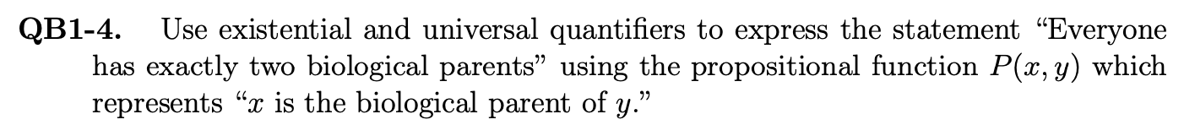
QB1-4

Slide 3
QB1-4
0
1 parent
population
2 parents
x
All possi. of P(y, x)
child: x
3 parents
“Everyone has exactly 2 parents”
4+

Slide 4
QB1-4
0
1 parent
population
y
2 parents
x
All possi. of P(y, x)
z
∀_{x} […]
child: x
3 parents
“Everyone has exactly 2 parents”
4+

Slide 5
QB1-4
All possible
“mappings”
of y, z in P(., x)
y
y
z
…
z
y
Select 2 different people
y
z
…
∀_{x} [∃_{y,z} y≠z …]
z
z
y
…
y
z

Slide 6
QB1-4
All possible
“mappings”
of y, z in P(., x)
y
y
z
…
z
y
Select 2 different people
y
z
…
∀_{x} [∃_{y,z} y≠z …]
z
w
z
“pointer”
y
…
y
z

Slide 7
QB1-4
All possible
“mappings”
of y, z in P(., x)
y
y
z
…
z
Select 2 different people
y
∀_{x} (∃_{y,z} {(y≠z) ∧
∀_{w} [(w=y ∨ w=z) ↔
P(w, x)]})
…
y
z
z
w
z
s.t. they are parents, and the ONLY parents
y
…
y
z

Slide 8
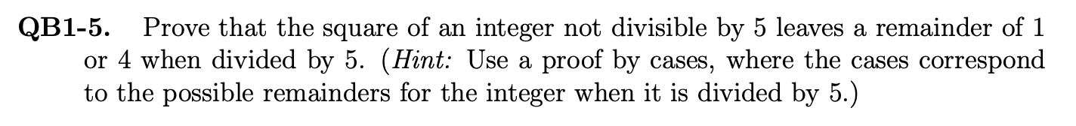
QB1-5

Slide 9
QB1-5
Integers
-2
-1
0
1
2
3
4
5
6
7
8
…
squares
4
1
0
1
4
9
16
25
36
49
64
…
remainders
4
1
0
1
…
4
4
1
0

Slide 10
QB1-5
Same as pos
Integers
-2
-1
0
1
2
3
4
5
6
7
8
…
squares
4
1
0
1
4
9
16
25
36
49
64
…
remainders
4
1
0
1
…
4
4
1
0

Slide 11
QB1-5
Must be divisible
Integers
-2
-1
0
1
2
3
4
5
6
7
8
…
squares
4
1
0
1
4
9
16
25
36
49
64
…
remainders
4
1
0
1
…
4
4
1
0

Slide 12
QB1-5
(5n+x)² ≡ 25n²+10n+x² ≡ x² (mod 5)
same remainder
Integers
-2
-1
0
1
2
3
4
5
6
7
8
…
squares
4
1
0
1
4
9
16
25
36
49
64
…
remainders
4
1
0
1
…
4
4
1
0

Slide 13
QB1-5
Integers
-2
-1
0
1
2
3
4
5
6
7
8
…
squares
4
1
0
1
4
9
16
25
36
49
64
…
remainders
4
1
0
1
…
4
4
1
0
ONLY THESE!

Slide 14
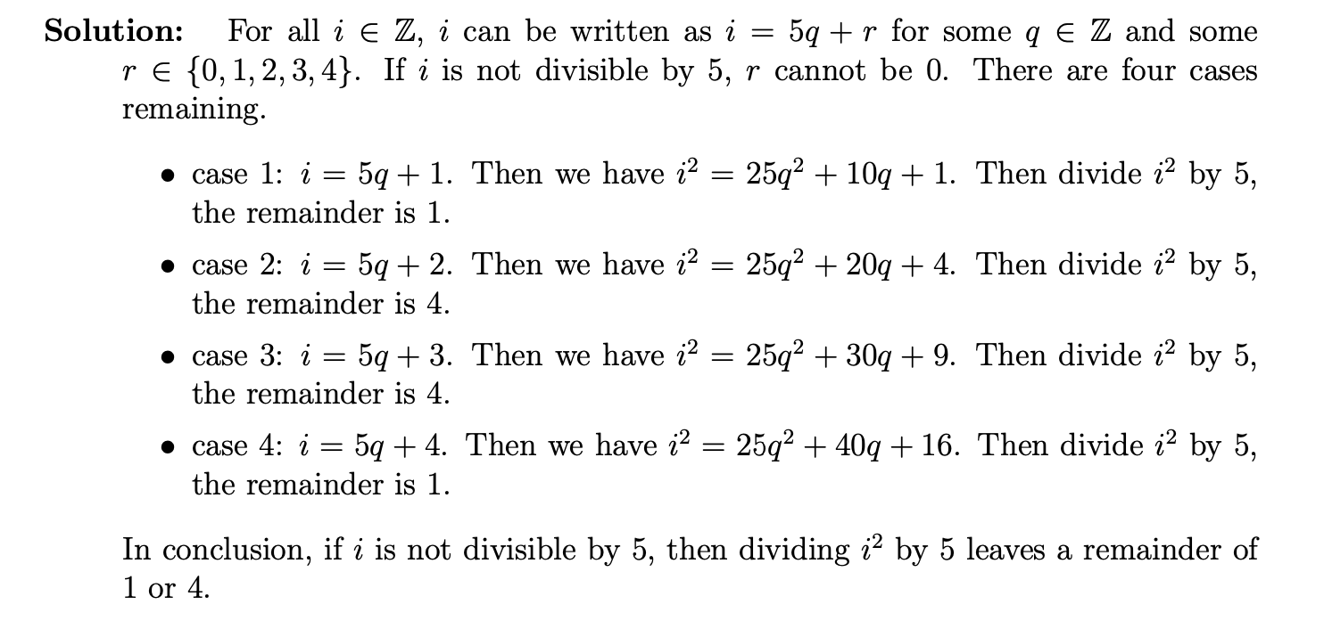
QB1-5

Slide 15
QB1-7

Slide 16
QB1-7
r³ + r + 1 = 0
r=p/q, (p,q ∈ ℤ, coprimes)
(p/q)³ + (p/q) + 1 = 0
substitute

Slide 17
QB1-7
r³ + r + 1 = 0
(p/q)³ + (p/q) + 1 = 0
p,q ∈ ℤ, coprimes
p³ + pq² + q³ = 0
p | q | p³ | pq² | q³ | Sum | 0
Odd | Odd | Odd | Odd | Odd | Odd | Even
Odd | Even | Odd | Even | Even | Odd | Even
Even | Odd | Even | Even | Odd | Odd | Even

Slide 18
QB1-8

Slide 19
QB1-8
Consider 1
person
Red: shaken hands
Blue: NOT shaken
A
1 colour has at least 3 lines!

Slide 20
QB1-8
Any red between: △ with A!
All blue between: △ formed!
Consider 1
person
A
Red: shaken hands
Blue: NOT shaken

Slide 21
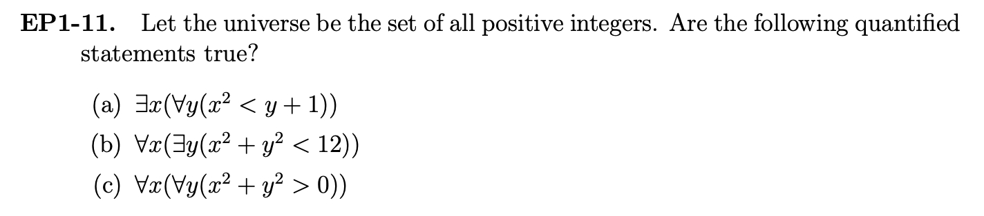
EP1-11
∀: try to break
∃: try to preserve

Slide 22
EP1-11
T
x=1
F
x=999
T

Slide 23
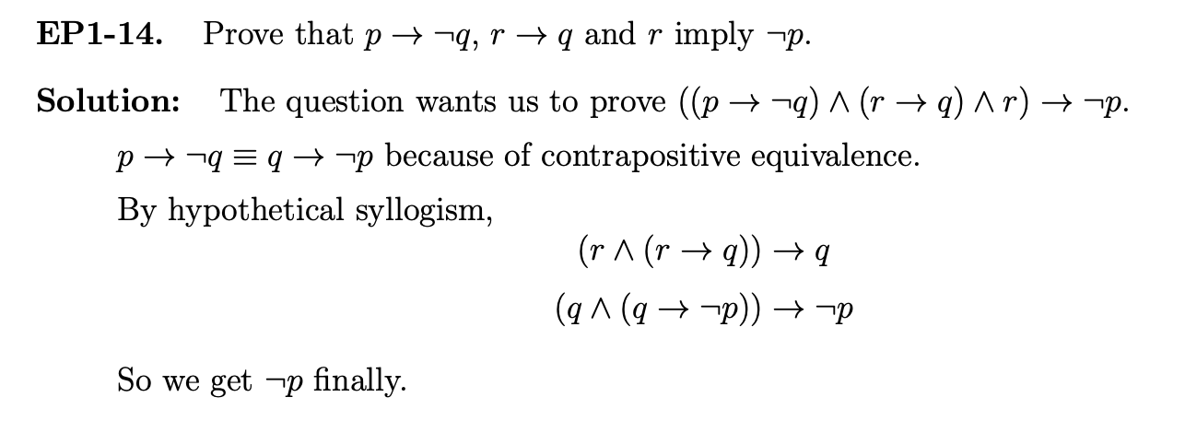
EP1-14

Slide 24
EP1-14
 | Proposition
1 | p → ¬q | given
2 | r → q | given
3 | r | given
4 | q | from 2, 3
5 | ¬p | from 1, 4

