Slide 1
COMP2711H Tutorial 4 Multiplicative Inverses
Henry, CHAK Hon Hing
hhchak@connect.ust.hk
Starting at 6:00 p.m.

Slide 2
QB2-2

Slide 3
QB2-2
(a) 17⁻¹ mod 1009 = ?

Slide 4
QB2-2
59
17 ) 1009
850
159
153
6
(a) 17⁻¹ mod 1009 = ?
q
r
1009 = 59×17 + 6
Linear combination
1009 | 17 | 6

Slide 5
QB2-2
(a) 17⁻¹ mod 1009 = ?
2
6 ) 17
12
5
q
r
1009 = 59×17 + 6
17 = 2× 6 + 5
Linear combination
1009 | 17 | 6 | 5

Slide 6
QB2-2
(a) 17⁻¹ mod 1009 = ?
q
r
1009 = 59×17 + 6
17 = 2× 6 + 5
6 = 1× 5 + 1
Linear combination
1009 | 17 | 6 | 5 | 1

Slide 7
QB2-2
(a) 17⁻¹ mod 1009 = ?
q
r
1009 = 59×17 + 6
17 = 2× 6 + 5
6 = 1× 5 + 1
1 = 6 - 1×5

Slide 8
QB2-2
(a) 17⁻¹ mod 1009 = ?
q
r
1009 = 59×17 + 6
17 = 2× 6 + 5
6 = 1× 5 + 1
1 = 6 - 1×5
Want to change them to 17 and 1009

Slide 9
QB2-2
(a) 17⁻¹ mod 1009 = ?
q
r
1 = 6 - 1×5
1009 = 59×17 + 6
17 = 2× 6 + 5
6 = 1× 5 + 1

Slide 10
QB2-2
(a) 17⁻¹ mod 1009 = ?
q
Substitution equations
r
1 = 6 - 1×5
1009 = 59×17 + 6
17 = 2× 6 + 5
6 = 1× 5 + 1
6 = 1009 - 59×17
5 = 17 - 2×6
1009 | 17 | 6 | 5 | 1

Slide 11
QB2-2
(a) 17⁻¹ mod 1009 = ?
q
r
1 = 6 - 1×5
1 = 6 - 1×(17 - 2×6)
1009 = 59×17 + 6
17 = 2× 6 + 5
6 = 1× 5 + 1
6 = 1009 - 59×17
5 = 17 - 2×6
convert
1009 | 17 | 6 | 5 | 1

Slide 12
QB2-2
(a) 17⁻¹ mod 1009 = ?
q
r
1 = 6 - 1×5
1 = -1×17 + 3×6
1009 = 59×17 + 6
17 = 2× 6 + 5
6 = 1× 5 + 1
6 = 1009 - 59×17
5 = 17 - 2×6
convert
1009 | 17 | 6 | 5 | 1

Slide 13
QB2-2
(a) 17⁻¹ mod 1009 = ?
q
r
1 = 6 - 1×5
1 = -1×17 + 3×6
1=-1×17+3×(1009-59×17)
1009 = 59×17 + 6
17 = 2× 6 + 5
6 = 1× 5 + 1
6 = 1009 - 59×17
5 = 17 - 2×6
convert
1009 | 17 | 6 | 5 | 1

Slide 14
QB2-2
(a) 17⁻¹ mod 1009 = ?
q
r
1 = 6 - 1×5
1 = -1×17 + 3×6
1 = 3×1009 -178×17
1009 = 59×17 + 6
17 = 2× 6 + 5
6 = 1× 5 + 1
6 = 1009 - 59×17
5 = 17 - 2×6
convert
1009 | 17 | 6 | 5 | 1

Slide 15
QB2-2
(a) 17⁻¹ mod 1009 = ?
q
r
1 = 6 - 1×5
1 = -1×17 + 3×6
1 = 3×1009 -178×17
1009 = 59×17 + 6
17 = 2× 6 + 5
6 = 1× 5 + 1
6 = 1009 - 59×17
5 = 17 - 2×6
Therefore, 17⁻¹ ≡ -178 ≡ 831 (mod 1009),
i.e. multiplicative inv. of 17 in Z₁₀₀₉ is 831.

Slide 16
QB2-2
(b) 100⁻¹ mod 1009 = ?
q
r
1 = 100 - 11×9
1 = -11×1009 +111×100
1009 = 10×100 + 9
100 = 11× 9 + 1
9 = 1009 - 10×100
Therefore, 100⁻¹ ≡ 111 (mod 1009),
i.e. multiplicative inv. of 100 in Z₁₀₀₉ is 111.

Slide 17
QB2-2
(c) 777⁻¹ mod 1009 = ?
1 = 4 - 1×3
1 = -1×11 + 3×4
1 = 3×70 - 19×11
1 = -19×81 + 22×70
1 = 22×232 - 63×81
1 = -63×777 + 211×232
1 = 211×1009 - 274×777
1009 = 1×777 + 232
777 = 3× 232 + 81
232 = 2× 81 + 70
81 = 1× 70 + 11
70 = 6× 11 + 4
11 = 2× 4 + 3
4 = 1× 3 + 1
232 = 1009 – 1 × 777
81 = 777 – 3 × 232
70 = 232 – 2 × 81
11 = 81 – 1 × 70
4 = 70 – 6 × 11
3 = 11 – 2 × 4
Therefore, 777⁻¹ ≡ -274 ≡ 735 (mod 1009),
i.e. multiplicative inv. of 777 in Z₁₀₀₉ is 735.

Slide 18
QB2-3

Slide 19
QB2-3
a⁻¹ NOT exists in ℤ_{m} ⟷ GCD(a, m) > 1
Strategy: Try to find some a∈ℤ_{m} s.t. a,m share factors>1

Slide 20
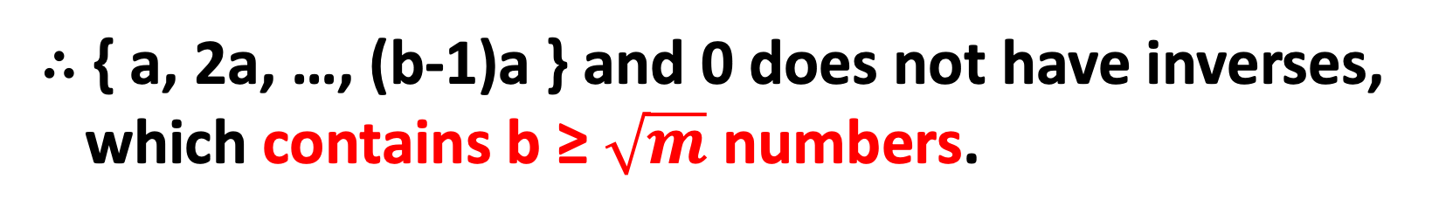
QB2-3
Let m=ab, for a,b∈ℤ⁺, 1<a,b<m.
Either a ≤ $\sqrt{m}$, b ≥ $\sqrt{m}$, or vice versa. WLOT, let a ≤ $\sqrt{m}$.
We can generate a series: { a, 2a, …, (b-1)a }, s.t.
GCD(a, m) ≥ a, GCD(2a, m) ≥ a, …, GCD((b-1)a, m) ≥ a > 1
∴ { a, 2a, …, (b-1)a } and 0 does not have inverses,
which contains b ≥ $\sqrt{m}$ numbers.

Slide 21
QB2-4

Slide 22
QB2-4
x∤n, for all x ∈ {2, 3, …, n-1}

Slide 23
QB2-4
Prove: x∤n, for all x ∈ {2, 3, …, n-1}
→ Prove: x⁻¹ exists in ℤ_{n} for all x ∈ {2, 3, …, n-1}

Slide 24
QB2-4
Prove: x⁻¹ exists in ℤ_{n} for all x ∈ {2, 3, …, n-1}
Since x<n (not multiples), x^{n-1} ≡ x ⋅ x^{n-2} ≡ 1 (mod n)
So, x⁻¹ ≡ x^{n-2} for all x ∈ {2, ..., n-1}, i.e. exist.
So, n is prime.

Slide 25
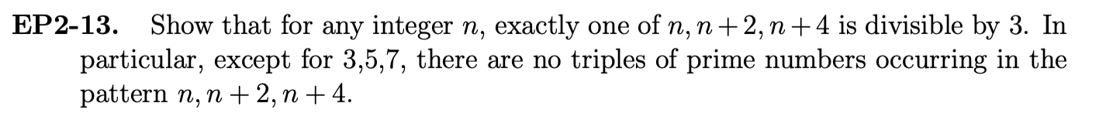
EP2-13

Slide 26
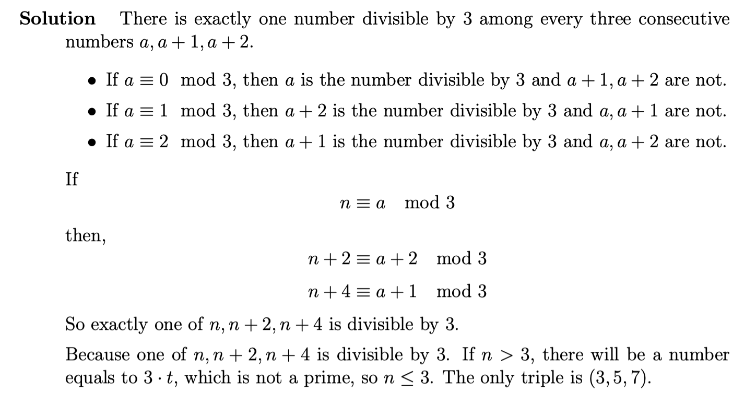
EP2-13
1, 2, 3, …, 6, 7, 8, …
a, (a+1), (a+2)
n, (n+2), (n+4)
3|n and n>3
-> 3 is factor

