Slide 1

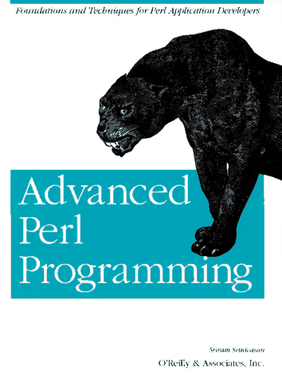

Software Tools
More CGI Programming

Slide 2
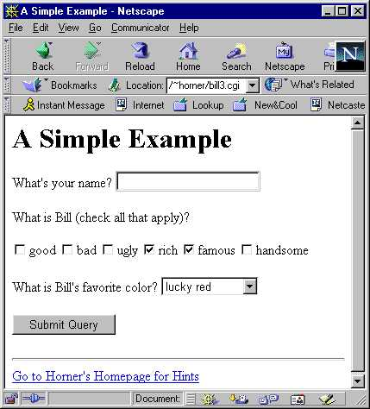
Checkbox and Link Example
The following example shows how to generate checkboxes and links with your CGI program.
Checkboxes allow you to select more than one option.
The initial screen is shown on the right.
Notes:
http://home-cgi.ust.hk/cgi-bin/cgiwrap/~horner/bill3.cgi

Slide 3
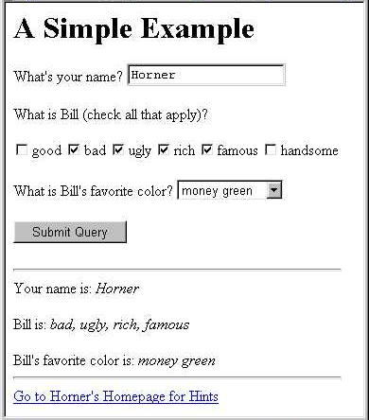
Checkbox and Link Example
The result screen is shown on the right.
Note that the output information is displayed between the original form and the link.

Slide 4
Checkbox and
Link Example page1
#!/usr/local/bin/perl5 -w
# Simple example with checkbox and link
use CGI qw(:standard);
print header;
print start_html("A Simple Example"),
h1("A Simple Example"),
start_form,
"What's your name? ",textfield("name"),
p,
"What is Bill (check all that apply)?",
p,
checkbox_group("words",[ qw(good bad ugly rich famous handsome) ],
["rich", "famous"]),
p,
"What is Bill's favorite color? ",
popup_menu("color",["lucky red","money green","Microsoft blue"]),
p,
submit,
end_form, hr;
Multi-line print statement
p puts a new paragraph/newline
which boxes to check as defaults
“Submit Query” used as default submit button name

Slide 5
Checkbox and
Link Example page2
em generates <em> HTML tag (~italics)
if (param()) {
print
"Your name is: ",em(param("name")),
p,
"Bill is: ",em(join(", ",param("words"))),
p,
"Bill's favorite color is: ",em(param("color")),
hr;
}
print a({href=>"http://home.ust.hk/~horner"},
"Go to Horner's Homepage for Hints");
print end_html;
The checkbox parameter is a list of checked boxes
generates HTML link

Slide 6
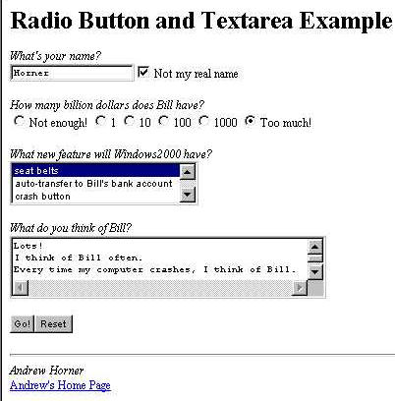
Radio Button
& Text Area Example
The following example shows how to generate radio buttons and textareas with your CGI program.
Radio buttons only allow you to select one option.
The initial screen is shown on the right.
Notes:
http://home-cgi.ust.hk/cgi-bin/cgiwrap/~horner/bill4.cgi

Slide 7
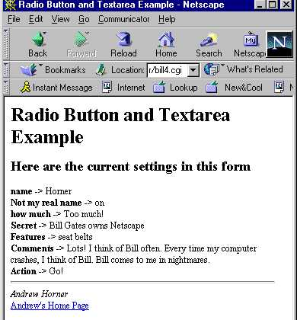
Radio Button
& Text Area Example
The result screen is shown on the right.
Note that both the initial screen and result screens have the same title and footer.

Slide 8
Radio Button
& Text Area Example page1
#!/usr/local/bin/perl5 -w
use CGI qw(:standard);
print header;
print start_html("Radio Button and Textarea Example");
print "<H1>Radio Button and Textarea Example</H1>\n";
if(!param()){
print_prompt(); # initial screen
}else{
do_work(); # result screen
}
print_end(); # print footer
print end_html;

Slide 9
Radio Button
& Text Area Example page2
sub print_prompt {
print start_form;
print "<EM>What's your name?</EM><BR>";
print textfield("name");
print checkbox("Not my real name");
print "<P><EM>How many billion dollars does Bill have?</EM><BR>",
radio_group("how much", ["Not enough!",1,10,100,1000,"Too much!"],1);
print hidden("Secret","Bill Gates owns Netscape");
print "<P><EM>What new feature will Windows2000 have?</EM><BR>";
print scrolling_list("Features", ["seat belts",
"auto-transfer to Bill's bank account", "crash button",
"invisible icons", "fill-disk function", "simulate power-surge"],
["seat belts"], 3);
print "<P><EM>What do you think of Bill?</EM><BR>";
print textarea("Comments", "", 3, 50); # 3 rows x 50 chars
print "<P>", submit("Action", "Go!"), reset, endform;
}
default value is 1
invisible text
3 items displayed

Slide 10
Radio Button
& Text Area Example page3
sub do_work {
my(@values,$key);
print "<H2>Here are the current settings in this form</H2>";
foreach $key (param()){
print "<STRONG>$key</STRONG> -> ";
@values = param($key);
print join(", ",@values),"<BR>\n";
}
}
sub print_end{ # print footer
print <<END;
<HR>
<ADDRESS>Andrew Horner</ADDRESS>
<A HREF="http://home.ust.hk/~horner">Andrew's Home Page</A>
END
}
parameters stored in hash as key-value pairs
<STRONG> similar to <BOLD>
use special font for addresses
here document for link

