Slide 1
Introduction of J2ME

Slide 2
Agenda
Introduction of Mobile Technology
Mobile Phone History
Software Technology for Mobile Device
J2ME Overview
  CDC
  CLDC
  MIDP
J2ME Resources

Slide 3
Introduction of Mobile Technology
The goals Mobile Technology
  Connecting people
  Information sharing
  Internet access
  Entertainment
with the most importance words – “at any time, any where”

Slide 4
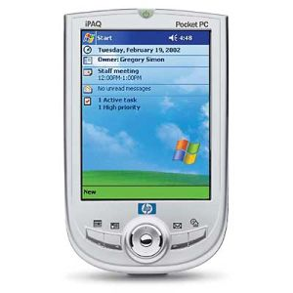
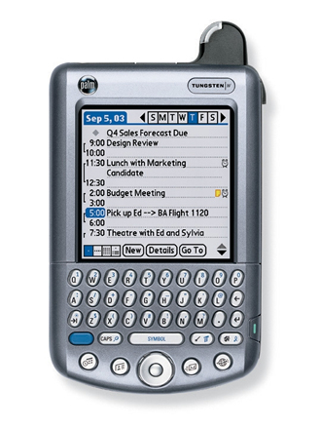
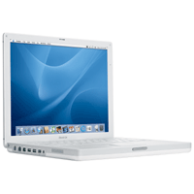
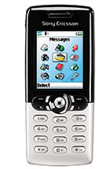
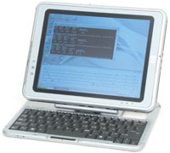
Introduction of Mobile Technology
Includes
  Notebook
  Palmtops
  PDAs
  Mobile Phones
  Tablet PCs
  And more ...

Slide 5
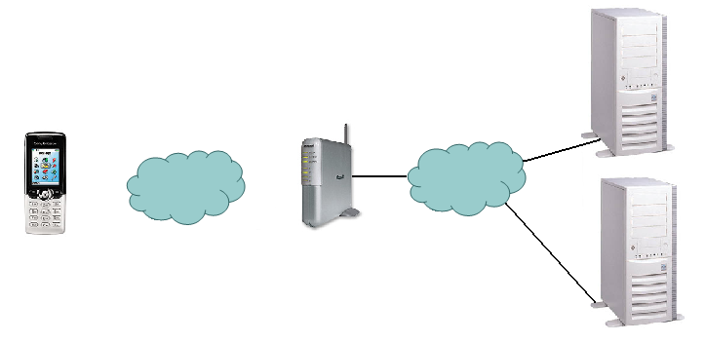
Introduction of Mobile Technology
The Internet Scenario for retrieving information in a wireless network
Base Station
Web Servers
Internet
Wireless Network
Request :
Response :

Slide 6
Introduction of Mobile Technology
Mobile Networking
  GSM, GPRS, EDGE
  1G, 2G, 2.5G, 2.75G, 3G and 4G
  IEEE802.11
  InfraRed and Bluetooth

Slide 7
Introduction of Mobile Technology
GSM
  Short for Global System for Mobile Communications, one of the leading digital cellular systems. Data speed for GSM is 9.6 kilobits.
EDGE
  Enhanced Data GSM Environment. EDGE is a faster version of GSM wireless service. EDGE enables data to be delivered at rates up to 384 Kbps on a broadband.

Slide 8
Introduction of Mobile Technology
EDGE
  Enhanced Data GSM Environment. EDGE is a faster version of GSM wireless service. EDGE enables data to be delivered at rates up to 384 Kbps on a broadband. The standard is based on the GSM standard.
GPRS
  Short for General Packet Radio Service, a standard for wireless communications which runs at speeds up to 115 kilobits per second.

Slide 9
Introduction of Mobile Technology
GPRS
  Short for General Packet Radio Service, a standard for wireless communications which runs at speeds up to 115 kilobits per second.

Slide 10
Introduction of Mobile Technology
First Generation (1G)
  Analog system designed for voice only communication. 1G systems are almost extinct now,
Second Generation (2G)
  Use GSM and IS-95 CDMA technologies
  CDMA
    Allows users to communicate with different codes
  Still designed for voice communication

Slide 11
Introduction of Mobile Technology
2.5 and 2.75 Generation
  GPRS and CDMA2000 (Phase 1) are belonged to 2.5 G
  EDGE is belonged to 2.75G
  As higher data rate is provided, allows some data transmission

Slide 12
Introduction of Mobile Technology
Third Generation (3G)
  Two 3G, UMTS and CDMA-2000, are used. UMTS is broadly deployed in Europe and CDMA-2000 is being deployed in North American and parts in Asia
  Higher data transmission rate (up to 2Mbps) which allows video conferencing

Slide 13
Introduction of Mobile Technology
Forth Generation (4G)
  Combined the technologies of Wireless local area network (will be introduced soon) and 3G

Slide 14
Introduction of Mobile Technology
IEEE802.11
  Wireless Local Area Network
  802.11a, 802.11b and 802.11g
  Allows 54Mbps data transmission speed (even 108Mbps is provided in the market)
  Used for PDA, Notebook or even desktop

Slide 15
Introduction of Mobile Technology
InfraRed
  Short range data transmission technology
  Normally used as remote controller
  Data rate is around tens kbps
  Line of sight transmission, hence the space between two InfraRed Devices should be clear

Slide 16
Introduction of Mobile Technology
Bluetooth
  Commonly used for hand-free earphone
  Short range data transmission – around 10 meters
  Data rate is up to 1Mbps
  Do not have light of sight requirement

Slide 17

Mobile Phone History
In1843
  Micheal Faraday a talented chemist begins researching the possibility that space can conduct electricity. His research starts the wheels turning for many other 19th century scientists. At the time, many of them were referred to as “crackpots”.
In 1865
  AVirginia Dentist/Scientist, Dr. Mahlon Loomis, develops a method of communicating through the earth’s atmosphere by using an electrical conductor. He does this by flying two kites, that are rigged with copper screens and wires, which are connected to the ground on two separate mountains about 18 miles apart. He later received a grant from the U.S. Congress for $50,000. (A fairly large chunk of change for 1865)

Slide 18
Mobile Phone History
In 1866
  The first trans-Atlantic telegraph is built (not much to do with cell phones, but a major advancement in communication nonetheless)
In 1921
  The Police Department in Detroit, Mich. begins installing mobile radios, operating around 2 MHz, in their squad cars. They encounter many problems such as overcrowding on the channels and terrible interference.

Slide 19
Mobile Phone History
In 1934
  The U.S. Congress creates the Federal Communications Commission. They decide who gets to use certain radio frequencies. Most channels are reserved for emergency use and for the government. Radio is still a baby.
In 1940’s
  the mobile radios are able to operate at 30 to 40 MHz and become much more common between police departments, and the wealthy. Several private companies and organizations begin using these same radios for personal gain.

Slide 20
Mobile Phone History
In1945
  The first mobile-radio-telephone service is established in St. Louis, Miss. The system is comprised of six channels that add up to 150 MHz. The project is approved by the FCC, but due to massive interference, the equipment barely works.
In 1947
  AT&T comes out with the first radio-car-phones that can be used only on the highway between New York and Boston; they are known as push-to-talk phones. The system operates at frequencies of about 35 to 44 MHz, but once again there is a massive amount of interference in the system. AT&T declares the project a failure.

Slide 21
Mobile Phone History
In 1949
  The FCC authorizes the widespread use of many separate radio channels to other carriers. They are know as Radio Common Carriers (RCC) and are the first link between mobile phones and the telephone, rather than just radio to radio. The RCC's are the first step toward the cellular phone industry, which is were designed more for profit than for the general public.
In 1956
  The first real car phones, not car radios, come into play accross the United States. Although, the system is still using push-to-talk phones, it is an improved version that acctually works. However, the units are big and bulky, and require a personal radio operator to switch the calls. A simular system appeared in Sweden a few years earlier.

Slide 22
Mobile Phone History
In 1964
  A new operating system is developed that operates on a single channel at 150 MHz. In essence, this removes the need for push-to-talk operators. Now customers can dial phone numbers directly from their cars. RCC's are finally taken seriously by the FCC as ligitimate competitors to the land-line phone companies.
In 1969
  The self-dialing capability is now upgraded to 450 MHz and becomes standard in the United States. This new service is known as (IMTS) Improved mobile telephone service.

Slide 23
Mobile Phone History
In 1970
  Cell phone lobbyists finally win with the FCC and get a window of 75 MHz in the 800 MHz region, which allocated specifically for cell phones. The FCC realizes the potential of the industry and can’t ignore it any longer.
In 1971
  AT&T is the first company to propose a modern-day mobile-phone system to the FCC. It involves dividing cities into “cells”. It is the first company to do so.

Slide 24
Mobile Phone History
In 1973
  Dr. Martin Cooper invents the first personal handset while working for Motorola. He takes his new invention, the Motorola Dyna-Tac., to New York City and shows it to the public. His is credited with being the first person to make a call on a portable mobile-phone.
In 1974
  The FCC actually starts to encourage cell phone companies to push forward the “cellular idea”. But unfortunately a law suit arises with Western Electric, who is the closest company to succeeding at the time, and it rules that they are not allowed to manufacture terminal and network phone systems under the same roof. This is an effort to prevent a monopoly. But it also prevents progress.

Slide 25
Mobile Phone History
In 1975
  AT&T adapts its own cellular plan for the city of Chicago, but the FCC is still uneasy about putting the plan into action. They have concerns about its success.
In 1977
  Finally cell phone testing is permitted by the FCC in Chicago. The Bell Telephone Company gets the license; they are in a partnership with AT&T which is a gerneral effort to battle the stubborn FCC.

Slide 26
Mobile Phone History
In 1981
  The FCC makes firm rules about the growing cell phone industry in dealing with manufactures. It finally rules that Western Electric can manufacture products for both cellular and terminal use. (Basically they admit that they put the phone companies about 7 years behind)
In 1988
  One of the most important years in cell phone evolution. The Cellular Technology Industry Association is created and helps to make the industry into an empire. One of its biggest contributions is when it helped create TDMA phone technology, the most evolved cell phone yet. It becomes available to the public in 1991.

Slide 27
Mobile Phone History
In 2001
  BellSouth announces that it is leaving the pay phone business because there is too much competition from cell phones.

Slide 28
Software Technology for Mobile Device
There are many terms about mobile application development
  Windows Mobile
  Symbian
  Embedded Visual C++ and .Net
  J2ME

Slide 29

Software Technology for Mobile Device
Windows Mobile
  Windows Mobile is Microsoft's software platform for Pocket PCs and Smartphones. Windows Mobile extends the familiarity of the Windows desktop to personal devices.
  Windows Powered mobile devices include Pocket PC, Pocket PC Phone Edition, Smartphone, and Handheld PC

Slide 30
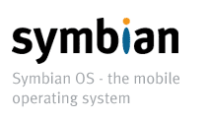
Software Technology for Mobile Device
Symbian
  Symbian is like an Operation System on mobile phone. It provides the required low level functions for application development

Slide 31
Software Technology for Mobile Device
Embedded Visual C++ 4.0 and .Net
  Programming language and related libraries that allows programmer to develop applications on Windows Mobile platform

Slide 32
Software Technology for Mobile Device
J2ME (Java 2, MicroEdition)
  Normally used for less memory and low processing power devices
  A collection of packages and classes for application development on mobile devices
We will use J2ME to develop applications in this course

Slide 33



J2ME Overview
Java
  A programming language developed by Sun Microsystems
  Required a Virtual machine to interpret the source codes and generate bytecode
  Syntax is similar to C++
  Platform independent feature

Slide 34
J2ME Overview
Java includes three different editions
  J2SE (Java 2 Standard Edition)
  J2EE (Java 2 Enterprise Edition)
  J2ME (Java 2 Micro Edition)
The above three editions target for different devices or systems

Slide 35
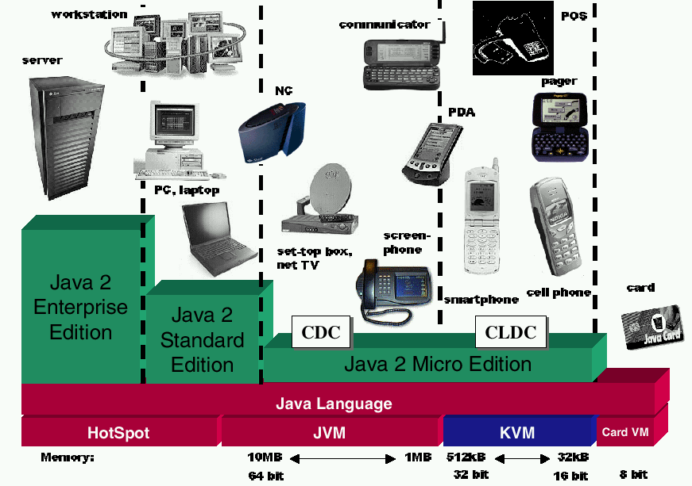
J2ME Overview

Slide 36


J2ME Overview
J2SE
  Provides a complete environment for applications development on desktops and servers
  The foundation of J2EE
  J2SE 1.5 (Tiger) is available now!

Slide 37
J2ME Overview
J2EE
  Target for business use
  Large scale of systems which may contain tens of servers and millions of users
  Web based services
  Machines are high performance

Slide 38
J2ME Overview
J2ME
  The Micro Edition of the Java 2 Platform provides an application environment that specifically addresses the needs of commodities in the vast and rapidly growing consumer and embedded space, including mobile phones, pagers, PDAs, set-top boxes, and vehicle telematics systems

Slide 39
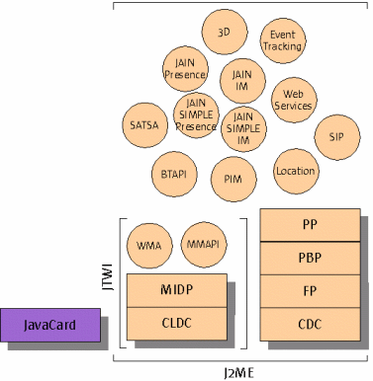
J2ME Overview
More detail Later …
J2ME Architecture

Slide 40
J2ME Overview
J2ME architecture is divided in to four different level
  KVM (Kilobyte Virtual Machine)
  Configurations
  Profiles
  Optional packages

Slide 41
J2ME Overview
KVM (Kilobyte Virtual Machine)
  As the name implies, it is used for small program
  A subset of JVM
  A pool for running java code on the device

Slide 42
J2ME Overview
Configurations
  defines a basic, lowest-common-denominator J2ME runtime environment
  includes the virtual machine and a set of core classes derived primarily from J2SE

Slide 43
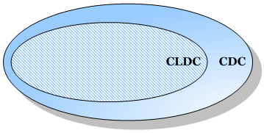
J2ME Overview
There are two different configurations
  Connected Device Configuration (CDC)
  Connected Limited Device Configuration (CLDC)
Relation between CLDC and CDC

Slide 44
J2ME Overview - CDC
Targeted for devices that have
  2 MB or more total available memory
  Memory dedicated to J2ME environment
  More than 2MB ROM/Flash
  More than 512 KB RAM
  Network connectivity
Full Java 2 Virtual Machine specification

Slide 45
J2ME Overview - CDC
CDC uses
  Wireless communicators
  High-end PDAs
  TV set-top boxes
  Gateways
  Automotive entertainment and navigation systems
  Telecomm/Networking Equipment
  Industrial Controllers

Slide 46
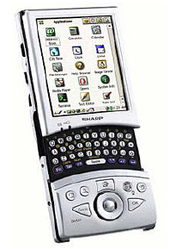
J2ME Overview - CDC
Full-featured Java 2 platform runs on small devices
  Sharp Zaurus can run J2ME CDC

Slide 47
J2ME Overview - CDC
Three profiles build on CDC
  Foundation Profiles (FP)
    Provides core Java functionalities, such as input/output streams, security, networking
  Personal Profiles (PP)
    Support Java Graphical User Interface
  Personal Basic Profiles (PBP)
    A smaller set of Personal Profiles
We will stop CDC here and focus on CLDC

Slide 48
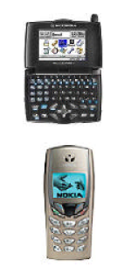
J2ME Overview - CLDC
Targeted at devices with:
  160KB to 512KB total memory available for Java technology
  Limited power (battery), connectivity (often intermittent), UI (small screen)

Slide 49
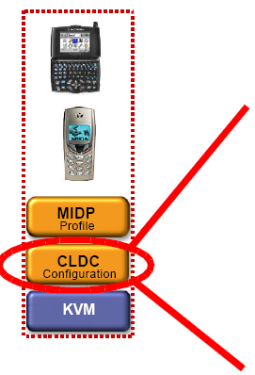
J2ME Overview - CLDC
CLDC scope
Core java.* libraries
Additional I/O and
networking libs
Security features
Internationalization

Slide 50
J2ME Overview - CLDC
Classes extended from Java 2 Platform, Standard Edition (J2SE) are in packages:
  java.lang.*
    Contain the basic Mathematics classes and data types
  java.util.*
    Contain some commonly used functionalities like Random and Vector (store a set of values)
  java.io.*
    Contain the data types for Input/output data
New classes introduced by CLDC are in package:
  javax.microedition.*

Slide 51
J2ME Overview - CLDC
Only CLDC is not enough for building applications
CLDC is the base for building the above profiles
It separates the machine dependent issues from the applications

Slide 52
J2ME Overview - CLDC
There are two version of CLDC
  CLDC 1.0
  CLDC 1.1
Today, most mobile phones only support 1.0 version
Main differences between 1.0 and 1.1 are
  Floating point is added in 1.1
  More Date related classes is added in 1.1
  The minimum memory budget has been raised from 160 to 192 kilobytes
  And more …
  [Reference: http://developers.sun.com/techtopics/mobility/getstart/articles/survey/]

Slide 53
J2ME Overview - MIDP
Targets mobile two-way devices implementing J2ME CLDC
Profile addresses
  Display toolkit, User input methods
  Persistent data storage
  HTTP 1.1-based networking using CLDC Generic Connection framework

Slide 54
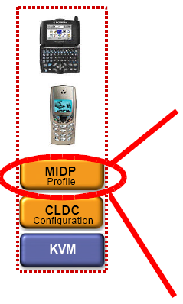
J2ME Overview - MIDP
Scope
Application model
Persistent storage (RMS APIs)
Networking (HTTP, etc.)
User interface (High and low level APIs)

Slide 55
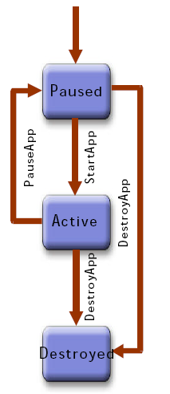
J2ME Overview - MIDP
MIDP Application Lifecycle
  MIDP applications, or “MIDlets”, move from state to state in their lifecycle according to a state diagram
  Paused – initialized and waiting
  Active – has resources and is executing
  Destroyed – has released all resources, destroyed threads, and ended all activity

Slide 56
J2ME Overview - MIDP
MIDlet Packaging
  MIDlets are packaged in a JAR (like a zip file) file including Class files of the MIDlet(s)
  Resource files
  Manifest with application properties
Application Descriptors (JAD files) accompany MIDlet JARs and provide deployment information (name, version, size, etc.)

Slide 57
J2ME Overview - MIDP
MIDlet Development Steps
  Write your Java application
  Compile it
  Preverify it
  Package it into a JAR file
  Create the application descriptor
  Deploy and run your application in the
J2ME Wireless Toolkit or your device of choice

Slide 58
J2ME Overview - MIDP
There are two version of MIDP: 1.0 and 2.0, we will focus on 2.0 because
  Supported by most mobile phone
  Enhanced UI
  Game and Sound APIs
  New Security Model through Signed MIDlets
  Enhanced Networking, including HTTPS

Slide 59
J2ME Overview - MIDP
There are many functionality supported by MIDP
  Graphical user interface
  Media
  Networking
  Security

Slide 60
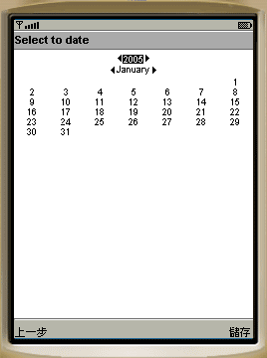
J2ME Overview - MIDP
Graphical user interface includes
  Included in javax.microedition.lcdui.*
  “Form” which conatins Basic items :
    ChoiceGroup -A ChoiceGroup is a group of selectable elements intended to be placed within a Form
    ImageItem –Hold an image for display
    StringItem – display text
    And some others like CustomItem, Gauge, DateField …
    Form is used for simple screen output and text input
A simple calendar application develop by Form

Slide 61
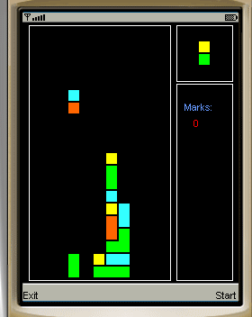
J2ME Overview - MIDP
  Canvas which contains Graphics
    Draw images and strings
    Draw rectangles, lines and arcs
    Set the color used
    Canvas also allows you to get “key” input from user
Form are used for some simple applications only have text input
Canvas are used for more interactive applications like games
A puzzle game developed by Canvas

Slide 62
J2ME Overview - MIDP
Media
  Included in javax.microedition.media.*
  Allows playing of audio and video
  Allows control the playing of the media like the volume and tone of audio

Slide 63
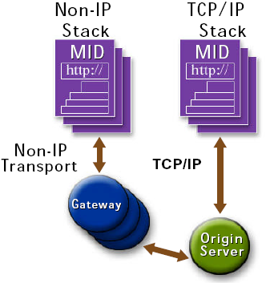
J2ME Overview - MIDP
Networking
  Included in javax.microedition.io.*
  MIDP devices must implement client portion of HTTP 1.1 protocol
May or may not use IP-based transport
  Non-IP Examples: HTTP layered on top of PDC-P for i-mode on WSP for WAP
IP is the protocol that we used in Internet

Slide 64
J2ME Overview - MIDP
Security
  Included in javax.microedition.pki.*
  Handling security certificate
  Allows you to get the public and perform encryption or verification

Slide 65
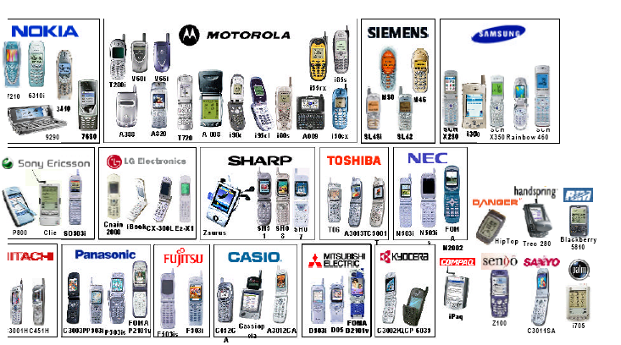
J2ME Resources
J2ME devices

Slide 66
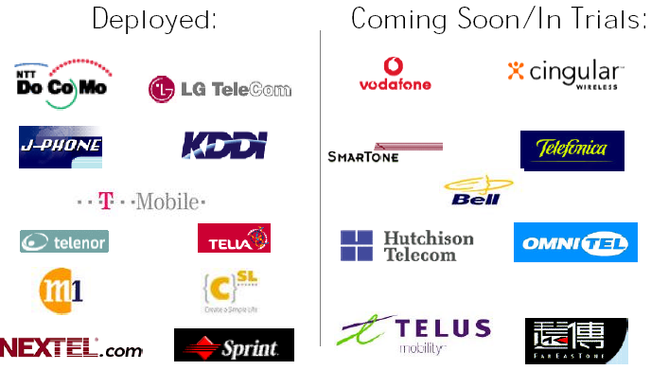
J2ME Resources
Key J2ME Deployments

Slide 67
J2ME Resources
J2ME Development Tools
  Sun J2ME Wireless Toolkit (SolarisTM platform, Linux, and Win32), standalone or plugged into Sun ONE Studio Mobile Edition IDE
  MIDP reference (Palm OS and Win32), CLDC SDK (Solaris platform, Linux, and Win32)
  Numerous third party tools (Borland/Nokia, Metrowerks/Motorola, Siemens, etc.)
  Any IDE or Java tool, including J2SE SDK
  Tools from the J2ME Archive (XML parsers and SOAP tools, J2ME-based microbrowsers, kAWT, etc.)

Slide 68
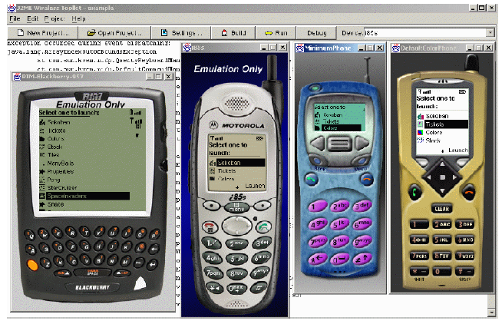
J2ME Resources
Sun J2ME Wireless Toolkit

Slide 69
J2ME Resources
Development Tools for the J2ME Platform
  Devices are available NOW
  Everything needed to start writing great Java applications for mobile devices is available TODAY
  Many of the best tools are FREE

