Slide 1
ITEPC 06 - Workshop on Fractal Creation
Chiew-Lan Tai and Oscar Au

Slide 2


Project Objectives
Objectives
  To introduce simple methods of constructing fractals
  To learn some related math
  To appreciate the beauty of fractals
  To have fun with programming
    C++, OpenGL

Slide 3
Mandelbrot & Nature
[Mandelbrot, 1983]: clouds are not spheres, mountains are not cones, coastlines are not circles, and bark is not smooth, nor does lightning travel in a straight line
How to represent natural objects?
  Using equations? No.
  Answer: fractal-geometry methods

Slide 4
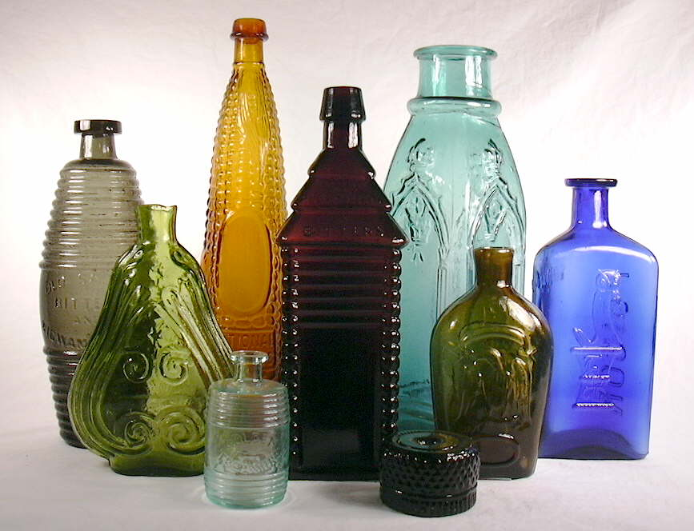
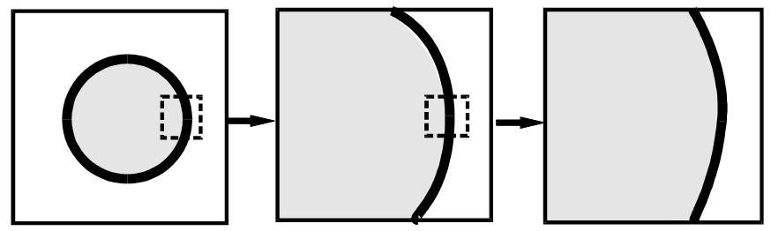
Equations vs. Procedures
Methods based on equations
  Adequate for describing manufactured objects
  For smooth surfaces and regular shapes.

Slide 5
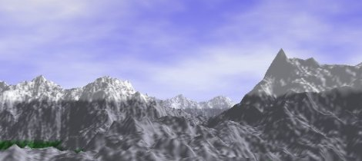
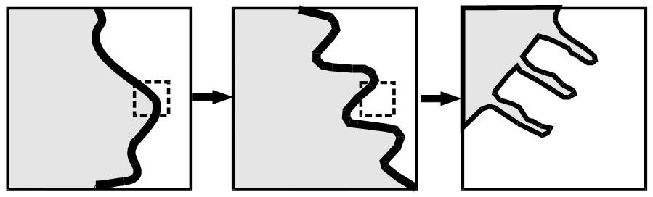
Equations vs. Procedures
Methods based on procedures
  Realistic representations for nature objects, such as mountains and clouds
  Objects with irregular or fragmented features

Slide 6
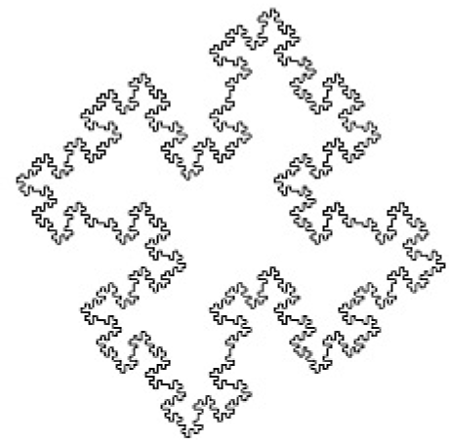
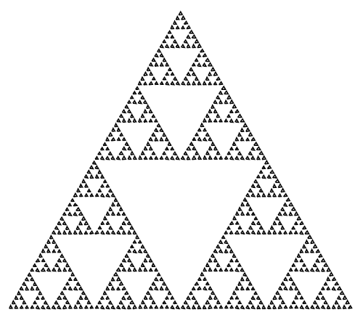
Fractal Gallery: Classic Fractals
Quadric Koch island
Sierpinski gasket reptile

Slide 7
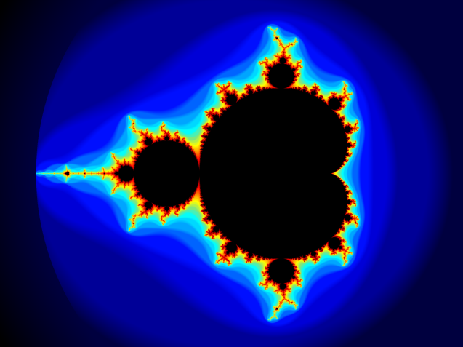
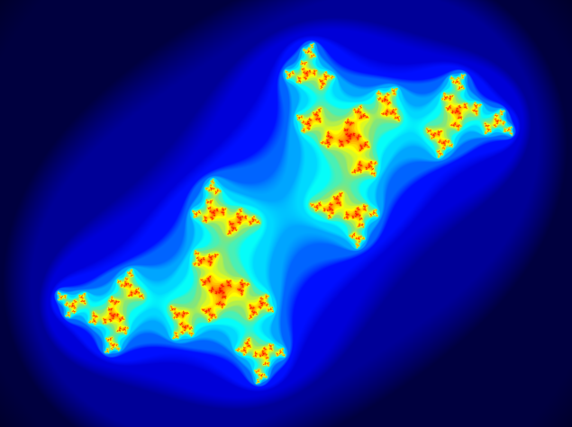
Fractal Gallery: Classic Fractals
The Mandelbrot set
The Julia set

Slide 8

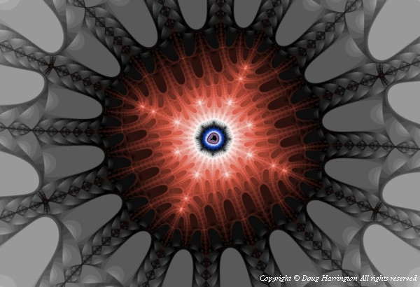
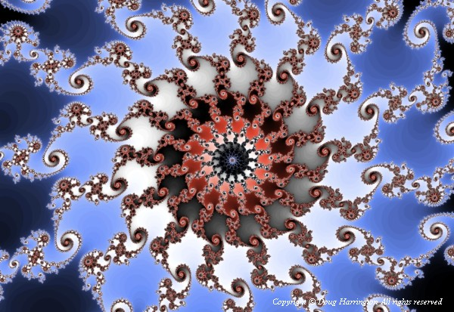
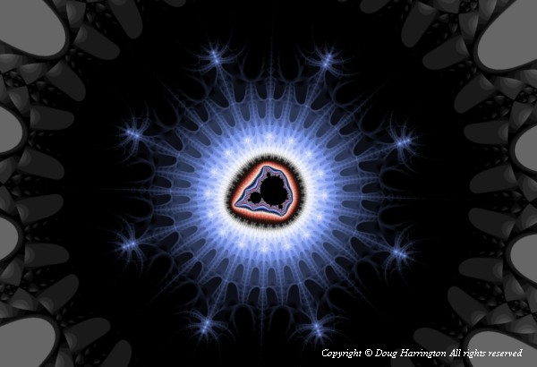
Fractal Gallery: Classic Fractals
courtesy of Amazing Seattle Fractals

Slide 9
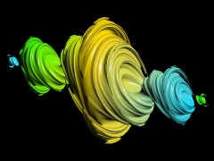
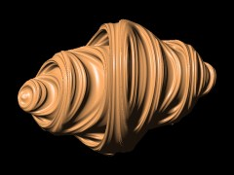
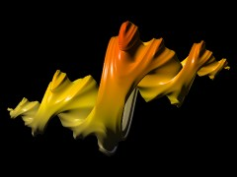
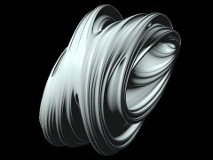
Fractal Gallery: Classic Fractals

Slide 10
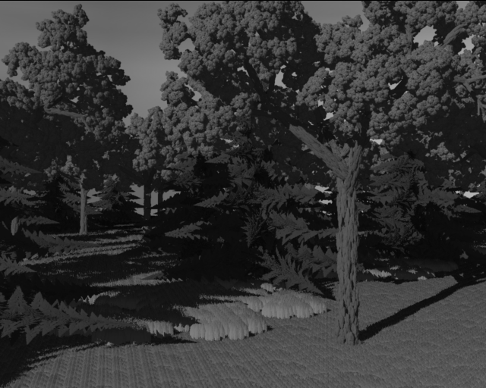
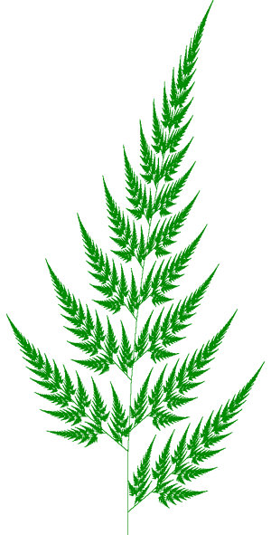
Fractal Gallery: Natural Phenomenon Synthesis
Fractal forest
(courtesy of John C. Hart, UIUC)
Fractal fern (courtesy of Paul Bourke)

Slide 11
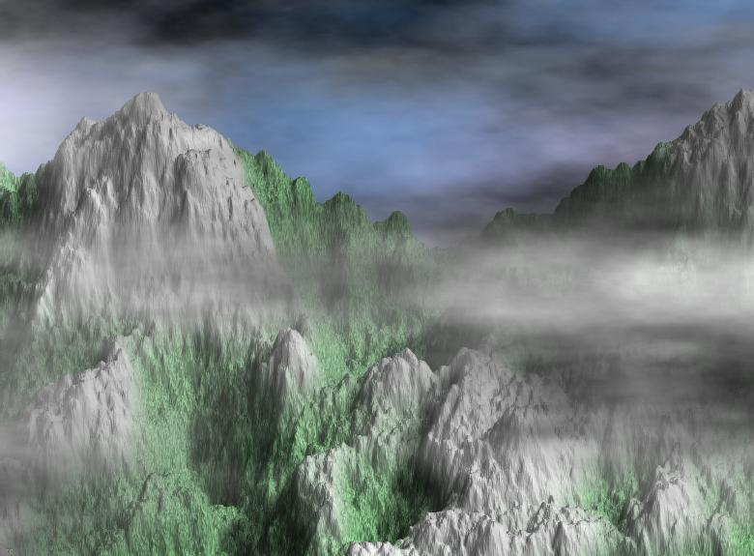
Fractal Gallery: Natural Phenomenon Synthesis
Mountain with vegetation & stormy clouds
(courtesy of Jean-Francois COLONNA)

Slide 12

Fractal Gallery: Natural Phenomenon Synthesis
Light clouds at sunset (courtesy of Jean-Francois COLONNA)

Slide 13
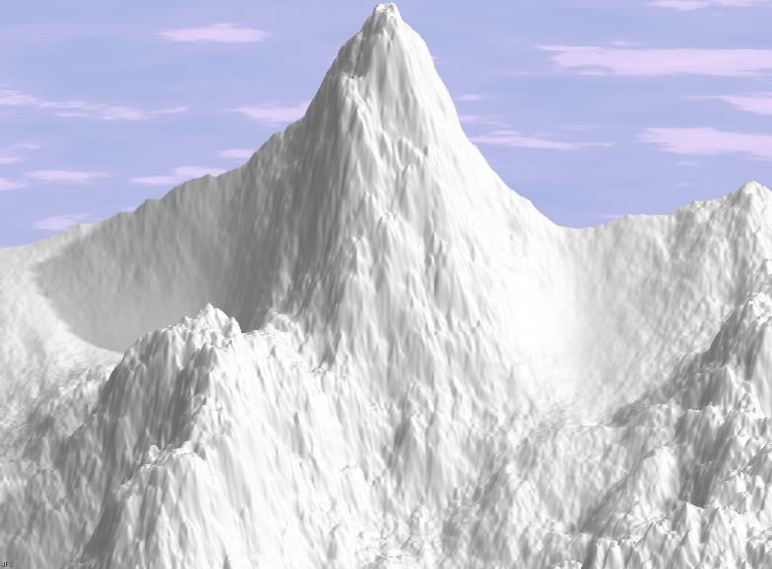
Fractal Gallery: Natural Phenomenon Synthesis
Snowy mountain (courtesy of Jean-Francois COLONNA)

Slide 14
OpenGL Programming
Part I
Main reference: [Hill] Computer Graphics uisng OpenGL (Chapter 2)

Slide 15

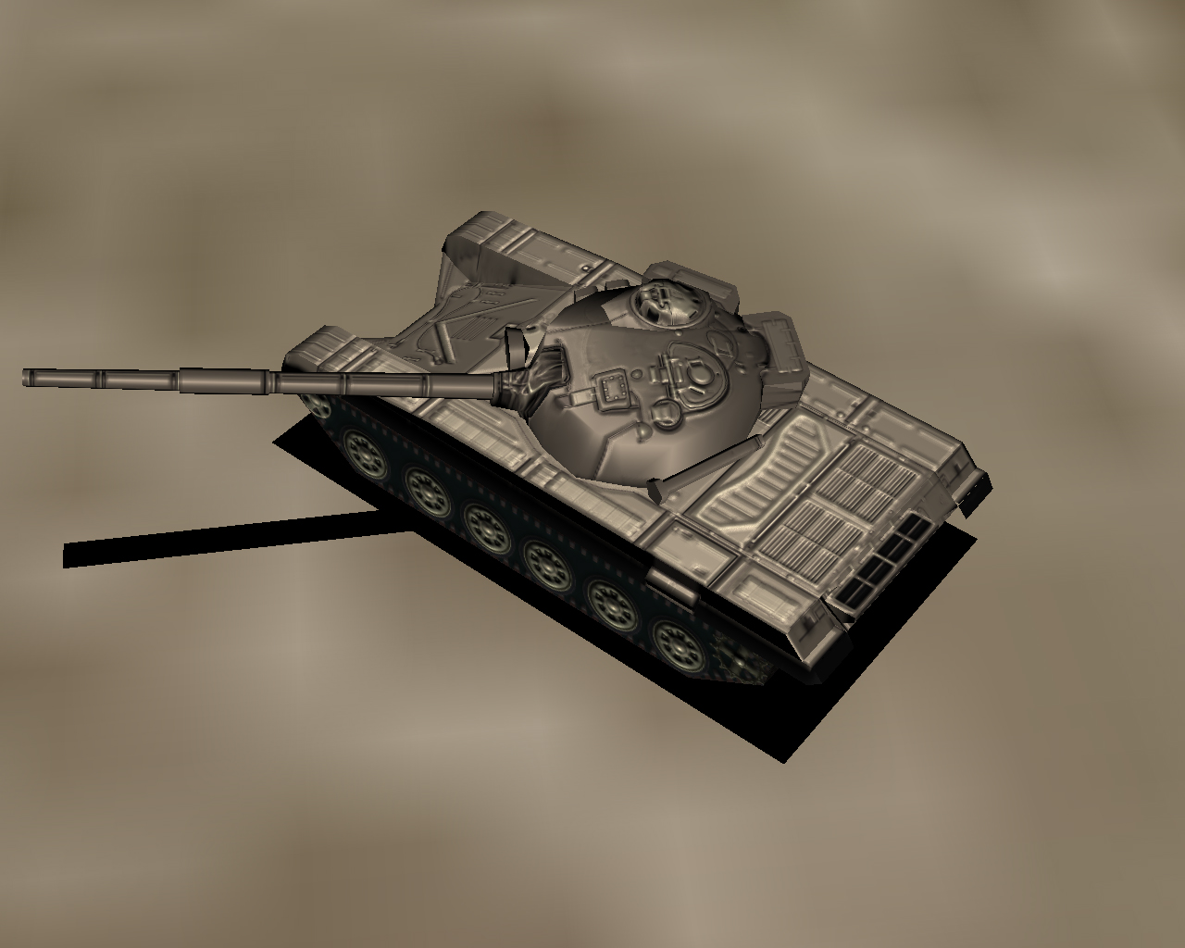
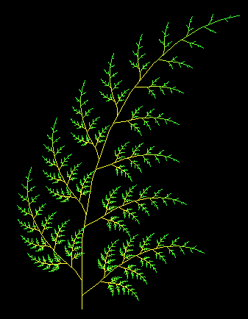
What is OpenG (OGL)?
OGL is 3D graphics & modeling library
In this project, we will only use it to draw 2D objects.

Slide 16

What is OpenG (OGL)?
Interactive computer graphics system that allows us to access graphics hardware
  Easy to use
  Programs run efficiently
  Hardware-independent
Graphics API (Application Programming Interface)
  A library of functions
  Others: DirectX (Microsoft), Java3D

Slide 17
What is OpenG (OGL)?
OGL is independent of any specific window system → basic window operations are not included
Graphics user interface programming:
  GLUT = OGL Utility Toolkit
    Simple but easy to use

Slide 18
Programming Environment
OGL is usually installed on a MS Windows machine.
Programming environment
  MS Visual Studio .Net 2003
Libraries we will use
  OGL (basic API tool)
  GLU (OGL Utility Library)
  GLUT (OGL Utility Toolkit, a windowing toolkit that handles window system operations)

Slide 19
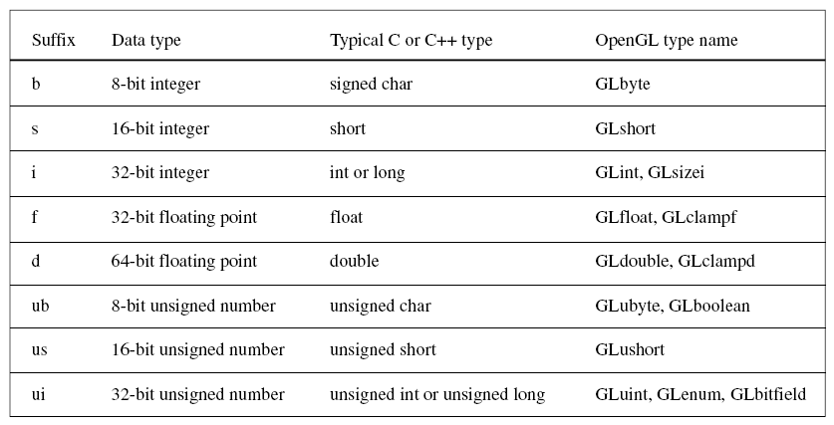
OGL Data Types
To make more portable, OGL provides internal data types

Slide 20
Basic OGL Syntax
Functions are prefixed with gl,
  glBegin, glClear, glClearColor
Constants in capital letters, and the underscore is used as a separator
  GL_2D, GL_LINES, GL_TRIANGLES
Built-in data-type names begin with GL
  GLbyte, GLshort, GLint, GLboolean

Slide 21
Skeleton of an OGL program using GLUT
int main(int argc, char** argv)
{
glutInit(&argc, argv); // initialize the toolkit
glutInitDisplayMode(GLUT_SINGLE | GLUT_RGB); // set the display mode
glutInitWindowSize(640, 480); // set window size
glutInitWindowPosition(150, 100); // set window position
glutCreateWindow("my first attempt"); // open the screen window
// register the callback functions
glutDisplayFunc(myDisplay);
glutReshapeFunc(myReshape);
glutMouseFunc(myMouse);
glutKeyboardFunc(myKeyboard);
myInit(); // additional initializations as necessary
glutMainLoop(); // go into a perpetual loop
}

Slide 22
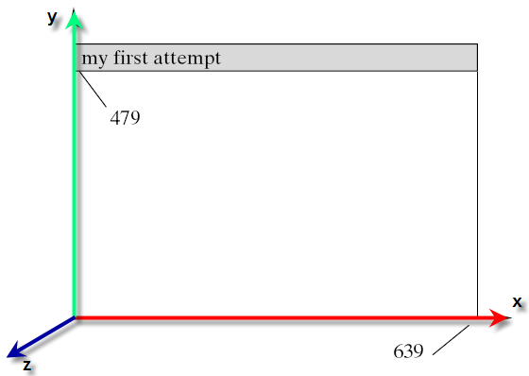
Creating Window for Drawing
The first five function calls use GLUT to open a window for drawing
sx
(150, 100)
Coordinate system in OGL
sy

Slide 23
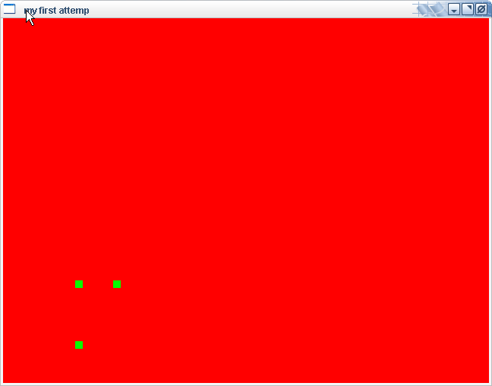
First OGL Program: DrawDots

Slide 24
First OGL Program: DrawDots
Our first program is not interactive. It consists of three functions: main, myDisplay, myInit. (see accompanying demo program)
int main(int argc, char** argv)
{
glutInit(&argc, argv); // initialize the toolkit
glutInitDisplayMode(GLUT_SINGLE | GLUT_RGB); // set the display mode
glutInitWindowSize(640, 480); // set window size
glutInitWindowPosition(100, 150); // set window position
glutCreateWindow("my first attemp"); // open the screen window
glutDisplayFunc(myDisplay); // register redraw function
myInit(); // additional initializations as necessary
glutMainLoop(); // go into a perpetual loop
}

Slide 25
First OGL Program: DrawDots
Draw primitives
  Display callback function myDisplay
void myDisplay()
{
glClear(GL_COLOR_BUFFER_BIT); // clear the screen
glBegin(GL_POINTS);
glVertex2i(100, 50); // draw three dots
glVertex2i(100, 130);
glVertex2i(150, 130);
glEnd();
glFlush(); // send all output to display
}

Slide 26
First OGL Program: DrawDots
Draw primitives
  glBegin(GLenum mode)
    mode can be GL_POINTS, GL_LINES, GL_POLYGON, etc.

Slide 27
First OGL Program: DrawDots
Initialization
void myInit()
{
glClearColor(1.0, 0.0, 0.0, 0.0); // set red background color
glColor3f(0.0, 1.0, 0.0); // set the drawing color
glPointSize(10.0); // a 'dot' is 10 by 10 pixels
// The following lines establish the coordinate system.
// Details will be covered later.
glMatrixMode(GL_PROJECTION);
glLoadIdentity();
gluOrtho2D(0, 640, 0, 480);
}

Slide 28
First OGL Program: DrawDots
OpenGL is a state machine
  It keeps track of many state variables
    Current size of a point, current color of drawing, current background color, etc.
    Color of drawing is specified using glColor3f(red, green, blue); (range: [0, 1])
    Background color is set with glClearColor(red, green, blue, alpha). glClear clears the entire window to the background color (cf. myDisplay).
  The value of a state variable remains active until a new value is given.

Slide 29
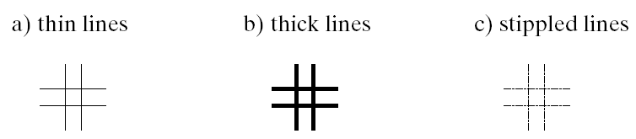
Line Drawing
glLineWidth(2.0); // set line thickness
glBegin(GL_LINES);
glVertex2i(10, 20); // first horizontal line
glVertex2i(40, 20);
glVertex2i(20, 10); // first vertical line
glVertex2i(20, 40);
// four more calls to glVertex here for the other two lines
glEnd();

Slide 30
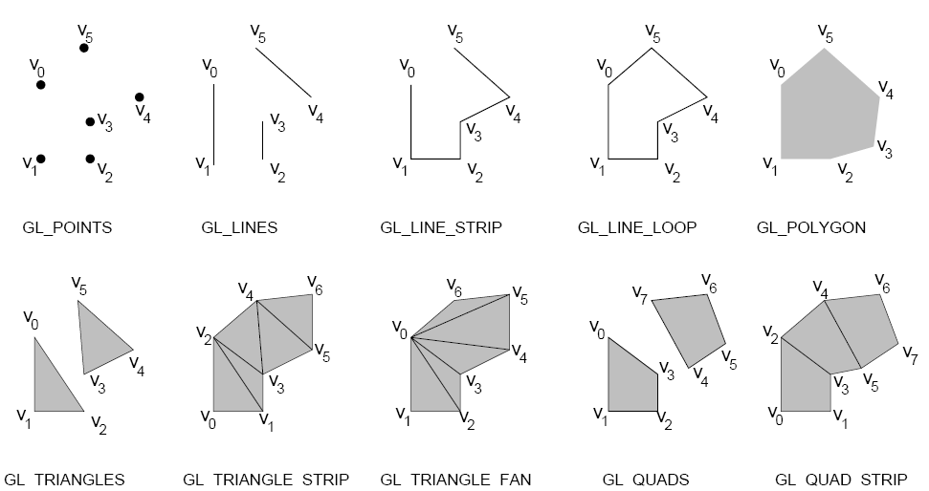
Drawing Modes
glBegin(GLenum mode)

Slide 31
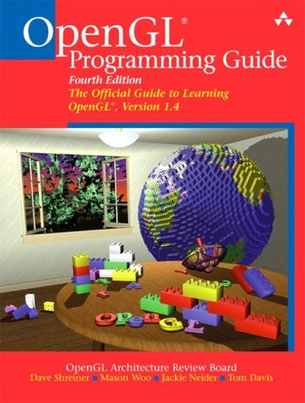
Recommended Resources
OpenGL official Website
OpenGL Utility Toolkit (GLUT) (download GLUT)
Nice GLUT Tutorial
NEHE: OpenGL tutorial
OpenGL red book

