Slide 1
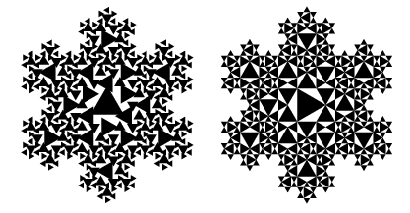
Fundamentals of Fractals
Main reference: [Hill] Computer Graphics uisng OpenGL (p472-477)

Slide 2

What are Fractals?
Fractal definition from MathWorld
  A fractal is an object or quantity that displays self-similarity, in a somewhat technical sense, on all scales.
  Fractals need not exhibit exactly the same structure at all scales, but the same "type" of structures must appear on all scales.

Slide 3

Self-Similarity Property of Fractal
Self similarity across scales
  As one zooms in or out the geometry/image has a similar (sometimes exact) appearance
  Types of self-similarity
    Exact self similarity
    Approximate self similarity
    Statistical self similarity

Slide 4
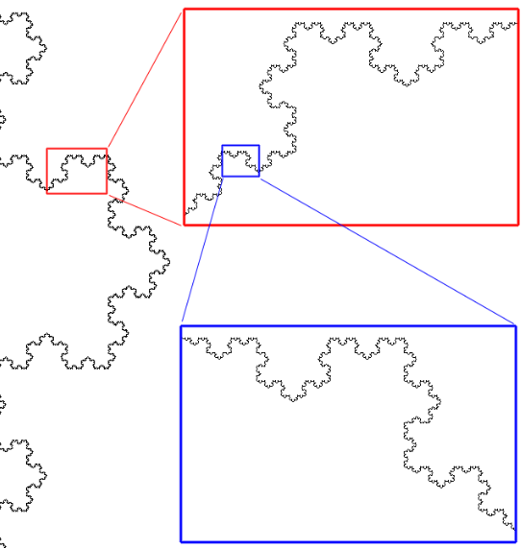
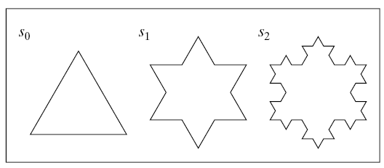
Exact Self-Similarity
Self similarity may be exact
  Normally only occurs in mathematically defined fractals
  Example:
  Koch snowflake

Slide 5
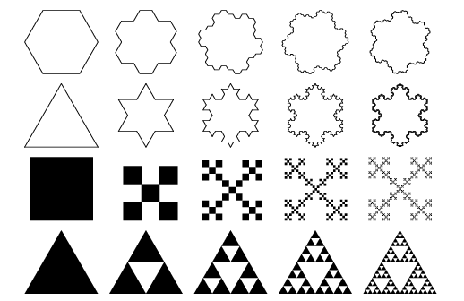
Exact Self-Similarity

Slide 6
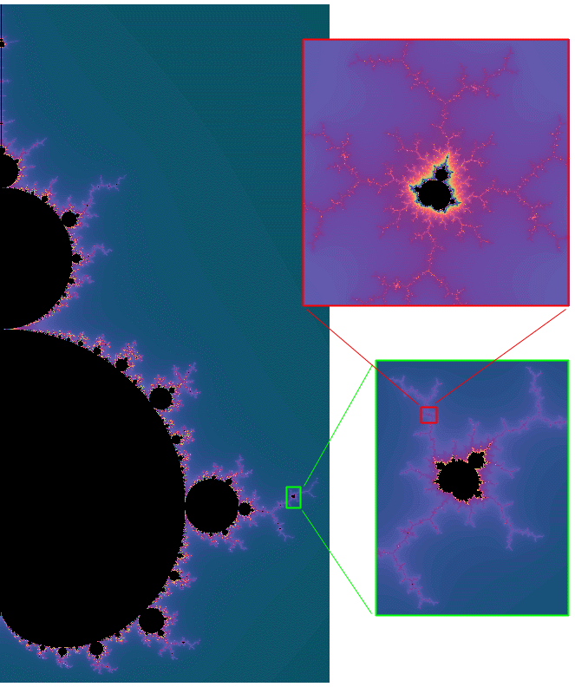
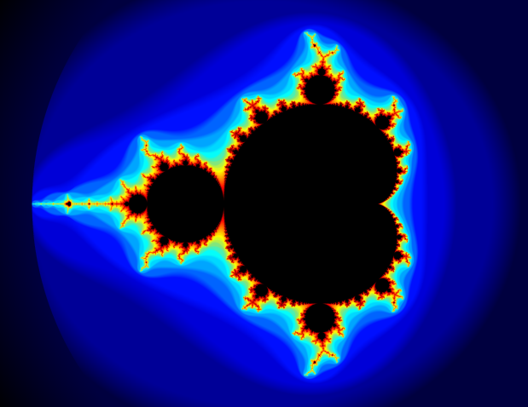
Approximate Self-Similarity
Structures that are recognizably similar but not exactly so
  More common type of
  self-similarity
  Example: Mandelbrot set

Slide 7
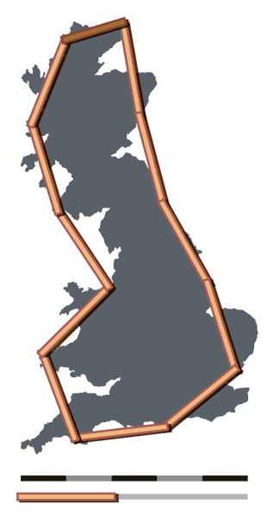
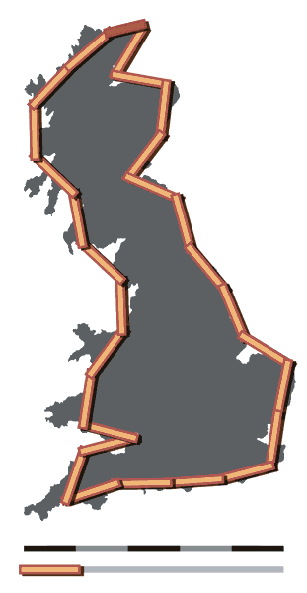
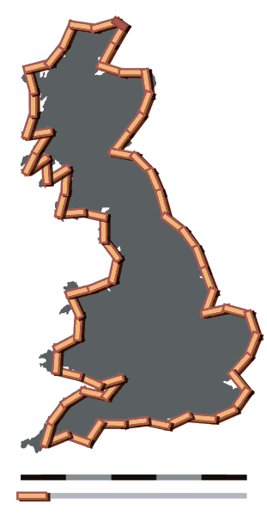
Statistical Self-Similarity
Irregularity is the same on the average
  Example: coastline

Slide 8
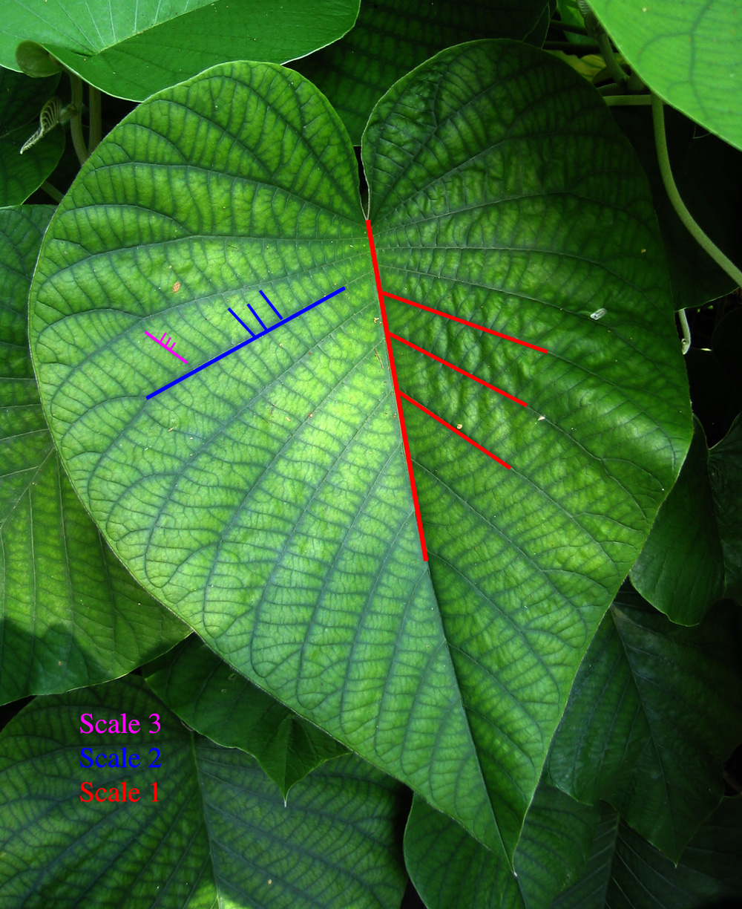
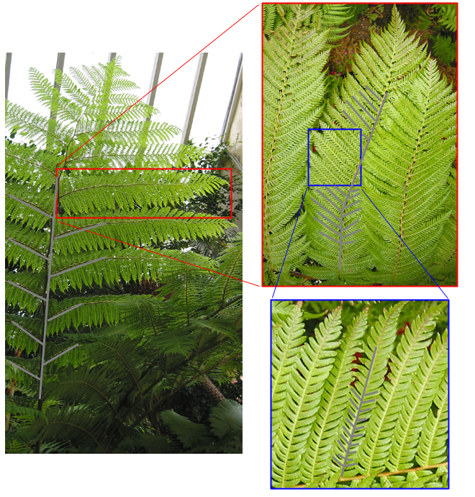
Self-Similarity in Real World

Slide 9
Successive Refinement of Curves
Very complex curves can be made by repeatedly refining a simple curve.
The simplest example: Koch curve
  Discovered in 1904 by Helge von Koch, an Swedish mathematician
  Exactly self-similar fractal
  Fascinating feature: an infinitely long line within a region of finite area

Slide 10
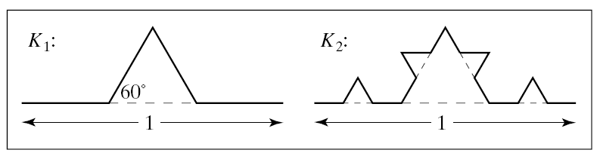
Koch Curves
K₀, K₁, K₂, …: successive generations of the Koch curve
K₀: a horizontal line of length unity.
K_{n}→ K_{n+1}: subdivide each segment of K_{n} into three equal parts and replace the middle part with a bump in the shape of an equilateral triangle.
Two generations of the Koch curve

Slide 11
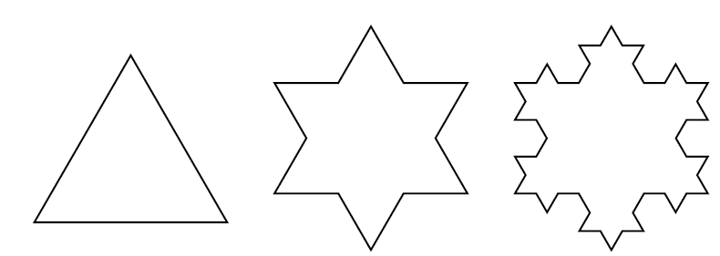
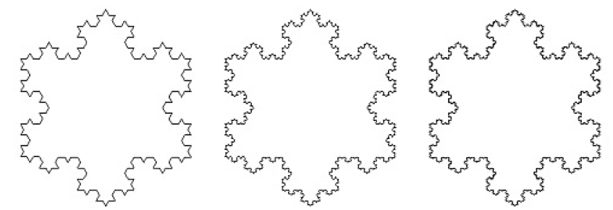
Koch Snowflake

Slide 12
Dimension of Koch Curves?
A line is one dimensional and a plane is two dimensional, are there “creatures” in between?
Koch curves are infinite in length (4/3)^{n}, yet lie inside a finite rectangle
  Their dimension lies somewhere between 1 and 2.

Slide 13
Fractional Dimension
Self-similar dimension
1D
2D
3D

Slide 14
Fractional Dimension
Self-similar dimension
  An object has dimension D if, when it is subdivided into N equal parts, each part must be made smaller on each side by r = 1 / N^{1/D}.
  Fractional dimension: D = log (N) / log (1 / r)
  Fractional dimension of Koch curve
    From one generation to the next, N = 4 segments are created from each parent segment, but their lengths are r = 1/3
    D = log(4) / log(3) = 1.26

Slide 15
Drawing Koch Curves
Another view of Koch curves
  Each generation consists of four versions of the previous generation.
Pseudo-code of drawing Koch curve recursively
To draw K_{n}:
if (n equals 0) Draw a straight line;
else {
Draw K_{n-1};
Perform a transformation;
Draw K_{n-1};
Perform a transformation;
Draw K_{n-1};
Perform a transformation;
Draw K_{n-1};
}
One demo program to draw Koch curves will be covered later.

Slide 16
OpenGL Programming
Part II
Main reference: [D. Mount] Computer Graphics (Lecture 5)
http://www.cs.umd.edu/~mount/427/Lects/427lects.pdf

Slide 17
Transformations in OGL
Recall that once you define the attributes (such as color), all the subsequent objects are drawn using those attributes.
Same rule for transformations
  Specify a transformation, and then this transformation is automatically applied to every object that is drawn, until the transformation is set again.
  Important: set transformations prior to drawing

Slide 18
Transformations in OGL
Transformations have different purposes
  Two of OGL’s matrix types will be covered.
  Modelview matrix for moving objects or change of coordinates
  Projection matrix for projection
    Project objects from the world window to the viewport, and mapping the viewport to the graphics display window.

Slide 19
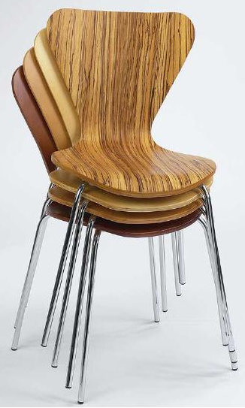
Transformations in OGL
For each matrix type, OGL maintains a stack of matrices
  Stack: last in, first out
To operate on a specific matrix type,
call glMatrixMode(mode)
  Different modes:
  GL_MODELVIEW, GL_PROJECTION
Once the matrix mode is set, perform
various operations on the stack.

Slide 20
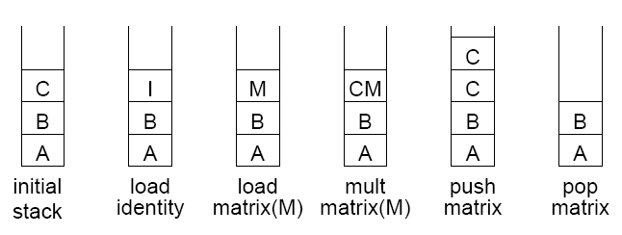
Matrix Stack Operations
glLoadIdentity(): sets the current matrix to the identity matrix.
glLoadMatrix(M): loads a given matrix over the current matrix.
glMultMatrix(M): multiplies the current matrix by a given matrix and replaces the current matrix with this result.
glPushMatrix(): pushes a copy of the current matrix on top the stack.
glPopMatrix(): pops the current matrix off the stack.

Slide 21
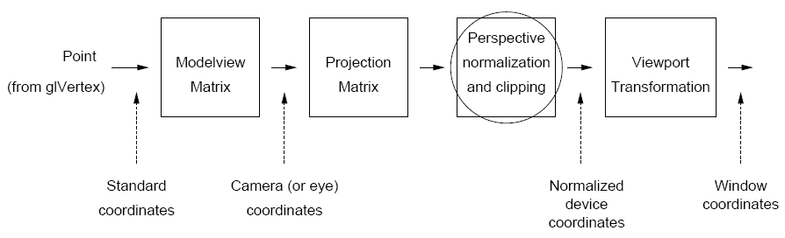
Transformation Pipeline
How do we apply the matrix to some point we want to transform?
  Answer: OGL do it for you automatically.
OGL’s transformations do not alter the state (e.g. coordinates) of the objects you are drawing.

Slide 22
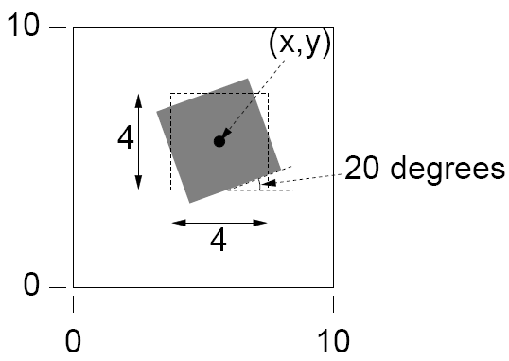
Transformation Example
Desired drawing
Of course, you can computed the desired coordinates of the vertices yourself.
Make your life easier with OGL.

Slide 23
Transformation Example
Assume the matrix mode is GL_MODELVIEW
General, the top of Modelview matrix is not identity
  This represents some more global transformation.
  This will be composed with our rotation transformation.
To avoid destroying the contents of the Modelview matrix, we may need to save the contents of the Modelview matrix and restore its contents after we are done.
  glPushMatrix(), glPopMatrix().

Slide 24
Transformation Example
In OGL, whenever you draw, the points are automatically transformed using the current Modelview matrix.
Common way of object transformations in OGL
  Push the matrix stack.
  Apply all desired transformations
  Draw your objects (the transformations will be applied automatically)
  Pop the matrix stack.

Slide 25
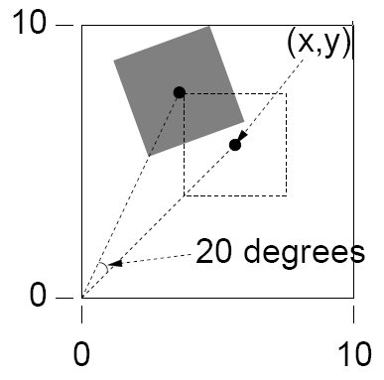
Transformation Example
First attempt
  Rotation command
    glRotatef(angle_in_degree, x, y, z);
    Rotation is performed about the origin of the coordinate system.
  Translation command
    glTranslatef(x, y, z);
glPushMatrix(); // save the current matrix
glRotatef(20, 0, 0, 1); // rotate by 20 degrees CCW
glRectf(x-2, y-2, x+2, y+2); // draw the rectangle
glPopMatrix(); // restore the old matrix
equivalent
glPushMatrix(); // save the current matrix
glRotatef(20, 0, 0, 1); // rotate by 20 degrees CCW
glTranslatef(x, y, 0); // apply translation
glRectf(-2, -2, 2, 2); // draw the rectangle
glPopMatrix(); // restore the old matrix

Slide 26
Transformation Example
Correct way
glPushMatrix(); // save the current matrix
glTranslatef(x, y, 0); // apply translation
glRotatef(20, 0, 0, 1); // rotate by 20 degrees CCW
glRectf(-2, -2, 2, 2); // draw the rectangle
glPopMatrix(); // restore the old matrix

Slide 27
World Windows & Viewports
Coordinates in the previous demo examples are essentially in pixels
  From 0 to some value screenWidth - 1 in x
  From 0 to some value screenHeight - 1 in y
If we want to use coordinates not in terms of pixels, say, x varying from [-1, 0.5], how to do it?
Solution: separate the values to describe geometrical objects and the size/position of the pictures of those objects on the display.

Slide 28
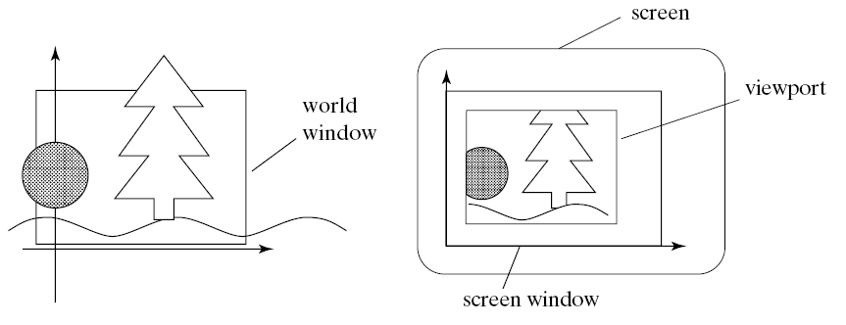
World Windows & Viewports
Define a scene in world coordinates (natural coordinate system for your problem)
  World window (with clipping)
Viewport: a rectangle in the screen window, showing a snapshot of the scene through world window
Need a transformation between world window & viewport

Slide 29
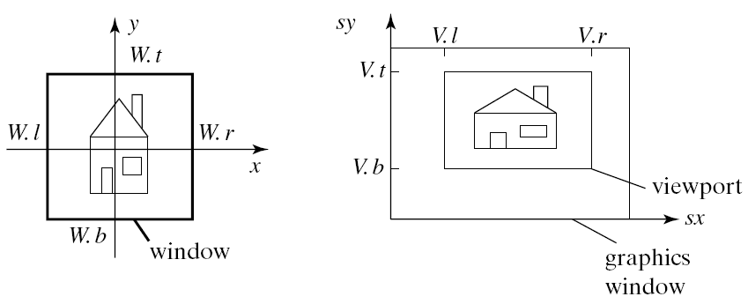
Window to Viewport Mapping
An axis-aligned rectangle → another axis-aligned rectangle
  Distortion may occur (different aspect-ratio)

Slide 30
Window to Viewport Mapping
Mapping is defined as
  sx = Ax + C
    A = (V.r – V.l) / (W.r – W.l)
    C = V.l – A W.l
  sy = By + D
    B = (V.t – V.b) / (W.t – W.b)
    D = V.b – B W.b
Note OGL will do the above mapping for you.

Slide 31
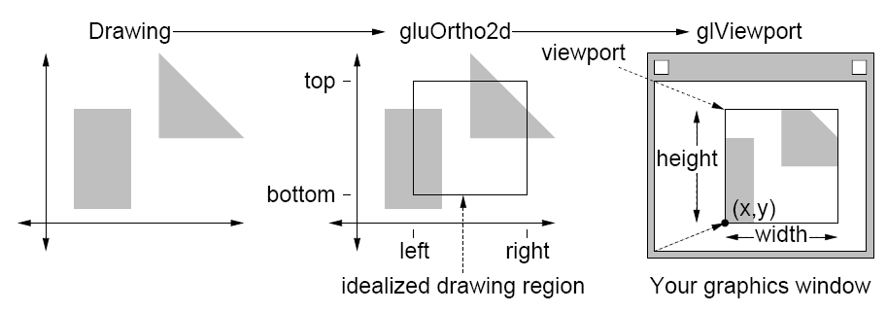
W→V Mapping in OGL
For 2D drawing, world window is set by
  gluOrtho2D(GLdouble left, GLdouble right,
  GLdouble bottom, GLdouble top)
  The mapping is performed by a transformation matrix (called projection matrix), internally maintained by OGL.
    glMatrixMode(GL_PROJECTION); // set projection matrix
    glLoadIdentity(); // initialize to identity
    gluOrtho2D(left, right, bottom, top);

Slide 32
W→V Mapping in OGL
Viewport is set by
  glViewport(GLint x, GLint y,
  GLint width, GLint height)
  E.g. usually we use the entire window as the viewport
    glViewport(0, 0, screen_with, screen_height)

Slide 33
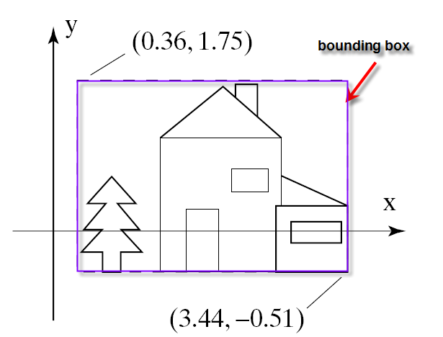
Window/Viewport Setting Tips
Setting the window automatically
  Let the application determine a good window to use
  Find the bounding box of scene

Slide 34
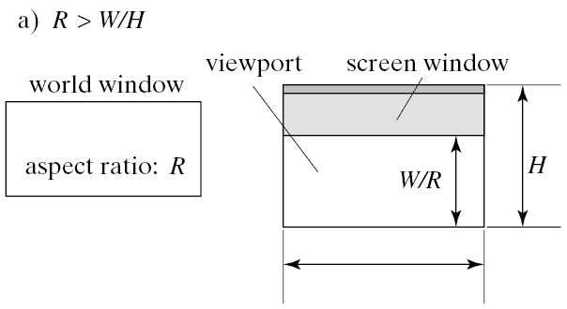
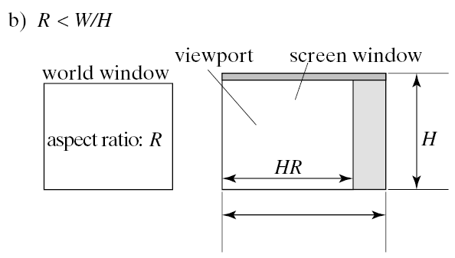
Window/Viewport Setting Tips
Automatically setting the viewport to preserve the aspect ratio
  Draw the largest undistorted version of a figure fitting in the screen window.
    glViewport(0, W, 0, W / R);
    glViewport(0, H * R, 0, h);

Slide 35
Window/Viewport Setting Tips
Making a matched viewport during resizing
  Register a callback function (e.g. myReshape) for the resize event (through glutReshapeFunc(myReshape))
void myReshape(GLsizei W, GLsizei H)
{
if (R > W / H) // use (global) window aspect ratio
glViewport(0, W, 0, W / R);
else
glViewport(0, H * R, 0, H);
}

Slide 36
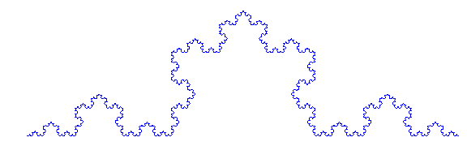
void DrawKoch(int level) { // recursion function
if (level == 0) {
glBegin(GL_LINES);
glVertex2f(0.0, 0.0); glVertex2f(1, 0.0);
glEnd();
}
else{
glPushMatrix();{
glScalef(0.3333333, 0.3333333, 0.3333333); DrawKoch(level - 1); // first component
glTranslatef(1, 0, 0); // second component glRotatef(60, 0, 0, 1);
DrawKoch(level - 1);
glTranslatef(1, 0, 0); // third component
glRotatef(-120, 0, 0, 1);
DrawKoch(level - 1);
glTranslated(1, 0, 0); // fourth component
glRotated(60, 0, 0, 1);
DrawKoch(level - 1);
}
glPopMatrix();
}
}
Draw Koch Curves in OGL
(see demo program)

