Slide 1
Spring 2022 COMP 3511
Review #2

Slide 2
Coverages
Quick review on Chapters 2
Process creation
fork() examples
Multi-threaded process

Slide 3
Quick review on Chapters 2
To best utilize the fast CPU, modern OSes employ multiprogramming, which allows many jobs to be in memory at the same time, thus ensuring that the CPU always has a job to execute
Multitasking can be considered an extension of multiprogramming wherein CPU scheduling (to be discussed in Chapter 5) can rapidly switch CPU between executing different processes, providing users with a fast response time, which is important for interactive types of jobs
Operating systems provide mechanisms for protecting. Protection measures the control of the resource (hardware and software) access available in computer systems.
Virtualization is a technology that allows an OS to run as an application within another OS. It involves abstracting hardware into several different execution environments – each referred as a virtual machine.
The virtual machine or VM creates an illusion for multiple processes in that each process “thinks” that it runs on a dedicate CPU with its own memory.

Slide 4
Quick review on Chapters 2 (cont.)
The three primary approaches for interacting with an operating system are (1) command interpreters (CLI or Shell), (2) graphical user interfaces, and (3) touchscreen interfaces
System calls provide services made available by an operating system, where programmers use a system call’s application programming interface (API) for accessing system-call services. The standard C library provides the system-call interface for UNIX and Linux
Operating systems include a collection of system programs that provide utilities to users – so users can use the operating system services
A linker combines several relocatable object modules into a single binary executable file. A loader loads the executable file into memory, where it becomes eligible to run on an available CPU
An operating system is designed with specific goals in mind. These goals ultimately determine the operating system’s policies. An operating system implements these policies through specific mechanisms

Slide 5
System Call and API
System calls are programming interfaces to the services provided by the OS – not directly accessed by application programs
Application Program Interface (API) specifies a set of functions that are available to application programmers, including the parameters passed to the function and return values it may expect
The system call interface of a programming language serves as a link to system calls made available by the OS.
There is a need for separating API and underlying system call:
  Program portability by using API, in which API can remain the same across different OSes or different platforms
  To hide the complex details in system calls from users

Slide 6
Operating System Structures
A monolithic operating system has no structure; all functionality provided in a single, static binary file that runs in a single address space. Although such systems are difficult to modify, their primary benefit is efficiency
A layered operating system is divided into a number of discrete layers, where the bottom layer is the hardware interface and the highest layer is the user interface. It provides modularity to ease coding and debugging, but it is generally not ideal for designing OS due to performance problems and difficulty in defining proper number of layers.
The microkernel approach for designing operating systems uses a minimal kernel, which is extensible, portable, more secured and reliable; other OS services run as user-level applications, in which communication takes place via the message passing mechanism – a major overhead
The loadable kernel module for designing OS provides services through modules that can be dynamically loaded and removed during runtime. It provides the most flexibility, and is widely used in contemporary OSes
Many operating systems are constructed as hybrid systems using a combination of a monolithic kernel and loadable kernel modules.

Slide 7
Fundamental OS concepts
Process
  An instance of an executing program is a process consisting of an address space and one or more threads of control
Thread
  A single unique execution context: fully describes program state
  It is presented by program counter, registers, execution flags, stack
Address Space (with address translation)
  Programs execute in its own address space that is distinct from the memory space of the physical machine
Dual mode operation / Protection
  Only the “system” has the ability to access certain resources
  The OS and the hardware are protected from user programs
  User programs are isolated from one another by proper access control

Slide 8
Process
Process – An OS abstraction of a running program. A process can be described by its state: the contents of memory in its address space, the contents of CPU registers (including the program counter and stack pointer, among others), and information about I/O (such as open files to be read or written).
The OS provides system calls for operations on processes, typically, including creation, termination, and other useful calls
Processes exist in one of many different process states, including ready, running, and waiting waiting (or called blocked). Different events, e.g., scheduled or de-scheduled, or waiting for an I/O to complete transition a process from one of these states to another
A process list – a kernel data structure OS manages to contain information about all processes currently in the system. Each entry is called a process control block (PCB) - an OS kernel data structure that contains all information about a specific process

Slide 9
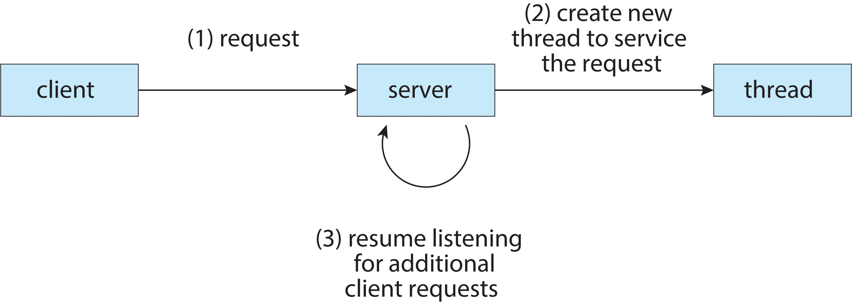
Multithreaded Process
Many modern applications are multithreaded - an application may be required to perform several similar tasks – for instance, a web server accepts client requests for retrieving web pages, which may have many (perhaps thousands of) clients concurrently accessing it
Creating a separate process to service each request is time-consuming and resource-intensive, and each process essentially performs the same task - It is generally much more efficient to create one process containing multiple threads, and each thread listens and serves requests.

Slide 10
Why Multithreaded
A single-threaded program or process runs sequentially, performing one operation followed by another
There are two major reasons for multi-threaded process
Parallelism: to take advantage of multicores or multi-processors - speed up process execution considerably by using each of the processors to perform a portion of the work
Overlap I/O with other activities within a single program
It is feasible to create multiple processes instead of a multi-threaded process. However, threads within a process share the address space and thus make it easy to share data naturally.
Processes are natural choices for logically separate tasks where little sharing of data structures in memory is needed.

Slide 11
Threads within a Process
If a process has a single or multiple thread(s) of execution – the execution context fully describes the state, i.e., the current activity of the thread
A thread is represented by
  Program counter, registers, execution flags, and stack
  A thread is executing on a processor (CPU) when it is resident in the processor registers. PC register holds the address of executing instruction in the thread
Threads within a process share code, data, I/O and files
  On multicore systems, multiple threads of a process can run in parallel on different CPU cores
Each Thread has a Thread Control Block (TCB) containing execution state (CPU registers, program counter, pointer to stack), scheduling info, accounting info, various pointers including the pointer to the process PCB that the thread belongs to

Slide 12
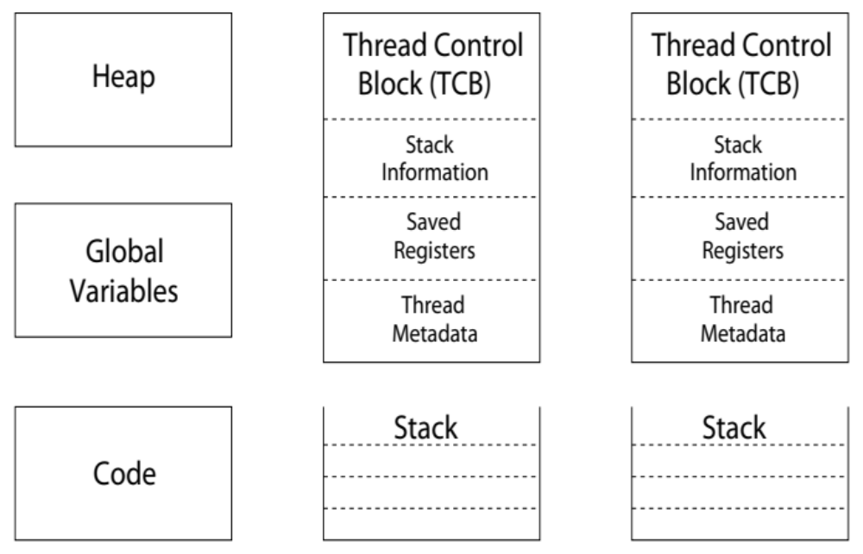
Shared vs. Per-Thread State
Shared State
Per-Thread State
Per-Thread State

Slide 13
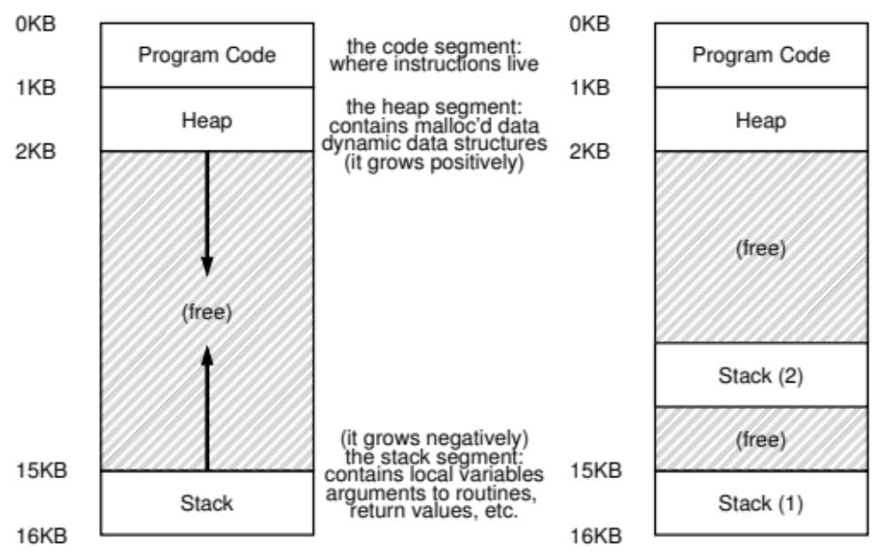
Thread Address Space
Single-threaded and multi-threaded address spaces
Here, we assume the virtual memory address space is 16KB
In practice, the address space is much larger than 16KB

Slide 14
Thread Libraries
Thread library provides programmers with API for creating and managing threads. Three main thread libraries are in use today :
  POSIX Pthreads - either a user-level or a kernel-level library
  Windows - kernel-level library available on Windows systems
  Java - Since JVM is running on top of a host operating system, the Java thread API is generally implemented using a thread library available on the host system, i.e., Pthreads or Windows threads
There are two primary ways of implementing a thread library
  Library entirely in user space - invoking a function in the library results in a local function call in user space and not a system call
  Kernel-level library supported by the OS - invoking a function in the API for the library typically results in a system call to the kernel
For POSIX and Windows thread, data declared globally (outside of any function) - are shared among all threads belonging to the same process
Java has no equivalent notion of global data, access to shared data must be explicitly arranged between threads

Slide 15
Process Creation
fork() creates a new process, perhaps the strangest routine you have seen so far - the newly created process (child process) is an (almost) exact copy of the calling process (parent process). That means that it looks like there are two copies of the same program running, and both are about to return from the fork()system call
The child isn’t an exact copy. Specifically, although it has its own copy of the address space (i.e., its own private memory), its own registers, its own PC, and so forth, the value it returns to the caller of fork() is different - the parent receives the PID of the newly-created child, the child receives a return code of zero. This is essential to distinguish which process (parent or child) is executing the code after fork()
When the child process is created, there are now two active processes in the system along with other processes – either the child or the parent might run before the other. The execution sequences are now non-deterministic, which is determined by CPU scheduling (to be discussed in Chapter 5). In another word, any process can not determine when it will be executed by CPU and for how long.

Slide 16
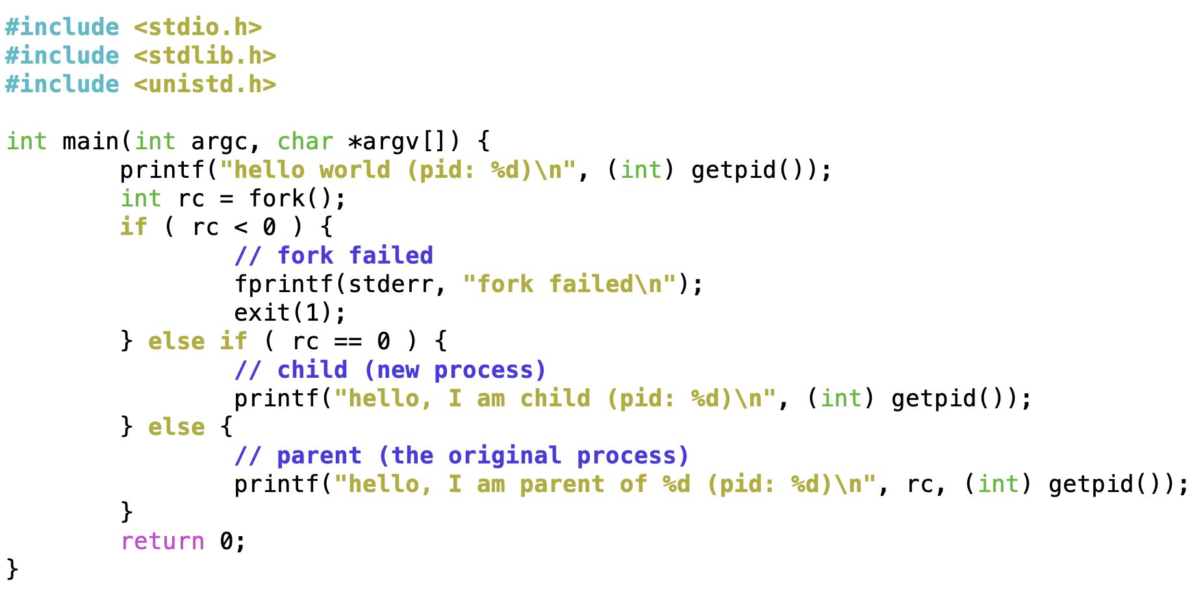
Process Creation (cont.)
http://pages.cs.wisc.edu/~remzi/OSTEP/cpu-api.pdf
Figure 5.1 (p1.c) the simple fork example (with error handling)

Slide 17

Concurrent Execution
fork() creates a new process, which duplicates entire address space of the parent, but with its own process ID and state
Both processes continue execution at the next instruction after fork()
exec() system call can be used after a fork() to replace the process’s memory space with a new program (load a new program to execute)
Parent process can call wait() system call to wait for a child to finish

Slide 18
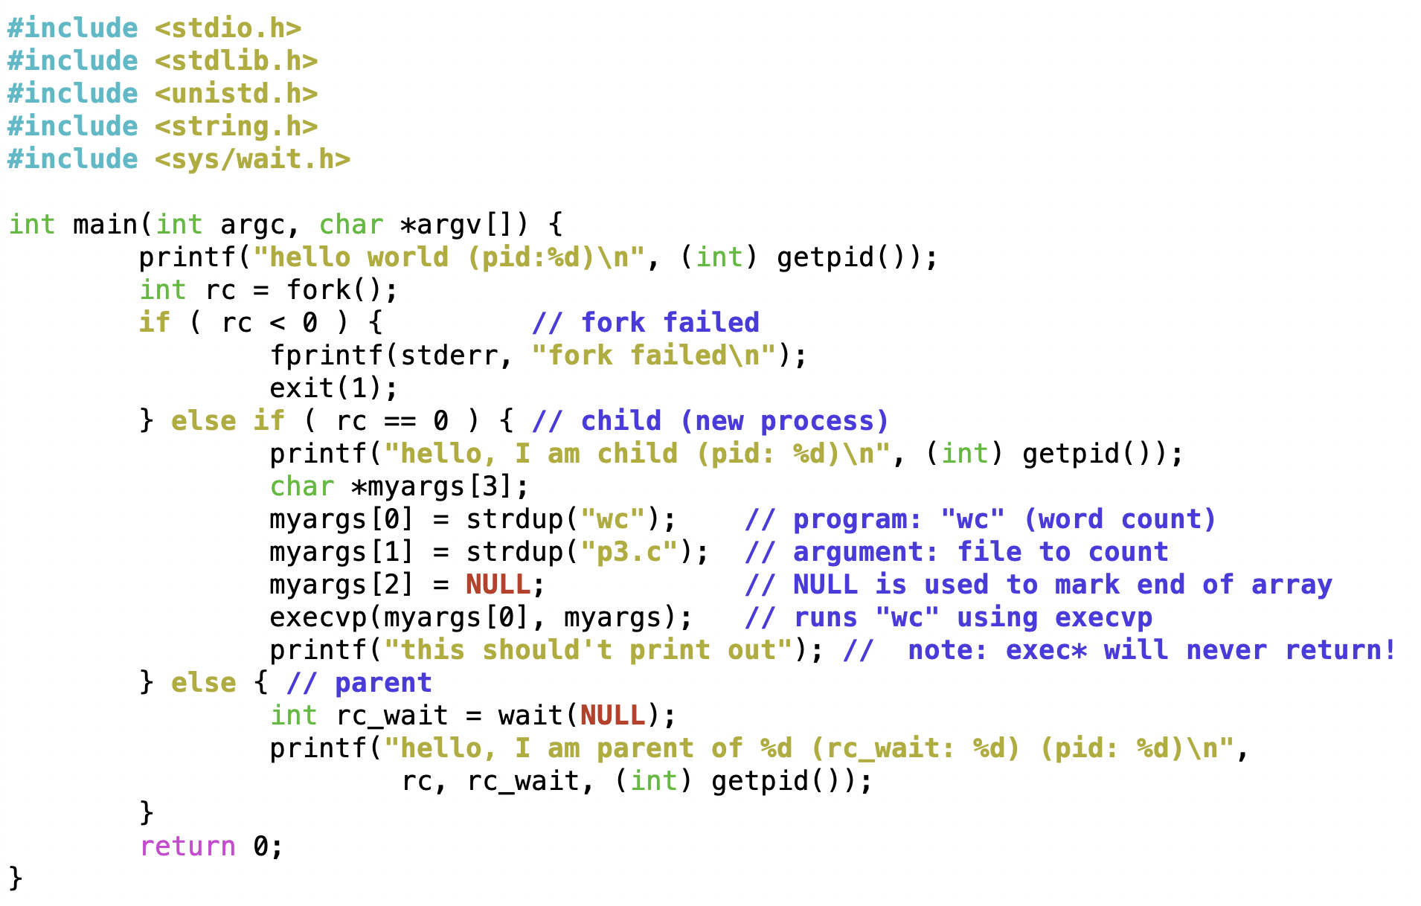
fork() Example
http://pages.cs.wisc.edu/~remzi/OSTEP/cpu-api.pdf
Figure 5.3 (p3.c), example with fork(), wait() and exec*()…
  In the child process, this example demonstrates the usage of execvp to run a command to count number of words in a text file (i.e. p3.c)
  Note: exec*() are special functions. They will never return!

Slide 19
fork() Example 1
Assume that necessary header files are included
Consider the following code segments, what is the total number of processes? Please elaborate
int main() {
int i=0;
for (i=0;i<3;i++)
fork();
return 0;
}
int main() {
fork();
fork();
fork();
return 0;
}
equivalent
Answer:
8 processes
There are 2 processes after each fork() and we have 3 consecutive fork(), so the answer is 2³ = 8

Slide 20
fork() Example 2
Assume that necessary header files are included
Consider the following code segments, what is the total number of processes? Please elaborate
256 processes
Each fork() will create 2 processes, and we have 8 consecutive fork() function calls, thus the total number of processes is 2⁸ = 256
int main() {
int i,j;
for (i=0; i<2; i++) {
fork();
for (j=0; j<3; j++)
if (!fork()) {
// do nothing
}
}
return 0;
}
int main()
{
fork();
if (!fork()); // do nothing
if (!fork()); // do nothing
if (!fork()); // do nothing
fork();
if (!fork()); // do nothing
if (!fork()); // do nothing
if (!fork()); // do nothing
return 0;
}
equivalent

Slide 21
fork() Example 3
Assume that necessary header files are included
Consider the following code segments, what is the total number of processes? Please elaborate (Hint: You can write your answer in terms of x^{y} processes)
6¹⁰ processes
In each loop, there are 6 processes from the initial one. Since there are 10 loops, the program will have 6¹⁰ processes
int main() {
int i=0;
for(i=0; i<10; i++) {
if(fork()) {
fork();
fork();
}
else
fork();
}
return 0;
}

