Slide 1
Spring 2022 COMP 3511 Review #7

Slide 2
Coverages
Memory Management
Segmentation
Paging
Translation look-aside buffer (TLB)

Slide 3
Segmentation

Slide 4
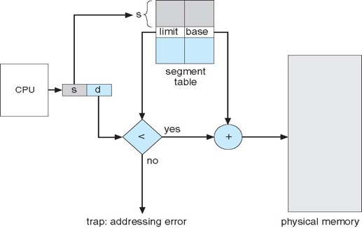
Segmentation Architecture
The logical address now consists of a two tuple:
<segment-number, offset>,
Segment table – maps two-dimensional programmer-defined addresses into one-dimensional physical addresses; each table entry has:
base – contains the starting physical address where the segments reside in memory
limit – specifies the length of the segment
Since segments vary in length, memory allocation for a segment is a dynamic storage-allocation problem
External fragmentation still exists, but is much less severe than that in a contiguous allocation

Slide 5
Example of Segmentation
An example
What are the physical addresses for the following logical addresses (segment number, offset)?
0, 227
2, 63
3, 45
Segment | Base | Length
0 | 120 | 189
1 | 2155 | 596
2 | 525 | 80
3 | 1650 | 64
4 | 846 | 378
Notes:
Find at least two set of problems from previous exam or homework to show translation under segmentation

Slide 6
Example of Segmentation
An example
What are the physical addresses for the following logical addresses (segment number, offset)?
0, 227 → Illegal address since 227 > 189
2, 63
3, 45
Segment | Base | Length
0 | 120 | 189
1 | 2155 | 596
2 | 525 | 80
3 | 1650 | 64
4 | 846 | 378

Slide 7
Example of Segmentation
An example
What are the physical addresses for the following logical addresses (segment number, offset)?
0, 227 → Illegal address since 227 > 189
2, 63 → 588 since 525 + 63
3, 45
Segment | Base | Length
0 | 120 | 189
1 | 2155 | 596
2 | 525 | 80
3 | 1650 | 64
4 | 846 | 378

Slide 8
Example of Segmentation
An example
What are the physical addresses for the following logical addresses (segment number, offset)?
0, 227 → Illegal address since 227 > 189
2, 63 → 588 since 525 + 63
3, 45 → 1695 since 1650 + 45
Segment | Base | Length
0 | 120 | 189
1 | 2155 | 596
2 | 525 | 80
3 | 1650 | 64
4 | 846 | 378

Slide 9
Example of Segmentation
An example
What are the logical addresses for the following physical addresses?
247
1450
1043
Segment | Base | Length
0 | 120 | 189
1 | 2155 | 596
2 | 525 | 80
3 | 1650 | 64
4 | 846 | 378

Slide 10
Example of Segmentation
An example
What are the logical addresses for the following physical addresses?
247 → 0, 127
1450
1043
Segment | Base | Length
0 | 120 | 189
1 | 2155 | 596
2 | 525 | 80
3 | 1650 | 64
4 | 846 | 378

Slide 11
Example of Segmentation
An example
What are the logical addresses for the following physical addresses?
247 → 0, 127
1450 → illegal physical address since there is no corresponding logical address
1043
Segment | Base | Length
0 | 120 | 189
1 | 2155 | 596
2 | 525 | 80
3 | 1650 | 64
4 | 846 | 378

Slide 12
Example of Segmentation
An example
What are the logical addresses for the following physical addresses?
247 → 0, 127
1450 → illegal physical address since there is no corresponding logical address
1043 → 4, 197
Segment | Base | Length
0 | 120 | 189
1 | 2155 | 596
2 | 525 | 80
3 | 1650 | 64
4 | 846 | 378

Slide 13
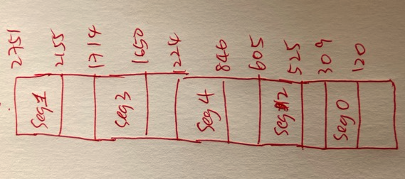
Example of Segmentation
You can draw the memory layout to help you verify the answers:
What are the logical addresses for the following physical addresses?
247 → 0, 127
1450 → illegal physical address since there is no corresponding logical address
1043 → 4, 197
Segment | Base | Length
0 | 120 | 189
1 | 2155 | 596
2 | 525 | 80
3 | 1650 | 64
4 | 846 | 378

Slide 14
Summary - Segmentation
Protection is easy in segmentation scheme
Protection with segment table
code segment would be read-only
data and stack would be read-write (stores allowed),
shared segment could be read-only or read-write
The main problem with segmentation
It must fit variable-sized chunks into physical memory
Dynamic Storage Allocation Problem
It may move processes multiple times to fit everything
External fragmentation still exists

Slide 15
PAGING

Slide 16
Paging Address Translation
Divide physical memory into fixed-sized blocks called frames and divide logical memory into blocks of same size called pages
Pages has the same size of frames
Address generated (logical or virtual address) by CPU is divided into:
Page number (p) – used as an index into a page table which contains base address (frame number) of each page in physical memory
Page offset (d) – combined with base address to define the physical memory address that is sent to the memory unit
The memory allocation in a paging scheme essentially allocates a frame in the physical memory to a page in a process virtual address space
For given logical address space 2^{m} and page size 2^{n}, thus the number of pages this logical address contains is 2^{m-n}
page number
page offset
p
d
m - n
n

Slide 17
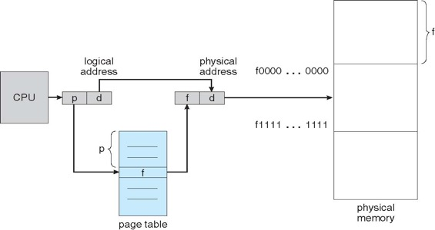
Paging Hardware
The following outlines the steps taken by the MMU to translate a logical address generated by the CPU to a physical address:
Extract the page number p and use it as an index into the page table.
Extract the corresponding frame number f from the page table.
Replace the page number p in the logical address with the frame number f
As the offset d does not change, it is not replaced, and the frame number and offset now comprise the physical address.

Slide 18
Example of Paging Scheme
Suppose logical address of a system is
What is the page size in such a system?
What is the size of the logical address space?
What is the number of pages?
page number
page offset
p
d
20-bit
12-bit

Slide 19
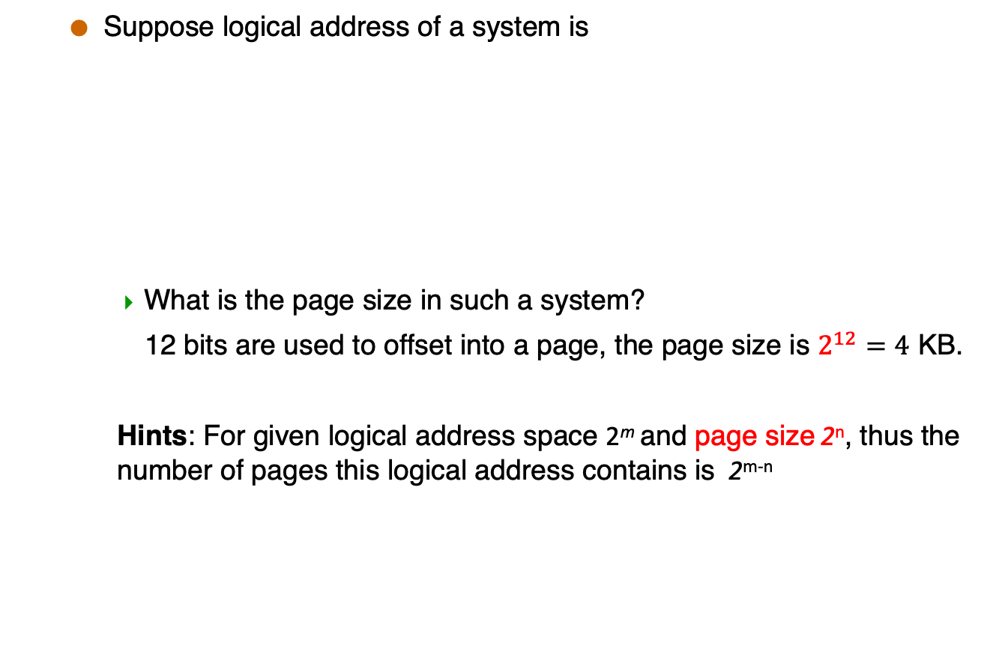
Example of Paging Scheme
Suppose logical address of a system is
What is the page size in such a system?
12 bits are used to offset into a page, the page size is $2^{12}=4$ KB.
Hints: For given logical address space 2^{m} and page size 2^{n}, thus the number of pages this logical address contains is 2^{m-n}
page number
page offset
p
d
20-bit
12-bit
page number
page offset
p
d
m - n
n

Slide 20
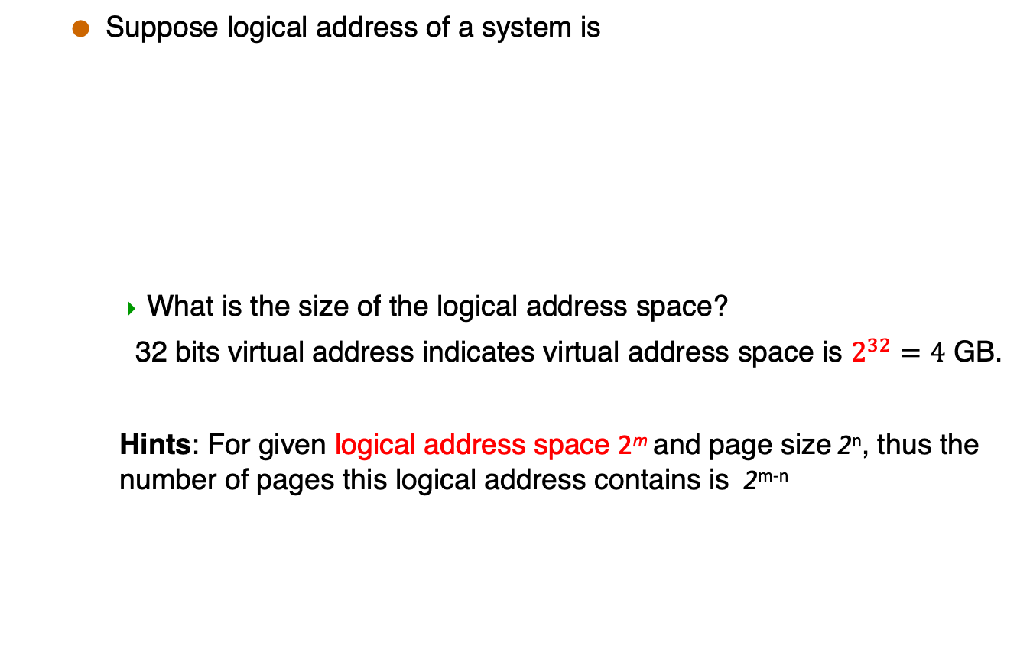
Example of Paging Scheme
Suppose logical address of a system is
What is the size of the logical address space?
32 bits virtual address indicates virtual address space is $2^{32}=4$ GB.
Hints: For given logical address space 2^{m} and page size 2^{n}, thus the number of pages this logical address contains is 2^{m-n}
page number
page offset
p
d
20-bit
12-bit
page number
page offset
p
d
m - n
n

Slide 21

Example of Paging Scheme
Suppose logical address of a system is
What is the number of pages?
$2^{20}$ pages
Hints: For given logical address space 2^{m} and page size 2^{n}, thus the number of pages this logical address contains is 2^{m-n}.
page number
page offset
p
d
20-bit
12-bit
page number
page offset
p
d
m - n
n

Slide 22
Example of page address translation
Suppose that the physical memory size is 4096 bytes. And there is 16 frames in physical memory.
The page table is listed as follows:
Please work out physical address of following logical addresses
717
508
Page No. | Frame No.
0 | 5
1 | 2
2 | 7
3 | 0

Slide 23
Example of page address translation
Suppose that the physical memory size is 4096 bytes. And there is 16 frames in physical memory.
The page table is listed as follows:
Please work out physical address of following logical addresses
Each page has 256 bytes (4096/16)
Page No. | Frame No.
0 | 5
1 | 2
2 | 7
3 | 0

Slide 24
Example of page address translation
Suppose that the physical memory size is 4096 bytes. And there is 16 frames in physical memory.
The page table is listed as follows:
Please work out physical address of following logical addresses
717 → 717 = 256*2+ 205 → 7*256 + 205 = 1997
508
Page No. | Frame No.
0 | 5
1 | 2
2 | 7
3 | 0

Slide 25
Example of page address translation
Suppose that the physical memory size is 4096 bytes. And there is 16 frames in physical memory.
The page table is listed as follows:
Please work out physical address of following logical addresses
717 → 717 = 256*2 + 205 → 7*256 + 205 = 1997
508 → 508 = 256*1 + 252 → 2*256 + 252 = 764
Page No. | Frame No.
0 | 5
1 | 2
2 | 7
3 | 0

Slide 26
Example of page address translation
Suppose that the physical memory size is 4096 bytes. And there is 16 frames in physical memory.
The page table is listed as follows:
Please work out logical address of following physical addresses
444
700
Page No. | Frame No.
0 | 5
1 | 2
2 | 7
3 | 0

Slide 27
Example of page address translation
Suppose that the physical memory size is 4096 bytes. And there is 16 frames in physical memory.
The page table is listed as follows:
Please work out logical address of following physical addresses
444 → 256*1 + 188 → illegal
700
Page No. | Frame No.
0 | 5
1 | 2
2 | 7
3 | 0

Slide 28
Example of page address translation
Suppose that the physical memory size is 4096 bytes. And there is 16 frames in physical memory.
The page table is listed as follows:
Please work out logical address of following physical addresses
444 → 256*1 + 188 → illegal
700 → 256*2 + 188 → 256*1 + 188 = 444
Page No. | Frame No.
0 | 5
1 | 2
2 | 7
3 | 0

Slide 29
Two-Level Page Table
In a 32-bit machine we subdivide the virtual address into 3 parts as follows:
First 10 bits of an address is an index into the first level page table.
The next 10 bits are an index into a second level page table.
Assume that each page table entry is 64 bits (8 bytes) in size.
page number |  | page offset
10 | 10 | 12

Slide 30
Two-Level Page Table
Q1: What is the advantage of using two-level paging scheme?
Two-level paging scheme can divide the large page table into many smaller pieces.
Therefore, there is no need to allocate the whole page table contiguously in main memory.

Slide 31

Two-Level Page Table
Q2: How much space is occupied in memory by the page tables for a process that has 128MB of actual virtual address space allocated?
Show your work with a detailed explanation.
Page size: $2^{12}=4096B=4KB$ (1 point)

Slide 32
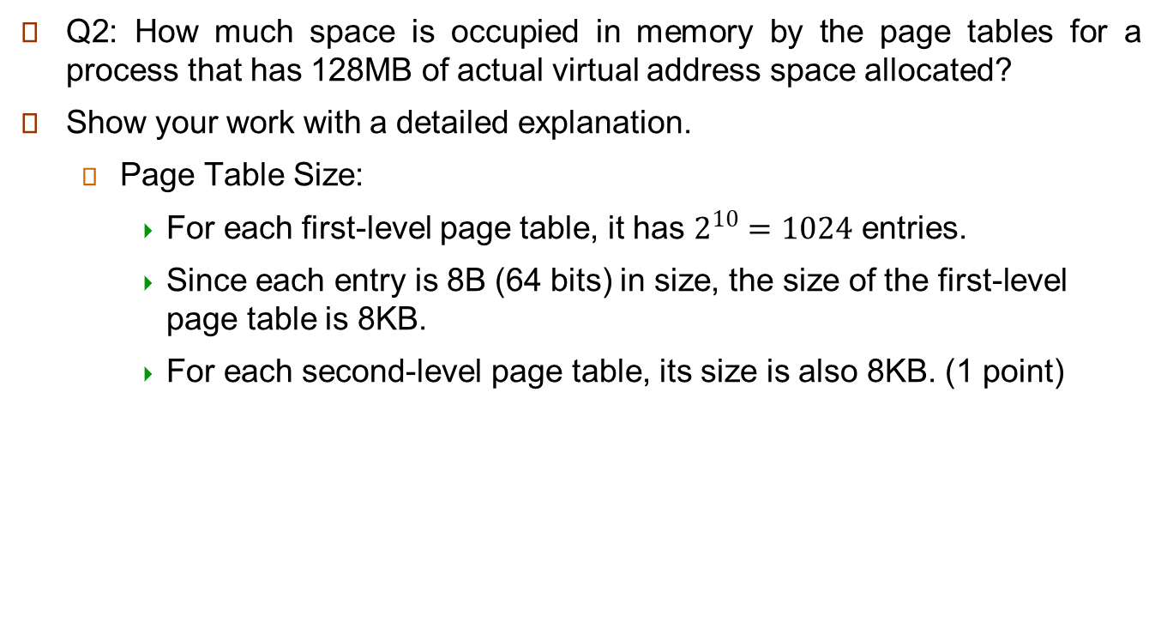
Two-Level Page Table
Q2: How much space is occupied in memory by the page tables for a process that has 128MB of actual virtual address space allocated?
Show your work with a detailed explanation.
Page Table Size:
For each first-level page table, it has $2^{10}=1024$ entries.
Since each entry is 8B (64 bits) in size, the size of the first-level page table is 8KB.
For each second-level page table, its size is also 8KB. (1 point)

Slide 33
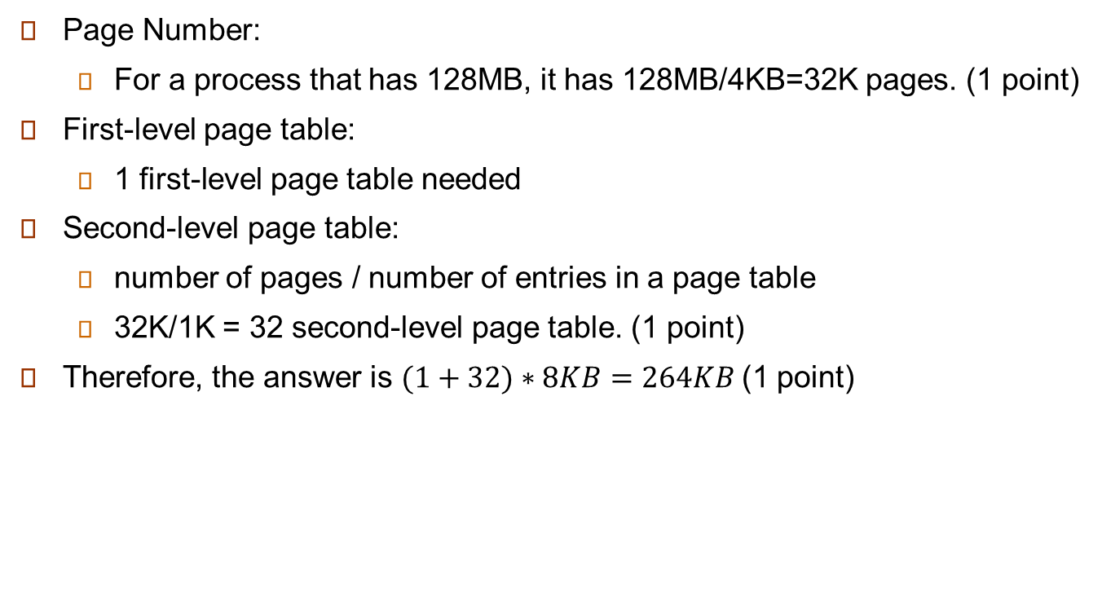
Two-Level Page Table
Page Number:
For a process that has 128MB, it has 128MB/4KB=32K pages. (1 point)
First-level page table:
1 first-level page table needed
Second-level page table:
number of pages / number of entries in a page table
32K/1K = 32 second-level page table. (1 point)
Therefore, the answer is $(1+32)∗8KB=264KB$(1 point)

Slide 34
Get Page Size with Linux
Use the command `getconf PAGESIZE`
Use the system call `getpagesize()`

Slide 35
translation look-aside buffer (TLB)

Slide 36
TLB
The two memory access problem can be solved by using TLB (translation look-aside buffer) – caching
a special, small, fast-lookup hardware cache
each entry in the TLB consists of a key (or tag) and a value
The page number is presented to the TLB, if found, its frame number is immediately available to access memory
fast but expensive – done in hardware
Typical size of a TLB 64 – 1,024 entries

Slide 37
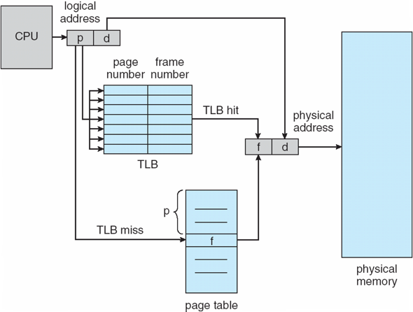
Paging Hardware With TLB
This table is small, e.g., 64 to 1,024 entries
Can be very large,
e.g., 1M entries

Slide 38
Effective Access Time (EAT): Example
Suppose that a system has a TLB hit ratio of 85%. It requires 10 nanoseconds to access the TLB, and 100 nanoseconds to access main memory. What is the effective memory access time in nanoseconds for this system?
Answer: If the hit ratio is 85%
EAT = (10 + 100) * 0.85 + // Hit: 1 TLB access + 1 memory access
(10 + 200) * 0.15 // Miss: 1 TLB access + 2 memory accesses
= 93.5 + 31.5 = 125
Note: EAT will also be used in Chapter 10: Virtual Memory to evaluate the performance of demand paging. Their calculations are different. Don’t mess them up!

