Slide 1

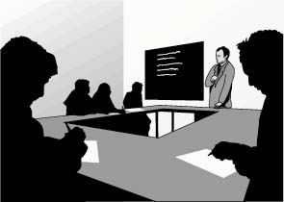

Conduct in the Classroom
Classrooms are for learning. Teachers and students must work together so that the classroom is a good place to learn. You can help by following a few simple rules. These rules are mostly just common sense and common courtesy. By following them, you show respect to your fellow students as well as your teachers.
Please try to get to class on time. When you come in late, you disrupt your class. As a general rule, if you are more than 10 minutes late, you should not enter the classroom. If you arrive late, but need to see the instructor or pick up lecture notes, please return at the end of the class period.

Slide 2


Conduct in the Classroom
Once in class, you should stay until the class is over. If you know you have to leave early, ask the instructor’s permission before the class starts.
You should not do things during class that disrupt the class or distract your classmates – such as talking while the instructor is lecturing. If you have a pager or cellular phone, turn if off when you are in class.
And please pay attention to the signs that tell you not to eat or drink in the classrooms.

Slide 3

Conduct in the Classroom
Assignments, tests and examinations are an integral part of the learning experience. Students who cheat disrupt this process. The instructor has a responsibility to make cheating difficult, but cheating is wrong even when you can get away with it. Don’t give in to the temptation to cheat, and be critical of those who do.
Your instructor has the authority to make other rules that he or she feels are necessary to help you learn. For example, some instructors may require that you attend a minimum number or percentage of their classes. If you do not follow these rules, it may affect your grade.

Slide 4

Conduct in the Classroom
You are investing several years of your life in your university education.
Learning to accept responsibility is an important part of that education.
The classroom is a good place to begin
showing that you are ready for the
responsibilities of being an adult.

