Slide 1
COMP2711H Tutorial 1 Propositional Logic
Henry, CHAK Hon Hing
hhchak@connect.ust.hk
Starting at 6:00 p.m.

Slide 2
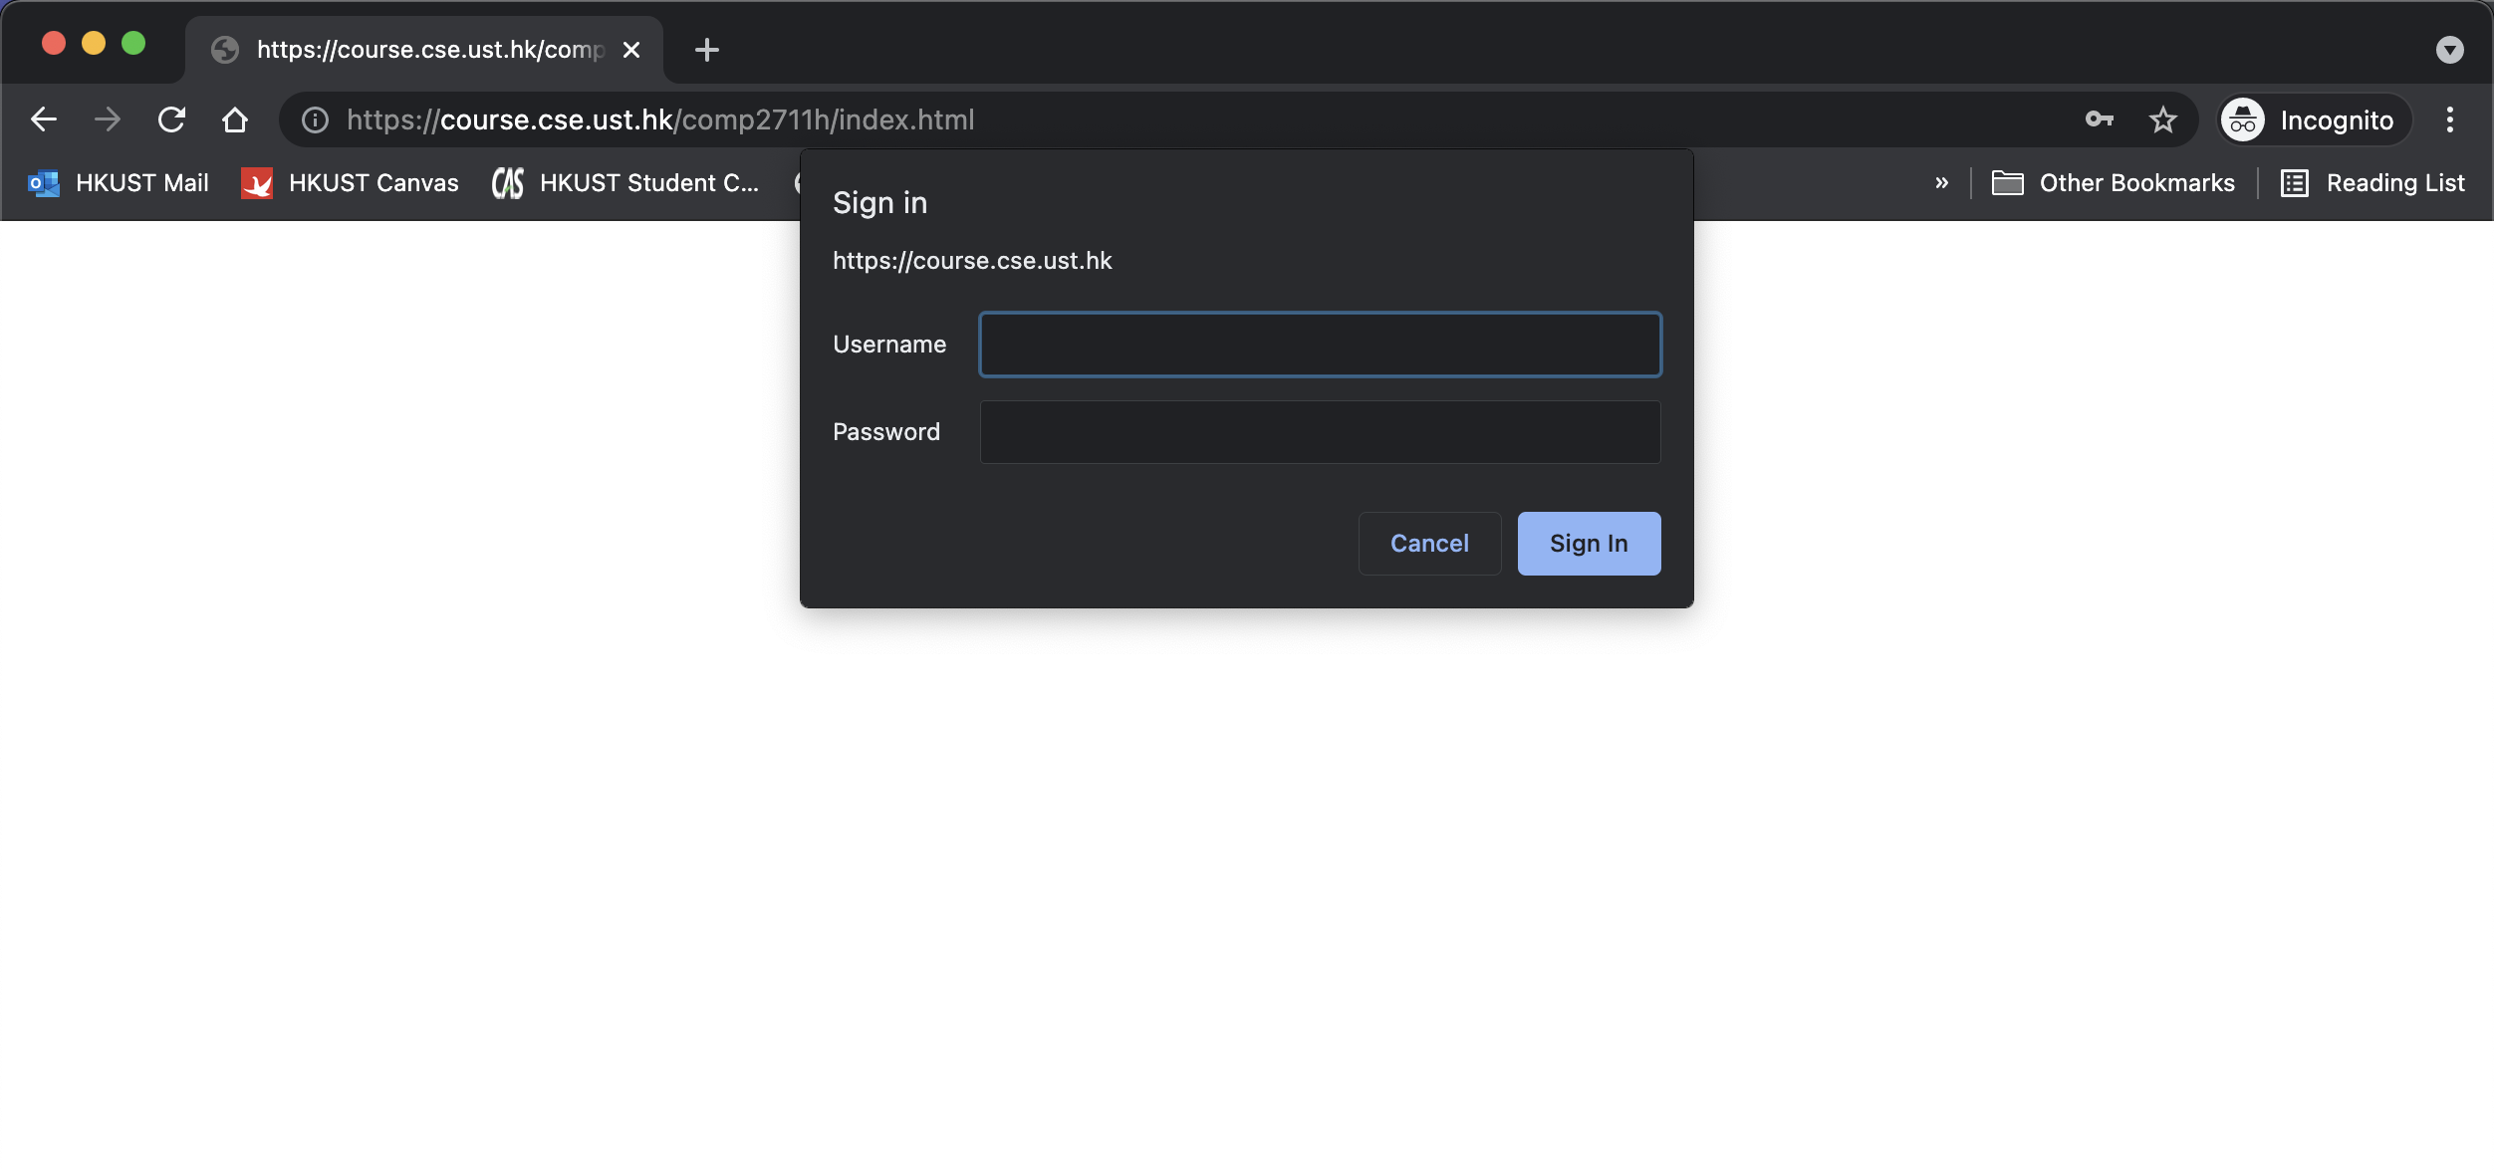
Course Website
https://course.cse.ust.hk/comp2711h
Activate CSD Account: https://cssystem.cse.ust.hk/UGuides/activation.html

Slide 3
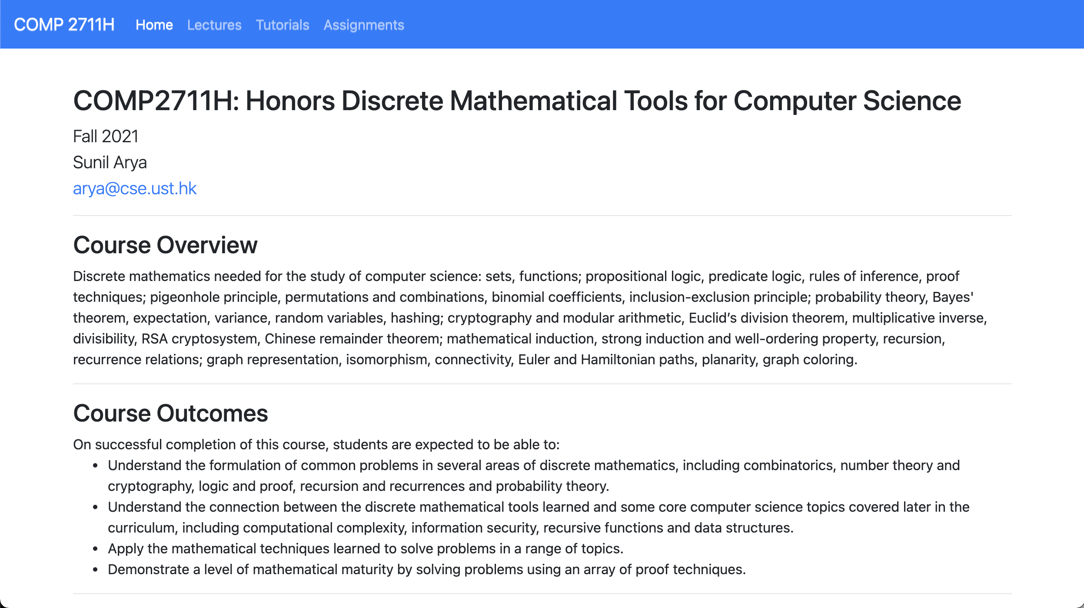
Course Website

Slide 4
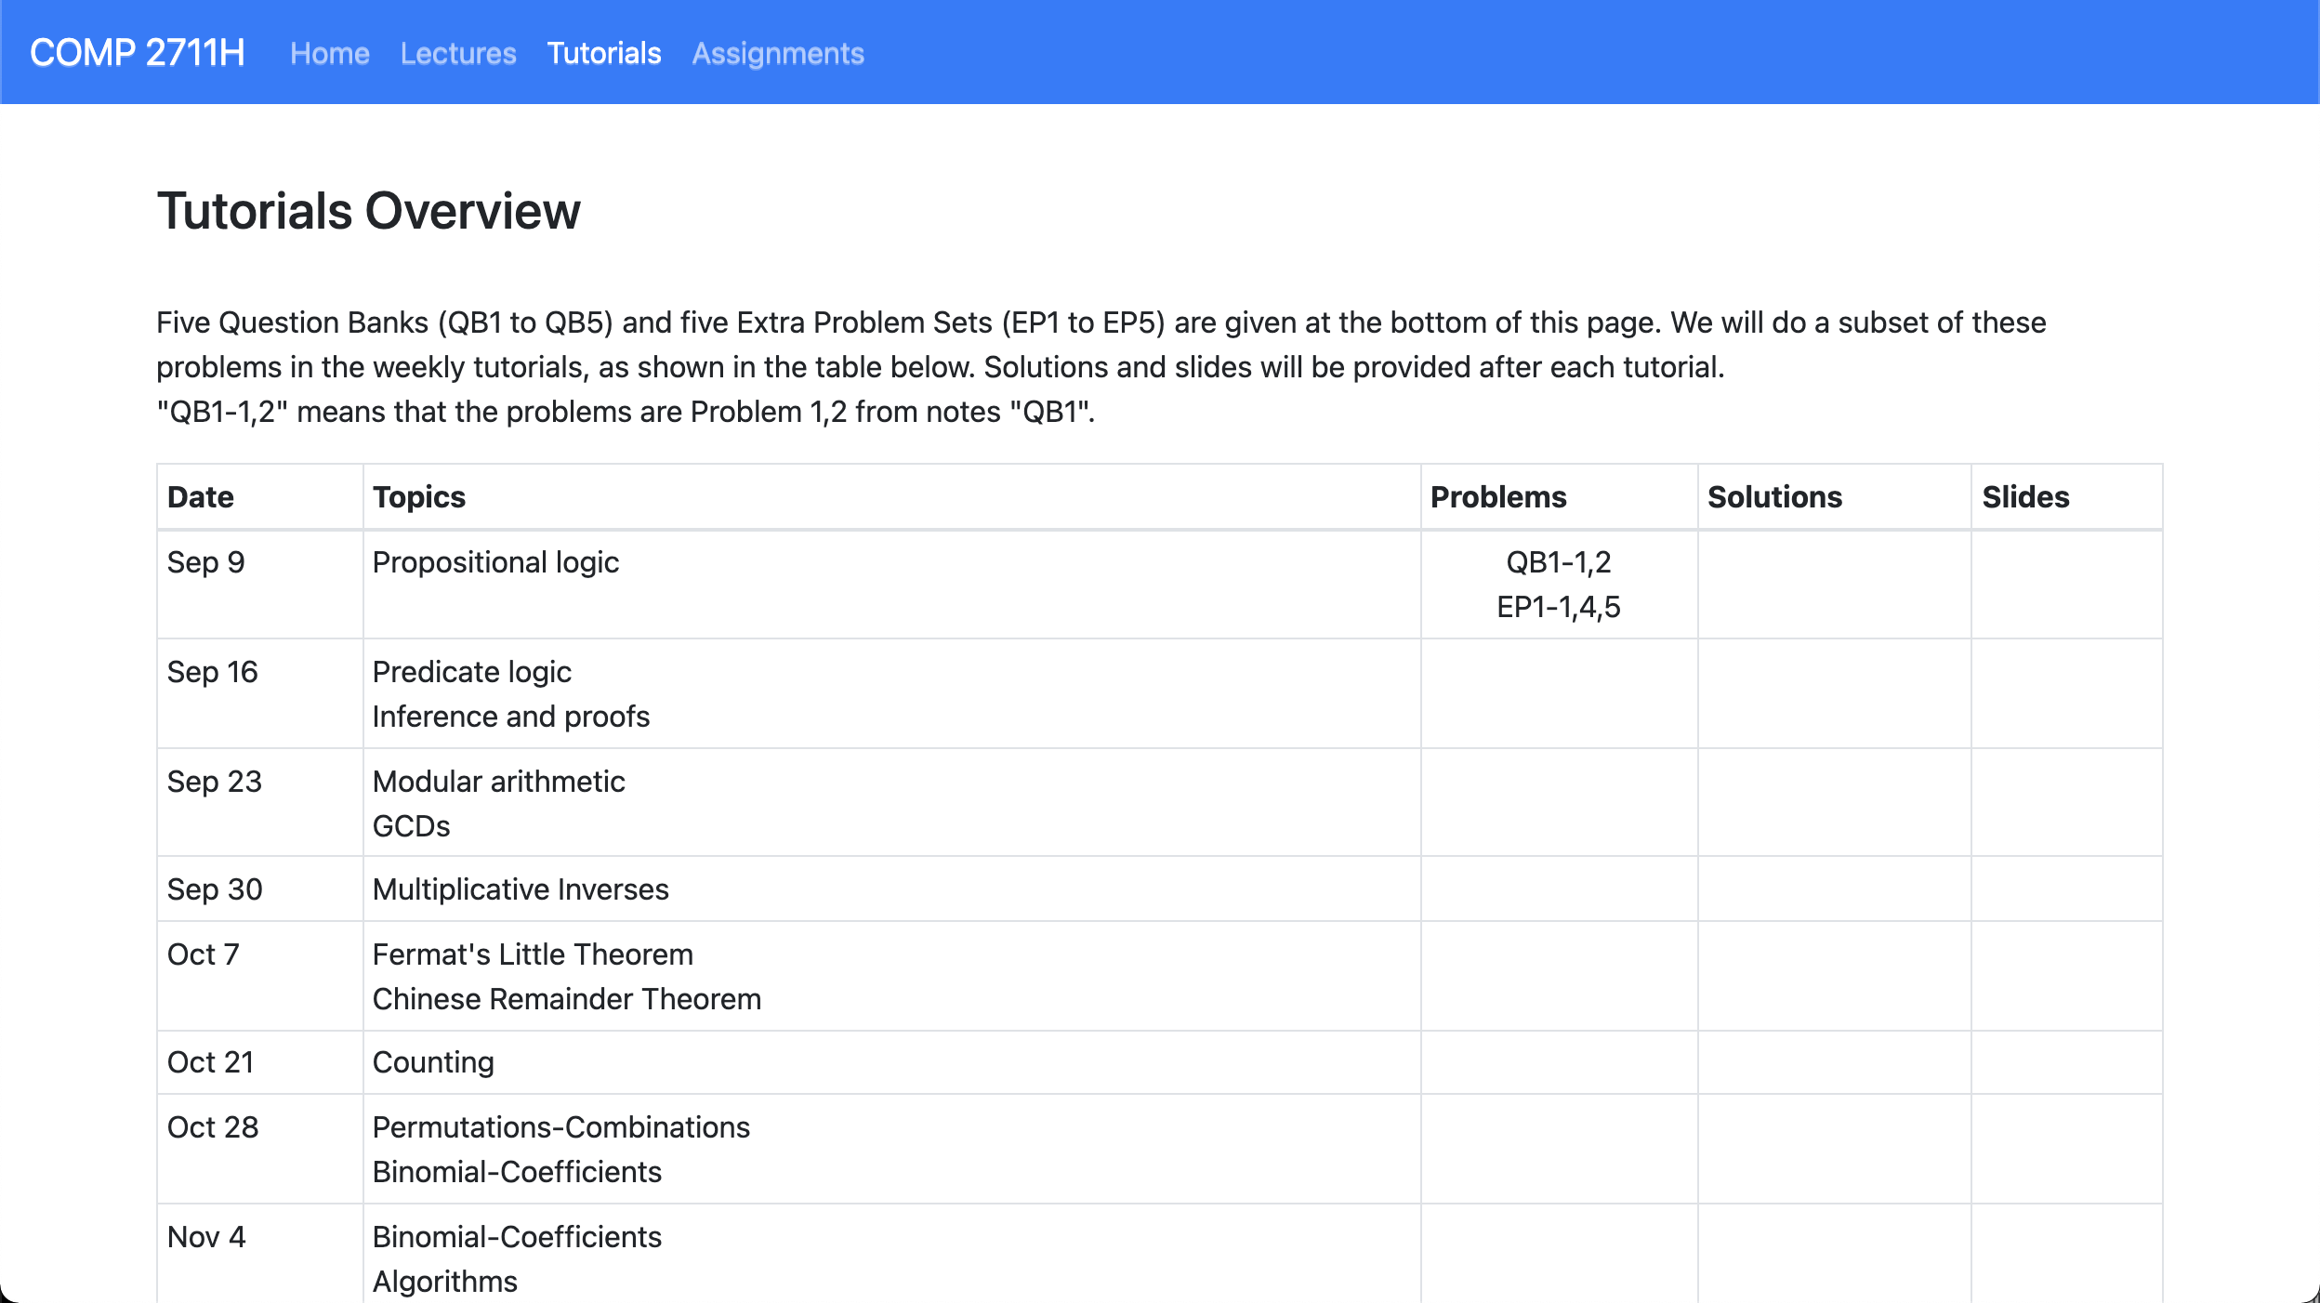
Course Website

Slide 5
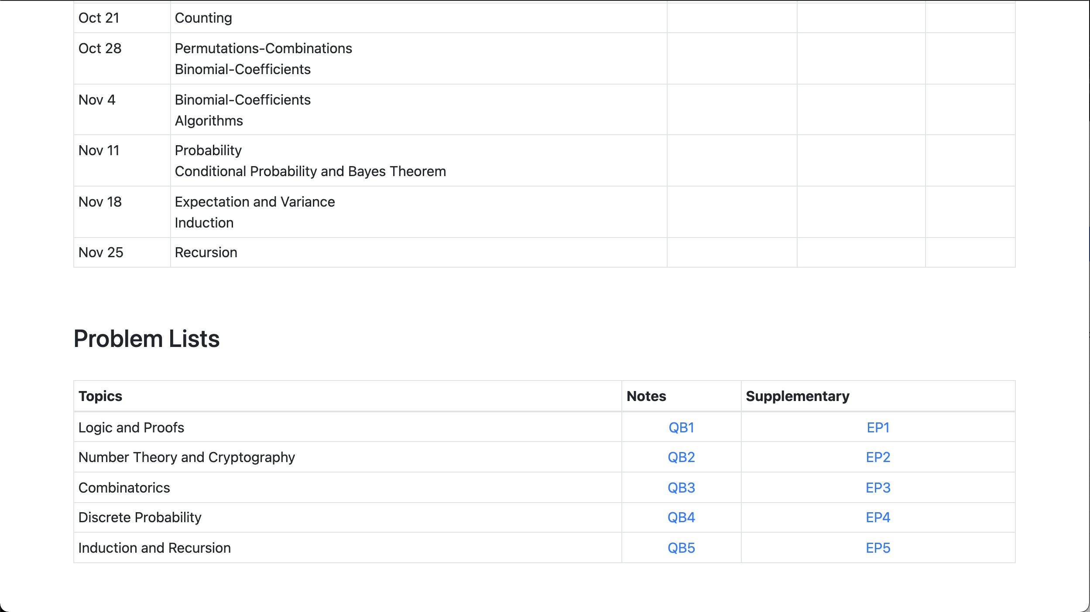
Course Website

Slide 6
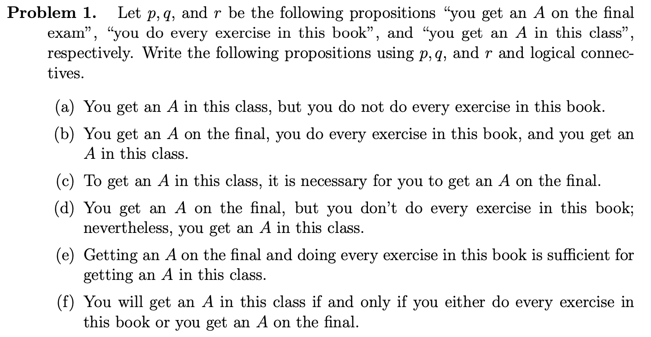
QB1-1

Slide 7
QB1-1

Slide 8
QB1-1
r ∧ ¬q
p ∧ q ∧ r
p ∧ ¬q ∧ r

Slide 9
QB1-1
r ∧ ¬q
p ∧ q ∧ r
p ∧ ¬q ∧ r

Slide 10
QB1-1
r ∧ ¬q
p ∧ q ∧ r
r → p
p ∧ ¬q ∧ r
(p ∧ q) → r
(p ∨ q) ↔ r

Slide 11
QB1-2

Slide 12
QB1-2
p | q | p ↔ q | (p ∧ q) | (¬p ∧ ¬q) | (p ∧ q) ∨ (¬p ∧ ¬q)
T | T | T | T | F | T
T | F | F | F | F | F
F | T | F | F | F | F
F | F | T | F | T | T

Slide 13
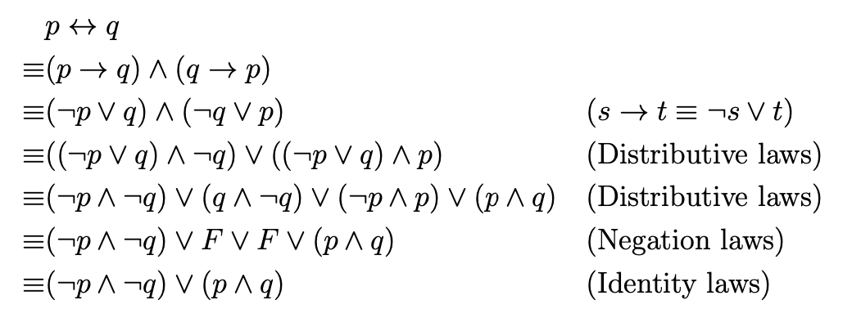
QB1-2

Slide 14
QB1-2

Slide 15
QB1-2

Slide 16
QB1-2
“Expansion”

Slide 17
QB1-2

Slide 18
QB1-2

Slide 19
EP1-1

Slide 20
EP1-1
Start from inner brackets
p | q | p ∨ q | (p ∨ q) ∧ ¬p | ¬((p ∨ q) ∧ ¬p) ∧ ¬p
T | T | T | T | F
T | F | T | F | F
F | T | T | F | F
F | F | F | F | T

Slide 21
EP1-1
Start from inner brackets
p | q | p ∨ q | (p ∨ q) ∧ ¬p | ¬((p ∨ q) ∧ ¬p) ∧ ¬p
T | T | T | F | F
T | F | T | F | F
F | T | T | T | F
F | F | F | F | T

Slide 22
EP1-1
Start from inner brackets
p | q | p ∨ q | (p ∨ q) ∧ ¬p | ¬((p ∨ q) ∧ ¬p) ∧ ¬p
T | T | T | F | F
T | F | T | F | F
F | T | T | T | F
F | F | F | F | T

Slide 23
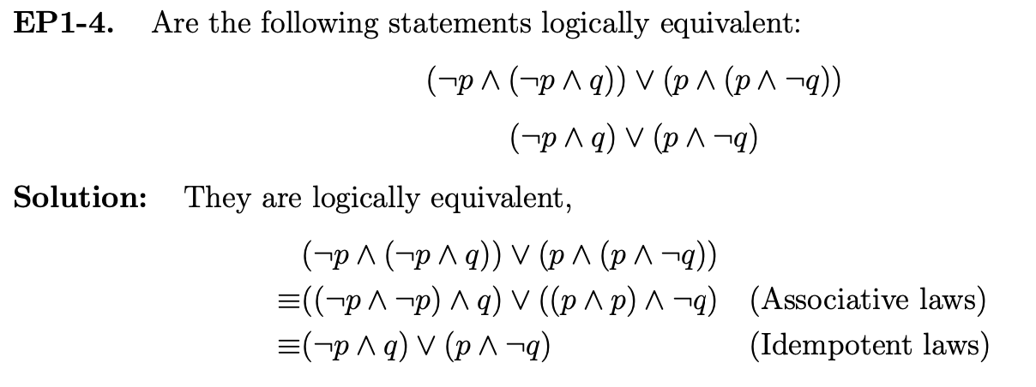
EP1-4

Slide 24
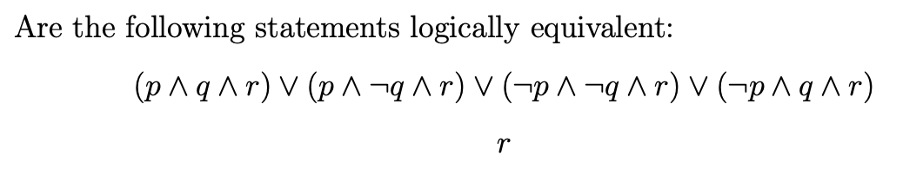
EP1-5

Slide 25
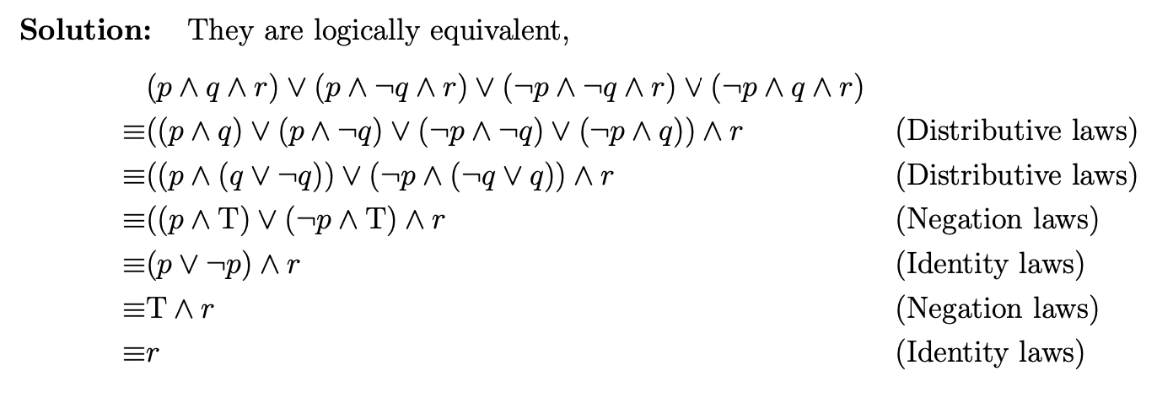
EP1-5

Slide 26
EP1-5
“Factorization”

Slide 27
EP1-5

