Slide 1

Acoustics

Slide 2
Acoustics:
The Properties of Sound
air pressure changes when objects vibrate, producing sound in the ear
  pound a table
  pluck a string

Slide 3
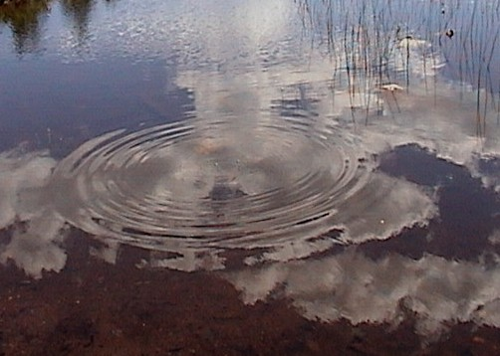
Sound Waves
vibrations are transmitted to our ears by a medium — usually air
sound waves radiate through air outward from the source sound like <W1:28> waves in water that radiate in circles from a tossed pebble

Slide 4
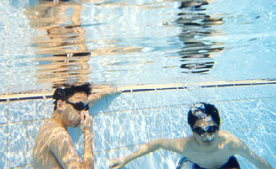
Sound Waves
sound waves also radiate through water and solid materials, such as doors
  listen to underwater sounds in the swimming pool!
  get a friend to hum underwater
  how far away can you hear the sound?

Slide 5

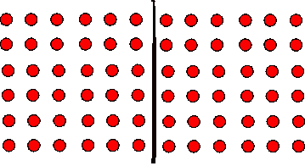
Vibrating String

Slide 6
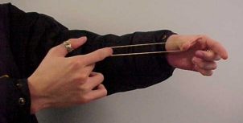
String Vibrations
rubber band experiment
  hold both ends of a rubber band
  have a partner pluck the rubber band
  notice the movement of the rubber band
    the whole length is vibrating

Slide 7
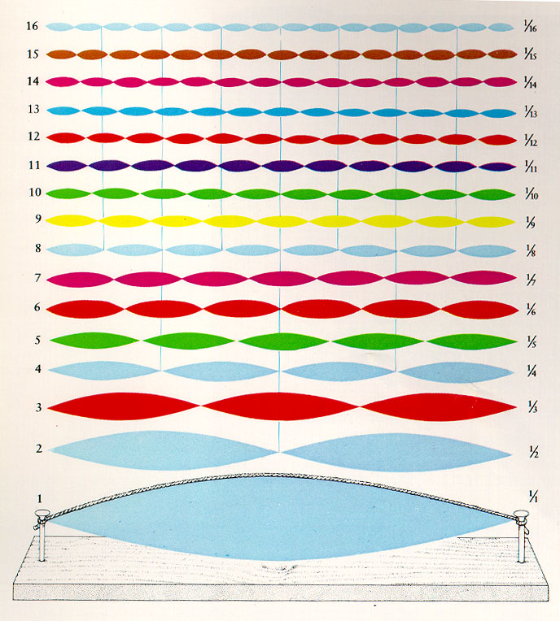
String Vibrations
strings and pipes vibrate in segments of their length, as well as in their entirety — at the same time
fundamental
  frequency produced by vibration of total length
  usually loudest frequency produced

Slide 8
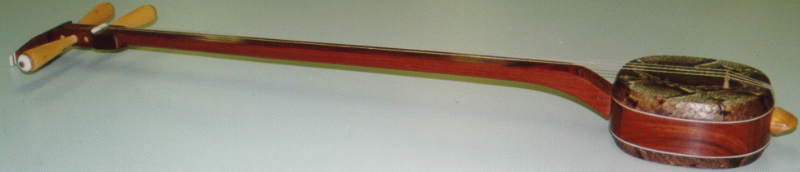
String Vibrations
harmonics
  exact whole-number multiples of fundamental
  proportion of string is reciprocal of frequency
    string length = f = fundamental frequency
    1/2 string length = 2f
    1/3 string length = 3f
    1/4 string length = 4f
  [i:30] harmonics
  on sanxian

Slide 9
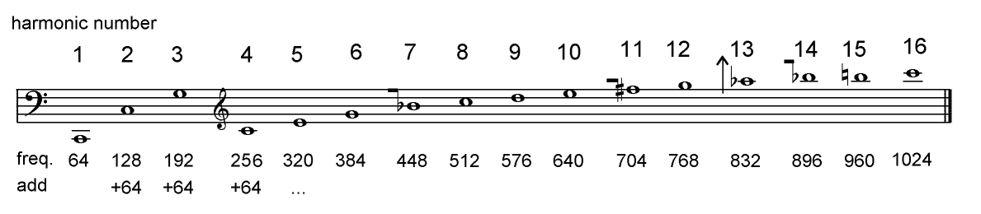
Harmonic Series
harmonic series
  a series of harmonics or partials above a given pitch
  harmonic partials
    occur at integer multiples of the fundamental
    wind and string instruments
      example: if the frequency of C= 64 Hertz, the frequency of the 2nd partial is 2 * 64 = 128 Hertz

Slide 10

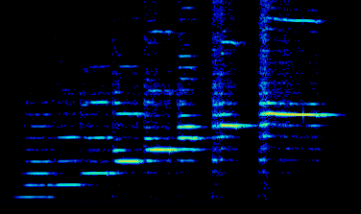
Harmonics
<w1:29> pipes like the flute have harmonics

Slide 11
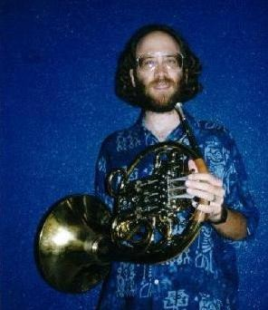
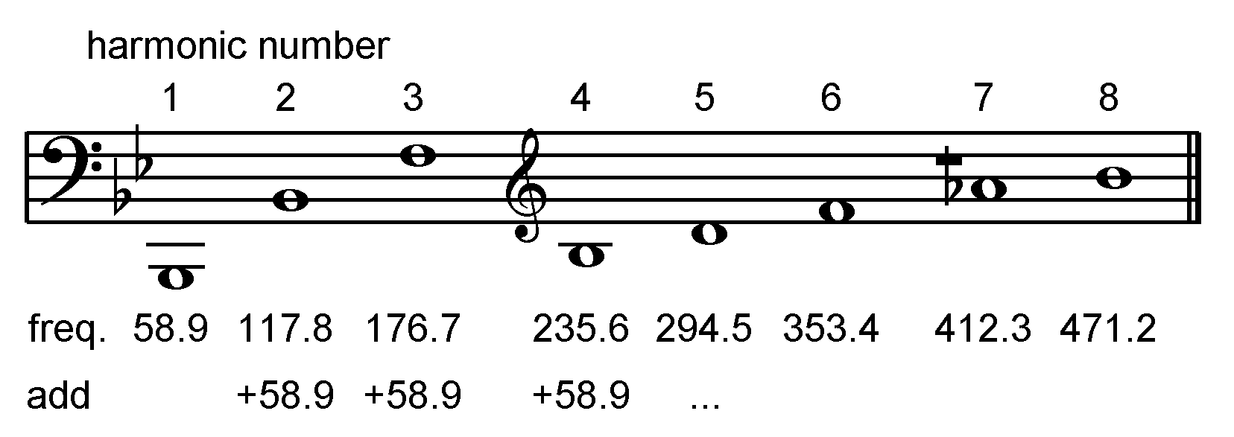
Harmonic Series
The French horn also has harmonic partials – live demo

Slide 12
How Does Sound Work?
Many musical sounds are made of special combinations of harmonics

Slide 13
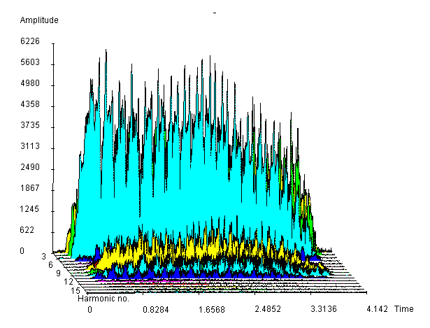
How Loud Are the Harmonics?
Here is a graph of the first 15 harmonics of a [i:31] vocal tone

Slide 14
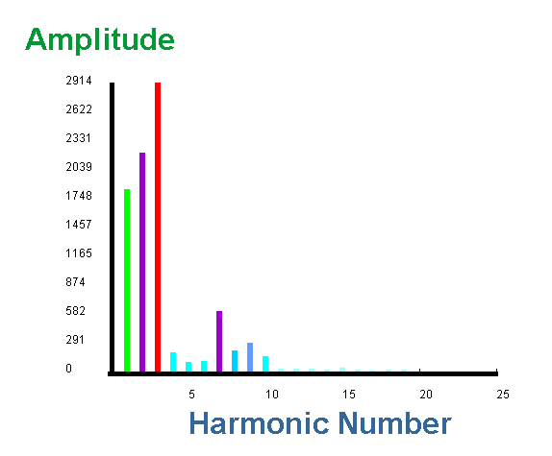
How Loud Are the Harmonics?
Here is the average loudness of the same [i:31] vocal tone

Slide 15
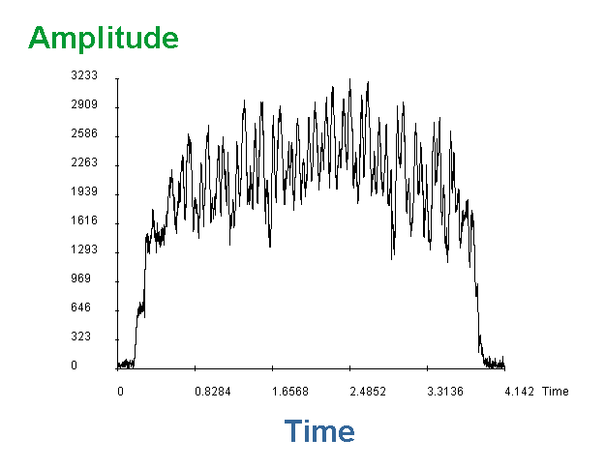
How Loud Are the Harmonics?
The vocal tone's first harmonic fades in and out like this:

Slide 16
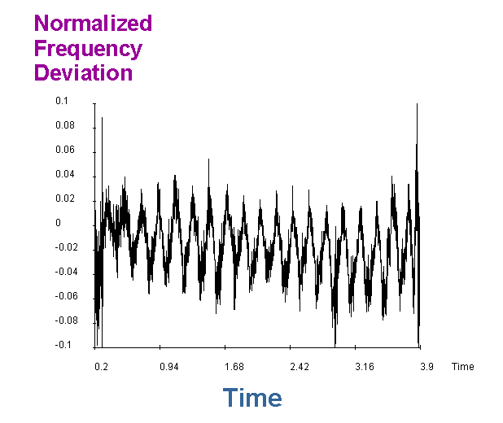
How Steady is the Sound?
The vocal tone's frequency moves up and down this:

Slide 17
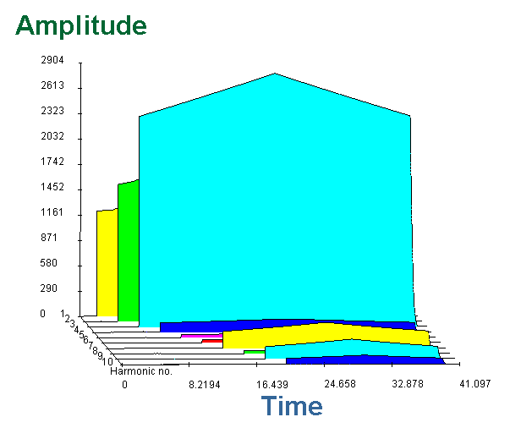
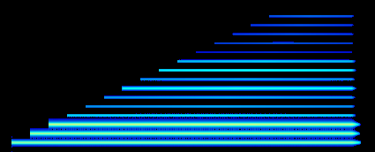
Harmonic Series
Using its harmonic pattern , we can recreate a [i:32] vocal tone

