Slide 1
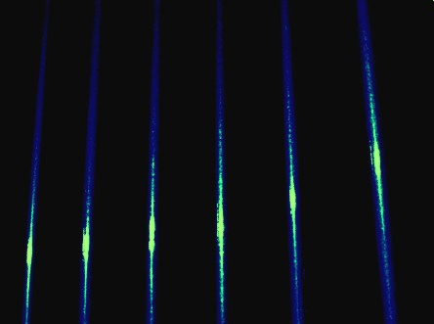
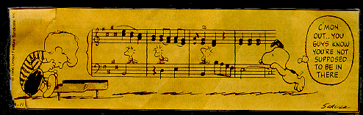
Amplitude
and Meter

Slide 2
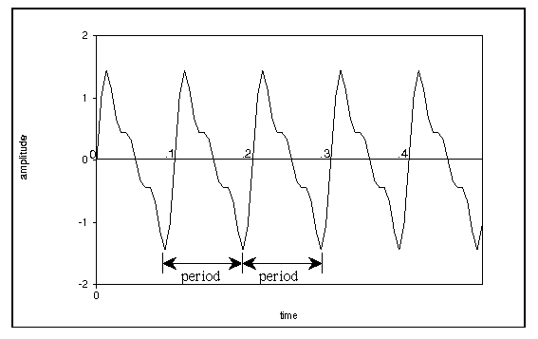
Amplitude and Meter
amplitude
  The strength (peak value) of the waveform
adding AMPLITUDE (loudness) to rhythm creates meter
AMPLITUDE

Slide 3

Beats and Meter
Beats
  the pulse that moves most music along
  when you clap your hands to music, you are following the beat
  the “heartbeat” of music
Meter
  a repeated pattern of a strong beat plus one or more weaker beats

Slide 4

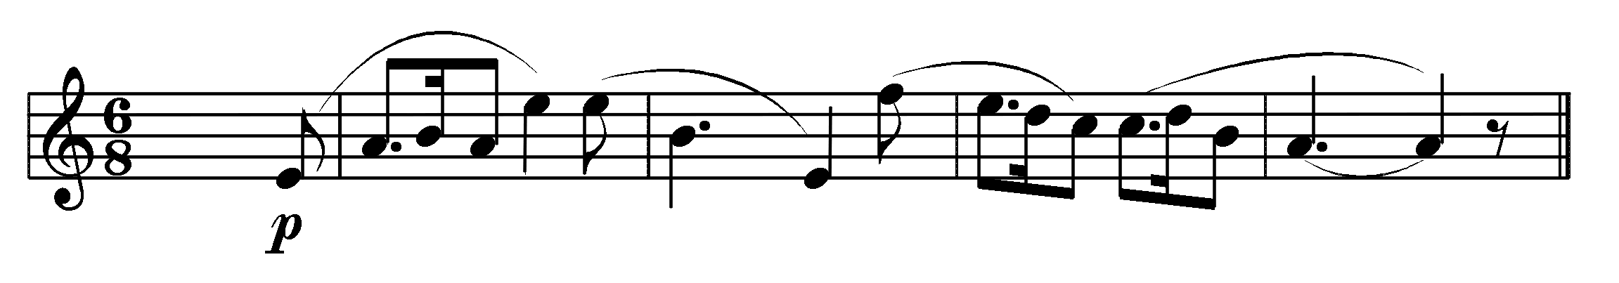
Measures
Measure (Bar)
  A “box” of beats
Bar Lines
  the vertical line at the end of the measure

Slide 5
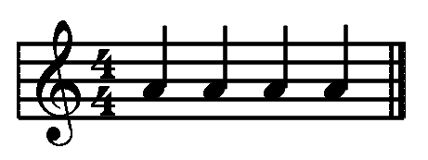

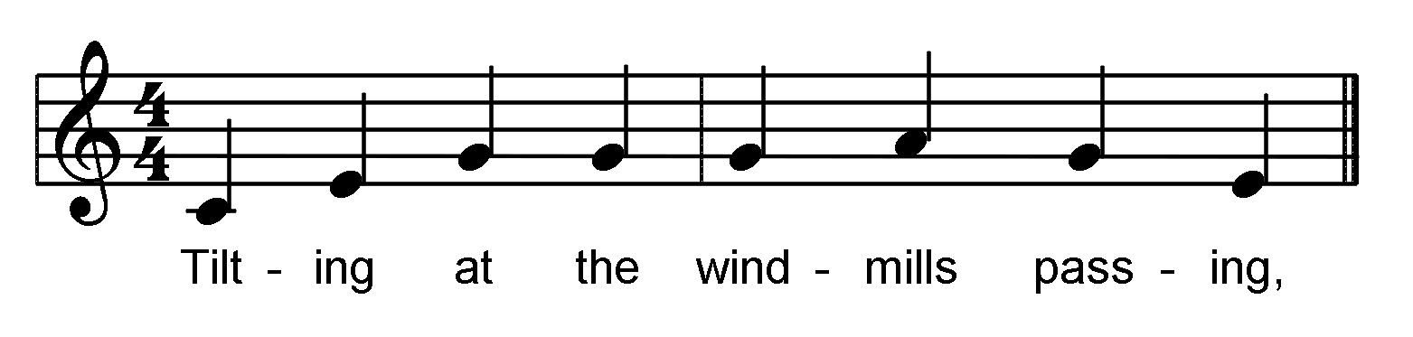
Quadruple Meter
4/4
  four beats per measure
    quarter note = one beat
    subgroups of two + two beats
    down beat is loudest, 3rd beat is next loudest, 2nd and 4th beats softer
1 2 3 4 | 1 2 3 4 |
Tilt- ing at the wind- mills pass- ing
[i:60] Gordon Lightfoot, Don Quixote

Slide 6
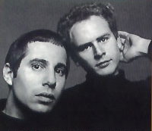
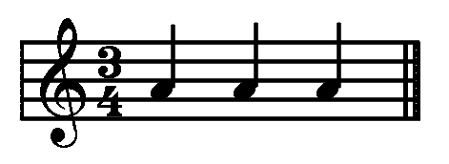
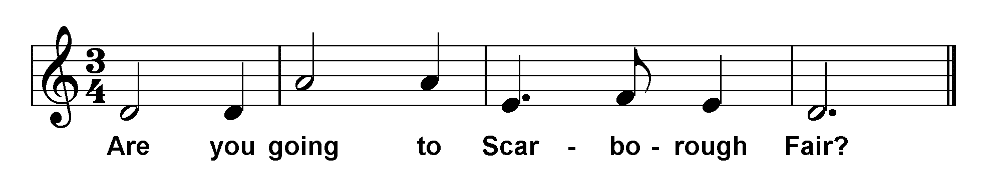
Triple Meter
3/4
  three beats per measure
    quarter note = one beat
    2nd and 3rd beats softer (sometimes the 2nd beat is a little louder than the third beat)
|1 2 3 | 1 2 3 |1 2 3 |1
Are you going to Scar- bo- rough Fair?
[i:63] Scarborough Fair

Slide 7
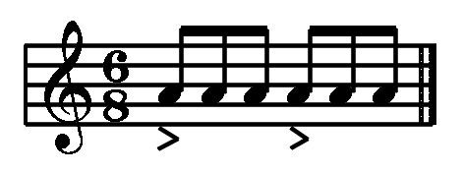
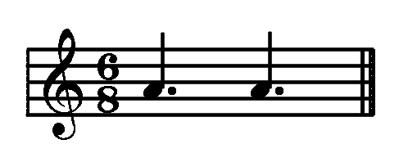
Compound Meter
6/8 — sextuple meter
  in slow music
    eighth note = one beat
    six beats per measure
    subgroups of three + three eight notes
  in fast music
    dotted quarter note (three eighth notes) = one beat
    two beats per measure
    subgroups of 3 + 3 eight notes

Slide 8

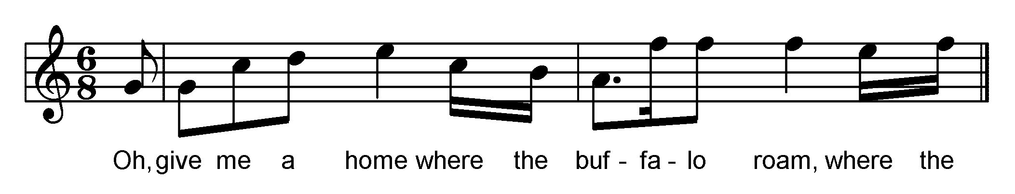
Compound Meter
6/8
| 1 2 3 4 5 6 |
Oh, give me a home where the
| 1 2 3 4 5 6 |
buf- fa- lo roam, where the
[i:64] Home on the Range

Slide 9
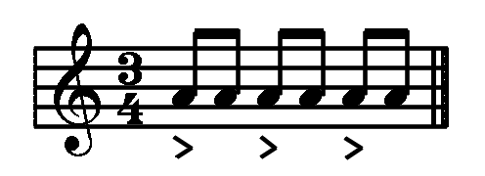
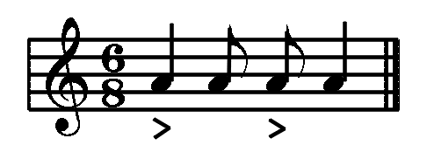
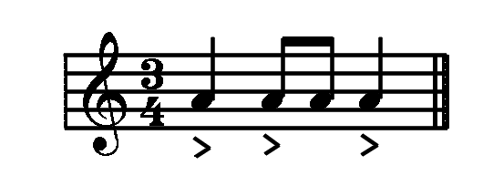
Compound Meter
6/8
  In 6/8 meter, the accents are different from 3/4 even though the duration values appear to be the same:

Slide 10
Compound Meter
Dotted Rhythms in 6/8
  some music gets a skipping effect by dotting the first eighth note in some of the groups:
[i:65] Ch. M. Widor, Pavane

Slide 11
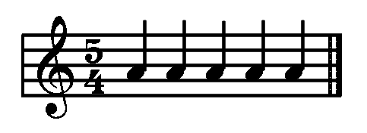
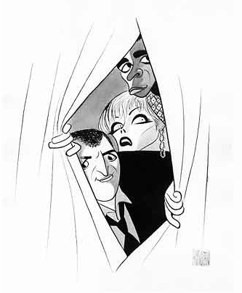
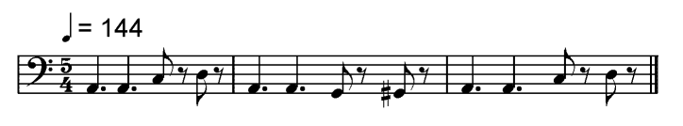
Quintuple Meter
5/4
  five beats per measure
    quarter note = one beat
    in subgroups of three quarter notes + two quarter notes (less frequently in subgroups of two + three)
[i:66] Lalo Schifrin, Mission Impossible television theme

Slide 12
Maximum Amplitude
maximum amplitude in Csound: 32,767
  the system will clip any amplitudes over 32,767 and give a message "number of samples out of range ...“
  If this happens, DON'T play the file
    lower the amplitude and recompile it.

Slide 13
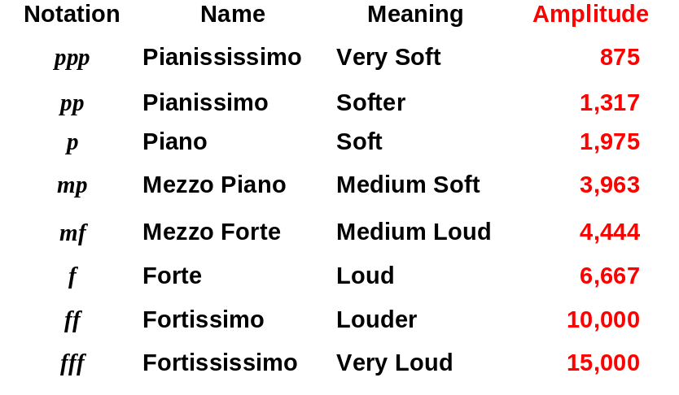
Dynamics
  loud vs. soft
  specify loudness, usually for groups of notes:

Slide 14
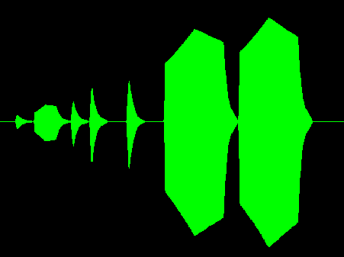
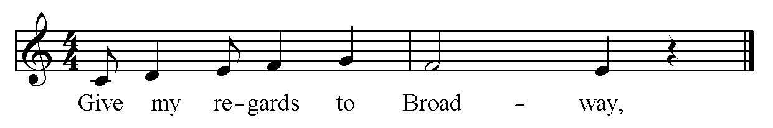
Dynamics
Crescendo
  get louder
[i:67] Give My Regards to Broadway

Slide 15
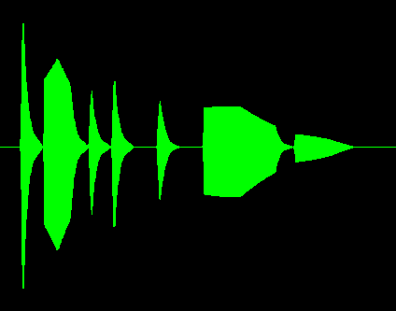
Dynamics
Decrescendo
  get softer
[i:68] Give My Regards to Broadway

Slide 16

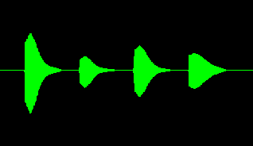
Articulation
staccato notes
  short notes, marked with a dot above or below the note head
  for [i:69] staccato notes in Csound, make the duration a little bit shorter
  separated by rests
    Example: quarter note = 1.0; staccato quarter note = .7 - .9

Slide 17


Articulation
legato notes
  long notes, marked with a short line above or below the note head
  for [i:70] legato notes in Csound, make the note the full duration
    Example: quarter note = 1.0; legato quarter note = 1.00

Slide 18


Articulation
slurs
  connect groups of legato notes with a long curved line
  for [i:71] slurred notes in Csound, make the notes overlap in duration
    E.g., the overlap time is .12

Slide 19


Metronomes
measure the tempo in beats per minute
  scores often have metronome markings for the tempo

Slide 20
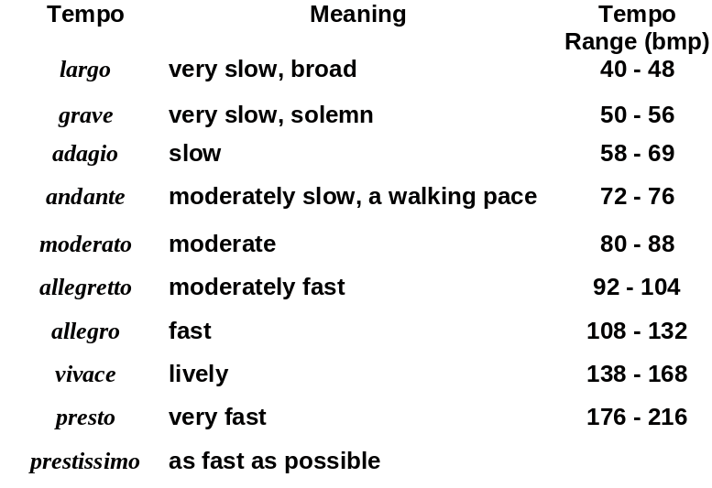
Common Tempo Names

Slide 21
Changing Tempos
Accelerando
  gradually get faster
Decelerando
  gradually get slower
Ritardando
  gradually get slower

Slide 22
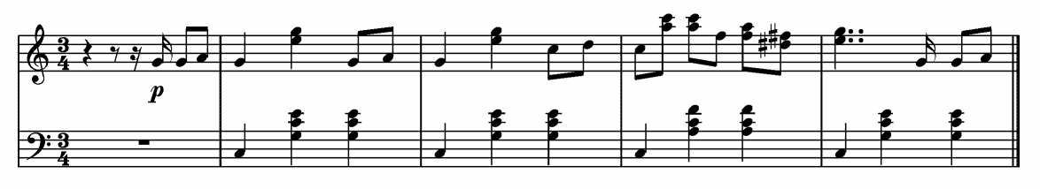
Csound Tempo Statements
Csound default tempo is 60 beats per minute
Change the tempo in Csound using a tempo statement:
  tempo statements usually go before the note list
  t0 92 for 92 beats per minute (Valses [i:72])

Slide 23
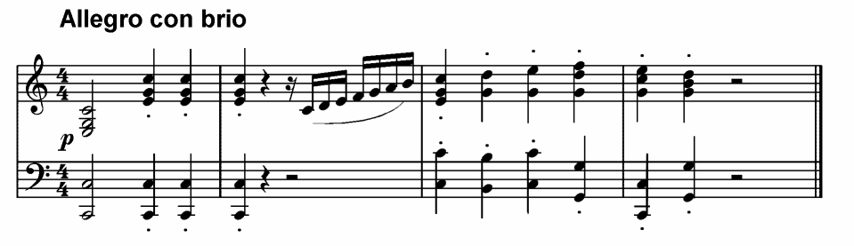
Csound Tempo Statements
  t0 112 for 112 beats per minute (Concerto [i:73])
  t0 76 9 120 for 76 bpm [i:74] changing to 120 bpm over the first nine beats (Concerto)

Slide 24
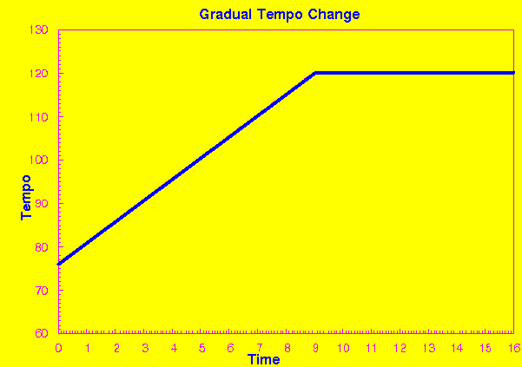
Csound Tempo Statements

Slide 25
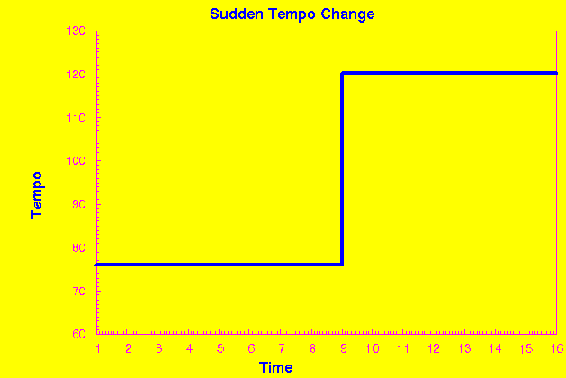
Csound Tempo Statements
t0 76 9 76 9 120 for 76 bpm changing to 120 bpm [i:75] suddenly at beat nine (Concerto)

Slide 26
Csound Score
Accelerating from 72 to 144 bpm over 8 beats
t0 72 8 144 ; tempo statement
; start other parameters
; ----------------- measure 1 bar line here
i1 0 ... ; starting tempo 72 bpm
i1 1 ... ; tempo ~81 bpm
i1 2 ... ; tempo ~90 bpm
i1 3 ... ; tempo ~99 bpm
; ----------------- measure 2 bar line here
i1 4 ... ; tempo ~108 bpm
i1 5 ... ; tempo ~117 bpm
i1 6 ... ; tempo ~126 bpm
i1 7 ... ; tempo ~135 bpm
; ----------------- measure 3 bar line here
i1 8 ... ; tempo 144 bpm

