Slide 1

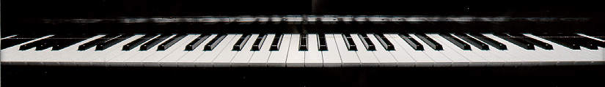
Introduction
to Csound 4

Slide 2
Local Variables
initial, audio rate and control rate variables beginning with "i," "a" and "k"
  effective only for a single note statement for a single instrument design

Slide 3
Global Variables
begin with "g"
different instruments can share global variable values
remain in effect
  for the entire duration of the score, OR
  until one of the instruments changes them
second letter an "i," "k" or "a" to indicate variable rate
gifreq = 98
garev init 0

Slide 4

Review Question
Which of the following statements is true?
A. Audio rate variables change every sampling
period.
B. Initial variables set their values at the
beginning of each note.
C. Control rate variables change once every
control period.
D. Global variables can pass values from one
instrument to another.
E. All of the above.

