Slide 1

Effects

Slide 2
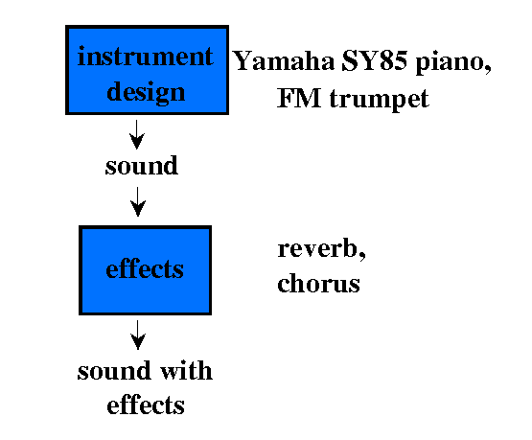
Effects
Effects change the character of a sound

Slide 3
Effects
types of effects:
  [iv:1] filters
  [iv:2] ring modulation
  [iv:3] flanging
  [iv:4] chorus
  [iv:5] delay & pitch shifter
  [iv:6] phasing
  [iv:7] echo
  [iv:8] stereo
  [iv:9] reverb

Slide 4
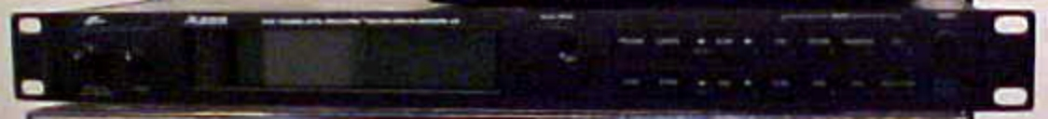

Effects
often use global instrument designs for adding effects to Csound instruments
can think of these global instruments as effects processing units

