Slide 1

Frequency
Modulation 2

Slide 2
Simple FM Instruments
John Chowning's FM Designs as shown in Dodge, Computer Music
  brass-like tone
  clarinet-like tone
  bell-like tone
  wood-drum-like tone
  clarbell

Slide 3
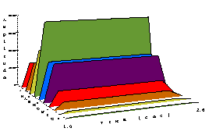
Clarinet and Brass-Like Tones
[iii:8] [iii:9] brass-like tone (Dodge p. 126)
fundamental is GCD of carrier and modulator frequencies: 440 Hertz
; start dur amp cfrq mfrq indx
i1 1 1.6 10000 440 440 5

Slide 4
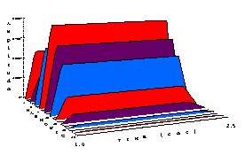
Clarinet and Brass-Like Tones
[iii:10] [iii:11] clarinet-like tone (pp. 126-127)
fundamental is GCD: 300 Hertz
; start dur amp cfrq mfrq indx
i1 1 1.6 10000 900 600 4

Slide 5
Clarinet and Brass-Like Tones
;dodge.orc - use with dodge.sco
instr 1 ; clarinet and brass tones
idur = p3
iamp = p4
icarfr = p5 ; carrier frequency
imodfr = p6 ; modulator frequency
index = p7 ; modulation index
iwave = 1 ; wavetable 1 (sine wave)
aenv linseg 0, .1, 1, idur-.3, 1, .2, 0
amod oscili index*imodfr, imodfr, iwave
acar oscili iamp, icarfr+amod, iwave
out acar * aenv
endin

Slide 6
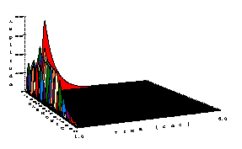
Bell and Wood-Drum-Like Tones
[iii:12] [iii:13] bell-like tone (Dodge p. 126)
fundamental is GCD: 40 Hertz
; start dur amp cfrq mfrq indx
i2 1 5 10000 200 280 10

Slide 7
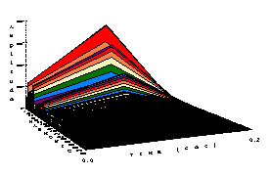
Bell and Wood-Drum-Like Tones
[iii:14] [iii:15] wood-drum-like tone (Dodge p. 126)
fundamental is GCD: 5 Hertz
; start dur amp cfrq mfrq indx
i2 1 .2 20000 80 55 25

Slide 8
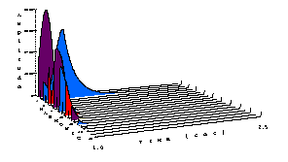
Bell and Wood-Drum-Like Tones
[iii:16] [iii:17] clarbell — hybrid clarinet and bell
fundamental is GCD: 300 Hertz
; start dur amp cfrq mfrq indx
i2 1 2.5 10000 900 600 4

Slide 9
Bell and Wood-Drum-Like Tones
;dodge.orc - use with dodge.sco
instr 2 ; bell and wood-drum tones
idur = p3
iamp = p4
icarfr = p5 ; carrier frequency
imodfr = p6 ; modulator frequency
imax = p7 ; maximum index
iwave = 1 ; wave table 1
index = imodfr * imax

Slide 10
Bell and Wood-Drum-Like Tones
; amplitude envelopes for modulator and carrier:
ampmod linseg index, .125 * idur, 0, idur * .875, 0
; expseg cannot use 0:
ampcar expseg .7, .121*idur, 1, idur*.879,.001,1,.001
; modulator and carrier oscillators:
amod oscili ampmod, imodfr, iwave
acar oscili ampcar, icarfr+amod, iwave
; expseg cannot use 0:
aenv expseg .001,.001,1,idur-.001,.001,1,.001
out acar * iamp * aenv
endin

Slide 11
Carrier-Modulator Ratio
CAR MOD n_{c} RATIO
Brass 440 440 1/1
Clarinet 900 600 3/2
Bell 200 280 5/7
Wood Drum 80 55 16/11
Clar-Bell 900 600 3/2
imodfr = p5
icarfr = imodfr * ______

Slide 12
Formant FM:
Generating Harmonic FM Spectra
A special case of FM with:
freq_{mod} = freq₁
freq_{car} = n_{c} freq_{mod} = n_{c} freq₁
where n_{c} is an integer representing the carrier frequency ratio usually in the range:
0 <= n_{c} <= 10

Slide 13
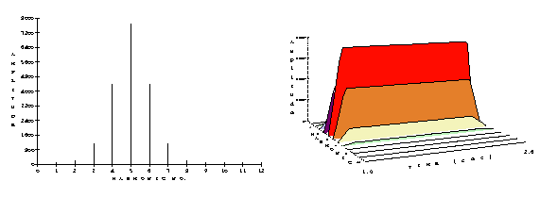
Formant FM
Carrier
[iii:18] formant fm
freq₁ = [iii:19] 100, freq_{mod}=freq₁ and freq_{car}= [iii:20] 5freq_{mod}
fundamental is 100 Hertz
; start dur amp cfrq mfrq indx
i1 1 1.6 10000 500 100 1

Slide 14
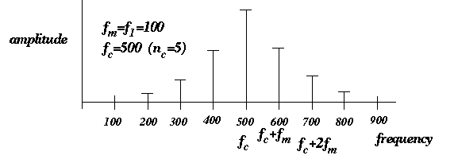
Formant FM
"formant" means resonance
freq_{car} acts like a resonance with sidebands falling off at harmonics around it.

Slide 15
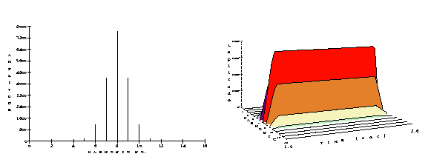
Formant FM
pitch ambiguity because fundamental is too soft — moving the formant does not move the fundamental, but it changes the pitch we think we hear
[iii:21] formant fm
freq₁ = [iii:22] 100, freq_{mod}=freq₁ and freq_{car}= [iii:23] 8freq_{mod}
; start dur amp cfrq mfrq indx
i1 1 1.6 10000 800 100 1

Slide 16
Quasi-Formant FM:
Quasi-Harmonic FM Spectra
A special case of FM with:
freq_{car} = freq₁
freq_{mod} = n_{m} freq_{car} = n_{m} freq₁
where n_{m} is an integer representing the modulator frequency ratio usually in the range:
0 <= n_{m} <= 5

Slide 17
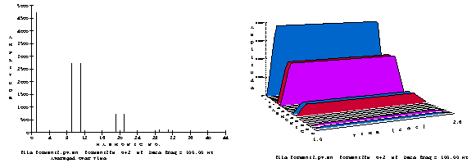
Formant FM
a modulator whose frequency is much greater than that of the carrier can give a strange spectrum with missing harmonics
[iii:24] quasi-formant fm
freq₁ = [iii:25] 100, freq_{car}=freq₁ and freq_{mod}= [iii:26] 10freq_{car}
; start dur amp cfrq mfrq indx
i1 1 1.6 10000 100 1000 1

