Slide 1

Frequency
Modulation 3

Slide 2
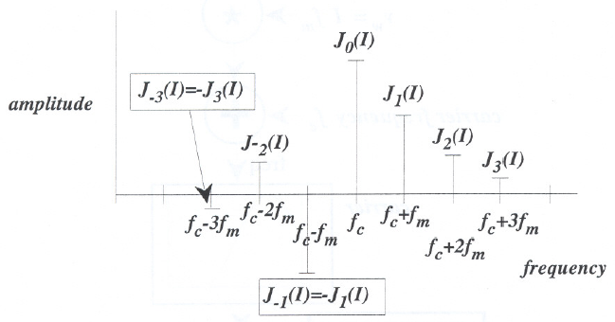
Spectra of FM
FM spectra contains the carrier frequency plus sideband components whose amplitudes depend on the Bessel functions (of the first kind).
I is the modulation index, f_{c} the carrier frequency, f_{m} the modulator frequency

Slide 3
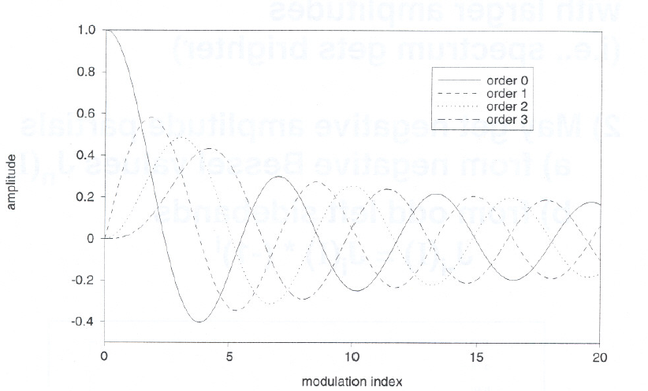
Bessel function of the first kind of orders 0 ~ 3
J₀(I) corresponds to order 0,
J₁(I) corresponds to order 1,
…

Slide 4
Spectra of FM
Bessel functions look like damped sine waves, where the order of the function is given by the subscript
A property of Bessel functions:
J_{-i}(I) = J_{i}(I) * (-1)^{i}
C library for Bessel functions: jn(order, I)

Slide 5
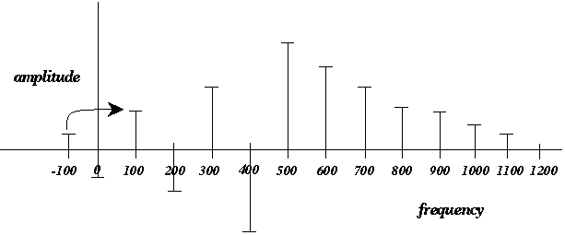
Properties of Formant FM Spectra
Negative frequencies fold up to corresponding positive harmonic frequencies.

Slide 6
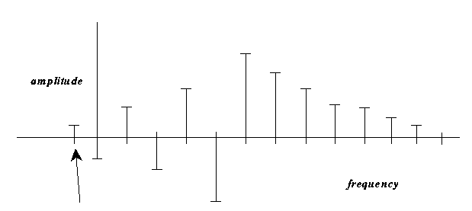
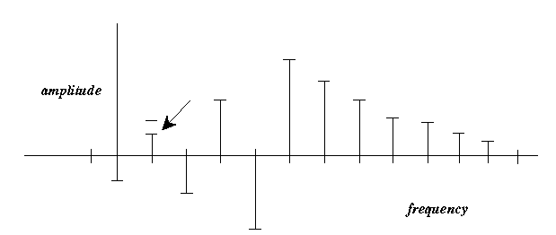
FM Spectra
May get negative frequency components:
these fold up with change of sign:

Slide 7
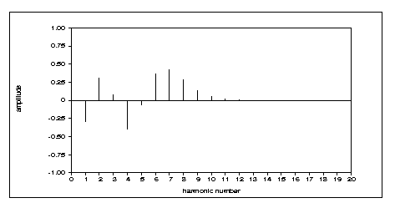
FM Spectra
With larger modulation index (I), we get more sidebands with larger amplitudes (i.e., spectrum gets brighter).
May get negative amplitude partials:
  from negative Bessel values J_{n}(I)
  from odd left sidebands
J_{-i}(I) = J_{i}(I) * (-1)^{i}

Slide 8
FM Spectra
May get components above the Nyquist frequency (causing aliasing)
To avoid aliasing with FM:
  use low carrier frequency f_{car}
0 <= f_{car} <= 10*f_{mod}
(0 <= n_{c} <= 10)
  use low modulation indices I
0 <= I <= 10

Slide 9
Generating Harmonic FM Spectra
Formant FM
A special case of FM with:
f_{m} = f₁
f_{c} = n_{c}f_{m} = n_{c}f₁
where n_{c} is an integer representing the carrier frequency ratio in the range:
0 ≤ n_{c} ≤ 10.

Slide 10
Formant FM
“formant” means resonance
f_{c} acts like a resonance with sidebands falling off at harmonics around it.
f_{m}=f₁=100
f_{c}=500 (n_{c}=5)
amplitude
100
200
300
400
500
f_{c}
600
700
f_{c}+2f_{m}
800
900
f_{c}+f_{m}
frequency

Slide 11
Properties of Formant FM Spectra
1) Negative frequencies fold up to corresponding positive harmonic frequencies.
amplitude
-100
0
100
200
300
400
500
600
700
800
900
1000
1100
1200
frequency

Slide 12
Properties of Formant FM Spectra
2) Amplitude of each harmonic k is given by:
a_{k} = J_{(k-nc)}(I) – J_{-(k+nc)}(I)
Example: n_{c} = 5
a₁ = J₍₁₋₅₎(I) – J₋₍₁₊₅₎(I) = J₋₄(I) – J₋₆(I)
a₆ = J₍₆₋₅₎(I) – J₋₍₆₊₅₎(I) = J₁(I) – J₋₁₁(I)
f_{c}=f₁=100
f_{c}=500 (n_{c}=5)
amplitude
-100
0
100
200
300
400
500
600
700
800
900
1000
1100
1200
f_{c}
frequency

Slide 13
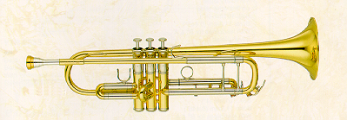
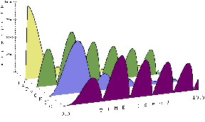
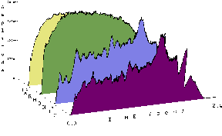
Dynamic (Time-Varying) Modulation Indices
Time-varying indices produce a dynamic spectrum
Spectral harmonics fade in and out as the modulation index I varies (unlike acoustic instruments)
Fixed modulation index I used in modeling acoustic instruments
[iii:7] FM sound
[iii:28] real trumpet
[iii:27] FM trumpet

Slide 14
Dynamic Spectra with
Multiple Carrier FM
Problem:
  Single carrier-modulator pair with fixed modulation index produces a fixed spectrum (not dynamic).
Solution:
  Multiple Carrier FM

Slide 15
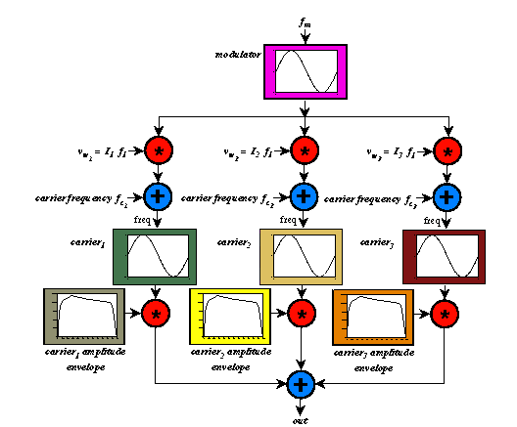
Multiple Carrier FM
uses multiple carriers, each with its own modulation index, amplitude envelope and carrier frequency ratio

Slide 16
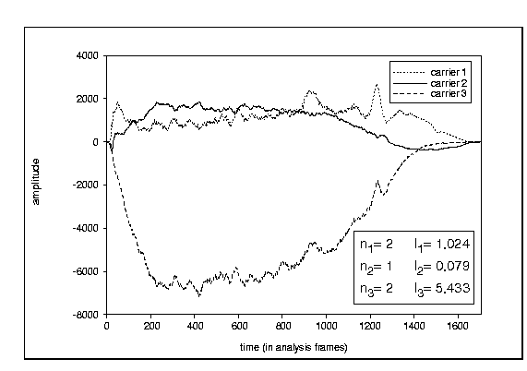
Multiple Carrier FM
carriers may add or partially cancel one another (complex interactions)
[iii:28] real trumpet
[iii:29] 3-carrier FM trumpet parameters
mod is the fundamental and
n_{c} is the carrier/mod ratio
negative amplitude is a (180°) phase shift

Slide 17
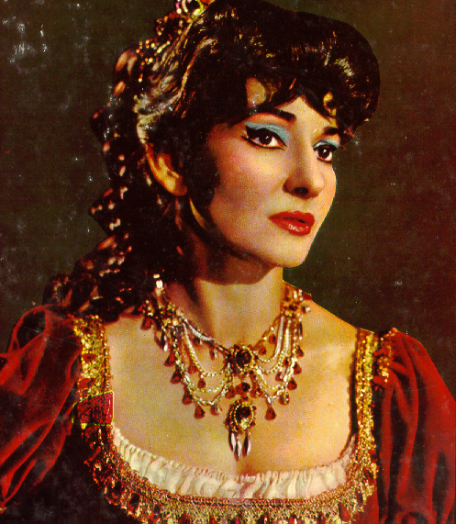
Multiple Carrier FM
[iii:30] 5-carrier fm soprano

