Slide 1

Frequency
Modulation 4;
Other Types of FM

Slide 2
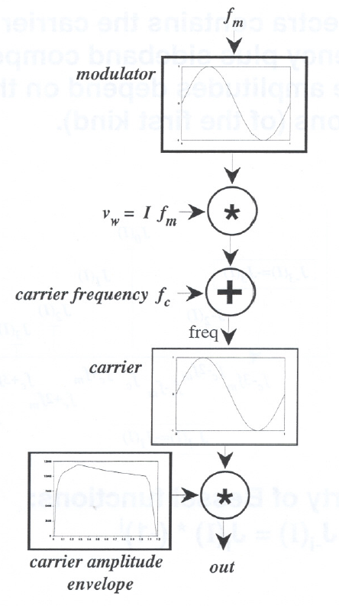
“Normal” Single-Modulator FM
Frequency Modulation
Modulation in frequency.
x(t) = w(t)sin[2π(f_{c} + If_{m}sin(2πf_{m}t))t]

Slide 3
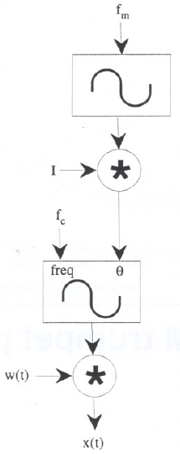
Phase Modulation
Phase Modulation
Equivalent to FM – implements the modulation in the phase instead of frequency.
x(t) = w(t)sin[2πf_{c}t + Isin(2πf_{m}t)]

Slide 4
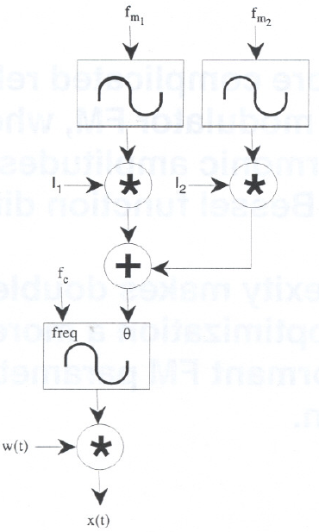
Double Modulator FM
Double Modulator FM
Uses two parallel modulators.
x(t) = w(t) sin[2πf_{c}t
+ I_{m1}sin(2πf_{m1}t)
+ I_{m2}sin(2πf_{m2}t)]

Slide 5
Double Modulator FM
Double FM-produced harmonic amplitudes depend on a sum of Bessel function differences and products
a_{k}(I_{m1}, I_{m2})=
Σ[J_{(k-nc-hnm)}(I_{m1}) - J_{- (k+nc+hnm)}(I_{m1})] J_{h}(I_{m2})
∞
h=-∞

Slide 6
Double Modulator FM
This is a more complicated relationship than single modulator FM, where each carrier’s harmonic amplitudes depend on a single Bessel function difference.
This complexity makes double FM parameter optimization a more difficult task than formant FM parameter optimization.

Slide 7
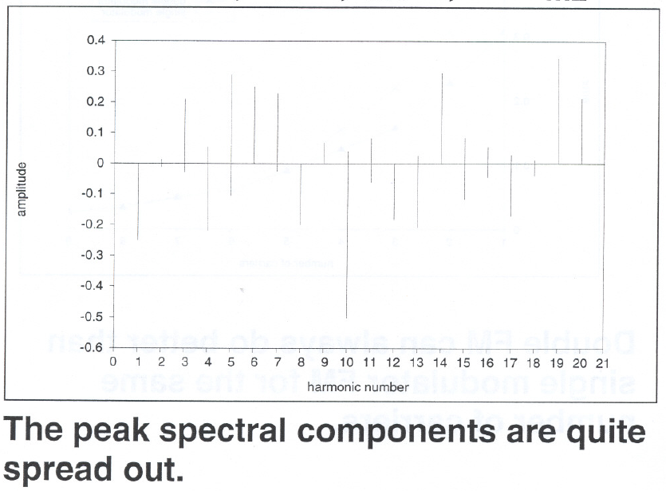
Double Modulator FM
Double FM modulation indices and frequency ratios are usually smaller than those of formant FM.
Example: Spectrum of double modulator FM with n_{c}=10, n_{m}=5, I_{m1}=6, and I_{m2}=2:

Slide 8
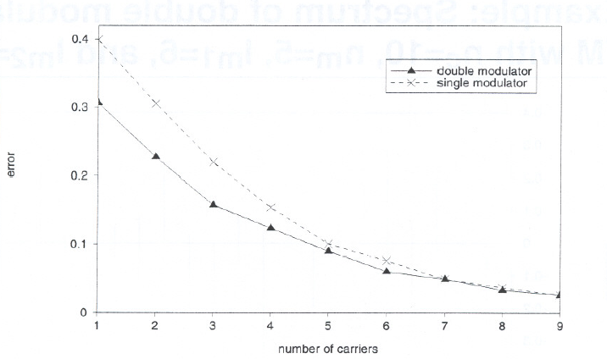
Double versus single Modulator FM
Convergence of error for different numbers of carriers using double modulator FM and formant FM to model the trumpet.
Double FM can always do better than single modulator FM for the same number of carriers.

Slide 9
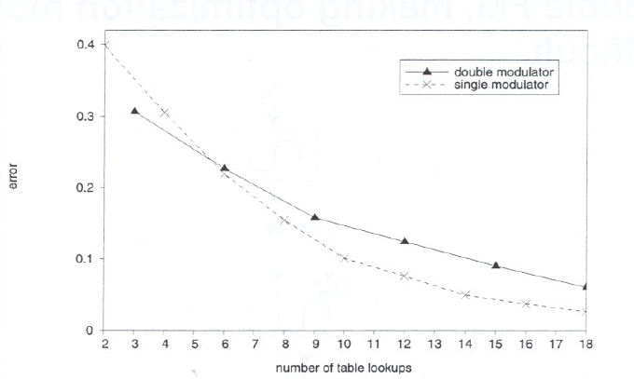
Double versus
Single Modulator FM
Convergence of error vs computation (number of table lookups) using double modulator FM and formant FM to model the trumpet.
Double modulator FM is only cost-effective when using 1 carrier
Otherwise it is better to just add more single modulated carriers.

Slide 10
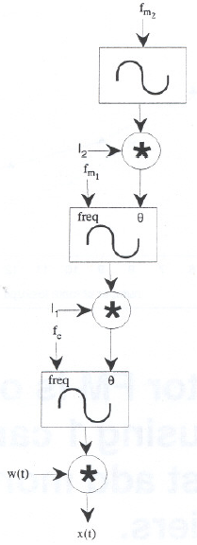
Nested Modulator FM
Nested Modulator FM
Uses nested (serial) modulators.
x(t) = w(t)sin[2πf_{c}t+
I_{m1}sin(2πf_{m1}t + I_{m2}sin(2πf_{m2}t))]
Nested FM is more nonlinear than double FM, making optimization more difficult.

Slide 11
Feedback FM
Feedback FM
A discrete formula for feedback FM is the following:
x_{n} = w_{n}sin[(2πf₁n/SR) + (Bx_{n-1}/w_{n-1})]
with w_{n} the discrete carrier amplitude envelope, and f₁ the desired fundamental frequency.

Slide 12
Feedback FM
The output of the carrier is used to modulate the following sample, scaled by the modulation index B.
  When B is less than about 1.5, a monotonically decreasing spectrum results.
Because of this, feedback FM is potentially more easily controlled than the other forms of FM (where the harmonics oscillate as the modulation index changes).
Another advantage of feedback FM over other forms of FM is that its spectral components are strictly positive for B < 1.5.
  This avoids phase cancellation when multiple carriers are added together.

Slide 13
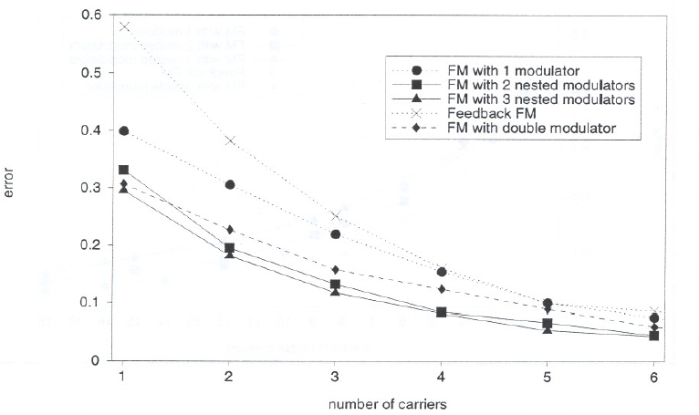
FM Types Compared
Convergence of error for different numbers of carriers using various types of FM to model the trumpet.
FM with 3 nested modulators
is best for a fixed number of carriers.

Slide 14
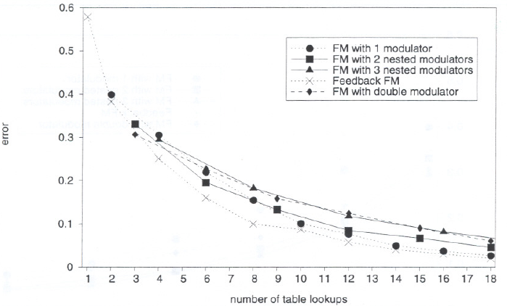
FM Types Compared
Convergence of error vs computation (number of table lookups) using various types of FM to model the trumpet.
Feedback
FM is best
for a fixed number of table lookups (computations)

