Slide 1

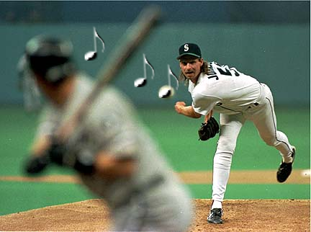
Pitch

Slide 2
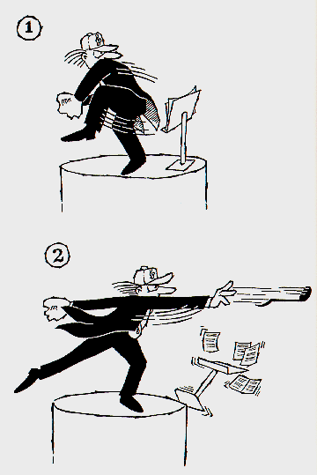
Pitch
Relative highness or lowness of a note.
adding PITCH to rhythm and amplitude creates melody

Slide 3
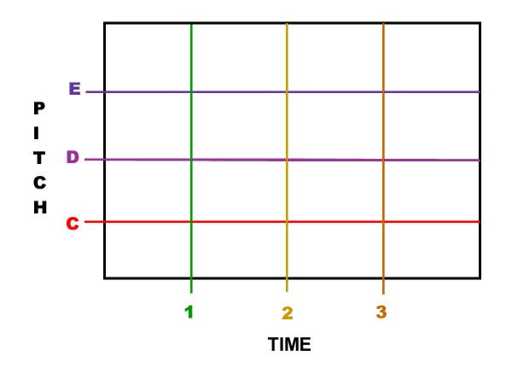
Pitch
[ii:1] continuous as we move from one note to another

Slide 4

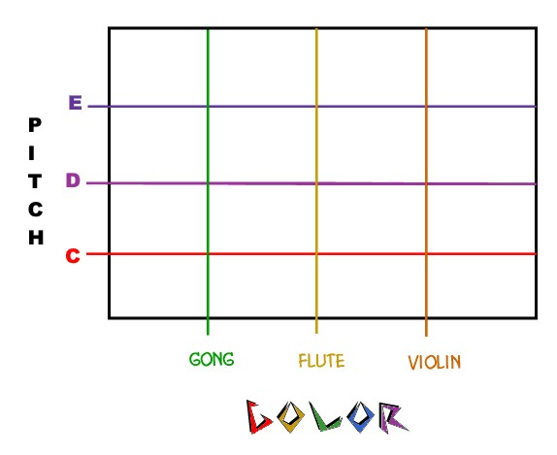
Pitch
Music usually uses notes ( )
  finite, discrete, grids of pitch/duration/tone color objects:
Pitch-Time Grid:
Pitch-Color Grid:

Slide 5
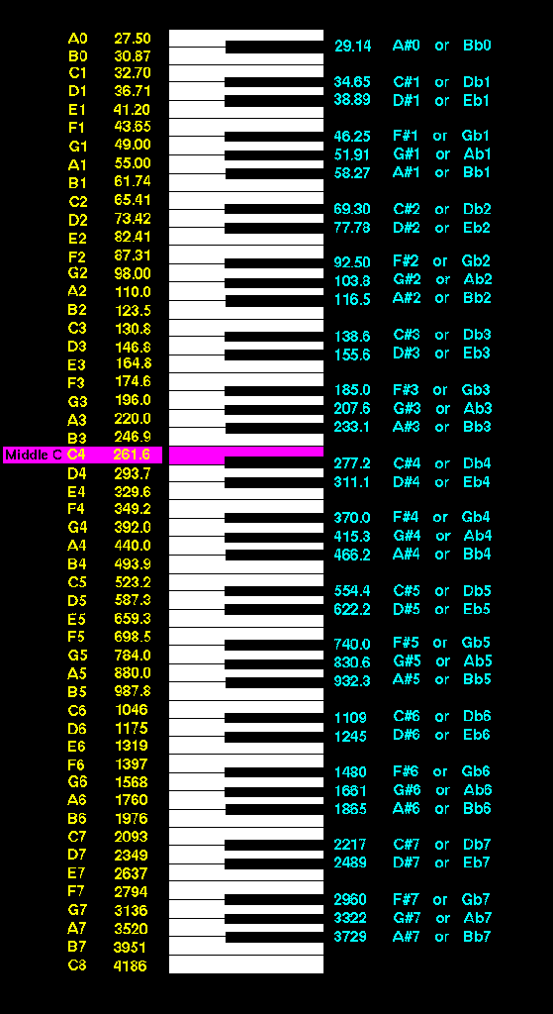

Pitch
piano plays a [ii:2] familiar scale of 12 standard notes per octave (see keyboard)
2
1
12

Slide 6
Pitch
computer can play many notes between these twelve
  an infinite number of pitches per octave
Example: the computer can play a [ii:3] 31-tone-per-octave scale

Slide 7
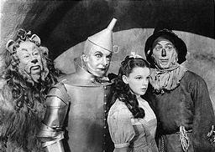
Pitch
the relative highness or lowness that we hear in a sound <c:5>
corbis.com
 
where, bow
 
o- rain-
 
the up
 
ver high
 
Some way

Slide 8
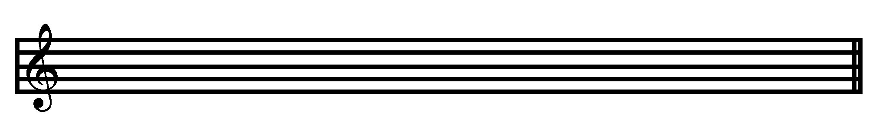
Pitch
adding PITCH to rhythm and amplitude creates melody
Staff
  a graph of pitch versus time
PITCH
TIME

Slide 9
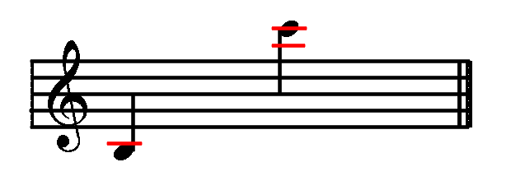
Pitch
Ledger Lines
  short horizontal lines that extend staves (plural of staff) up or down and are spaced at the same distance as the staff lines
  ledger lines extend through the stems of notes

Slide 10
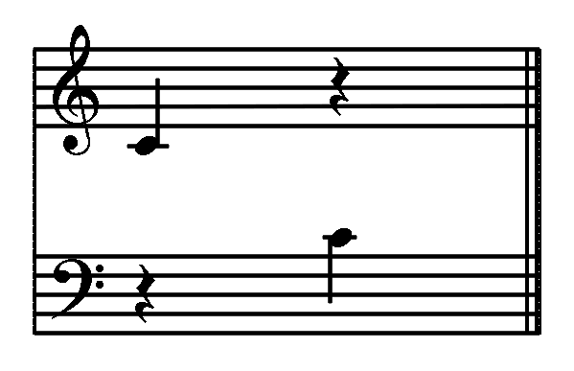
Pitch
[ii:4] Middle C
  Called C4 in Csound
  the note in the middle of the two clefs
  Middle C uses one ledger line below the treble clef staff
  Middle C uses one ledger line above the bass clef staff

Slide 11


Clefs
  signs found at the left-hand side of staves to indicate the lines and spaces that represent the pitches
  a staff with a clef sign indicates pitches:
    treble clef for middle C and higher notes (read from bottom to top):
Fine
E
Does
C
Boy
A
Good
F
Every

Slide 12
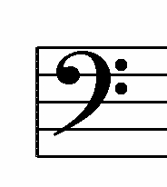

Bass Clef
    bass clef for middle C and lower notes (read from bottom to top):
Always
Grass
Fine
Eat
Do
Cows
Boys
All
Good

Slide 13
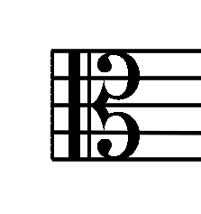
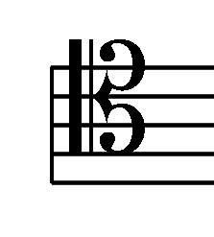
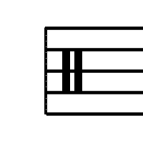
Other Clefs
alto clef used for the viola:
Middle C
tenor clef used for the bassoon (high notes):
Middle C
percussion clef — lines represent percussion instruments:
gong
wood block

Slide 14
What are the Properties of Sound?
Perceived Property
(how we hear it)
Physical Property
frequency
pitch
amplitude
loudness
harmonic content
timbre (color)

Slide 15
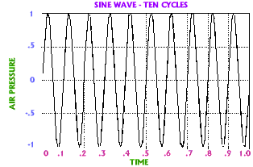
Frequency
the rate at which a regular vibration pattern repeats itself
  precise measurement in cycles per second

Slide 16
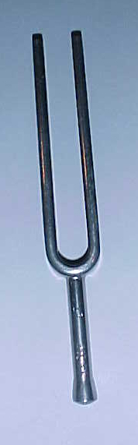
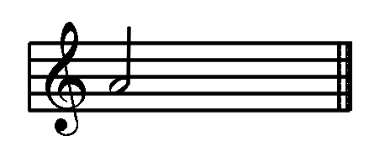
Frequency
Rate
  number of cycles (times) per second
Hertz
  cycles per second
[ii:5] A440
  frequency of 440 cycles per second
  the modern tuning reference
A440
A4

Slide 17
Lowest Frequency
We Can Hear
about 20 Hertz
can you hear:
  [ii:6] 10 Hertz?
  [ii:7] 20 Hertz?
  [ii:8] 30 Hertz?
  [ii:9] 40 Hertz?
  [ii:10] 50 Hertz?
below about 20 Hz, we only hear clicks
limit about 20 Hz for how fast we can perform and hear [ii:11] separate notes

Slide 18
Highest Frequency
We Can Hear
Varies according to age and other individual factors
can you hear:
  [ii:12] 8000 Hertz?
  [ii:13] 12000 Hertz?
  [ii:14] 14000 Hertz?
  [ii:15] 16000 Hertz?
  [ii:16] 18000 Hertz?
  [ii:17] 20000 Hertz?

Slide 19
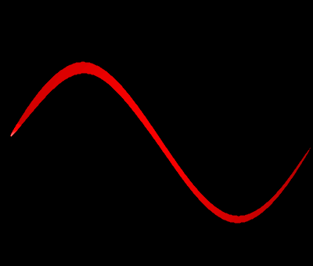
Cycle
the distance from one point of maximum or minimum air compression to the next
[ii:18] Sine Waves
  Simplest sound waves
  Harmonics are similar to sine waves
Sine Wave – One Cycle
MAX
AIR PRESSURE
MIN
TIME

Slide 20
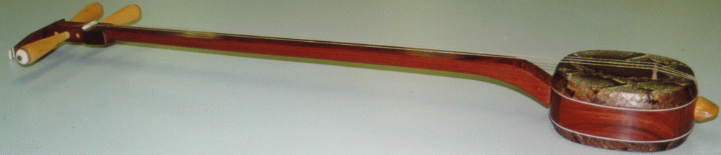
Harmonic Series
The simple sounds form a pattern at exact whole-number multiples of fundamental
String proportion is reciprocal of frequency ratio
    string length = f = fundamental frequency
    1/2 string length = 2f
    1/3 string length = 3f
    1/4 string length = 4f
  [ii:19] demo
  on sanxian

Slide 21
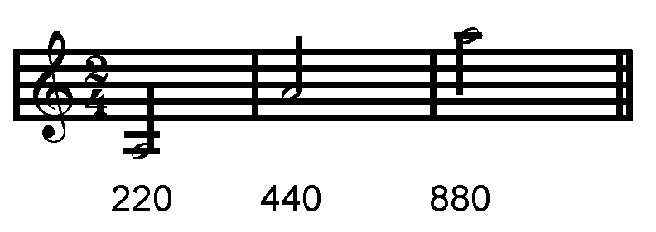
Octave
a pitch an octave higher than another has [ii:20] double its frequency
  Example: 440 Hertz * 2 = 880 Hertz
a pitch an octave lower has [ii:21] half the frequency
  Example: 440 Hertz * .5 = 220 Hertz
A3 A4 A5

Slide 22
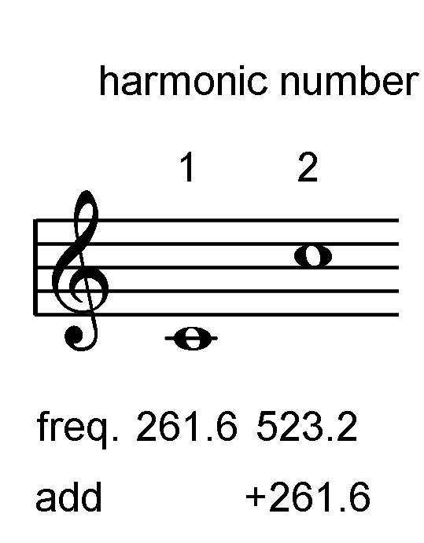
Harmonic Series
[ii:22] In any harmonic series, the 2nd harmonic is the octave
For a harmonic series starting on Middle C with a frequency of 261.6 Hertz, the frequency of the 2nd harmonic (octave) is 261.6 x 2 = 523.2 Hertz
…
C4
C5

Slide 23

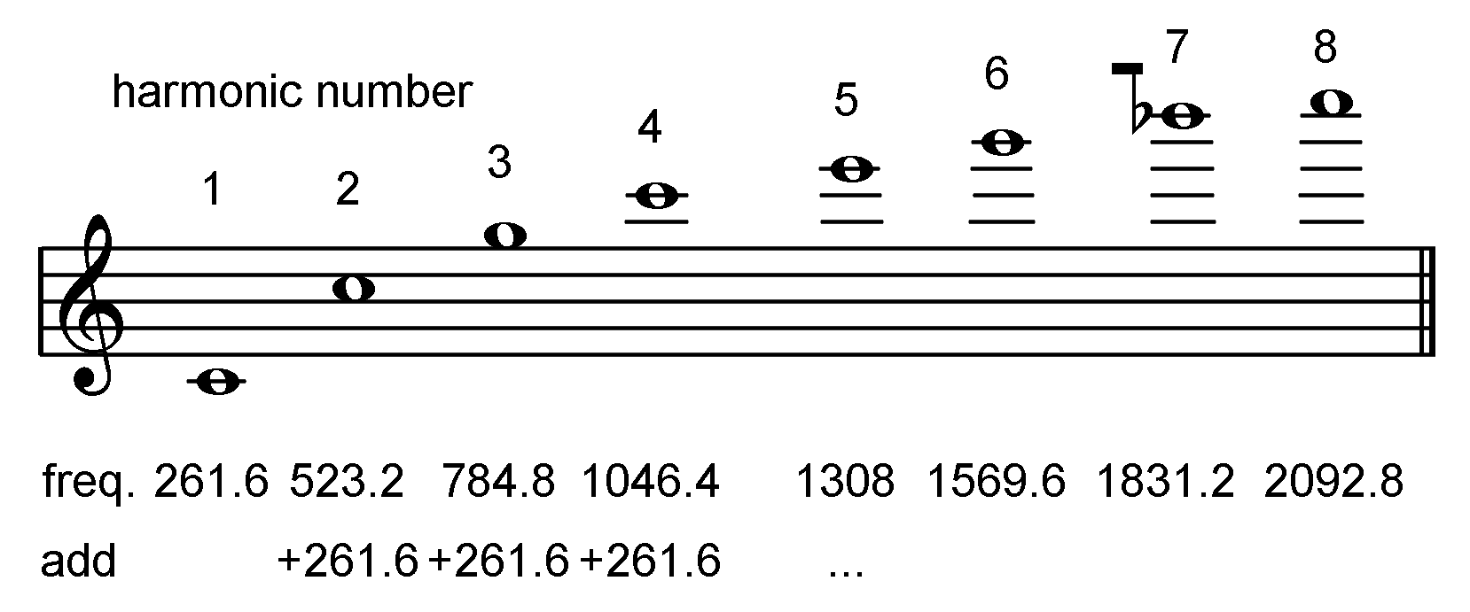
Harmonic Series
Continuing to add 261.6 produces the other harmonics in the series
<W1:37> Video Example
C4
C5
G5
C6
E6
G6
Bb6
C7

Slide 24
Pitch
Tone
  a musical sound (describes the quality or color of a sound)
Pitch
  how high or low musical tones sound (describes the frequency of a sound)
Note
  a written symbol that shows the pitch and duration of a sound

Slide 25

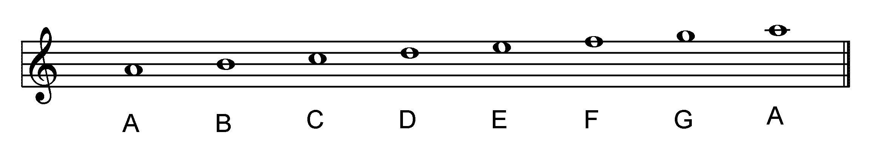
Pitch
  pitches and notes use 7 letter names, [ii:23] A-A, equivalent to the white keys on the piano keyboard
  7 Letter Names for Pitches and Notes

Slide 26
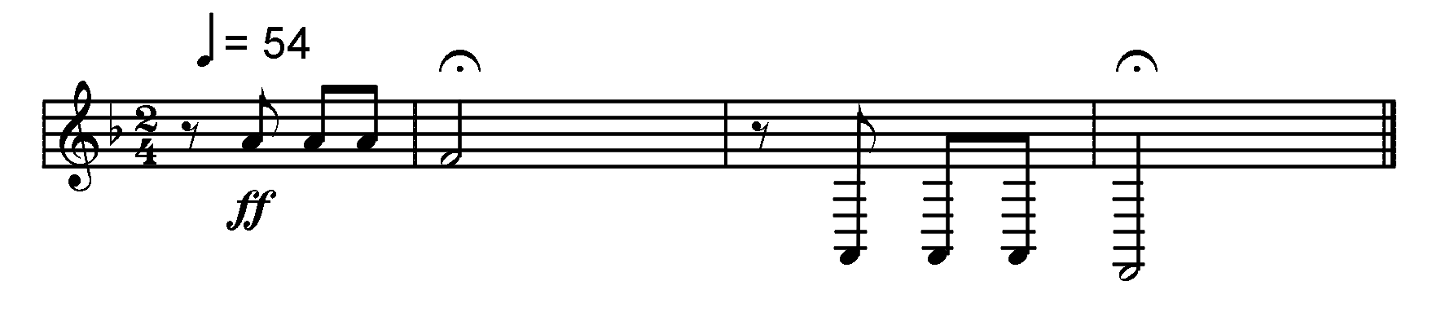
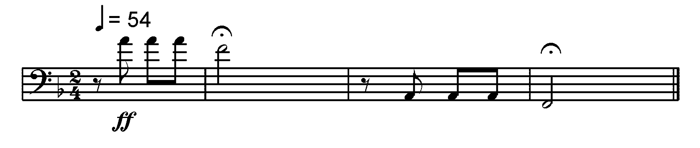
Pitch
  Notes Lower than Middle C Require Many Ledger Lines on Staves with the Treble Clef
A2 F2
A4 F4
  Notes Higher than Middle C Require Many Ledger Lines on Staves with the Bass Clef
A2 F2
A4 F4

Slide 27

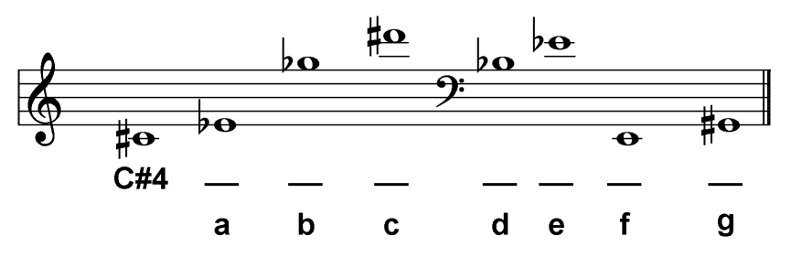
Pitch Drill
  Write the correct pitch name below each note:

Slide 28
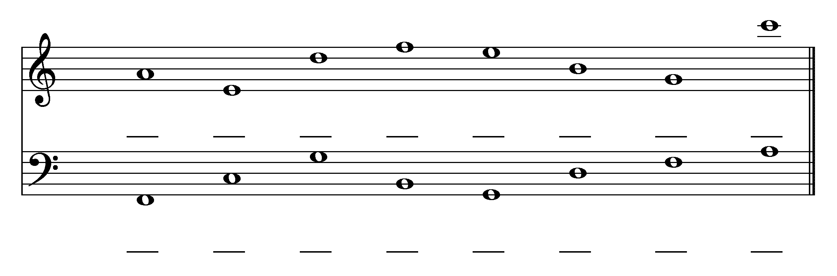
Pitch Drill
  Write the correct pitch name below each note:

