Slide 1
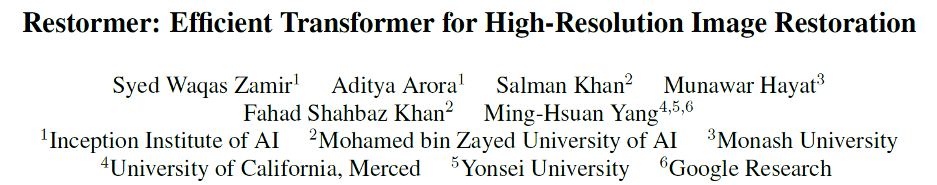
CVPR 2022 oral
Presenter: Chenyang QI

Slide 2
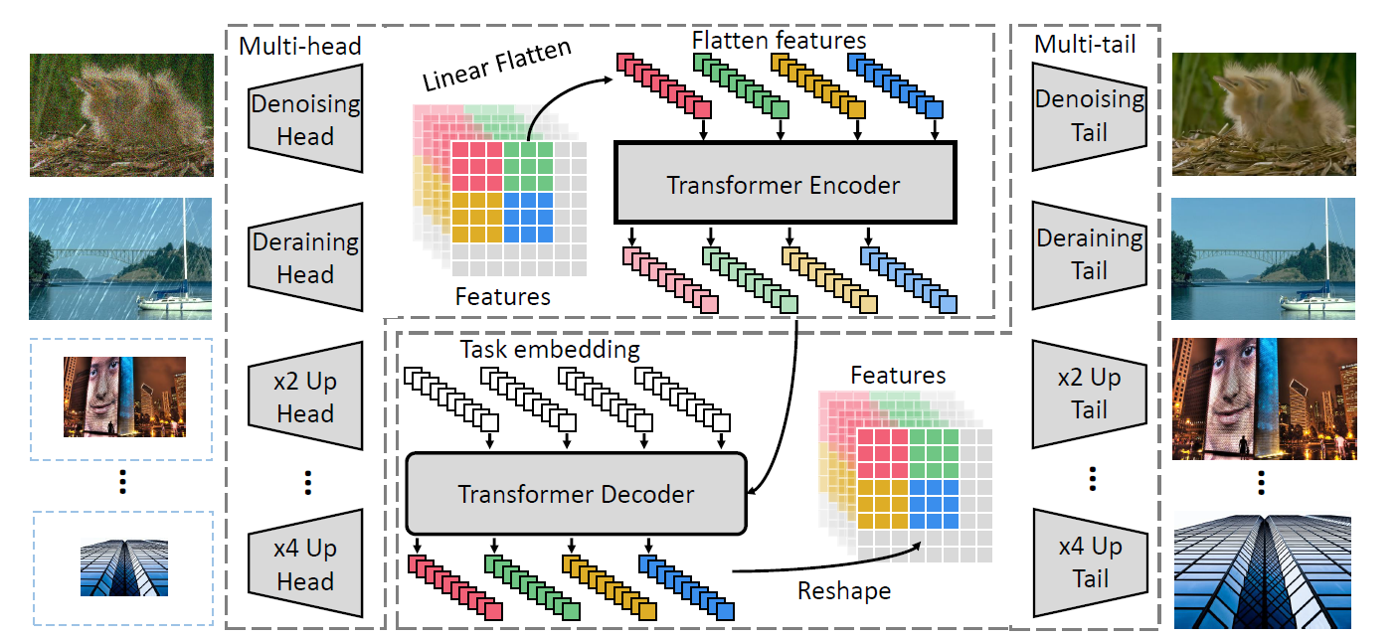
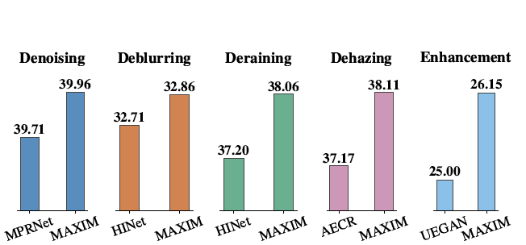
Problem Setting
Common Restoration Tasks:
Denoising
Super-resolution
Deblurring
Deraining
JPEG Artifact Removal
Dehazing
Enhancement
…
Evaluation Setting:
Large pretrained model for all task
Train different model for each task separately
Even different model for subtask
Different noise level
Different upscaling scale
Different JPEG quality factor

Slide 3
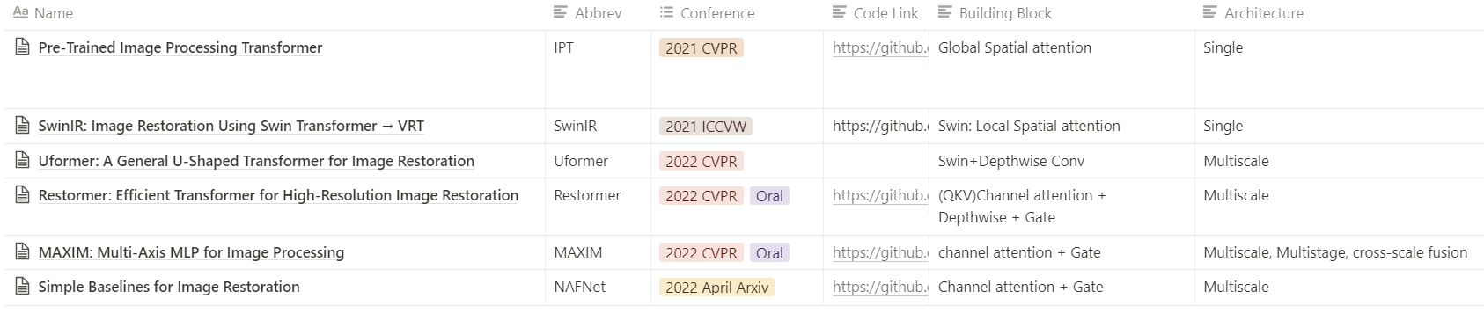
Recent Progress:

Slide 4
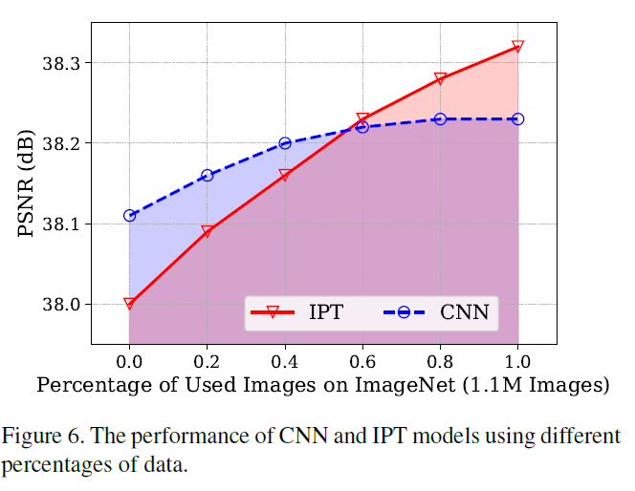
Pre-Trained Image Processing Transformer
Motivation of Transformer over CNN:
Weight Kernel is image adaptive
Flexible Long-range dependency
Method
Single scale global spatial attention
Pretrained on corrupted ImageNet pairs with contrastive loss
Finetuned separately on each tasks
Result:
Transformer may outperform CNN on large dataset

Slide 5
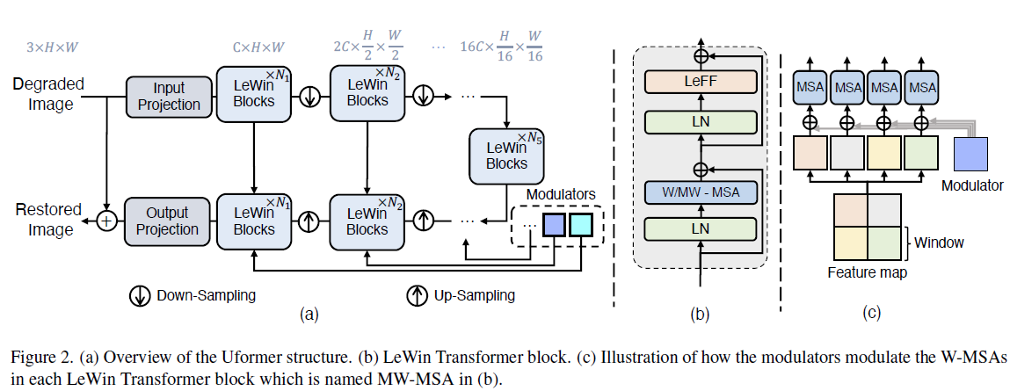
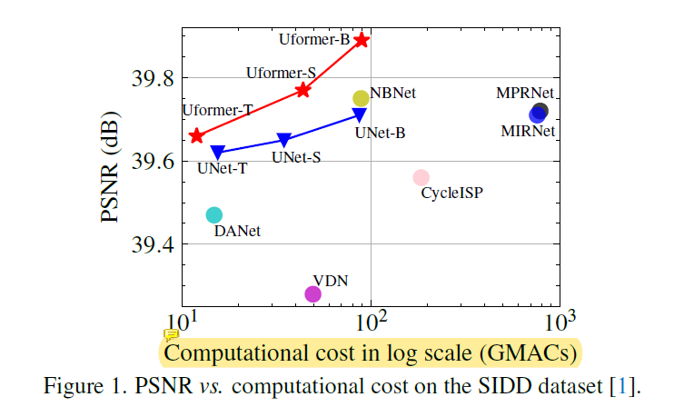
SwinIR and Uformer(CVPR 2022)
Motivation of Swin (window-based local attention) over VIT:
Efficiency of time, memory and parameter.
Motivation of Uformer over Swin:
Multiscale: larger receptive field, efficiency for HR image
Method:
Result:
Reduce the complexity of Transformer to that of Unet
Better Fidelity

Slide 6
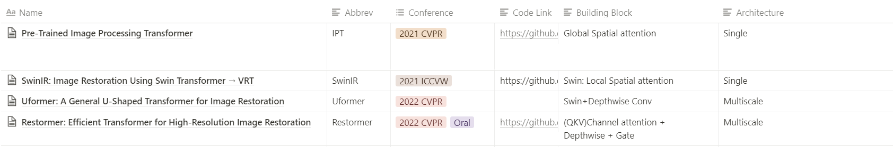

Motivation of Restormer (2022 CVPR oral)
Spatial self-attention is $O\left(H^{2}W^{2}\right)$, where $H,W$ is the Hight, Width of attention window
ViT: Global but expensive
Swin: Efficient but local (not optimal for HR image)
Global and Efficient?

Slide 7
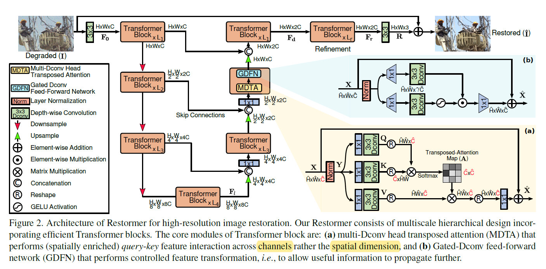
Method of Restormer

Slide 8
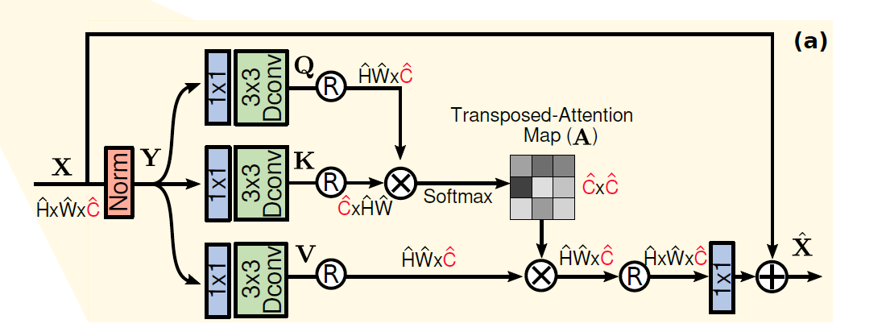
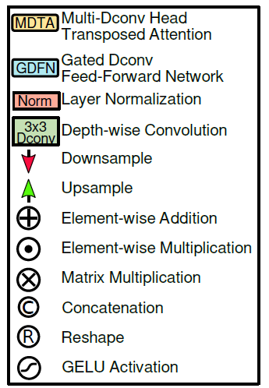
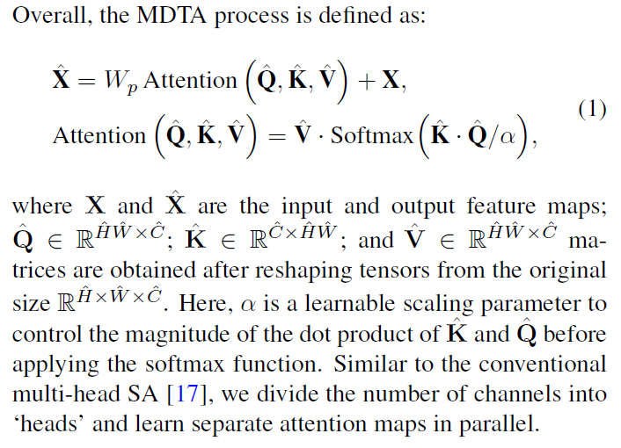
Method of Restormer: Channel Attention

Slide 9
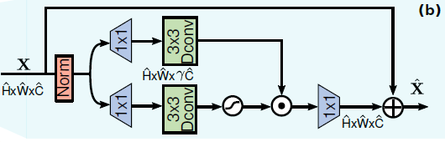
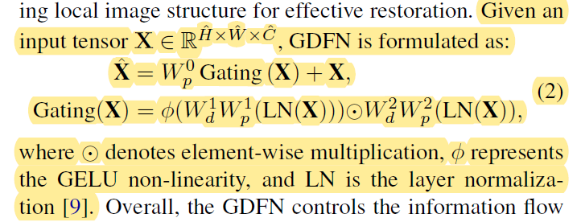
Method of Restormer: Gate

Slide 10
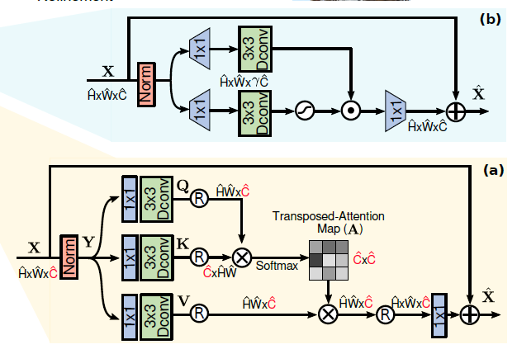
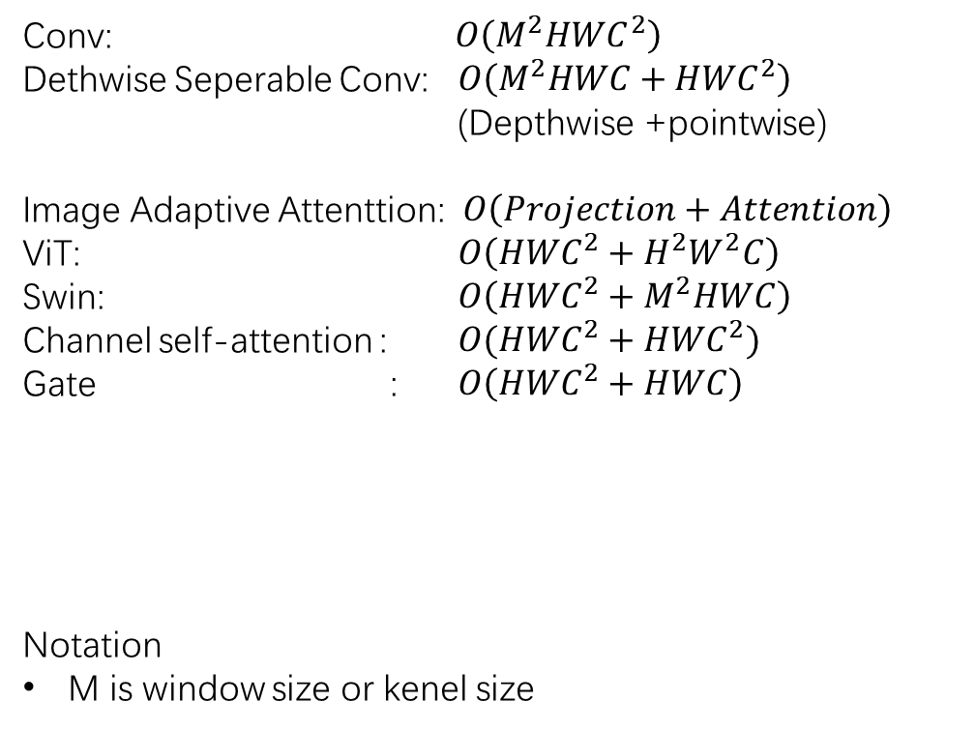
Analysis of Computation Complexity
Conv: $O\left(M^{2}HWC^{2}\right)$
Dethwise Seperable Conv: $O\left(M^{2}HWC+{HWC}^{2}\right)$
(Depthwise +pointwise)
Image Adaptive Attenttion: $O\left(Projection+Attention\right)$
ViT: $O\left({HWC}^{2}+H^{2}W^{2}C\right)$
Swin: $O\left({HWC}^{2}+M^{2}HWC\right)$
Channel self-attention : ${O(HWC}^{2}+{HWC}^{2})$
Gate : $O\left({HWC}^{2}+HWC\right)$
Notation
M is window size or kenel size
Gate
Channel Attention

Slide 11
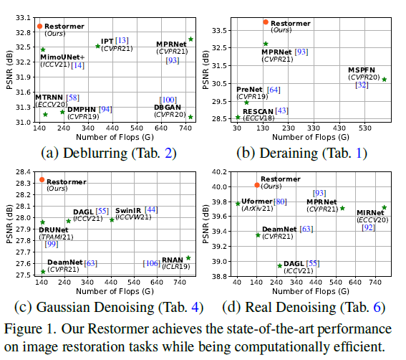
Result

Slide 12
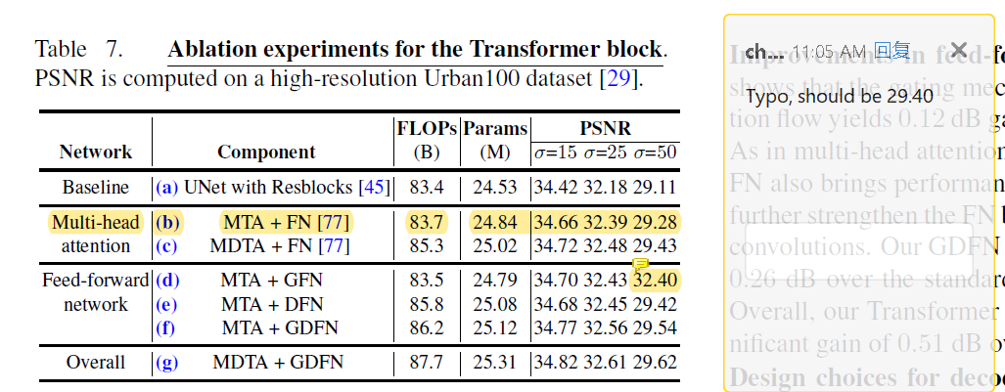
Ablation

Slide 13
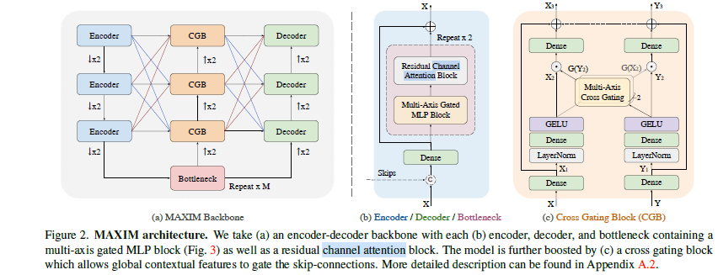
Concurrent Work: MAXIM: Multi-Axis MLP for Image Processing

Slide 14
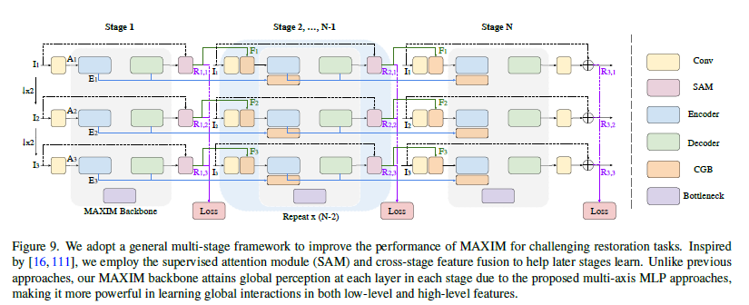
Concurrent Work: MAXIM: Multi-Axis MLP for Image Processing (CVPR 2020 oral)

Slide 15
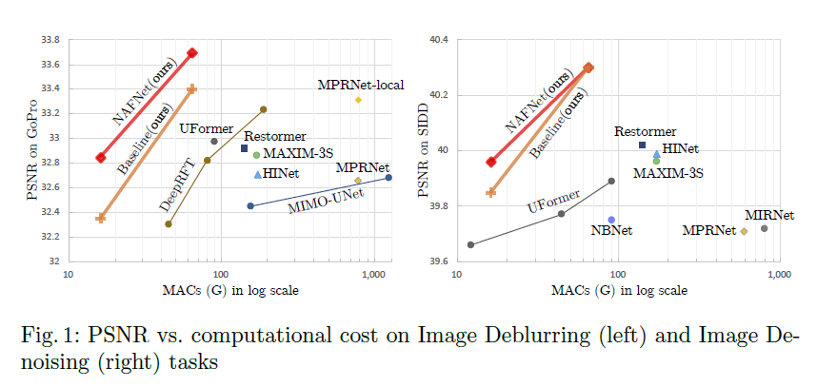
Concurrent Work: Nonlinear Activation Free Network

Slide 16
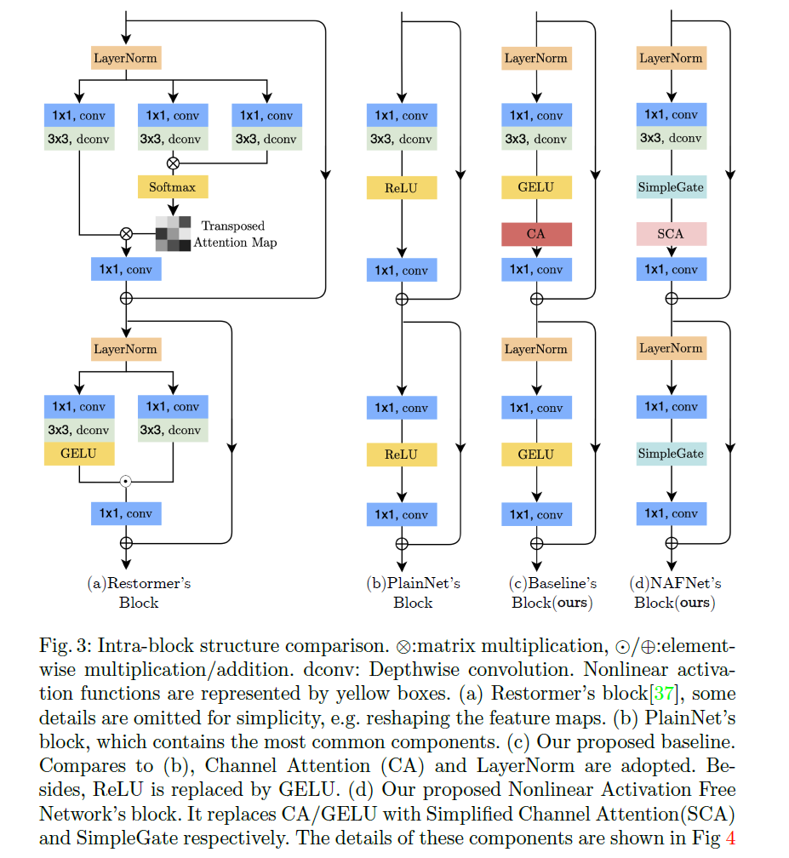

SCA: Simplified channel activation
GELU or ReLU is not necessary
Gate provides non-linearity
X = X(w(X))

Slide 17
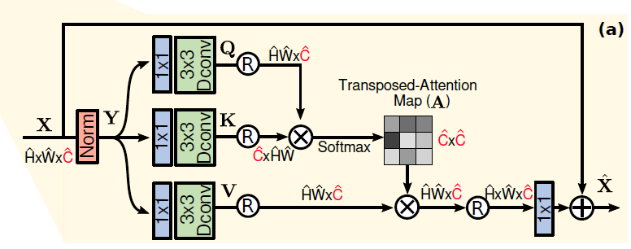

Limitation and future work
Analysis of design details
Gate
Layer Norm
GeLU
Channel attention
Analysis and Visualization of Channel attention is difficult
Spatial attention -> spatial similarity
Channel attention -> channel similarity?
Generalizability to HR image
$C×C=(C×HW).dot(HW ×C)$
$ChaAtt\left(Concat\left(A,B\right)\right)!=Concat[ChaAtt\left(A\right), ChaAtt\left(B\right)]$
Restormer increases the patch size during training. However, the ablation show improvement is only about 0.07dB
Data scale:
The performance on small-scale training set
The generalizability on edge case real data
Development:
Computation cost to train

Slide 18
Recent Progress:

