Slide 1
ERNIE: Enhanced Language Representation with Informative Entities
Zhengyan Zhang, Xu Han, Zhiyuan Liu, Xin Jiang, Maosong Sun, Qun Liu
Department of Computer Science and Technology, Tsinghua University, Beijing, China
Institute for Artificial Intelligence, Tsinghua University, Beijing, China
State Key Lab on Intelligent Technology and Systems, Tsinghua University, Beijing, China
Huawei Noah’s Ark Lab
Presenter: Jia Le XU

Slide 2
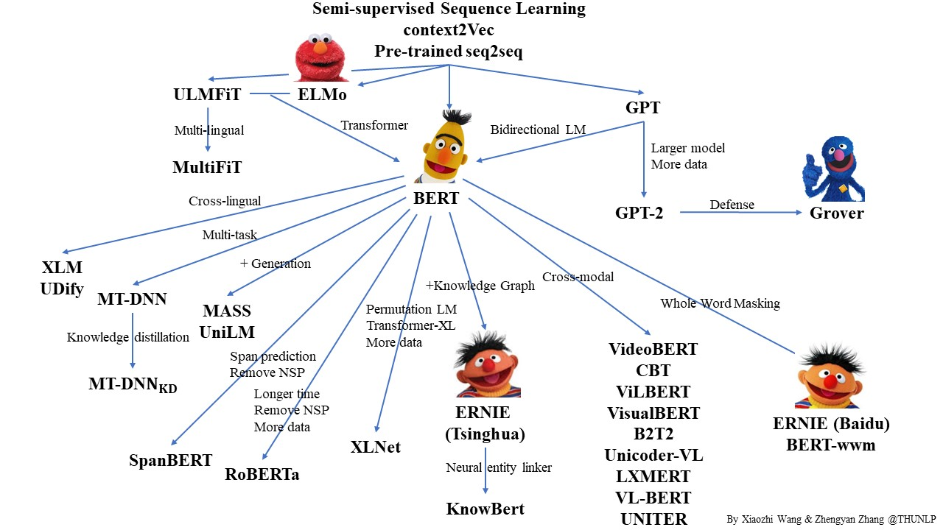
BERT Family
Source: https://github.com/thunlp/PLMpapers

Slide 3
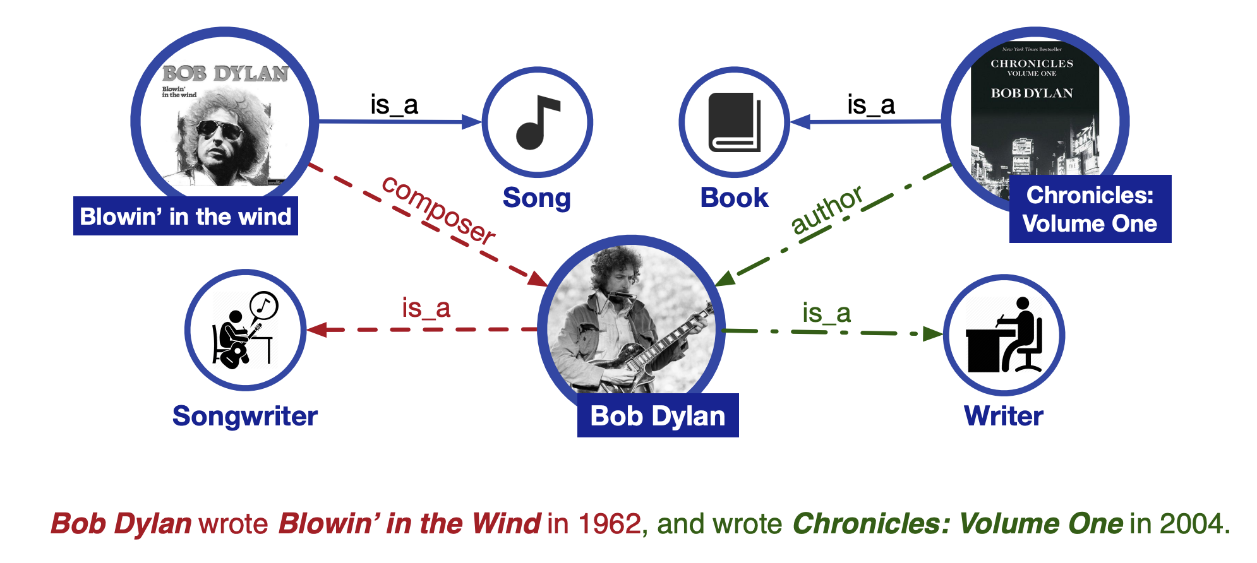
Background

Slide 4
Contributions
Structured Knowledge Encoding
Named entity in text aligned to their corresponding entities in KGs.
Encoded KGs with TransE and took the informative entity embeddings as input.
Integrated entity representations in the knowledge module into the underlying layers of the semantic module.
Heterogeneous Information Fusion
Adopted the masked language model and the next sentence prediction as the pre-training objectives.
Randomly masked some of the named entity alignments in the input text and asked the model to select appropriate entities from KGs to complete the alignments.
Aggregated both context and knowledge facts for predicting both tokens and entities and led to a knowledgeable language representation model.

Slide 5
Related Works
Feature based approaches
Words distributed representations
Pretrained input embeddings and initialization parameters
ELMo
Finetuning approaches
Pretrained auto-encoders
AWD-LSTM
ULMFiT
GPT
BERT

Slide 6
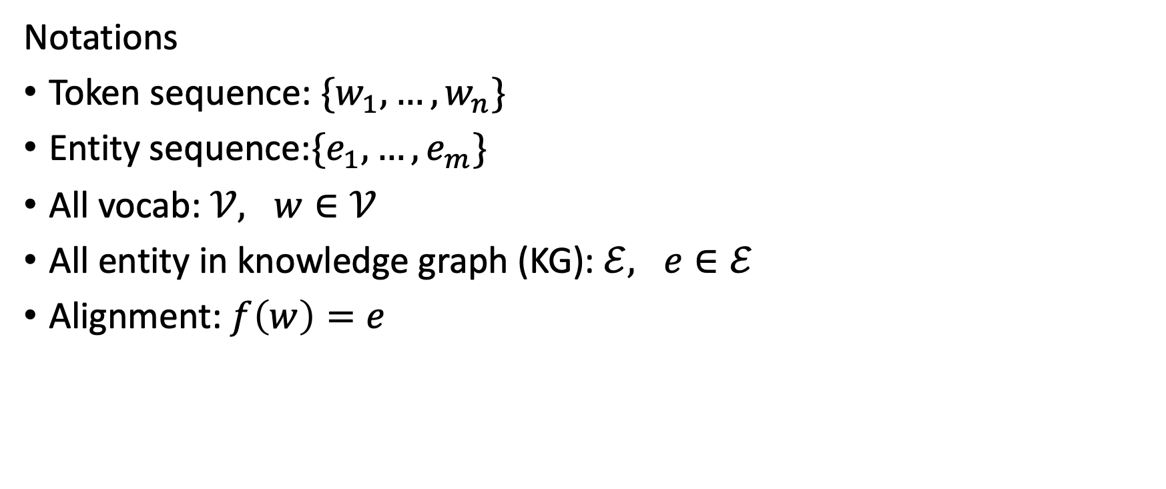
Methodology
Notations
Token sequence: $\{w_{1}, …,w_{n}\}$
Entity sequence:$\{e_{1}, …,e_{m}\}$
All vocab: $𝒱, w∈𝒱$
All entity in knowledge graph (KG): $ℰ, e∈ℰ$
Alignment: $f\left(w\right)=e$

Slide 7
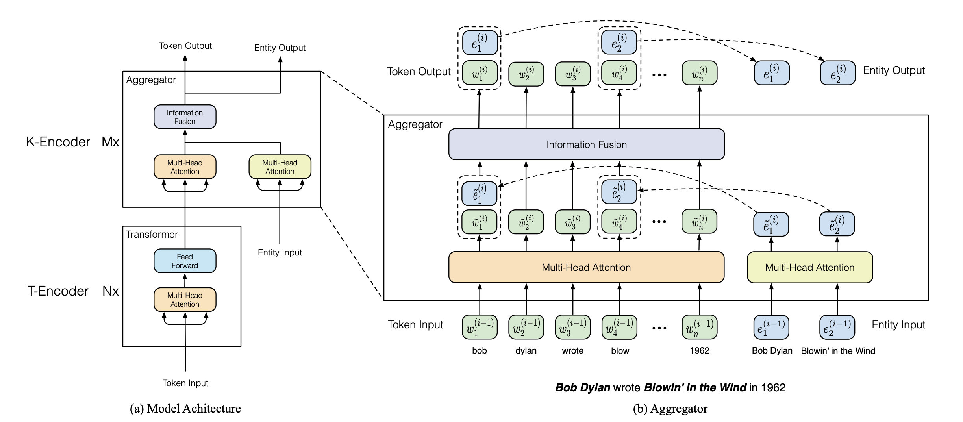
Methodology
Model Architecture

Slide 8
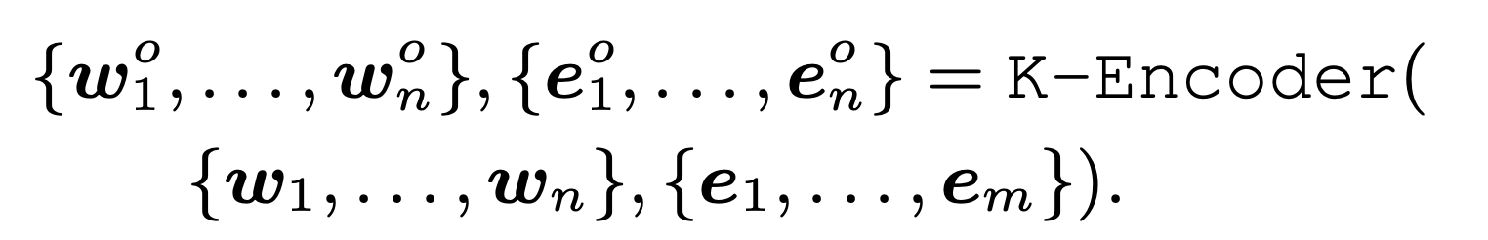
Methodology
Textual Encoder (T-Encoder)
Knowledgeable Encoder (K-Encoder)

Slide 9
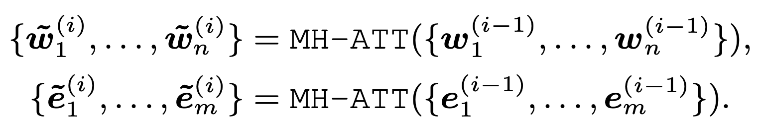
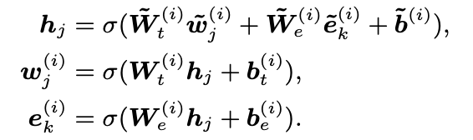
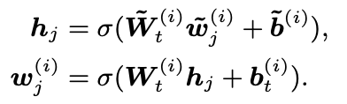
Methodology
Knowledgeable Encoder
With Entity:
Without Entity:

Slide 10
Methodology
Pretraining for Injecting Knowledge
In 5% of the time, for a given token-entity alignment, replaced the entity with another random entity.
In 15% of the time, masked token-entity alignments.
In the rest of the time, kept token entity alignments unchanged.

Slide 11
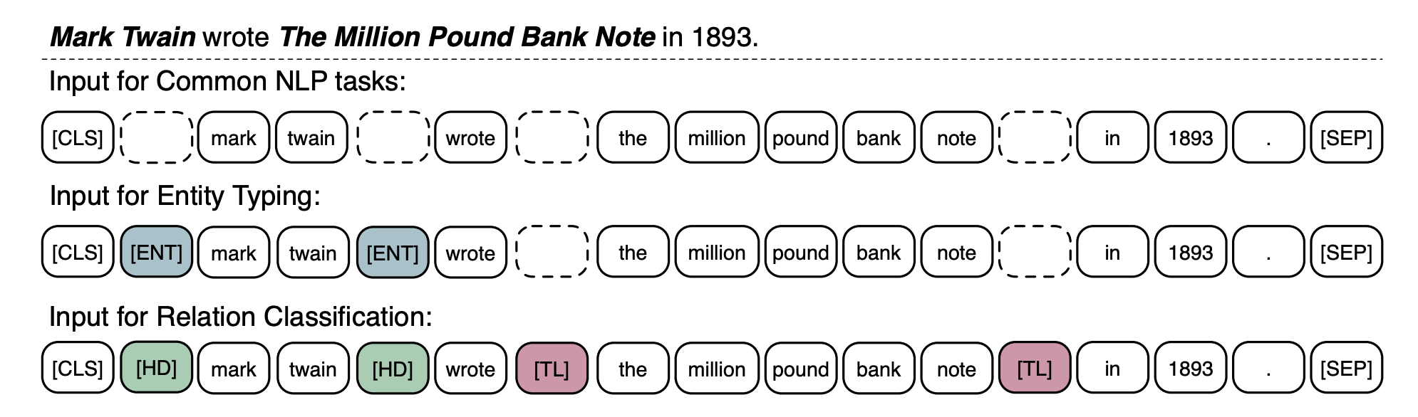
Methodology
Finetuning for Specific Tasks

Slide 12
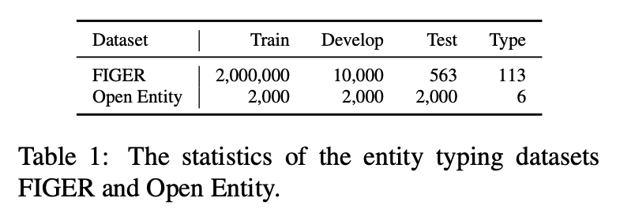
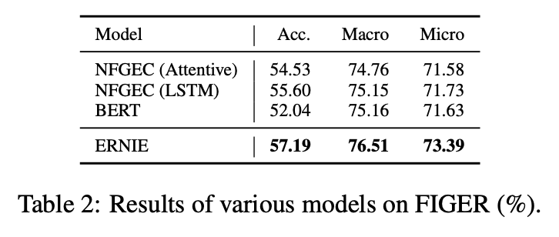
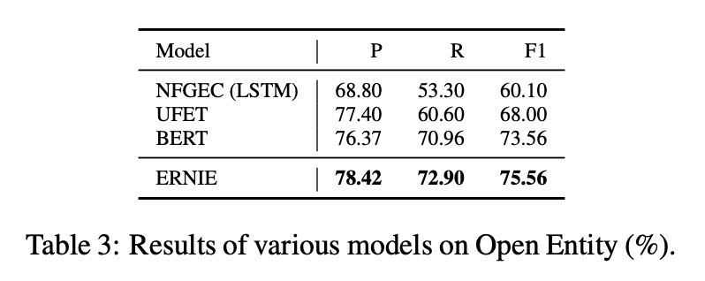
Experiments
Entity Typing

Slide 13
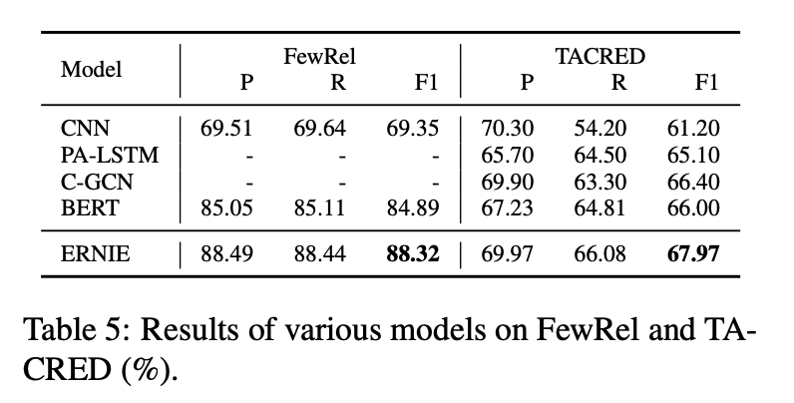
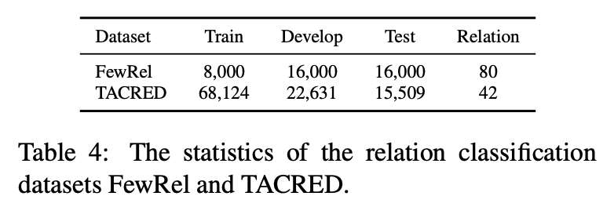
Experiments
Relation Classification

Slide 14
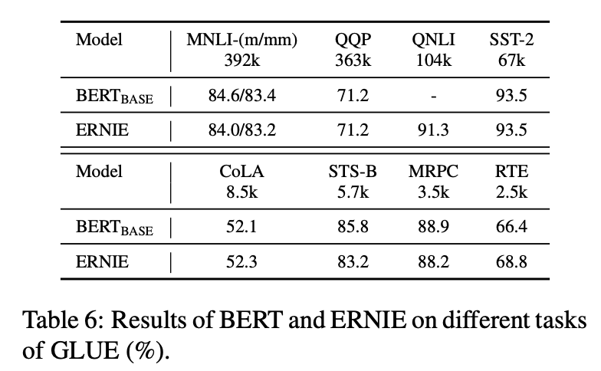
Experiments
GLUE

Slide 15
Conclusion
ERNIE can incorporate knowledge information into language representation models.
The knowledgeable aggregator and the pre-training task dEA for better fusion of heterogeneous information from both text and KGs are proposed.
Future research directions:
To inject knowledge into feature-based pre-training models such as ELMo.
To introduce diverse structured knowledge into language representation models such as ConceptNet.
To annotate more real-world corpora heuristically for building larger pre-training data.

Slide 16
Thank You

