Slide 1
The Idea of Public Key Cryptography
Cunsheng Ding
HKUST, Hong Kong

Slide 2



The Idea of Public Key Cryptography
Put (lock, locking key) in the public domain, i.e., in a post office.
Anyone who wants to send me a letter confidentially can do the following:
  Buy a strong box
  Use my lock with the locking key to lock the letter inside.
  Send me the locked box.
Locking key
Unlocking key

Slide 3
Encryption with a Public Key System
Bob
(k , k ) is the key pair
of Alice
Alice
e
d
file
encryted
file
file
m
E (m)
m
Alice’s
public
Key k
k
Alice’s
Private
Key k
e
e
d

Slide 4
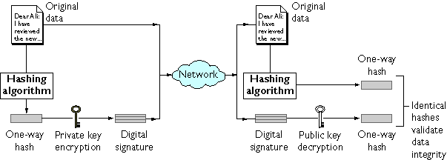
Digital Signature with a public key system
Bob
(k , k ) is Bob’s
key pair
Alice
e
d
m
m
m||D (f(m))
k
d
f
f(m)
D (f(m))
f(m)
k
d

Slide 5
Key Exchange with a Public Key System
Bob
(k , k ) is the key pair
of Alice
Alice
e
d
session
key
encryted
sess. key
session
key
k
E (k)
k
Alice’s
public
Key k
k
Alice’s
Private
Key k
e
e
d
Bob generates the session key k, sends Alice the encrypted session key.

