Slide 1
COMP 3511
Operating Systems
Lab 01

Slide 2
Outline
Welcome
UNIX basics and Vi editor
Using SSH to remote access Lab2(4214)
Compiling a C Program
Makefile
Basic C/C++ programming
(Optional) GDB – text base debugger

Slide 3
Welcome
TA Self-introduction
  Room number
  Office hour

Slide 4
UNIX basic
Basic command
  ls
    ls –a : show hidden files or directories
    ls –l : list in long listing format
    ls –al
  cd
    cd ~ / cd ; : change to home directory
  mkdir, rmdir, mv
  rm
    rm –r directory : remove the contents of directories recursively
    rm –f file : remove file without prompt
  cp: copy a file

Slide 5
UNIX basic
Practice
  Create a comp3511 directory for lab1 under home directory
  cd ~
  mkdir comp3511
  cd comp3511
  mkdir lab01
  cd lab01
  Copy a file from comp3511 directory
  wget http://course.cse.ust.hk/comp3511/lab/lab01/Makefile/numprint.c
  wget http://course.cse.ust.hk/comp3511/lab/lab01/Makefile/main.h
  wget http://course.cse.ust.hk/comp3511/lab/lab01/Makefile/main.c

Slide 6
UNIX basic
Cat
  cat “filename” : display content of a file
  cat > “filename” : create and append content to a file
  cat >> “filename” : append content at the end of a file
Practice
  cat main.c // show you the content of main.c
  cat > helloworld.txt (enter)
    type “Hello World” (Enter) (Ctrl + D)
  cat helloworld.txt

Slide 7
UNIX basic
Get help information to see how to use UNIX command
  rm --help
  cp --help | more
  cat --help
find command
  search for files in a directory hierarchy
  try “find --help | more”
  Search main.c file in your home directory
    find . -name main.c

Slide 8
UNIX basic
Useful links
  http://course.cse.ust.hk/comp3511/Reference.html
  (References)

Slide 9
Vi – Starting vi
You can use editors under X-windows like “kate”, you can also use a text base editor like “Vi”
Starting vi
  vi “filename” – Start at line 1 of file
  vi +n “filename” – start at line n of file
  vi + “filename” – start at last line of file
  vi –r “filename” – recover file after a system crash
Two modes in vi
  Insertion mode : press “i” or “I” enter this mode
  Command mode : press “Esc” enter this mode

Slide 10
Vi – saving files and leaving vi
Saving files
  :e “filename” – save current and edit other file
  :w – save current editing file
  :w “filename” – save as file
  :w! “filename” – save as existing file
Leaving vi
  :q – quit vi
  :wq – save file and quit vi
  :q! – quit vi without saving
Copy : ‘yy’
Paste: ‘p’
Cut: ‘cc’

Slide 11
Vi – commands
Moving cursor
Inserting text
Changing and replacing text
Deleting text
Markers
Search and replace
……
(Go to here)
  http://course.cse.ust.hk/comp3511/references/vi-ref.pdf

Slide 12
Vi – Practice
Practice
  Open helloworld.txt
    vi helloworld.txt (In command mode at the beginning)
    (press “i” to enter insertion mode, you can edit the file now)
    (press ‘Esc’ to enter command mode)
    (press ‘dd’ to delete current line)
    (press ‘ndd’ to delete n line below current line)
    (press ‘:wq’ in command mode to leave vi and save the file)

Slide 13
Remote access Lab2(4214)
Software
  SSH secure Shell
  http://www.ssh.com
  http://cssystem.cse.ust.hk/home.php?docbase=UGuides/RemoteAccess&req_url=UGuides/RemoteAccess/ssh.html
  Putty
  http://www.putty.nl
UNIX ssh command
  ssh –l “username” “hostname”
  eg. ssh –l lfxad csl2wk35.cse.ust.hk

Slide 14
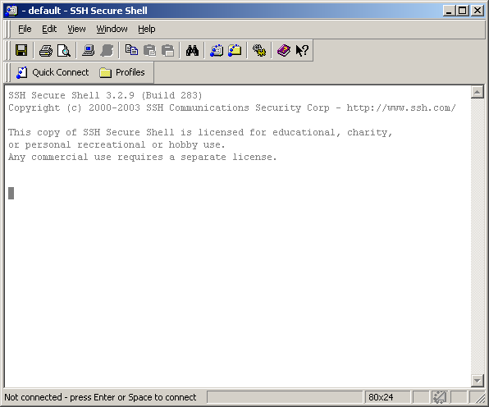
How to use SSH secure shell
After you install SSH and start it, click “Quick Connect”

Slide 15
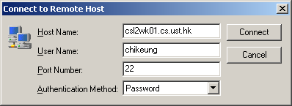
Logging Page
Host Name: csl2wkXX.cse.ust.hk
  XX can be 01 to 40
User Name: your CSD logging account
Port Number: 22 (SSH default port)
Authentication method: Password

Slide 16
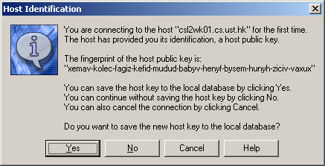
First time logging to a machine
Press “Yes” to save a host key
  If you save it in your local computer, this windows will not popup when you logging to same machine again

Slide 17

Enter your password
Enter your password and click OK

Slide 18
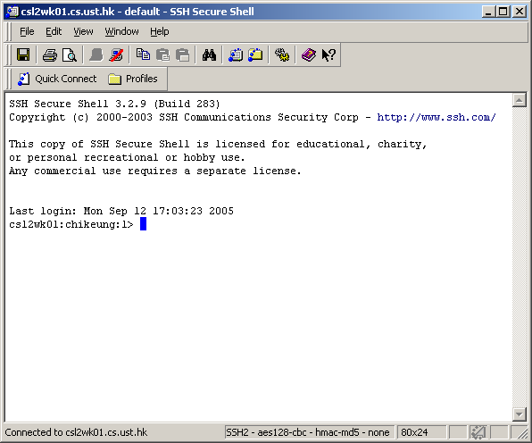
You logging to a machine!!!

Slide 19
Notes
A machine can be accessed for more than one user at the same time, use “who” command to know who is using the machine
You can click “Window -> New Terminal” to start another terminal to the same machine
SSH secure Shell is available in the CS lab 1, lab 3, lab 4 and all computer barn.

Slide 20
Compiling a C Program
GNU’s C Compiler (gcc)
  The main compiler that will be used in this course
  For compiling C++ programs, you can use g++
  Linux/UNIX does not have a pretty program like Microsoft Visual Studio for managing C programming projects
Compiling a C program
  gcc –g –m32 –ansi –Wall –c main.c –o main.o
  gcc –g –m32 –ansi –Wall –c numprint.c –o numprint.o
    -g: include symbols for gdb debugger.
    -m32: compile and link 32bit i386 binaries
    -ansi: check code against ansi C standard.
    -Wall: display all warnings.
  Use –ansi and -Wall for user programs.
  Use –Wall for kernel programs.
Linking
  gcc –g –m32 –ansi –Wall main.o numprint.o –o lab01

Slide 21
Makefile
You need to type quite a bit for compiling a simple program
For large projects
  You may have many .c and .h files
  You may use many library calls
  You need to specify them at compilation time.
  Things start to get tedious and messy
One way to manage this complexity is to use a Makefile
  Automates the compilation process
  Easy to declare all the compilation options and flags

Slide 22
Makefile
Example Makefile
SRCS = main.c numprint.c
HDRS = main.h
OBJECTS = main.o numprint.o
INCLUDE = -I/usr/local/include
LIBS = -lm
CC = gcc
CFLAGS = -g –ansi –Wall
EXEC = lab01
all: $(EXEC)
$(EXEC): $(OBJECTS)
$(CC) $(CFLAGS) $(INCLUDE) $(LIBS) $(OBJECTS) –o $(EXEC)
clean:
rm –f $(OBJECTS) $(EXEC) core *~
depend:
makedepend -- $(CFLAGS) $(INCLUDES) $(SRCS) $(HDRS) –
# DO NOT DELETE THIS LINE – make depend depends on it.

Slide 23
Makefile
The first few lines are fairly straightforward
  SRCS, HDRS, and OBJECTS specify the source, header, and object files
  INCLUDE, the directory for include files
  LIBS, the library to be linked into the compilation
  CC, the type of C compiler
  CFLAGS, the compilation flags
  EXEC, the name of the executable image.
The line containing all specifies the final compilation targets
  in this case, the content of EXEC, or $(EXEC).
The creation of $(EXEC) depends on the $(OBJECTS), or object files.
To create $(EXEC), the compiler needs to link the objects by running the $(CC) command.
All the .c files are automatically converted to .o files without the need of specifications.
Note that you need to tab the indentation of the $(CC) command. Makefile won’t work if you use the space bar to create the indentation.
Lines start with # denote comments. Let’s ignore the remaining lines for now. With this Makefile in your current project directory, all you need to type to compile your project is gmake.

Slide 24
Makefile
Prepare a Makefile
  wget http://course.cse.ust.hk/comp3511/lab/lab01/Makefile/Makefile
  wget http://course.cse.ust.hk/comp3511/lab/lab01/Makefile/numprint.c
  wget http://course.cse.ust.hk/comp3511/lab/lab01/Makefile/main.h
  wget http://course.cse.ust.hk/comp3511/lab/lab01/Makefile/main.c
  cat Makefile
Run the Makefile
  gmake
More about Makefile
  http://www.gnu.org/software/make/manual/html_node/index.html

Slide 25
Basic C/C++ programming
Please read a C tutorial on our course web
  http://course.cs.ust.hk/comp3511/lab/lab01/Cbasics/c_tutorial.pdf
And write a “HelloWorld” C program
Understand command line arguments in C/C++ program
  http://course.cs.ust.hk/comp3511/lab/lab01/Cbasics/command-line_color.pdf
And run ./lab01 –h –n 5

Slide 26
Basic C/C++ programming
Read and understand the source code that we just compiled
  main.h, main.c, numprint.c
  Run ./lab01 –h –n 5
A quick introduction to C++
  http://course.cs.ust.hk/comp3511/lab/lab01/Cbasics/c++.pdf
Useful Links
  http://course.cse.ust.hk/comp3511/Reference.html
  (References)

Slide 27
(Optional) Debugging
Printf/Printk
  Simple programs can often be debugged efficiently with well placed print statements.
    See the example programs to see how we use print statements to verify the arguments supplied
  Kernel programming requires the use of printk for debugging.
gdb
  The GNU debugger. An interactive debugger.
  Useful for debugging complex logic.
gdb name_of_executable
  Starts GNU debugger (gdb) and loads the executable file into memory.

Slide 28
(Optional) GDB debugger
Basic command is introduced here:
  http://course.cs.ust.hk/comp3511/Others/GDB.htm
  http://www.dirac.org/linux/gdb/

Slide 29
(Optional) GDB Practice
  Compilation
    wget http://course.cse.ust.hk/comp3511/lab/lab01/Makefile/gdb.c
    gcc -g -o gdb_demo gdb.c
    gdb gdb_demo
  View the code
    list (view 10 lines of code)
    list (view next 10 lines of code)
    list - (view previous 10 lines of code)
    list 3,8 (view line 3 to line 8)
  Run it
    run 1 2 (run the program with arguments)

Slide 30
(Optional) GDB Practice
  Insert / delete breakpoint
    break 7 (inset a break point in line 7)
    info breakpoint (view break point information)
    delete 1 / clear 1 (delete break point # 1)
  Enable / disable breakpoint
    break 7
    break 16
    run
    disable 3 (disable break point # 3)
    run (can you see the different?)
    info breakpoint
    enable 3 (enable break point #3)

Slide 31
(Optional) GDB Practice
  Print out the value of a variable
    disable 3
    run (program will stop at line 7)
    print i (print out the current value of i)
    next (go to next line, it is line 6)
    step (go to next line, it is line 7)
      Note: different between next and step
    print i (i become 1)
    continue (go to next break point, it is line 7 again)
  Quit GDB
    quit

