Slide 1
COMP 3511
Operating Systems
Lab #4

Slide 2
Interprocess Communication - IPC
Processes within a system may be independent or cooperating
Cooperating process can affect or be affected by other processes, including sharing data
Reasons for cooperating processes:
  Information sharing
  Computation speedup
  Modularity
  Convenience
Cooperating processes need interprocess communication (IPC)
Two models of IPC
  Shared memory
  Message passing

Slide 3
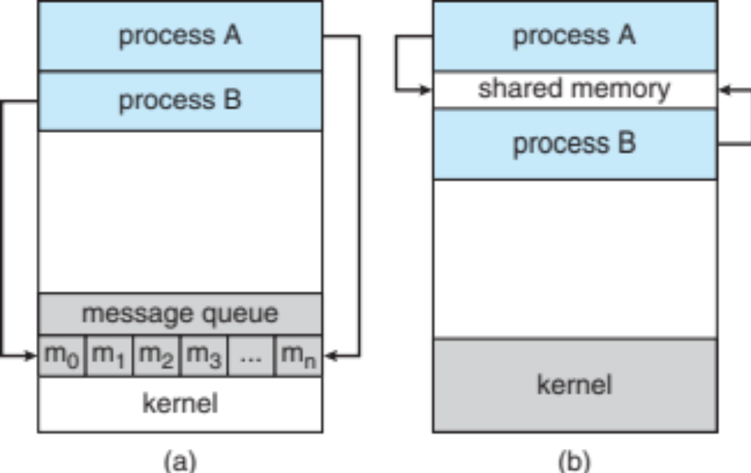
Communications Models

Slide 4
Cooperating Processes
Independent process cannot affect or be affected by the execution of another process
Cooperating process can affect or be affected by the execution of another process
Advantages of process cooperation
  Information sharing
  Computation speed-up
  Modularity
  Convenience

Slide 5
Producer-Consumer Problem
Paradigm for cooperating processes, producer process produces information that is consumed by a consumer process
  unbounded-buffer places no practical limit on the size of the buffer
  bounded-buffer assumes that there is a fixed buffer size

Slide 6
Bounded-Buffer – Shared-Memory Solution
Shared data
      #define BUFFER_SIZE 10
      typedef struct {
      . . .
      } item;
      item buffer[BUFFER_SIZE];
      int in = 0;
      int out = 0;
Solution is correct, but can only use BUFFER_SIZE-1 elements

Slide 7
Bounded-Buffer – Producer
item next produced;
while (true) {
/* produce an item in next produced */
while (((in + 1) % BUFFER SIZE) == out)
; /* do nothing */
buffer[in] = next produced;
in = (in + 1) % BUFFER SIZE;
}

Slide 8
Bounded Buffer – Consumer
item next consumed;
while (true) {
while (in == out)
; /* do nothing */
next consumed = buffer[out];
out = (out + 1) % BUFFER SIZE;
/* consume the item in next consumed */
}

Slide 9
Sockets
A socket is defined as an endpoint for communication
Concatenation of IP address and port – a number included at start of message packet to differentiate network services on a host
The socket 161.25.19.8:1625 refers to port 1625 on host 161.25.19.8
Communication consists between a pair of sockets
All ports below 1024 are well known, used for standard services
Special IP address 127.0.0.1 (loopback) to refer to system on which process is running

Slide 10

Socket Communication

Slide 11

Sockets in Java
Three types of sockets
  Connection-oriented (TCP)
  Connectionless (UDP)
  MulticastSocket class–
  data can be sent to multiple
  recipients
Consider this “Date” server:

Slide 12
Remote Procedure Calls
Remote procedure call (RPC) abstracts procedure calls between processes on networked systems
  Again uses ports for service differentiation
Stubs – client-side proxy for the actual procedure on the server
The client-side stub locates the server and marshalls the parameters
The server-side stub receives this message, unpacks the marshalled parameters, and performs the procedure on the server
On Windows, stub code compile from specification written in Microsoft Interface Definition Language (MIDL)
Data representation handled via External Data Representation (XDL) format to account for different architectures
  Big-endian and little-endian
Remote communication has more failure scenarios than local
  Messages can be delivered exactly once rather than at most once
OS typically provides a rendezvous (or matchmaker) service to connect client and server

Slide 13

Execution of RPC

Slide 14
Thread Libraries
Thread library provides programmer with API for creating and managing threads
Two primary ways of implementing
  Library entirely in user space
  Kernel-level library supported by the OS

Slide 15
Pthreads
May be provided either as user-level or kernel-level
A POSIX standard (IEEE 1003.1c) API for thread creation and synchronization
Specification, not implementation
API specifies behavior of the thread library, implementation is up to development of the library
Common in UNIX operating systems (Solaris, Linux, Mac OS X)

Slide 16

Pthreads Example

Slide 17
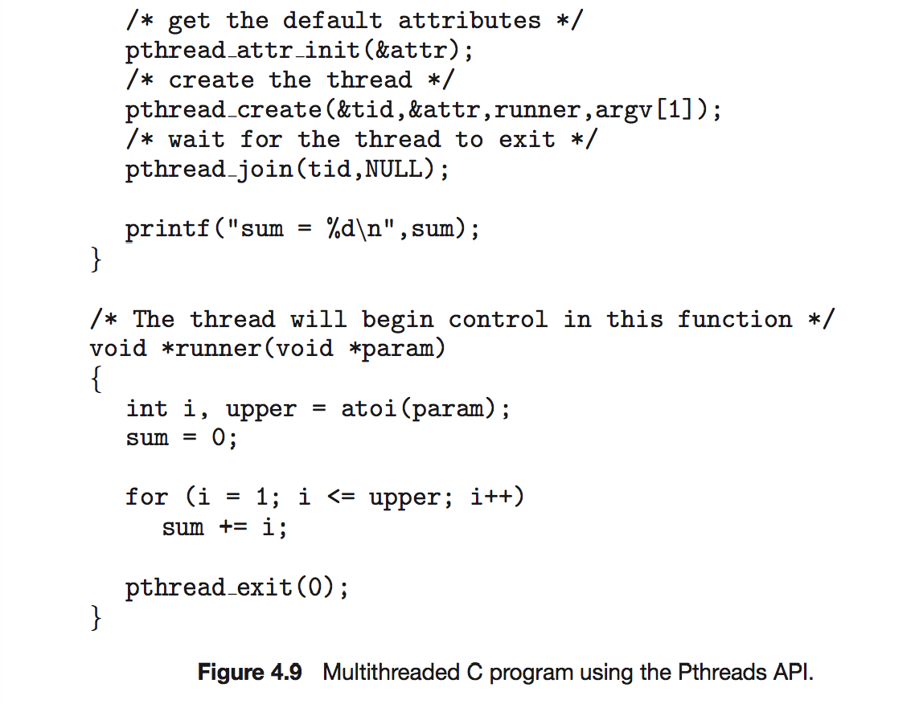
Pthreads Example (Cont.)

Slide 18
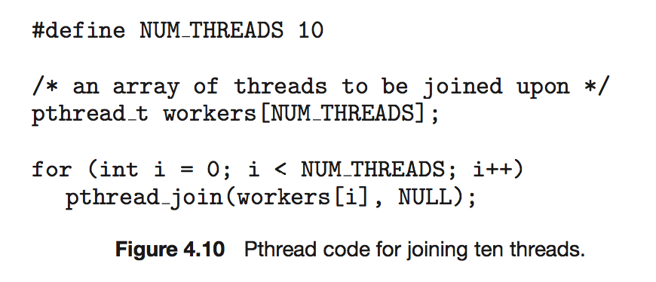
Pthreads Code for Joining 10 Threads

Slide 19
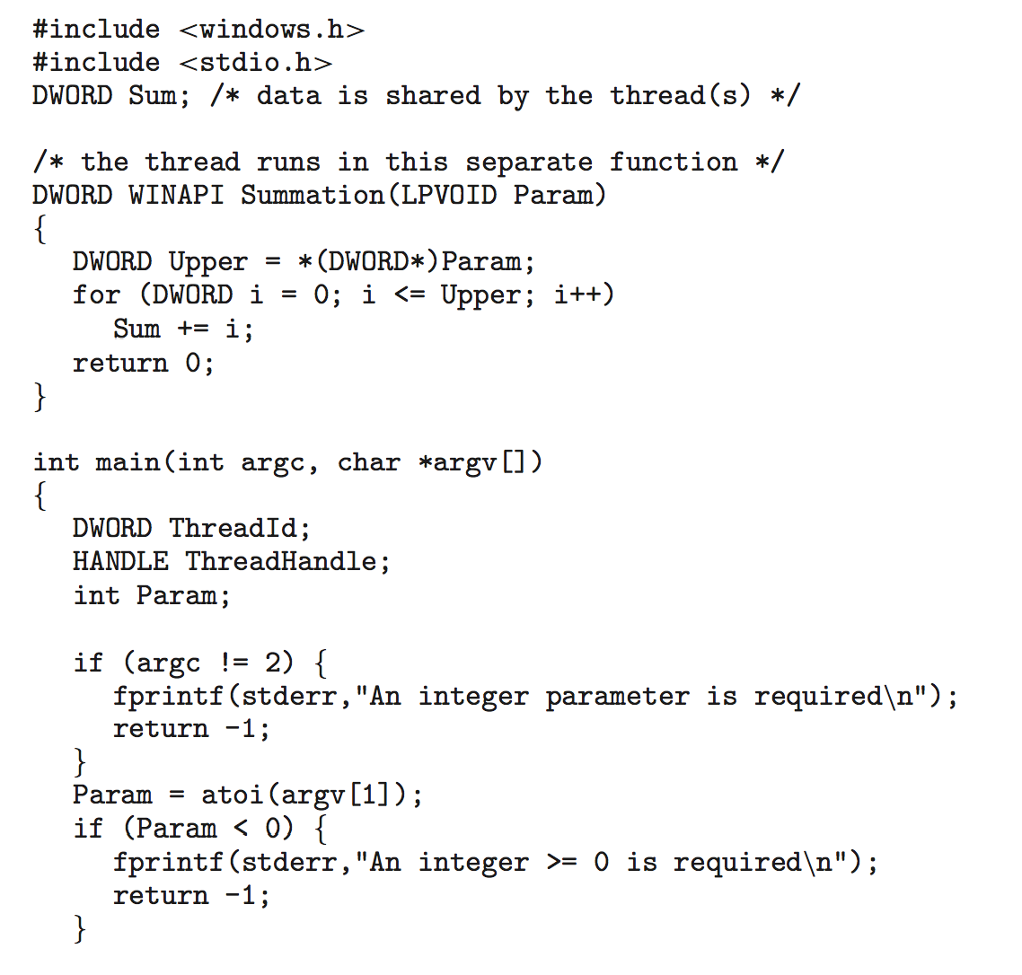
Win32 API Multithreaded C Program

Slide 20
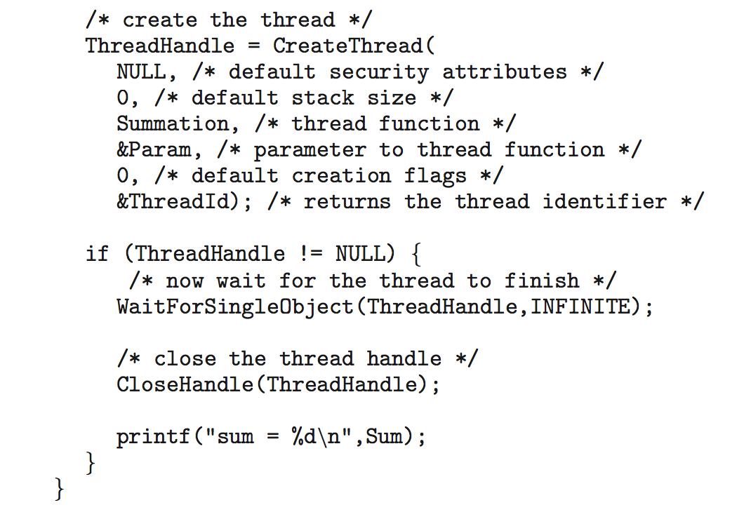
Win32 API Multithreaded C Program (Cont.)

Slide 21

Scheduler Activations
Both M:M and Two-level models require communication to maintain the appropriate number of kernel threads allocated to the application
Typically use an intermediate data structure
between user and kernel threads –
lightweight process (LWP)
  Appears to be a virtual processor on
  which process can schedule user thread
  to run
  Each LWP attached to kernel thread
  How many LWPs to create?
Scheduler activations provide upcalls - a communication mechanism from the kernel to the upcall handler in the thread library
This communication allows an application to maintain the correct number kernel threads

Slide 22
Operating System Examples
Linux scheduling
Windows scheduling
Solaris scheduling

Slide 23
Linux Scheduling Through Version 2.5
Prior to kernel version 2.5, ran variation of standard UNIX scheduling algorithm
Version 2.5 moved to constant order O(1) scheduling time
  Preemptive, priority based
  Two priority ranges: time-sharing and real-time
  Real-time range from 0 to 99 and nice value from 100 to 140
  Map into global priority with numerically lower values indicating higher priority
  Higher priority gets larger q
  Task run-able as long as time left in time slice (active)
  If no time left (expired), not run-able until all other tasks use their slices
  All run-able tasks tracked in per-CPU runqueue data structure
    Two priority arrays (active, expired)
    Tasks indexed by priority
    When no more active, arrays are exchanged
  Worked well, but poor response times for interactive processes

Slide 24
Linux Scheduling in Version 2.6.23 +
Completely Fair Scheduler (CFS)
Scheduling classes
  Each has specific priority
  Scheduler picks highest priority task in highest scheduling class
  Rather than quantum based on fixed time allotments, based on proportion of CPU time
  2 scheduling classes included, others can be added
    default
    real-time
Quantum calculated based on nice value from -20 to +19
  Lower value is higher priority
  Calculates target latency – interval of time during which task should run at least once
  Target latency can increase if say number of active tasks increases
CFS scheduler maintains per task virtual run time in variable vruntime
  Associated with decay factor based on priority of task – lower priority is higher decay rate
  Normal default priority yields virtual run time = actual run time
To decide next task to run, scheduler picks task with lowest virtual run time

Slide 25

CFS Performance

Slide 26

Linux Scheduling (Cont.)
Real-time scheduling according to POSIX.1b
  Real-time tasks have static priorities
Real-time plus normal map into global priority scheme
Nice value of -20 maps to global priority 100
Nice value of +19 maps to priority 139

Slide 27
Windows Scheduling
Windows uses priority-based preemptive scheduling
Highest-priority thread runs next
Dispatcher is scheduler
Thread runs until (1) blocks, (2) uses time slice, (3) preempted by higher-priority thread
Real-time threads can preempt non-real-time
32-level priority scheme
Variable class is 1-15, real-time class is 16-31
Priority 0 is memory-management thread
Queue for each priority
If no run-able thread, runs idle thread

Slide 28
Windows Priority Classes
Win32 API identifies several priority classes to which a process can belong
  REALTIME_PRIORITY_CLASS, HIGH_PRIORITY_CLASS, ABOVE_NORMAL_PRIORITY_CLASS,NORMAL_PRIORITY_CLASS, BELOW_NORMAL_PRIORITY_CLASS, IDLE_PRIORITY_CLASS
  All are variable except REALTIME
A thread within a given priority class has a relative priority
  TIME_CRITICAL, HIGHEST, ABOVE_NORMAL, NORMAL, BELOW_NORMAL, LOWEST, IDLE
Priority class and relative priority combine to give numeric priority
Base priority is NORMAL within the class
If quantum expires, priority lowered, but never below base
If wait occurs, priority boosted depending on what was waited for
Foreground window given 3x priority boost
Windows 7 added user-mode scheduling (UMS)
  Applications create and manage threads independent of kernel
  For large number of threads, much more efficient
  UMS schedulers come from programming language libraries like C++ Concurrent Runtime (ConcRT) framework

Slide 29
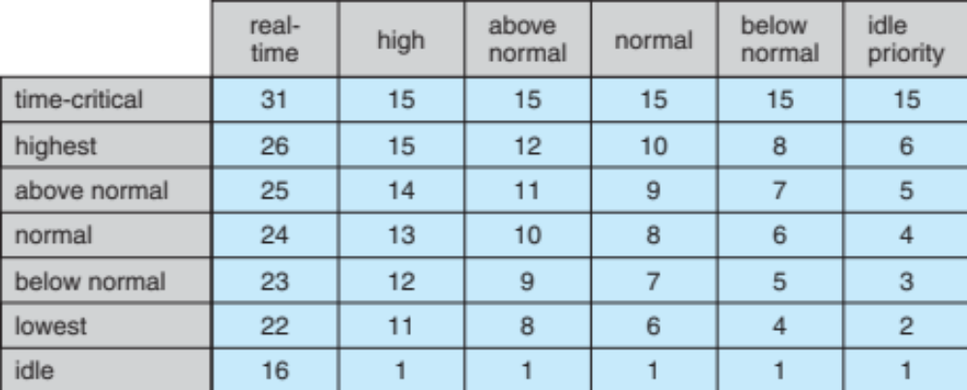
Windows Priorities

Slide 30
Solaris
Priority-based scheduling
Six classes available
  Time sharing (default) (TS)
  Interactive (IA)
  Real time (RT)
  System (SYS)
  Fair Share (FSS)
  Fixed priority (FP)
Given thread can be in one class at a time
Each class has its own scheduling algorithm
Time sharing is multi-level feedback queue
  Loadable table configurable by sysadmin

Slide 31
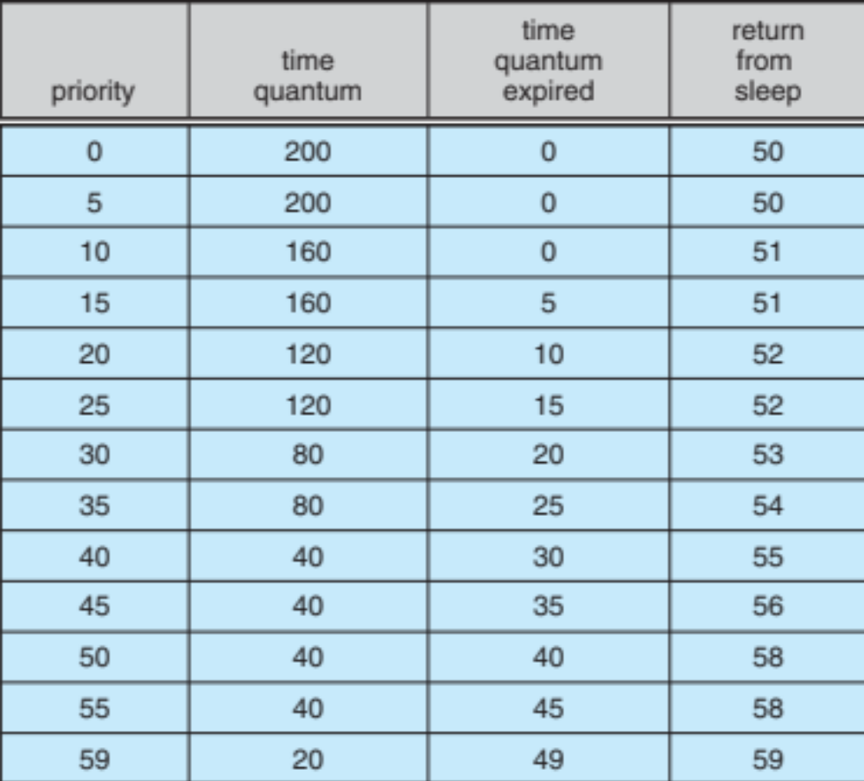
Solaris Dispatch Table

Slide 32
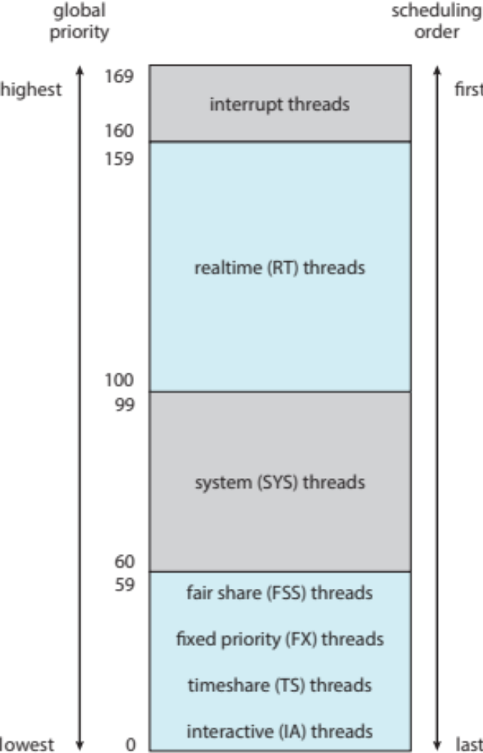
Solaris Scheduling

Slide 33
Solaris Scheduling (Cont.)
Scheduler converts class-specific priorities into a per-thread global priority
  Thread with highest priority runs next
  Runs until (1) blocks, (2) uses time slice, (3) preempted by higher-priority thread
  Multiple threads at same priority selected via RR

Slide 34
CPU Scheduler & Dispatcher
Selects from among the processes in memory that are ready to execute, and allocates the CPU to one of them
CPU scheduling decisions may take place when a process
  Switches from running to waiting state
  Switches from running to ready state
  Switches from waiting to ready
  Terminates
Dispatcher module gives control of the CPU to the process selected by the CPU scheduler; this involves
  switching context
  switching to user mode
  jumping to the proper location in the user program to restart that program

Slide 35
Scheduling Criteria
To Maximize:
  CPU utilization – keep the CPU as busy as possible
  Throughput – # of processes that complete their execution per time unit
To Minimize:
  Turnaround time – amount of time to execute a particular process
  Waiting time – amount of time a process has been waiting in the ready queue
  Response time – amount of time it takes from when a request was submitted until the first response is produced, not output (for time-sharing environment)

Slide 36
First-Come, First-Served (FCFS) Scheduling
First-Come-First-Serve (FCFS)
Pro: easy to implement
Con: potentially bad for short jobs
Process Burst Time
P₁ 24
P₂ 3
P₃ 3
Average waiting time:
(0 + 24 + 27)/3 = 17
Average Turnaround time:
(24+27+30)/3 = 27
P₁
P₂
P₃
0
24
27
30
Average waiting time:
(6 + 0 + 3)/3 = 3
Average Turnaround time:
(30+3+6)/3 = 13
If arrive in the order P₂ , P₃ , P₁
P₂
P₃
P₁
0
3
6
30

Slide 37

Shortest-Job-First (SJF) Scheduling
Associate with each process the length of its next CPU burst. Use these lengths to schedule the process with the shortest time
Two schemes:
  Non-preemptive – once CPU given to the process it cannot be preempted until completes its current CPU burst
  Preemptive – if a new process arrives with CPU burst length less than remaining time of current executing process, preempt. This scheme is know as the Shortest-Remaining-Time-First (SRTF)
Long
Short
SJF is optimal
gives minimum average waiting time for a given set of processes
Short
Long

Slide 38
Non-preemptive SJF: Example
Process | Burst Time | Arrival Time
P1 | 6 | 0
P2 | 8 | 0
P3 | 7 | 0
P4 | 3 | 0
P4 (3)
P1 (6)
P3 (7)
P2 (8)
0
3
9
16
24
P4 waiting time: 0
P1 waiting time: 3
P3 waiting time: 9
P2 waiting time: 16
The average waiting time
(0+3+9+16)/4 = 7

Slide 39
Comparing to FCFS
Process | Burst Time | Arrival Time
P1 | 6 | 0
P2 | 8 | 0
P3 | 7 | 0
P4 | 3 | 0
P1 (6)
P2 (8)
P3 (7)
P4 (3)
0
6
14
21
24
Assume execution order is P1, P2, P3, P4
P1 waiting time: 0
P2 waiting time: 6
P3 waiting time: 14
P4 waiting time: 21
The average waiting time
(0+6+14+21)/4 = 10.25 > 7

Slide 40
Preemptive SJF: Example
Process | Burst Time | Arrival Time
P1 | 7 | 0
P2 | 4 | 2
P3 | 1 | 4
P4 | 4 | 5
P1
P2
P3
P2
P4
P1
0
2
4
5
7
11
16
P1 gets preempted at time 2
The average waiting time
(9 + 1 + 0 +2)/4 = 3
P2 gets preempted at time 4

Slide 41
Priority Scheduling
A priority number (integer) is associated with each process
The CPU is allocated to the process with the highest priority (smallest integer ≡ highest priority)
  Preemptive
  Nonpreemptive
SJF is a priority scheduling where priority is the predicted next CPU burst time
Problem ≡ Starvation – low priority processes may never execute
Solution ≡ Aging – as time progresses increase the priority of the process

Slide 42
Round Robin (RR) Scheduling
Each process gets a small unit of CPU time (time quantum), usually 10-100 milliseconds. After quantum expires, the process is preempted (OS timer interrupt) and added to the end of the ready queue.
n processes in the ready queue and the time quantum is q
  Each process gets 1/n of the CPU time
  In chunks of at most q time units at once.
  No process waits more than (n-1)q time units
Performance
  q large ⇒ FIFO
  q small ⇒ Interleaved
  q must be large with respect to context switch, otherwise overhead is too high

Slide 43
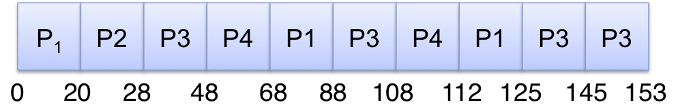
Example of RR in Notes
Example: Process Burst Time
P1 53
P2 8
P3 68
P4 24
The Gantt chart is:
Waiting time for P1=(68-20)+(112-88)=72 P2=(20-0)=20
P3=(28-0)+(88-48)+(125-108)=85
P4=(48-0)+(108-68)=88
Average waiting time = (72+20+85+88)/4=66¼
Average completion time = (125+28+153+112)/4 = 104½
turnaround time = completion time-arrival time

Slide 44
Consider Different Arrival Time
Example: Process Burst Time Arrival Time
P1 53 28
P2 8 16
P3 68 0
P4 24 10
The Gantt chart is:
Waiting time for P1=(68-28)+(112-88)+(140-132)=72 P2=(40-16)=24
P3=(48-20)+(92-68)+(132-112)=72
P4=(20-10)+(88-40)=58
Average waiting time = (72+24+72+58)/4=56½
Average completion time = (153+48+140+92)/4 = 108¼
p3
p4
p2
p3
p1
p4
p3
p1
p3
p1
0
20
40
48
68
88
92
112
132
140
153

Slide 45

Turnaround Time Varies With The
Time Quantum
Turnaround time
(waiting time + burst)
the total amount of time
to execute a particular
process

Slide 46
Turnaround Time Varies With The Time Quantum: Example
P1: 6; P2: 3
P3: 1; P4: 7
p1
p2
p3
p4
p1
p2
p4
p1
p2
p4
p1
p4
p1
p4
p1
p4
p4
0
3
6
9
12
15
17
Q=1
Avg Turnaround Time = (15+9+3+17)/4 = 11
p1
p1
p2
p2
p3
p4
p4
p1
p1
p2
p4
p4
p1
p1
p4
p4
p4
Q=2
Avg Turnaround Time = (14+10+5+17)/4 = 11.5
p1
p1
p1
p2
p2
p2
p3
p4
p4
p4
p1
p1
p1
p4
p4
p4
p4
Q=3
Avg Turnaround Time = (13+6+7+17)/4 = 10.75

Slide 47
P1: 6; P2: 3
P3: 1; P4: 7
Q=4
Avg Turnaround Time = (14+7+8+17)/4 = 11.5
p1
p1
p1
p1
p2
p2
p2
p3
p4
p4
p4
p4
p1
p1
p4
p4
p4
0
3
6
9
12
15
17
Q=5
Avg Turnaround Time = (15+8+9+17)/4 = 12.25
p1
p1
p1
p1
p1
p2
p2
p2
p3
p4
p4
p4
p4
p4
p1
p4
p4
Q=6
Avg Turnaround Time = (6+9+10+17)/4 = 10.5
p1
p1
p1
p1
p1
p1
p2
p2
p2
p3
p4
p4
p4
p4
p4
p4
p4
Q=7
Avg Turnaround Time = (6+9+10+17)/4 = 10.5
p1
p1
p1
p1
p1
p1
p2
p2
p2
p3
p4
p4
p4
p4
p4
p4
p4

