Slide 1
COMP2611: Computer Organization
Introduction to Logisim
(Combinational Logic)
COMP2611 Spring 2015

Slide 2
Overview
You will learn the following in this lab:
  basic Logisim operations,
  building a simple circuit using Logisim,
  storing a built-circuit as a library and loading it for future uses.
Logisim

Slide 3
Introduction to Logisim 1
If you have not downloaded Logisim to your computer, please do so now. The details are in the last week’s notes.
If you have downloaded Logisim, locate the Logisim file and Start the Logisim program.
Logisim

Slide 4
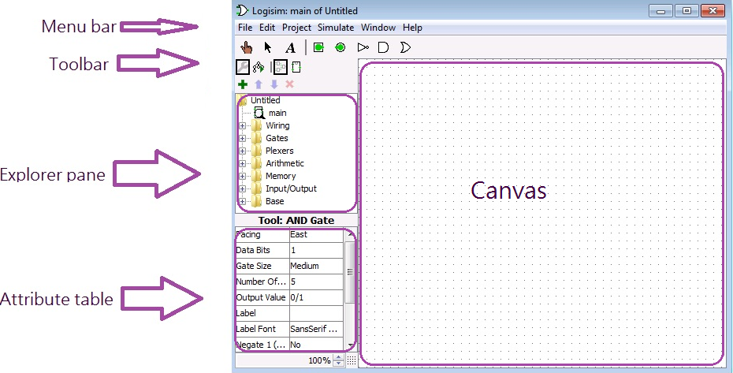
Introduction to Logisim 2
The different components of the Logisim interface are shown below:
The Menu bar is for accessing the different Logisim functions.
The Toolbar shows icons of some of the more frequently used tools/modules.
The Explorer pane is for maneuvering and accessing the available Logic components/circuits.
The Attribute table shows the properties of a selected component
The Canvas is the workspace for designing circuits.
Logisim

Slide 5
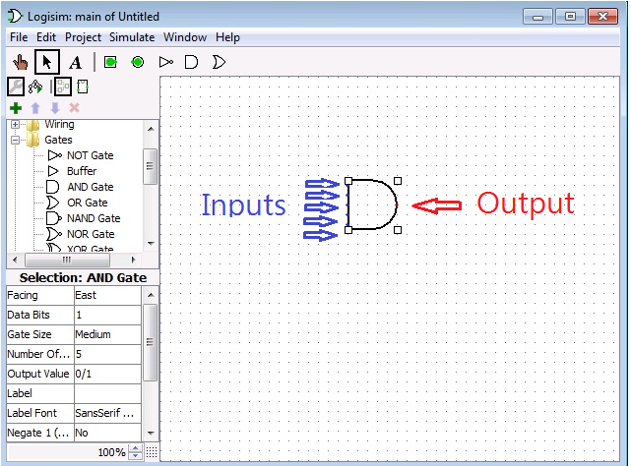
Testing simple logic component in Logisim 1
Let’s test an simple logic component - the AND gate on Logisim.
To incorporate an AND gate to the Logisim canvas, select “AND gate” from the “Gates” folder in the “Explorer pane”, then move the mouse cursor to the canvas, click the left mouse button to fix the position of the gate.
Note the five small blue dots and the single red dot. These are the spots where input or output wires can be attached.
Logisim

Slide 6
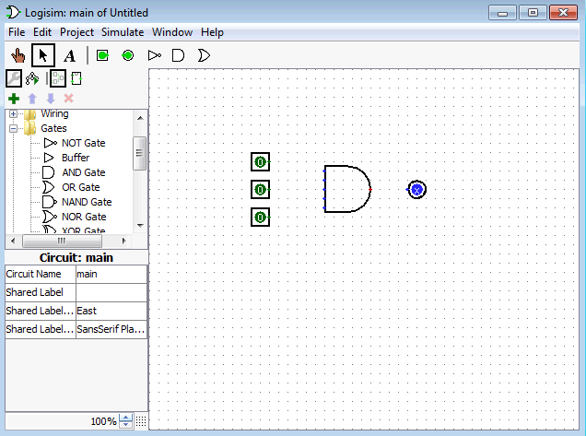
Testing simple logic component in Logisim 2
Add three inputs and one output to the AND gate (assume this AND gate accepts three inputs).
The inputs are added by selecting the input pin (solid circle in a square) from the toolbar, and then dragging it to the canvas
The output is added in a similar manner, except that you have to select the output pin (solid circle in a circle) from the toolbar.
If you want to move any component on the canvas to another location, click the arrow icon on the toolbar, select the component you want to move, and then move it.
Logisim

Slide 7
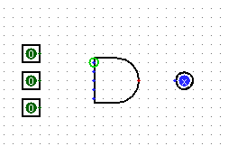
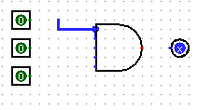
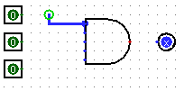
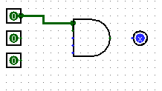
Testing simple logic component in Logisim 3
Now we have added the input and output pins, but we have not yet connected them to the AND gate.
To connect the inputs to the AND gate, first click the arrow icon on the toolbar and then point the mouse cursor to the possible input spots of the gate, a small green circle will appear:
Now click the left mouse button continuously and you will be able to draw a wire from the input spot.
Whenever necessary, you can draw the wire for multiple times as shown below:
Logisim

Slide 8
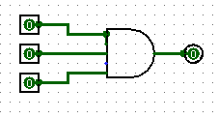

Testing simple logic component in Logisim 4
Connect the remaining wires as follows:
Note once you have completely connected the input/output wires, the output changes from the blue “x” to “0”. This indicate the AND gate has already computed a zero for the zero inputs.
To change the input values, select the poke tool from the toolbar (make sure “simulation enabled” is ticked under the “simulate” option of the menu bar)
Move the cursor to the input pin and change it by clicking the left mouse button at the pin.
Logisim

Slide 9
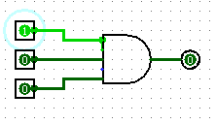
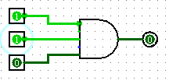
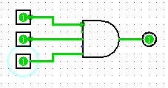
Testing simple logic component in Logisim 5
After poking the first input, it changes from “0” to “1”, the output from the AND gate is now “0”.
The second input also changes from “0” to “1” after being poked, the output is from the AND gate is still “0”, which is to be expected.
Now the third input has been changed to “1” and note that the output becomes “1”.
Logisim

Slide 10
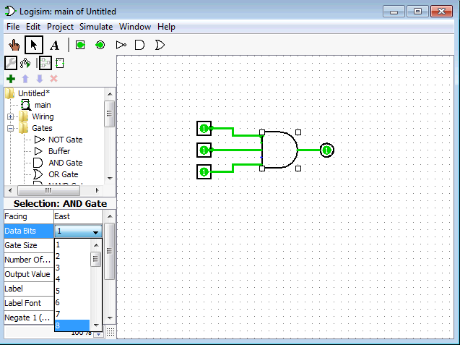
Testing simple logic component in Logisim 6
Each input pin of the previous AND gate is 1-bit wide. To modify the width of the data, one can use the attribute table.
To increase the data width of the AND gate, first point the cursor to the gate in the canvas to select the gate.
Then find the item “Data Bits” in the attribute table, and adjust it as wishes.
Logisim

Slide 11
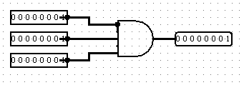
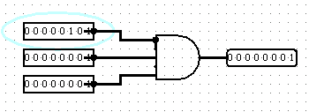
Testing simple logic component in Logisim 7
Continue to adjust the data widths for the remaining components (input/output), until all the wires are in black and none of the wires is orange in color.
You don’t have to adjust the data widths for the wires as they will adjust automatically to match the components.
Now the three 8-bit inputs are 0000 0001 and the output is 0000 0001, a bitwise AND operation has been performed on the three inputs.
You can change the value of the individual bits by poking them just like before:
Logisim

Slide 12
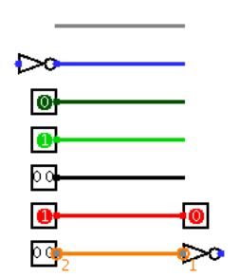
A summary on the Logisim wire colors
Color | Meaning
Gray | The wire’s bit width is unknown
Blue | The wire is one-bit in width, but the value it carries is not known
Dark green | The wire is carrying a one-bit 0
Light green | The wire is carrying a one-bit 1
Black | The wire is carrying a multi-bit value. Some or all of the bits may not be specified
Red | The wire is carrying an error value
Orange | The components attached to the wire do not agree in bit width
Logisim

Slide 13
Questions?
At this point can you
  drag logic components onto the canvas of Logisim?
  identify the input/output spot of a component once it is on the canvas?
  draw input/output wires to/from the component and connect them correctly?
  poke to change the input values?
  specify data widths of the components?
If there is any question, it is good to be sorted out at this point, before we go on to discuss more complicated operations in Logisim.
Logisim

Slide 14
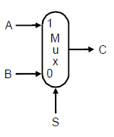
Testing a simple circuit on Logisim 1
Now you already know the basics of Logisim, so we can build a circuit using it.
We are going to build a 1-bit (2-input) multiplexer on Logisim.
The following is the figure of a 1-bit (2-input) multiplexer, A and B are two inputs, S is the control input that selects data either from A or B to be forwarded to the output C.
The Boolean expression for C in terms of A, B and S is:
C=A·S + B·(~S), where ~S is the negation of S
Logisim

Slide 15
Testing a simple circuit on Logisim 2
Basically the idea is to make zero the values of B and let the values of A get through, when S=1. When S=0, we need to somehow let the values of B get through and make zero the values of A.
The Boolean expression tells us how we can do that.
We just need to perform an AND operation between A and S, then when S=1, the result of the AND operation will be A, if S=0, the result of the AND operation will be 0.
We also make the same operation between B and (~S), if S=0, the result of the AND operation will be B, and if S=1 the result will be 0.
We OR the result of A·S and B·(~S ), and we have a multiplexer that selects according to the value of S.
Logisim

Slide 16



Testing a simple circuit on Logisim 3
To build such a multiplexer, first we need to draw an OR gate in Logisim, and connect it with an output
Then we need to build the part that does A·S, we need to give the names A, B, S for the inputs/control, to do that just click on the “text tool” in the toolbar, and then click the component to enter the desired name.
Logisim

Slide 17
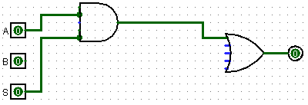
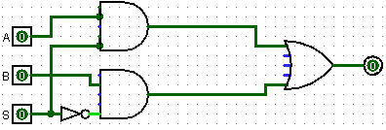
Testing a simple circuit on Logisim 4
Now connect A and S to an AND gate, and connect the output of the AND gate to the OR gate.
Do the same thing for B and (~S) with the help of a NOT gate, we have the completed multiplexer.
Logisim

Slide 18
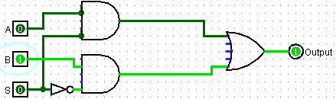
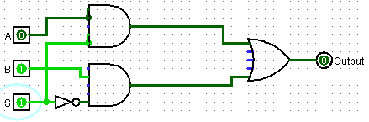
Testing a simple circuit on Logisim 5
Let’s poke the circuit to see if it works as expected. When S=0, the value of B is forwarded to the output.
When S=1, the value of A is forwarded to the output.
Logisim

Slide 19
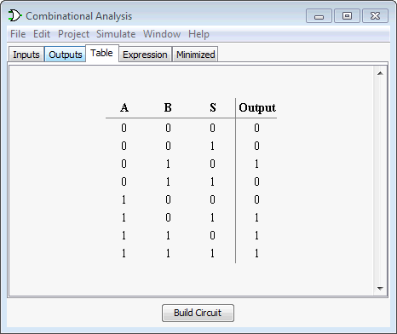
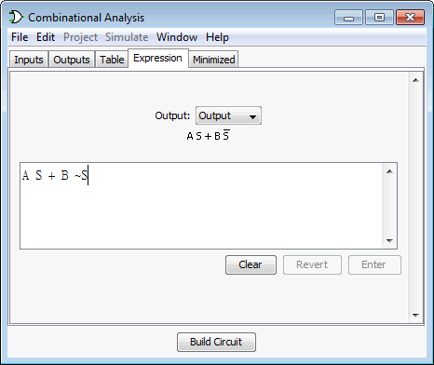
Testing a simple circuit on Logisim 6
By clicking “Project”, “Analyze circuit”, “Table”, we can see the input/output relationship. And if you click “Expression” instead of “Table”, you will see the corresponding Boolean expression of the circuit.
Logisim

Slide 20
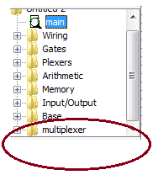
Storing a circuit for future uses 1
From time to time, you may want to store your work for future use. To do that, save your work as a .circ file under Logisim (i.e. multiplexer.circ).
To load the work for use, click “Project”, “Load Library”, “Logisim Library” and choose the .circ file you saved.
The circuit will appear in the explorer pane. One just need to click the folder to access the real circuit.
Logisim

Slide 21
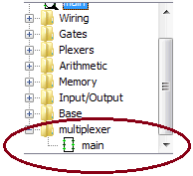

Storing a circuit for future uses 2
To use the circuit, just drag the circuit from the explorer pane to canvas.
The circuit will be characterized by the inputs and the output only (i.e. like a black-box). You can use it to build more complicated circuits.
Logisim

Slide 22
Take home exercises
By referring to the previous slides (i.e. slides 15-21), build a 2-bit (4-input) multiplexor with Logisim.
By referring to the lecture notes (comp2611_logic_design_2014-part1.pdf, slide 15), build a 4-output decoder with Logisim.
Logisim

Slide 23
Conclusion
Today we have learnt:
  basic Logisim operations,
  building a simple circuit with Logisim,
  storing a built-circuit as a library and loading it for future uses.
Logisim

