Slide 1
COMP2611: Computer Organization
MIPS programming
COMP2611 Spring 2015

Slide 2
Overview
You will learn the following in this lab:
  MIPS programming by practicing it in Mars.
MIPS programming

Slide 3
The number guessing game
  Complete the program code of guessingGame.s by following the comments on the code.
    The program picks a lucky number randomly from the interval 1 to 100. It then prompts the user to guess the number by telling him/her this interval as a hint.
    If the input guess is correct, the program tells the user and then terminates.
    Otherwise, the user’s guess will be used to update (shorten) the interval as the hint for the user's next guess (until a guess is correct).
    The number of guesses the user has made so far should also be displayed (until a correct guess is made).
    The program code for updating the number interval as the hint has already been completed. You just need to complete the other syscall-related codes (as suggested by the code comments), e.g., I/O syscalls.
MIPS programming

Slide 4
The number guessing game
  Follow the comments on the code to complete the program. The program tasks to be completed are also highlighted in yellow in the flow chart on the next page.
MIPS programming

Slide 5
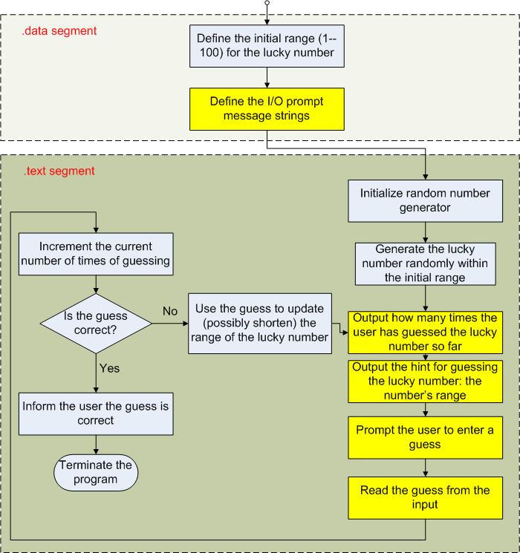
Program flow
MIPS programming

Slide 6
Conclusion
You have learnt:
  MIPS programming for the number guessing game in MARS.
MIPS programming

