Slide 1
Sequential logic and Data representation
COMP2611: Computer Organization

Slide 2
Overview
You will learn the following in this tutorial:
  clock, simple memory elements (SR latch, D latch, D flip flop) and register file,
  data representations (IEEE 754 single/double precision floating point numbers, ASCII encoding).
Sequential logic , data representation

Slide 3
Sequential logic and data representation
Sequential logic
- clock
- Memory elements: SR latch, D latch, D flip flop, register file
Data representation
- base conversions, two’s complement
- IEEE 754 floating point format,
- ASCII representation of characters
Exercises
Sequential logic , data representation

Slide 4
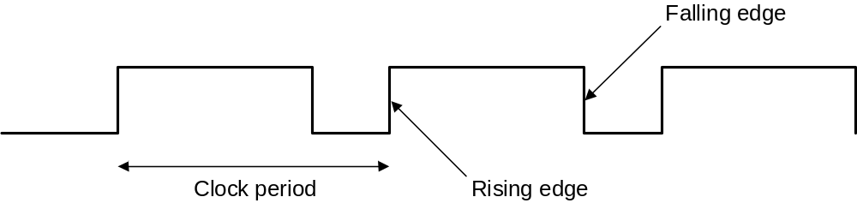
Clock
A clock acts as a global signal that gives all the components in the system an indication of time.
Clock is used in sequential logic to decide and co-ordinate state updates.
Just to remind you, a clock signal has three important key words that you need to know:
Sequential logic , data representation

Slide 5
Sequential logic and data representation
Sequential logic
- clock
- Memory elements: S-R latch, D latch, D flip flop, register file
Data representation
- base conversions, two’s complement
- IEEE 754 floating point format,
- ASCII representation of characters
Exercises

Slide 6
The simplest memory element : S-R latch
A S-R latch (Set-Reset latch) shown below is the simplest memory element.
Question: How does this circuit “stores” information? What is the size of the information being stored?
S | R | Action on Q
0 | 0 | Nothing changed
0 | 1 | Q=0
1 | 0 | Q=1
1 | 1 | forbidden
R
Q
_
Q
S
Sequential logic , data representation
Notes:
The circuit will be “set” or “reset” according to the active high value of S and R. It is considered set when its output Q is high (when S is asserted to a 1, then R will be 0), and reset (or clears the latch) when its output Q is low (with inputs as S = 0, R = 1). It will “Latch” which means remembering its previous value when either S or R is left as 0.
The circuit is built to store only one-bit of information. We can duplicate this circuit to build storage units to hold information of any size.

Slide 7
A clocked memory element – D latch
The value stored in a D-latch can be updated iff the clock is asserted (i.e. C=1). It is a level Triggering device.
Note the S-R latch on the right part of the D-latch circuit.
Question: From the circuit, argue whether it is possible to do update when the clock is not asserted?
C (Clock) | D | Action on Q
0 | 0 | Nothing changed
0 | 1 | Nothing changed
1 | 0 | Q=0
1 | 1 | Q=1
C
Q
_
Q
D
Sequential logic , data representation
Notes:
When Clock is not asserted, both the upper and lower AND gate will output 0, which is the case of both R and S is not asserted in the S-R latch, therefore, previous value of D input will be reserved. That is, updating will not happen.

Slide 8
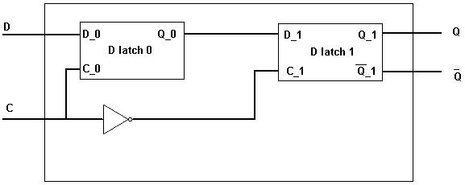
D Flip-Flop
A D flip-flop can be updated only on a falling/rising clock edge(edge Triggering device).
There are many ways to create a D flip flop, the figure below (from the lecture note) shows a D flip flop created from two D latches.
This flip flop can be updated in a falling edge or in a rising edge?
Question: Without adding new hardware, how to modify the device so that it can only be updated on rising edges (if this is not already the case)?
Sequential logic , data representation

Slide 9
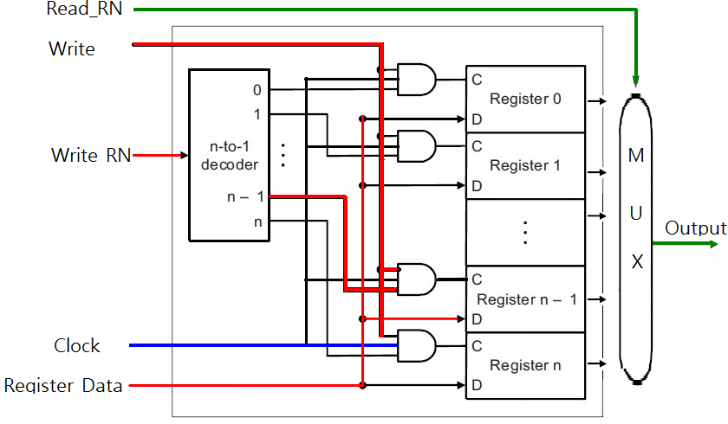
Register file
A register file is a piece of hardware that allows reading from and writing to the desired registers. The following figure shows a sample register file.
Figure 1
How do you read from a register (what are the inputs)?
How do you write to a register (what are the inputs)?
Sequential logic , data representation
Notes:
Reading values from register 0 to register n, we need only supply the register number (specified by Read RN in green color in Figure 1) to obtain the data stored in the target register. Each read port is implemented using a multiplexer which has log₂N control lines ( for 32-bits registers, there are 5 control lines). The read register number signal hence is used as the multiplexor selector signal.

Slide 10
How to write to a register
How do you write to a register (what are the inputs)?
Sequential logic , data representation
Notes:
When writing to a register we need to (1) provide a register number (e.g. the n-1 line) (2) provide an authorization bit as the write operation will overwrite the previous stored contents of the target register, and (3) assert a clock pulse that controls writing of data into the register. When the register number is input to the N-bit to 2^{N} 1-bit decoder, it acts as the control signal to switch the data stream input into the Register Data input. Only the AND gate has a unitary decode output (in red line in the Figure) will set the Clock C asserted to pass the Register data into the target register (or Register n -1).

Slide 11
Sequential logic and data representation
Sequential logic
- clock
- Memory elements: SR latch, D latch, D flip flop, register file
Data representation
- base conversions, two’s complement
- IEEE 754 floating point format,
- ASCII representation of characters
Exercises
Sequential logic , data representation

Slide 12
Conversion of bases
Example : Convert .625₍₁₀₎ to the binary format:
0.625 x 2 LHS of decimal pt=1 RHS =0.25
0.25 x 2 LHS of decimal pt=0 RHS =0.5
0.5 x 2 LHS of decimal pt=1 RHS = 0 done!
0.625₍₁₀₎ => 0.101₍₂₎
Example : Convert 101.101 ₍₂₎ to the decimal format:
(1x2²) + (0x2¹) + (1x2⁰) + (1x2⁻¹) + (0x2⁻²) + (1x2⁻³) = 5.625₍₁₀₎
101.101₍₂₎ => 5.625₍₁₀₎
Most significant digit
Least significant digit
Sequential logic , data representation
Notes:
To convert a real number like 0.625₍₁₀₎ to the binary format, we keep on multiplying the number at the RHS of the decimal point with 2, until the product becomes zero (or until the desired number of binary digits has been reached). The number at the LHS of the decimal points are the binary digits, from the Most Significant digit to the Least Significant digit.

Slide 13
Two’s complement representation
Computers use two’s complement representation scheme for signed numbers.
The positive numbers are represented as before. The negative numbers are converted as follows:
  bit inverted the number to get its one’s complement,
  add 1 to the one’s complement number to get the two’s complement.
Bit 31 is the sign bit. (for +ve numbers bit 31 is 0, for –ve numbers bit 31 is 1)
Example : -5 (0000 0000 0000 0000 0000 0000 0000 0101₍₂₎)
  Its 1’s complement is
  1111 1111 1111 1111 1111 1111 1111 1010₍₂₎
  After adding 1 the 2’s complement becomes
  1111 1111 1111 1111 1111 1111 1111 1011₍₂₎
Sequential logic , data representation

Slide 14
Two’s complement representation
To convert a two’s complement number back to its decimal form, one needs to do the follows:
  Look at the sign bit, if sign bit is zero, convert the binary number directly to decimal format,
  If the sign bit is one, invert the number and then add 1 to the inverted number. Convert the result to decimal format and put a
  –ve sign to the number
Example : Convert the two’s complement number 1111 1111 1111 1111 1111 1111 1111 1011₍₂₎ to decimal format
  Sign bit =1, invert all the bits we have
  0000 0000 0000 0000 0000 0000 0000 0100₍₂₎
  Add 1 to the inverted number we have
  0000 0000 0000 0000 0000 0000 0000 0101₍₂₎
  Convert the result to decimal format and add a –ve sign
  -5₍₁₀₎

Slide 15
The IEEE 754 single precision floating point format
The IEEE 754 standard uses 32 bits to represent single precision floating point numbers.
S : sign bit (0 positive, 1 negative),
Exponent : 8-bit field, bias = 127,
Significant : 23-bit field.
Exercise: Convert -5.625₍₁₀₎ to the single precision floating point format:
31 30 22 0
S | Exponent | significand
1 bit 8 bits 23 bits
Sequential logic , data representation

Slide 16
Convert to the single precision floating point format
To convert a real number into the single precision format, three steps are involved:
  1. note the sign and convert the absolute value
  of number into binary format,
  2. normalize the number in 1,
  3. calculate the exponent value in binary format.
Exercise:
Convert -5.625₍₁₀₎ to the single precision floating point format:
1. 5.625₍₁₀₎ = 101.101₍₂₎, sign bit =1
2. normalize 101.101 = 1.01101 x 2²
3. exponent value = (bias +2)= (127+2) = 129₍₁₀₎
= 1000 0001₍₂₎
The resulting single precision representation is
1 1000 0001 01101000000000000000000
Implicit leading 1
Sequential logic , data representation

Slide 17
Convert from the single precision floating point format
To convert a number in single precision representation back to the decimal representation, one just needs to reverse the procedure:
  1. calculate the exponent value and convert it to decimal
  format,
  2. re-construct the value from the exponent and
  the significant,
  3. put the proper sign to the number by referring
  to the sign bit
An example:
Convert 1 1000 0001 01101000000000000000000 to the decimal representation.
1. exponent = 1000 0001 = 129, => exponent = 129-127=2
2. reconstruct from the exponent 1.01101 x 2² = 101.101₍₂₎
= 5.625₍₁₀₎
3. sign bit =1 => -5.625₍₁₀₎
Implicit leading 1
Sequential logic , data representation

Slide 18
The IEEE 754 double precision floating point format
The IEEE 754 standard uses 64 bits to represent double precision floating point numbers.
S : sign bit (0 positive, 1 negative),
Exponent : 11-bit field, bias = 1023,
Significant : 52-bit field.
Exercise: Convert -5.625₍₁₀₎ to the double precision floating point format:
63 62 51 0
S | Exponent | significand
1 bit 11 bits 52 bits
Sequential logic , data representation

Slide 19
Convert to the double precision floating point format
The steps for converting a real number into the double precision format are identical to those of the single precision, except for two things :
  1. the exponent is 11-bit and the bias is now 1023 (instead
  of 127),
  2. the significant contains 52 bits (instead of 23 bits).
Exercise :
Convert -5.625₍₁₀₎ to the double precision floating point format:
1. 5.625₍₁₀₎ = 101.101₍₂₎, sign bit =1
2. normalize 101.101 = 1.01101 x 2²
3. exponent value = (bias+2)= (1023+2) = 1025₍₁₀₎
= 100 0000 0001₍₂₎
The resulting single precision representation is
1 100 0000 0001 0110100000000000000000…0000
1bit 11 bits 52 bits
Implicit leading 1
Sequential logic , data representation

Slide 20
Convert from the double precision floating point format
To convert a number in double precision representation back to the decimal representation, follows a reverse procedure as below:
  1. calculate the exponent value and convert it to decimal
  format,
  2. re-construct the value from the exponent and
  the significant by adding the implicit leading 1,
  3. put the proper sign to the number by referring
  to the sign bit
An example:
Convert 1 100 0000 0001 0110100000000000000000…0000 to the decimal representation.
1. exponent = 1000 0000 0001 = 1025₍₁₀₎ => exponent = 1025-1023=2
2. reconstruct from the exponent 1.01101 x 2² = 101.101 ₍₂₎
= 5.625 ₍₁₀₎
3. sign bit =1 => -5.625 ₍₁₀₎
Sequential logic , data representation

Slide 21
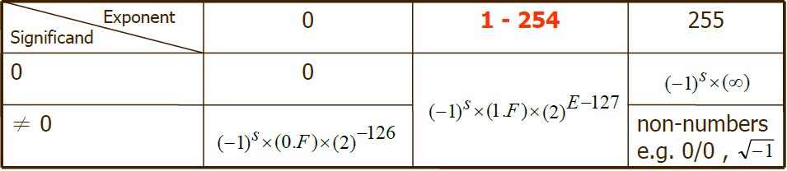
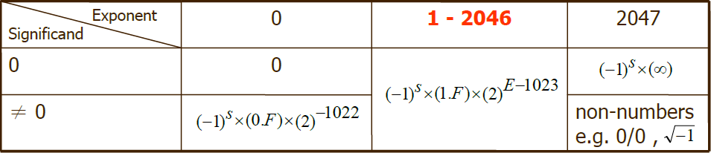
IEEE 754 special cases
IEEE 754 Single precision format:
IEEE 754 Double precision format:
Sequential logic , data representation

Slide 22
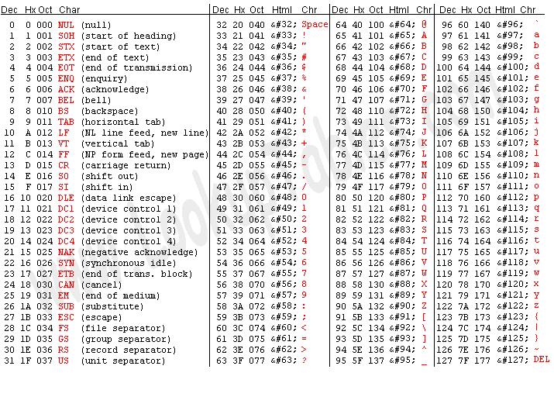
Representing text– the ASCII codes
The American Standard Code for Information Interchange (ASCII) is a character encoding scheme for encoding text.
ASCII code uses 8 bits to represent one character.
The list of the first 128 characters is listed in the table below

Slide 23
Sequential logic and data representation
Sequential logic
- clock
- Memory elements: SR latch, D latch, D flip flop, register file
Data representation
- base conversions, two’s complement
- IEEE 754 floating point format,
- ASCII representation of characters
Exercises

Slide 24
Exercises
Question 1: Given the bit pattern 1000 0000 0100 0110 0000 0000 0000 0000
- What is the value if this is a 2’s complement representation?
- What if the pattern is an unsigned integer?
What if it is an IEEE single precision number?
- What if it represents 4 ASCII characters (assume bits 31-24, 23-16, 15-8, 7-0 store the characters, and ASCII value of 128 is the symbol ‘€’).

Slide 25
Exercises
Question 2: Assume the bit pattern 1001 1100 follows the IEEE-like floating point representation format
- What is the bias of the exponent?
- What value the given pattern is representing?
S | Exponent | significand
1 bit 3 bits 4 bits

Slide 26
Exercises
Question 3: Convert the decimal real numbers given below into their Binary fractions in IEEE 754 single precisions, using either rounding to nearest (ties to even) or truncating when overflow occurs:
a) 5.5
b) 8.25
c) 9.6
Sequential logic , data representation

Slide 27
Conclusion
Today we have reviewed:
  clock, simple memory elements (S-R latch, D latch, D flip-flop) and register file,
  simple base conversions, the IEEE 754 floating point format, and the ASCII character scheme.
Sequential logic , data representation

