Slide 1
Control of the single cycle datapath
COMP2611: Computer Organization
Control of the single cycle datapath

Slide 2
Overview
You will learn the following in this tutorial:
  the hardware control units of the single cycle datapath,
  the effects of the individual control signals,
  how an instruction is executed through the guidance of the control signals.
Control of the single cycle datapath

Slide 3
Single Cycle Datapath
Review of the control signals
- the two hardware control units
- the effects of the control signals
Sample execution of an instruction
- instruction fetch, decoding, executing, memory referencing and writing back
- Exercises
Exercises
Control of the single cycle datapath

Slide 4
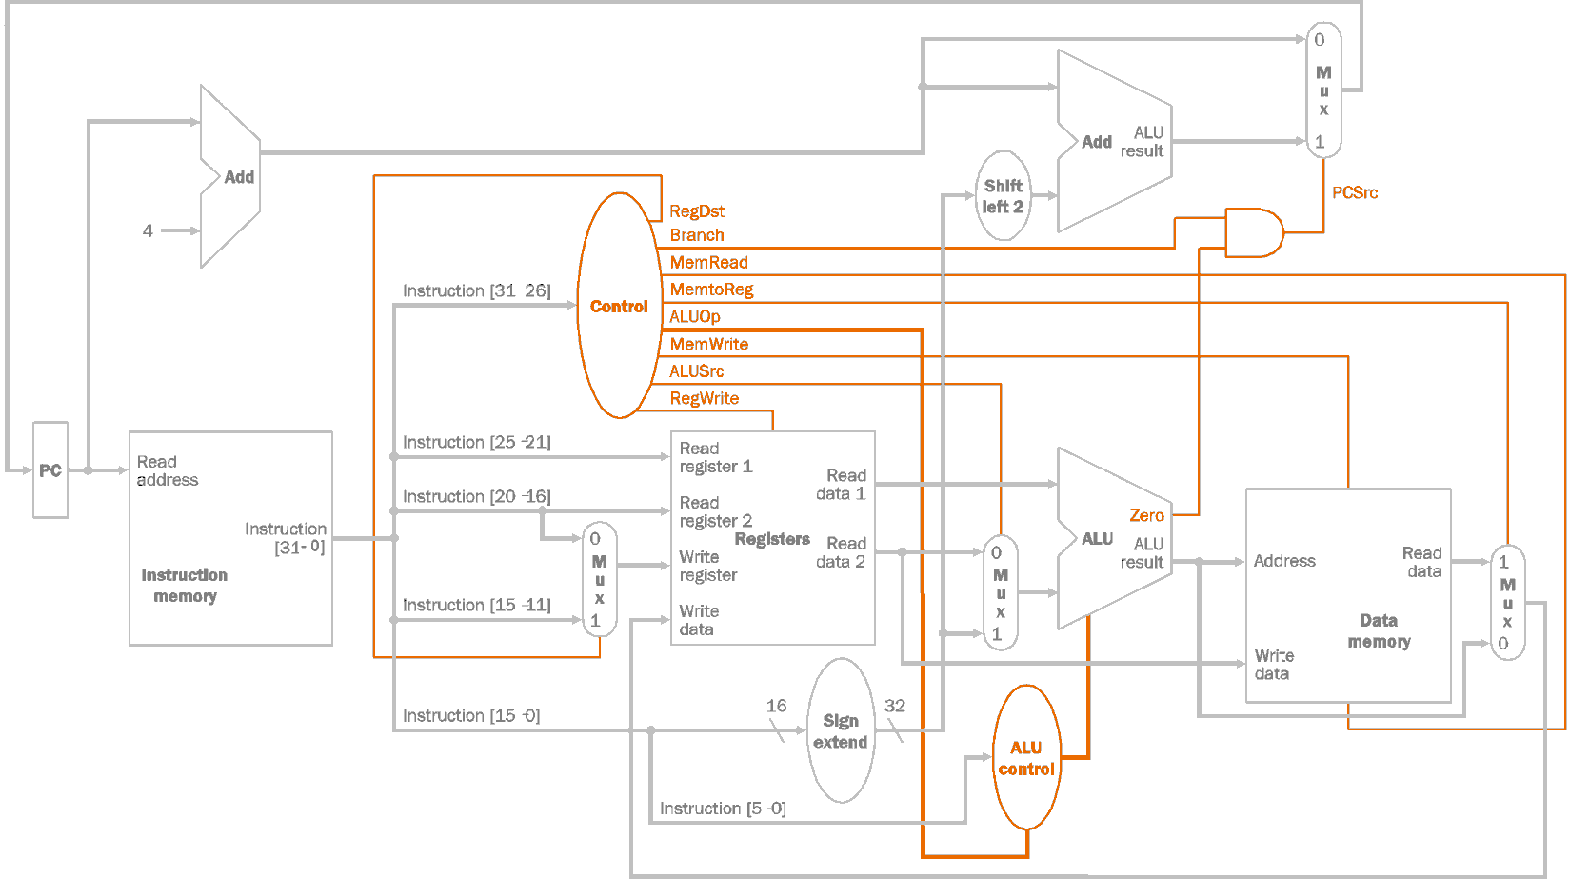
Review of the Control signals
The control units of the datapath are responsible for setting all the control signals for the instructions.
Two hardware units:
  Control – 6 bits of input (bits [31-26]),
  ALU Control – 2+6 bits of input (ALUOp from control, bits [5-0])
Control of the single cycle datapath

Slide 5
Review of the Control signals
Signal name | Effect when deasserted | Effect when asserted
RegDst | The register destination number for the write register comes from rt field (bits 20-16) | The register destination number for the write register comes from rd field (bits 15-11)
Branch + Zero | When both signals are asserted, PCSrc will be asserted | When either one is deasserted, PCSrc will be deasserted
MemRead | None | Enable read from memory. Memory contents designated by the address are put on the read data output
MemtoReg | Feed the write data input of the register file with the output from the ALU | Feed the write data input of the register file with output from the memory
Control of the single cycle datapath

Slide 6
Review of the Control signals
Signal name | Effect when deasserted | Effect when asserted
MemWrite | None | Enable write to the memory. Overwrite the memory contents designated by the address with the value on the write data input
ALUSrc | The Second ALU operand comes from the second register file output (read data port 2) | The second ALU operand is the sign-extended 16-bit data (bits 15-0)
PCSrc | The next PC picks up from the output of the adder that computes PC+4 | The next PC picks up the output of from the adder that computes the branch target
RegWrite | None | Enable data write to the register specified by the register destination number
Control of the single cycle datapath

Slide 7
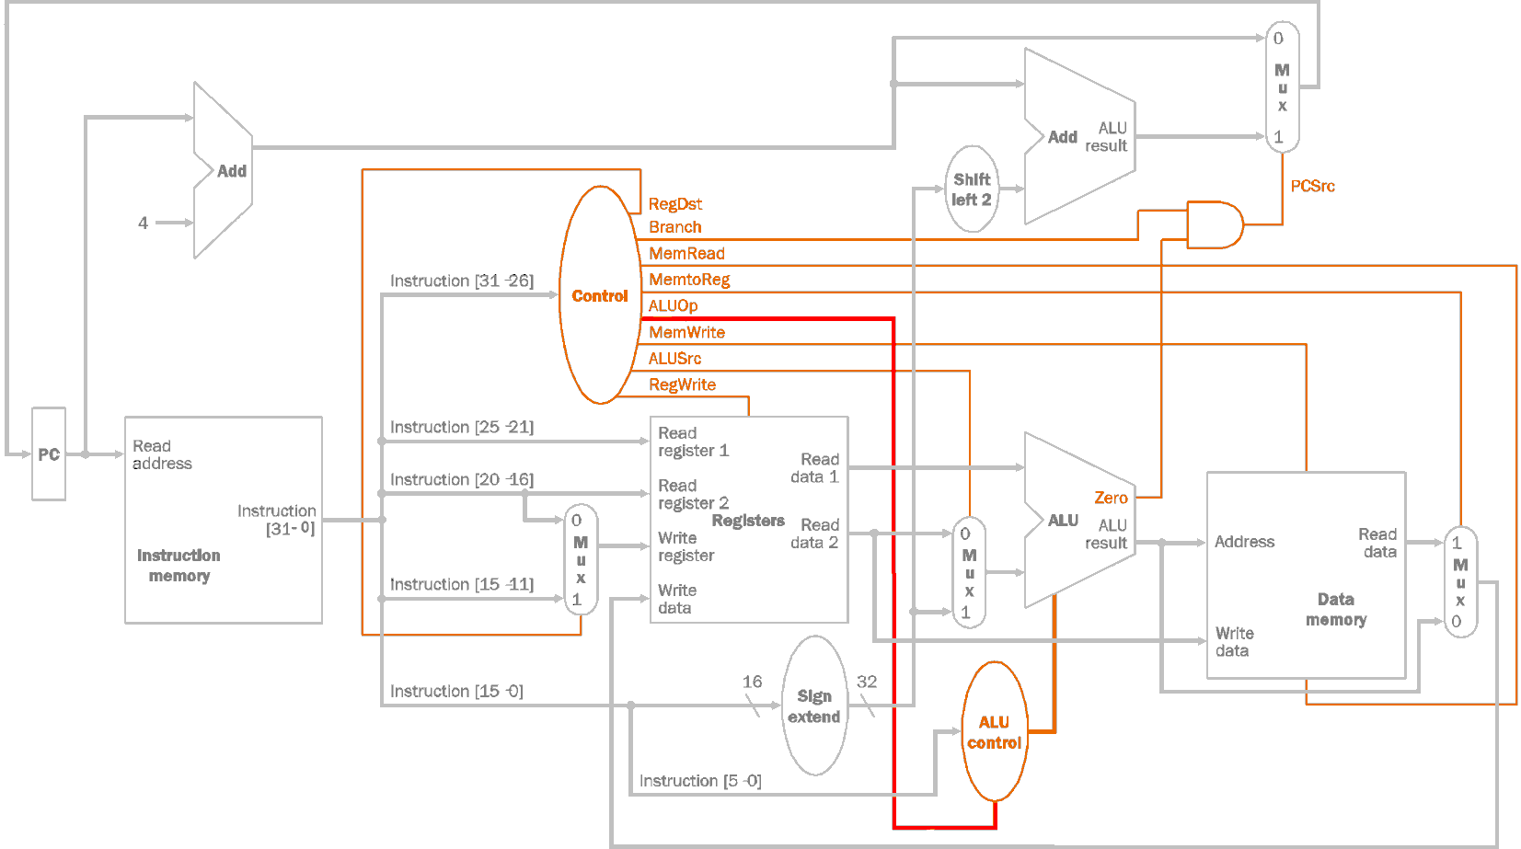
Review of the Control signals
ALUOp signal (2-bit) | Effect
00 | ADD operation at the ALU for Load/Store instructions
01 | SUB operation at the ALU for BEQ
10 | ALU operation determined by the funct field (bits 5-0)
Control of the single cycle datapath

Slide 8
Review of the Control signals
ALU control signal (4-bit) | Effect
0000 | The ALU will perform the AND operation
0001 | The ALU will perform the OR operation
0010 | The ALU will perform the ADD operation
0110 | The ALU will perform the SUB operation
0111 | The ALU will perform the Set on Less Than (SLT) operation
1100 | The ALU will perform the NOR operation
Control of the single cycle datapath

Slide 9
Single Cycle Datapath
Review of the control signals
- the two hardware control units
- the effects of the control signals
Sample execution of an instruction
- instruction fetch, decoding, executing, memory
referencing and writing back
- Exercises
Exercises
Control of the single cycle datapath

Slide 10
Execution of an instruction (with control signals)
Execution of the R-type instruction “AND“
Example: AND $t0, $t1, $t2
  Encoding 000000 01001 01010 01000 00000 100100
Description | Bitwise AND operation on the values of the registers Rs and Rt. Store the result in Rd.
Operation | $Rd=$Rs & $Rt; PC=PC+4
Syntax | AND $Rd, $Rs, $Rt
Encoding | 000000 sssss ttttt ddddd 00000 100100 OpCode Rs Rt Rd Shift function
Control of the single cycle datapath

Slide 11

Execution of “AND $t0, $t1, $t2”
Step 1 (fetch):
A= address of the instruction
B= 000000 01001 01010 01000 00000 100100
Control signals not yet generated
Control of the single cycle datapath

Slide 12
Execution of “AND $t0, $t1, $t2”
Instruction fetched:
000000 01001 01010 01000 00000 100100
OpCode Rs Rt Rd Shift function
Step 2 (decode):
C = 01001, D = 01010, E = 01000
F = value of Rs
G = value of Rt, H= 0000 0000 0000 0000 01000 00000 100100
Control of the single cycle datapath

Slide 13
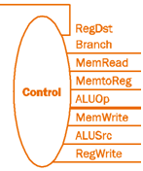
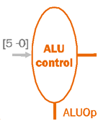
Execution of “AND $t0, $t1, $t2”
Instruction fetched:
000000 01001 01010 01000 00000 100100
OpCode Rs Rt Rd Shift function
Step 2 (control signals)
Control signal | Value
RegDst | 1 (R-type instruction)
Branch | 0 (not a branch instruction i.e. BEQ)
MemRead | 0 (not the LW instruction)
MemtoReg | 0 (not the LW instruction)
ALUOp | 10 (R-type instruction)
MemWrite | 0 (not the SW instruction)
ALUSrc | 0 (R-type instruction)
RegWrite | 1 (R-type instruction needs to write back)
Inputs |  | Outputs
Funct (bits 5:0) | ALUOp | ALU Control
100 100 | 10 | 0000 (AND operation)
Control of the single cycle datapath

Slide 14
Execution of “AND $t0, $t1, $t2”
Instruction fetched:
000000 01001 01010 01000 00000 100100
Step 3 (execution):
ALUSrc = 0, therefore I= value of Rt
J = 0000 0000 0000 0001 0000 0000 1001 0000+PC+4
ALU Control = 0000, therefore K = (value of Rs) bitwise_AND (value of Rt),
Branch =0 => PCSrc=0, therefore L = PC+4
Control of the single cycle datapath

Slide 15
Execution of “AND $t0, $t1, $t2”
Instruction fetched:
000000 01001 01010 01000 00000 100100
Step 4 (memory)
MemRead=0, therefore M = Empty (can’t read)
Control of the single cycle datapath

Slide 16
Execution of “AND $t0, $t1, $t2”
Instruction fetched:
000000 01001 01010 01000 00000 100100
Step 5 (write back):
MemtoReg=0, therefore N= Results of the ALU
= (value of Rs) bitwise_AND (value of Rt)
RegWrite=1, RegDst=1, therefore N is written back to register 01000 ($t0)
Control of the single cycle datapath

Slide 17
Single Cycle Datapath
Review of the control signals
- the two hardware control units
- the effects of the control signals
Sample execution of an instruction
- instruction fetch, decoding, executing, memory
referencing and writing back
- Exercises
Exercises
Control of the single cycle datapath

Slide 18
Exercises
Question 1: Repeat the execution of the I-type instruction “LW $t0, 8($t1)” by filling the values for A-N and also the control signals.
Control of the single cycle datapath

Slide 19
Exercises
Question 2: Repeat the execution of the I-type instruction “BEQ $t0, $t1,100” by filling the values for A-N and also the control signals. Assume $t0==$t1.
Control of the single cycle datapath

Slide 20
Single Cycle Datapath
Review of the control signals
- the two hardware control units
- the effects of the control signals
Sample execution of an instruction
- instruction fetch, decoding, executing, memory
referencing and writing back
- Exercises
Exercises
Control of the single cycle datapath

Slide 21
Exercises
Question 1: Repeat the execution of the following instructions by filling the values for A-N and also the control signals :
1) SW $t0, 8($t1)
2) ADD $t0, $t1, $t2
3) OR $t0, $t1, $t2
Control of the single cycle datapath

Slide 22
Exercises
Question 2: Modify the datapath on slide 11 to support the execution of an I-type instruction “LUI $t0, 100”. The instruction shifts the immediate value by 16 bits to the left (lower 16 bits are filled with zeroes) and stores the shifted value to the register. Include all the control signals.
(encoding 000111 00000 ttttt iiiiiiiiiiiiiiii, t: destination register,
i:immediate).
Control of the single cycle datapath

Slide 23
Conclusion
Today we have reviewed:
  the control units of the single cycle datapath,
  the effects of the individual control signals,
  how an instruction is executed through the guidance of the control signals.
Control of the single cycle datapath

