Slide 1
Data Mining
Association Analysis: Basic Concepts and Algorithms
Lecture Notes for Chapter 6
Introduction to Data Mining
By Tan, Steinbach, Kumar
Also, slides from Jiawei Han and Jian Pei
© Tan,Steinbach, Kumar Introduction to Data Mining 4/18/2004 <number>

Slide 2
What Is Frequent Pattern Mining?
Frequent pattern: pattern (set of items, sequence, etc.) that occurs frequently in a database [AIS93]
Frequent pattern mining: finding regularities in data
  What products were often purchased together?
  What are the subsequent purchases after buying a PC?

Slide 3
Why Is Frequent Pattern Mining an Essential Task in Data Mining?
Foundation for many essential data mining tasks
  Association, correlation, causality
  Sequential patterns, temporal or cyclic association, partial periodicity, spatial and multimedia association
  Associative classification, cluster analysis, iceberg cube, fascicles (semantic data compression)
Broad applications
  Basket data analysis, cross-marketing, catalog design, sale campaign analysis
  Web log (click stream) analysis, DNA sequence analysis, etc.

Slide 4
Basic Concepts: Frequent Patterns and Association Rules
Itemset X={x₁, …, x_{k}}
Find all the rules X→Y with min confidence and support
  support, s, probability that a transaction contains X∪Y
  confidence, c, conditional probability that a transaction having X also contains Y.
Transaction-id | Items bought
10 | A, B, C
20 | A, C
30 | A, D
40 | B, E, F
Customer
buys both
Customer
buys diaper
Let min_support = 50%, min_conf = 50%:
  A → C (50%, 66.7%)
  C → A (50%, 100%)
Customer
buys beer

Slide 5
Concept: Frequent Itemsets
Outlook | Temperature | Humidity | Play
sunny | hot | high | no
sunny | hot | high | no
overcast | hot | high | yes
rainy | mild | high | yes
rainy | cool | normal | yes
rainy | cool | normal | no
overcast | cool | normal | yes
sunny | mild | high | no
sunny | cool | normal | yes
rainy | mild | normal | yes
sunny | mild | normal | yes
overcast | mild | high | yes
overcast | hot | normal | yes
rainy | mild | high | no
Minimum support=2
  {sunny, hot, no}
  {sunny, hot, high, no}
  {rainy, normal}
Min Support =3
  ?
How strong is {sunny, no}?
  Count =
  Percentage =

Slide 6
Concept: Itemset → Rules
{sunny, hot, no} = {Outlook=Sunny, Temp=hot, Play=no}
Generate a rule:
  Outlook=sunny and Temp=hot ➔ Play=no
How strong is this rule?
Support of the rule
  = support of the itemset {sunny, hot, no} = 2 = Pr({sunny, hot, no})
  Either expressed in count form or percentage form
Confidence = Pr(Play=no | {Outlook=sunny, Temp=hot})
  In general LHS→ RHS, Confidence = Pr(RHS|LHS)
Confidence
  =Pr(RHS|LHS)
  =count(LHS and RHS) / count(LHS)
What is the confidence of Outlook=sunny➔Play=no?

Slide 7
Frequent Patterns
Patterns = Item Sets
  {i1, i2, … in}, where each item is a pair: (Attribute=value)
Frequent Patterns
  Itemsets whose support >= minimum support
Support
  count(itemset)/count(database)

Slide 8

Frequent Itemset Generation
Given d items, there are 2^{d} possible candidate itemsets

Slide 9
Max-patterns
Max-pattern: frequent patterns without proper frequent super pattern
  BCDE, ACD are max-patterns
  BCD is not a max-pattern
Tid | Items
10 | A,B,C,D,E
20 | B,C,D,E,
30 | A,C,D,F
Min_sup=2

Slide 10
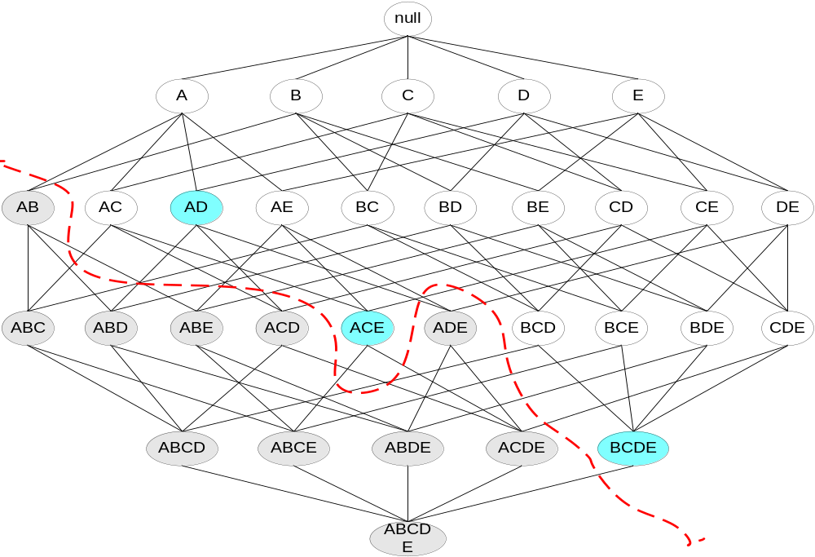
Maximal Frequent Itemset
An itemset is maximal frequent if none of its immediate supersets is frequent
Maximal Itemsets
Infrequent Itemsets
Border

Slide 11
Frequent Max Patterns
Succinct Expression of frequent patterns
  Let {a, b, c} be frequent
  Then, {a, b}, {b, c}, {a, c} must also be frequent
  Then {a}, {b}, {c}, must also be frequent
By writing down {a, b, c} once, we save lots of computation
Max Pattern
  If {a, b, c} is a frequent max pattern, then {a, b, c, x} is NOT a frequent pattern, for any other item x.

Slide 12
Find Frequent Max Patterns
Outlook | Temperature | Humidity | Play
sunny | hot | high | no
sunny | hot | high | no
overcast | hot | high | yes
rainy | mild | high | yes
rainy | cool | normal | yes
rainy | cool | normal | no
overcast | cool | normal | yes
sunny | mild | high | no
sunny | cool | normal | yes
rainy | mild | normal | yes
sunny | mild | normal | yes
overcast | mild | high | yes
overcast | hot | normal | yes
rainy | mild | high | no
Minimum support=2
  {sunny, hot, no} ??

Slide 13
Mining Association Rules—an Example
Min. support 50%
Min. confidence 50%
Transaction-id | Items bought
10 | A, B, C
20 | A, C
30 | A, D
40 | B, E, F
Frequent pattern | Support
{A} | 75%
{B} | 50%
{C} | 50%
{A, C} | 50%
For rule A ⇒ C:
  support = support({A}∪{C}) = 50%
  confidence = support({A}∪{C})/support({A}) = 66.6%

Slide 14
Method 1:
Apriori: A Candidate Generation-and-test Approach
Any subset of a frequent itemset must be frequent
  if {beer, diaper, nuts} is frequent, so is {beer, diaper}
  Every transaction having {beer, diaper, nuts} also contains {beer, diaper}
Apriori pruning principle: If there is any itemset which is infrequent, its superset should not be generated/tested!
Method:
  generate length (k+1) candidate itemsets from length k frequent itemsets, and
  test the candidates against DB
The performance studies show its efficiency and scalability
Agrawal & Srikant 1994, Mannila, et al. 1994

Slide 15
The Apriori Algorithm — An Example
Itemset | sup
{A} | 2
{B} | 3
{C} | 3
{D} | 1
{E} | 3
Database TDB
Itemset | sup
{A} | 2
{B} | 3
{C} | 3
{E} | 3
L₁
Tid | Items
10 | A, C, D
20 | B, C, E
30 | A, B, C, E
40 | B, E
C₁
1st scan
C₂
Itemset | sup
{A, B} | 1
{A, C} | 2
{A, E} | 1
{B, C} | 2
{B, E} | 3
{C, E} | 2
C₂
L₂
Itemset
{A, B}
{A, C}
{A, E}
{B, C}
{B, E}
{C, E}
Itemset | sup
{A, C} | 2
{B, C} | 2
{B, E} | 3
{C, E} | 2
2nd scan
C₃
Itemset
{B, C, E}
3rd scan
L₃
Itemset | sup
{B, C, E} | 2

Slide 16
FP-growth Algorithm
Use a compressed representation of the database using an FP-tree
Once an FP-tree has been constructed, it uses a recursive divide-and-conquer approach to mine the frequent itemsets

Slide 17
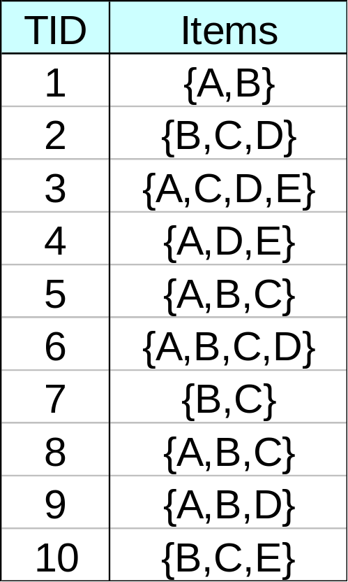
FP-tree construction
null
After reading TID=1:
A:1
B:1
After reading TID=2:
null
A:1
B:1
B:1
C:1
D:1

Slide 18
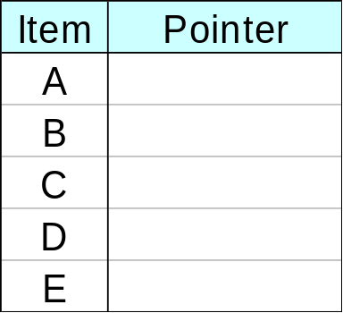
FP-Tree Construction
Transaction Database
null
A:7
B:3
B:5
C:3
C:1
D:1
Header table
D:1
C:3
E:1
D:1
E:1
D:1
E:1
D:1
Pointers are used to assist frequent itemset generation

Slide 19
FP-growth
null
Conditional Pattern base for D:
P = {(A:1,B:1,C:1),
(A:1,B:1),
(A:1,C:1),
(A:1),
(B:1,C:1)}
Recursively apply FP-growth on P
Frequent Itemsets found (with min sup = 2):
AD, BD, CD, ACD, BCD, ABD
A:7
B:1
B:5
C:1
C:1
D:1
C:3
D:1
D:1
D:1
D:1

Slide 20
Conclusion
Effective hash-based algorithm for the candidate itemset generation
Two phase transaction database pruning
Much more efficient ( time & space ) than Apriori algorithm

