Slide 1
Logistic Regression
Adapted from: Tom Mitchell’s Machine Learning Book
Evan Wei Xiang and Qiang Yang

Slide 2
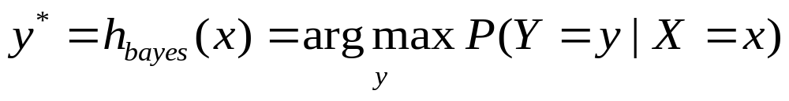
Classification
Learn: h: X->Y
  X – features
  Y – target classes
Suppose you know P(Y|X) exactly, how should you classify?
  Bayes classifier:
Why?

Slide 3
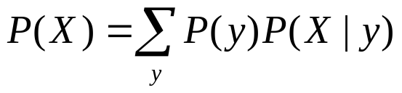
Generative vs. Discriminative
Classifiers - Intuition
Generative classifier, e.g., Naïve Bayes:
  Assume some functional form for P(X|Y), P(Y)
  Estimate parameters of P(X|Y), P(Y) directly from training data
  Use Bayes rule to calculate P(Y|X=x)
  This is ‘generative’ model
    Indirect computation of P(Y|X) through Bayes rule
    But, can generate a sample of the data,
Discriminative classifier, e.g., Logistic Regression:
  Assume some functional form for P(Y|X)
  Estimate parameters of P(Y|X) directly from training data
  This is the ‘discriminative’ model
    Directly learn P(Y|X)
    But cannot sample data, because P(X) is not available

Slide 4
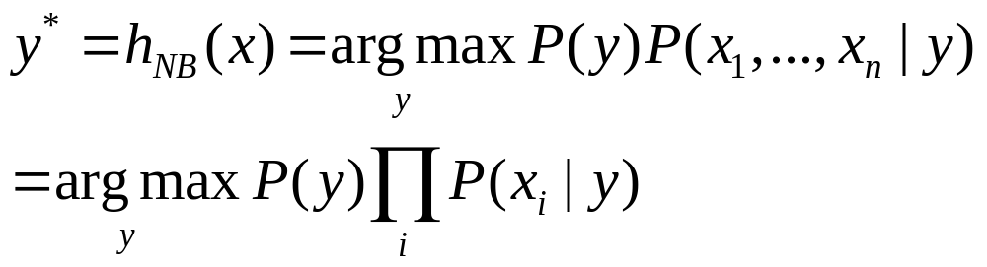
The Naïve Bayes Classifier
Given:
  Prior P(Y)
  n conditionally independent features X given the class Y
  For each Xi, we have likelihood P(X_{i}|Y)
Decision rule:
If assumption holds, NB is optimal classifier!

Slide 5
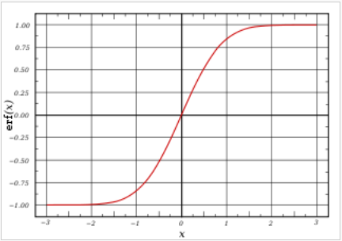
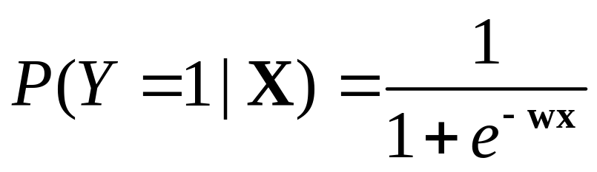
Logistic Regression
Let X be the data instance, and Y be the class label: Learn P(Y|X) directly
  Let W = (W1, W2, … Wn), X=(X1, X2, …, Xn), WX is the dot product
  Sigmoid function:

Slide 6
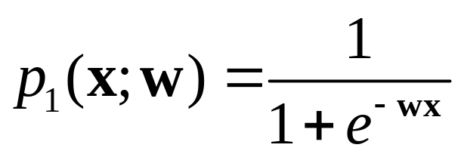
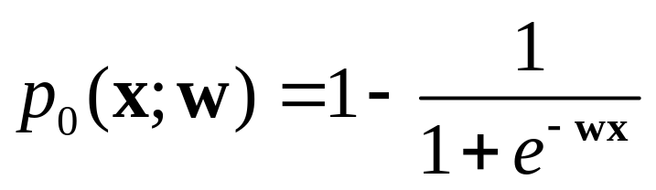
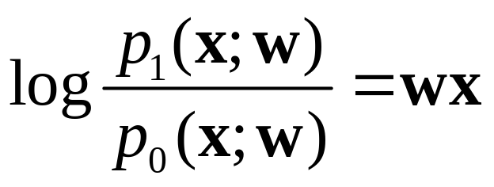
Logistic Regression
In logistic regression, we learn the conditional distribution P(y|x)
Let p_{y}(x;w) be our estimate of P(y|x), where w is a vector of adjustable parameters.
Assume there are two classes, y = 0 and y = 1 and
This is equivalent to
That is, the log odds of class 1 is a linear function of x
Q: How to find W?

Slide 7
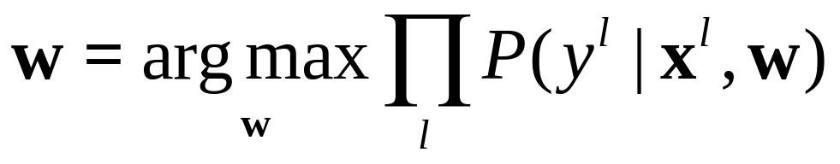
Constructing a Learning Algorithm
The conditional data likelihood is the probability of the observed Y values in the training data, conditioned on their corresponding X values. We choose parameters w that satisfy
where w = <w₀,w₁ ,…,w_{n}> is the vector of parameters to be estimated, y^{l} denotes the observed value of Y in the l th training example, and x^{l} denotes the observed value of X in the l th training example

Slide 8
Summary of Logistic Regression
Learns the Conditional Probability Distribution P(y|x)
Local Search.
  Begins with initial weight vector.
  Modifies it iteratively to maximize an objective function.
  The objective function is the conditional log likelihood of the data – so the algorithm seeks the probability distribution P(y|x) that is most likely given the data.

Slide 9
What you should know LR
In general, NB and LR make different assumptions
  NB: Features independent given class -> assumption on P(X|Y)
  LR: Functional form of P(Y|X), no assumption on P(X|Y)
LR is a linear classifier
  decision rule is a hyperplane
LR optimized by conditional likelihood
  no closed-form solution
  concave -> global optimum with gradient ascent

