Slide 1
An Intro to Nerual Networks
Thanks: Professors Frank Hoffmann and Jiawei Han, and Russell and Norvig

Slide 2
Biological Neural Systems
Neuron switching time : > 10⁻³ secs
Number of neurons in the human brain: ~10¹⁰
Connections (synapses) per neuron : ~10⁴–10⁵
Face recognition : 0.1 secs
High degree of distributed and parallel computation
  Highly fault tolerent
  Highly efficient
  Learning is key

Slide 3
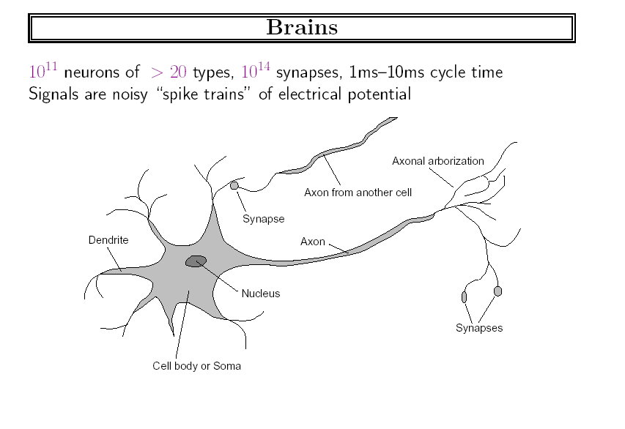
Excerpt from Russell and Norvig’s Book

Slide 4
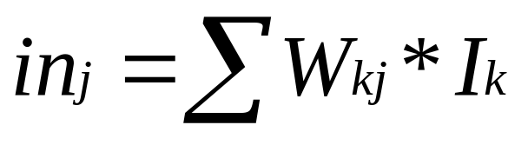
A Neuron
a_{k}
W_{kj}
in_{j}
output
Input links
a_{j}
output links
∑
a_{i} = output(in_{j})
j
Computation:
  input signals → input function(linear) → activation function(nonlinear) → output signal

Slide 5
Part 1. Perceptrons: Simple NN
inputs
weights
x₁
w₁
output
w₂
activation
x₂
Σ
y
.
.
.
θ
a=Σ_{i=1}^{n} w_{i} x_{i}
w_{n}
x_{n}
Xi’s range: [0, 1]
1 if a ≥ θ
y=
0 if a < θ
{

Slide 6
Decision Surface of a Perceptron
1
1
Decision line
w₁ x₁ + w₂ x₂ = θ
x₂
w
1
0
0
0
x₁
1
0
0

Slide 7
Linear Separability
x₂
w₁=?
w₂=?
θ= ?
w₁=1
w₂=1
θ=1.5
0
1
0
1
x₁
x₁
0
0
1
0
Logical AND
Logical XOR
x₁ | x₂ | a | y
0 | 0 | 0 | 0
0 | 1 | 1 | 0
1 | 0 | 1 | 0
1 | 1 | 2 | 1
x₁ | x₂ | y
0 | 0 | 0
0 | 1 | 1
1 | 0 | 1
1 | 1 | 0

Slide 8
Threshold as Weight: W0
θ=w₀
x₀=-1
x₁
w₁
w₀
w₂
x₂
Σ
y
.
.
.
a= Σ_{i=0}^{n} w_{i} x_{i}
w_{n}
x_{n}
1 if a ≥ 0
y=
0 if a <0
{
Thus, y= sgn(a)=0 or 1

Slide 9
Training the Perceptron
Training set S of examples {x,t}
  x is an input vector and
  t the desired target vector
  Example: Logical And
  S = {(0,0),0}, {(0,1),0}, {(1,0),0}, {(1,1),1}
Iterative process
  Present a training example x , compute network output y , compare output y with target t, adjust weights and thresholds
Learning rule
  Specifies how to change the weights w and thresholds θ of the network as a function of the inputs x, output y and target t.

Slide 10
Perceptron Learning Rule
w’=w + α (t-y) x
w_{i} := w_{i} + Δw_{i} = w_{i} + α (t-y) x_{i} (i=1..n)
The parameter α is called the learning rate.
  In Han’s book it is lower case L
  It determines the magnitude of weight updates Δw_{i} .
If the output is correct (t=y) the weights are not changed (Δw_{i} =0).
If the output is incorrect (t ≠ y) the weights w_{i} are changed such that the output of the Perceptron for the new weights w’_{i} is closer/further to the input x_{i}.

Slide 11
Perceptron Training Algorithm
Repeat
for each training vector pair (x,t)
evaluate the output y when x is the input
if y≠t then
form a new weight vector w’ according
to w’=w + α (t-y) x
else
do nothing
end if
end for
Until y=t for all training vector pairs or # iterations > k

Slide 12
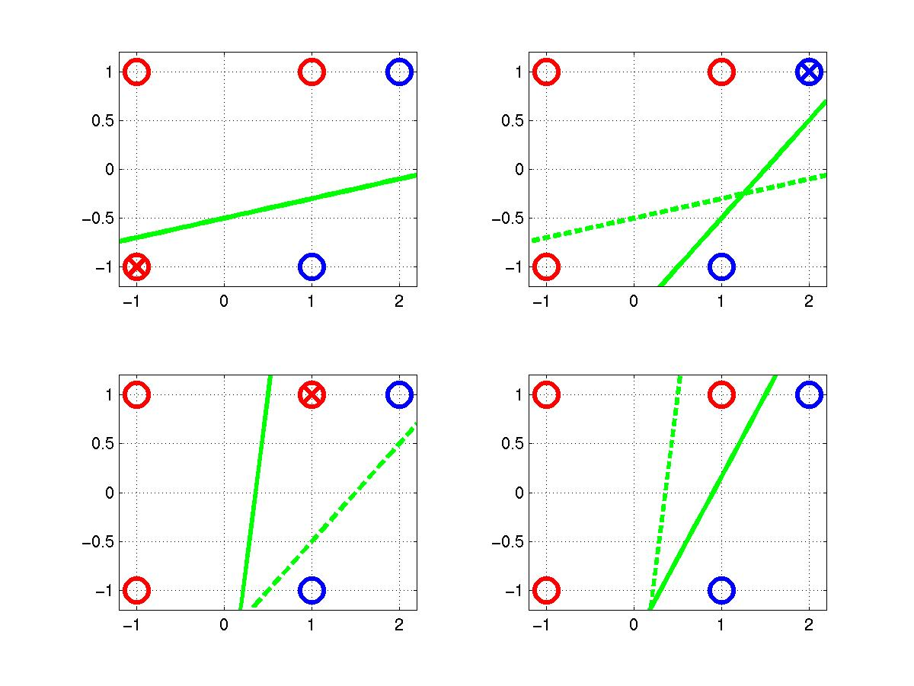
Perceptron Learning Example
t=-1
t=1
o=1
w=[0.25 –0.1 0.5]
x₂ = 0.2 x₁ – 0.5
o=-1
(x,t)=([2,1],-1)
o=sgn(0.45-0.6+0.3)
=1
(x,t)=([-1,-1],1)
o=sgn(0.25+0.1-0.5)
=-1
(x,t)=([1,1],1)
o=sgn(0.25-0.7+0.1)
=-1
Δw=[0.2 –0.2 –0.2]
Δw=[-0.2 –0.4 –0.2]
Δw=[0.2 0.2 0.2]

Slide 13
Perceptron Convergence Theorem
The algorithm converges to the correct classification
  if the training data is linearly separable
  and learning rate is sufficiently small
If two classes of vectors X₁ and X₂ are linearly separable, the application of the perceptron training algorithm will eventually result in a weight vector w₀, such that w₀ defines a Perceptron whose decision hyper-plane separates X₁ and X₂ (Rosenblatt 1962).
Solution w₀ is not unique, since if w₀ x =0 defines a hyper-plane, so does w’₀ = k w₀.

Slide 14
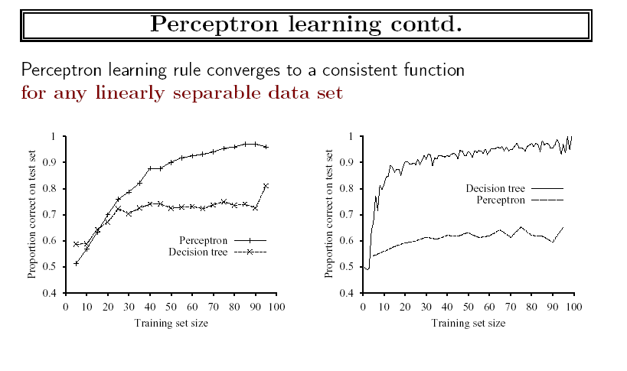
Experiments

Slide 15
Perceptron Learning from Patterns
x₁
w₁
w₂
x₂
Σ
.
.
.
w_{n}
x_{n}
weights (trained)
fixed
Input
pattern
Association
units
Summation
Threshold
Association units (A-units) can be assigned arbitrary Boolean
functions of the input pattern.

Slide 16
Multiple Output Perceptrons
Handwritten alphabetic character recognition
  26 classes : A,B,C…,Z
  First output unit distinguishes between “A”s and “non-A”s, second output unit between “B”s and “non-B”s etc.
. . .
y₁
y₂
y₂₆
w_{ji} connects x_{i} with y_{j}
x₁
x₂
x₃
. . .
x_{n}
w’_{ji} = w_{ji} + α (t_{j}-y_{j}) x_{i}

Slide 17
Part 2. Multi Layer Networks
Output vector
Output nodes
Hidden nodes
Input nodes
Input vector

Slide 18
Can use multi layer to learn nonlinear functions
w₁=?
w₂=?
θ= ?
How to set the weights?
0
1
3
x₁
1
0
x1
w35
w23
5
Logical XOR
x2
x₁ | x₂ | y
0 | 0 | 0
0 | 1 | 1
1 | 0 | 1
1 | 1 | 0
4

Slide 19
Examples
Learn the AND gate?
Learn the OR gate?
Learn the NOT gate?
Is X1 → X2 a linear learning problem?

Slide 20
Learning the Multilayer Networks
Known as back-propagation algorithm
Learning rule slightly different
Can consult the text book for the algorithm, but we need not worry in this course.

