Slide 1
Collaborative Filtering and Pagerank in a Network
Qiang Yang
HKUST
Thanks: Sonny Chee
Notes:
Lecture 1

Slide 2


Motivation
Question:
  A user bought some products already
  what other products to recommend to a user?
Collaborative Filtering (CF)
  Automates “circle of advisors”.
+

Slide 3
Collaborative Filtering
“..people collaborate to help one another perform filtering by recording their reactions...” (Tapestry)
Finds users whose taste is similar to you and uses them to make recommendations.
Complimentary to IR/IF.
  IR/IF finds similar documents – CF finds similar users.

Slide 4

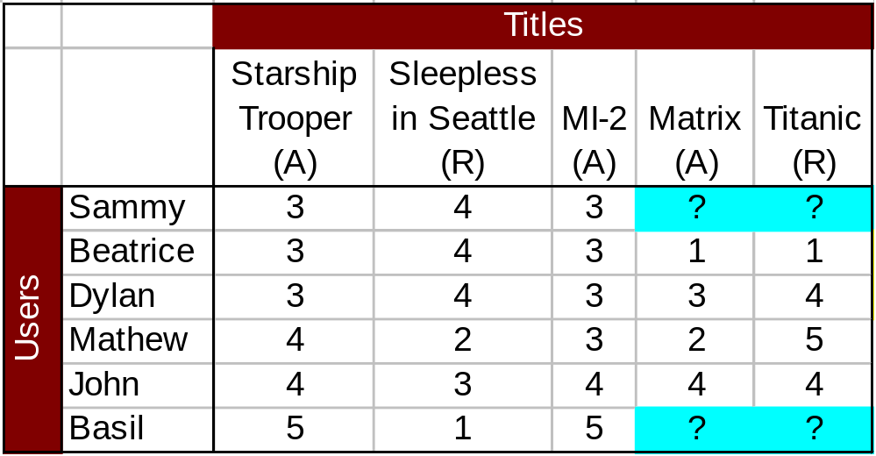
Example
Which movie would Sammy watch next?
    Ratings 1--5
If we just use the average of other users who voted on these movies, then we get
  Matrix= 3; Titanic= 14/4=3.5
  Recommend Titanic!
But, is this reasonable?

Slide 5
Types of Collaborative Filtering Algorithms
Collaborative Filters
Open Problems
  Sparsity, First Rater, Scalability

Slide 6
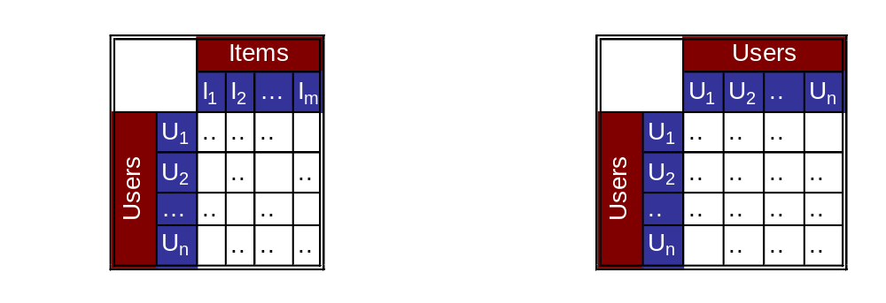
Statistical Collaborative Filters
Users annotate items with numeric ratings.
Users who rate items “similarly” become mutual advisors.
Recommendation computed by taking a weighted aggregate of advisor ratings.

Slide 7
Basic Idea
Nearest Neighbor Algorithm
Given a user a and item i
  First, find the the most similar users to a,
    Let these be Y
  Second, find how these users (Y) ranked i,
  Then, calculate a predicted rating of a on i based on some average of all these users Y
    How to calculate the similarity and average?

Slide 8
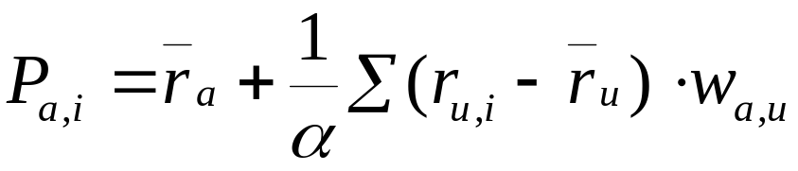
Statistical Filters
GroupLens [Resnick et al 94, MIT]
  Filters UseNet News postings
  Similarity: Pearson correlation
  Prediction: Weighted deviation from mean

Slide 9
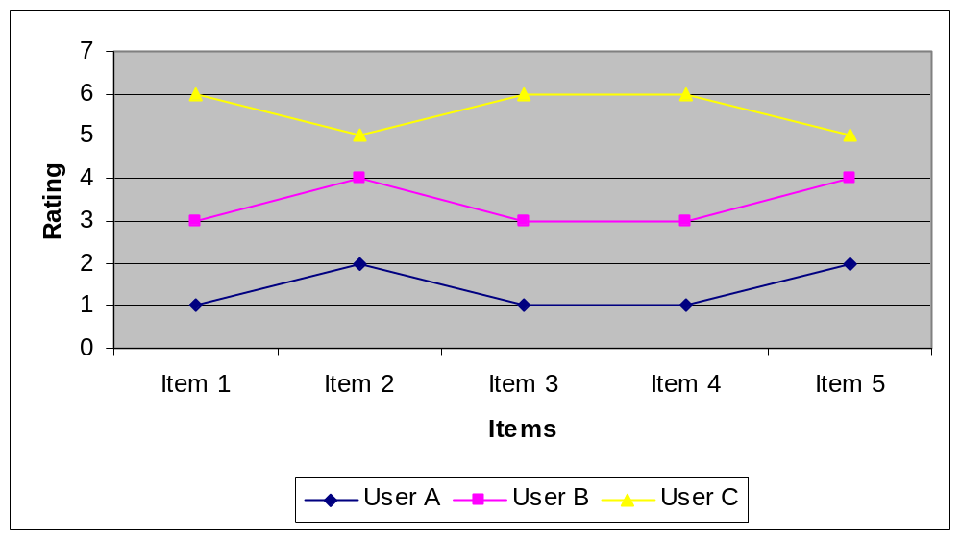
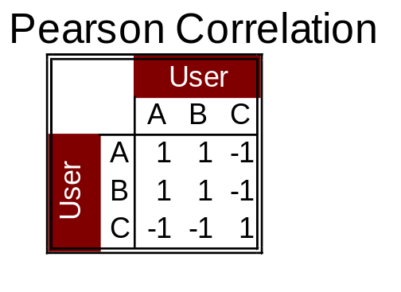
Pearson Correlation

Slide 10
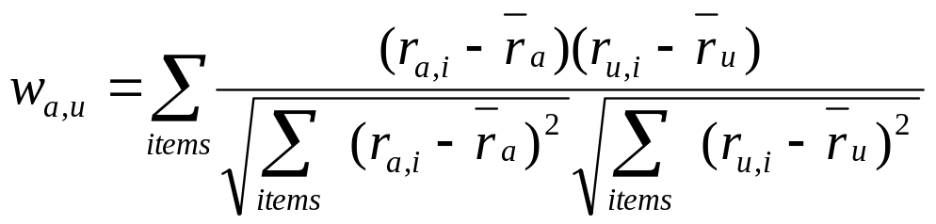
Pearson Correlation
Weight between users a and u
  Compute similarity matrix between users
    Use Pearson Correlation (-1, 0, 1)
    Let items be all items that users rated

Slide 11
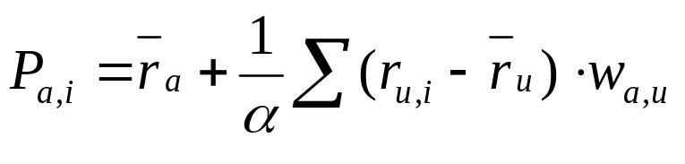

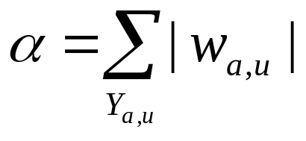
Prediction Generation
Predicts how much user a likes an item i (a stands for active user)
  Make predictions using weighted deviation from the mean
: sum of all weights
(1)

Slide 12
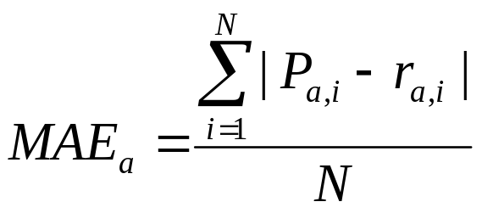
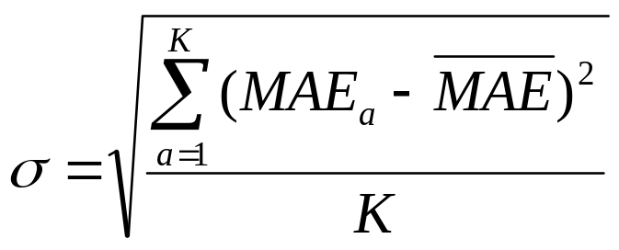
Error Estimation
Mean Absolute Error (MAE) for user a
Standard Deviation of the errors

Slide 13
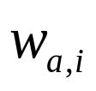
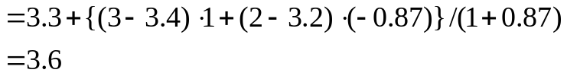
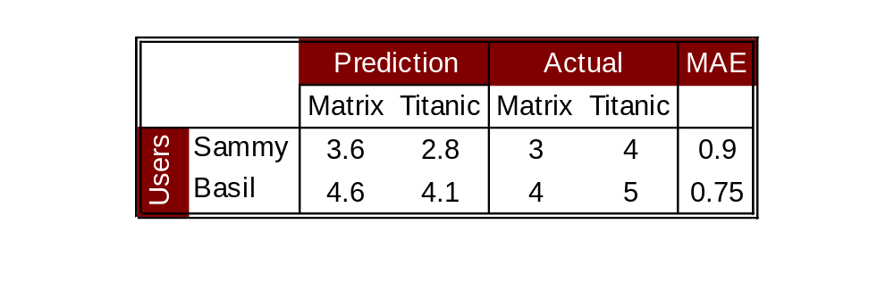

Example
Correlation
Sammy
Dylan
Mathew
Sammy
1
1
-0.87
Users
Dylan
1
1
0.21
Mathew
-0.87
0.21
1
=0.83

Slide 14
Open Problems in CF
“Sparsity Problem”
  CFs have poor accuracy and coverage in comparison to population averages at low rating density [GSK⁺99].
“First Rater Problem” (cold start prob)
  The first person to rate an item receives no benefit. CF depends upon altruism. [AZ97]

Slide 15
Open Problems in CF
“Scalability Problem”
  CF is computationally expensive. Fastest published algorithms (nearest-neighbor) are n².
    Any indexing method for speeding up?
  Has received relatively little attention.

Slide 16
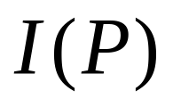
The PageRank Algorithm
Fundamental question to ask
  What is the importance level of a page P,
Information Retrieval
  Cosine + TF IDF → does not give related hyperlinks
Link based
  Important pages (nodes) have many other links point to it
  Important pages also point to other important pages

Slide 17
The Google Crawler Algorithm
“Efficient Crawling Through URL Ordering”,
  Junghoo Cho, Hector Garcia-Molina, Lawrence Page, Stanford
  http://www.www8.org
  http://www-db.stanford.edu/~cho/crawler-paper/
“Modern Information Retrieval”, BY-RN
  Pages 380—382
Lawrence Page, Sergey Brin. The Anatomy of a Search Engine. The Seventh International WWW Conference (WWW 98). Brisbane, Australia, April 14-18, 1998.
  http://www.www7.org

Slide 18
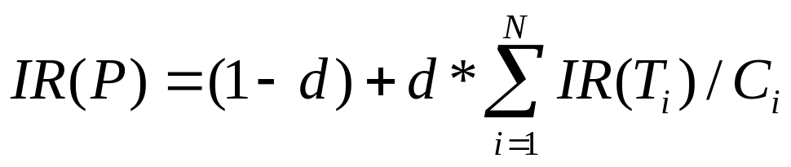
Page Rank Metric
C=2
Let 1-d be probability
that user randomly jump to page P;
“d” is the damping factor. (1-d) is the likelihood of arriving at P by random jumping
Let N be the in degree of P
Let C_{i} be the number of
out links (out degrees) from each T_{i}
T₁
Web Page
P
T₂
T_{N}
d=0.9

Slide 19
How to compute page rank?
For a given network of web pages,
  Initialize page rank for all pages (to one)
  Set parameter (d=0.90)
  Iterate through the network, L times

Slide 20
Example: iteration K=1
IR(P)=1/3 for all nodes, d=0.9
A
C
node | IR
A | 1/3
B | 1/3
C | 1/3
B

Slide 21
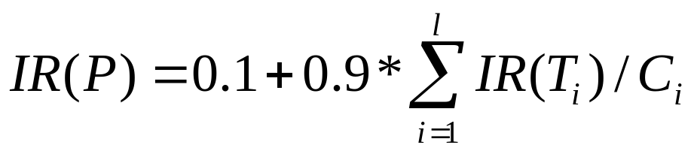
Example: k=2
A
l is the in-degree of P
C
node | IR
A | 0.4
B | 0.1
C | 0.55
B
Note: A, B, C’s IR values are
Updated in order of A, then B, then C
Use the new value of A when calculating B, etc.

Slide 22
Example: k=2 (normalize)
A
C
node | IR
A | 0.38
B | 0.095
C | 0.52
B

Slide 23
Crawler Control
All crawlers maintain several queues of URL’s to pursue next
  Google initially maintains 500 queues
  Each queue corresponds to a web site pursuing
Important considerations:
  Limited buffer space
  Limited time
  Avoid overloading target sites
  Avoid overloading network traffic

Slide 24
Crawler Control
Thus, it is important to visit important pages first
Let G be a lower bound threshold on IR(P)
Crawl and Stop
  Select only pages with IR>G to crawl,
  Stop after crawled K pages

Slide 25
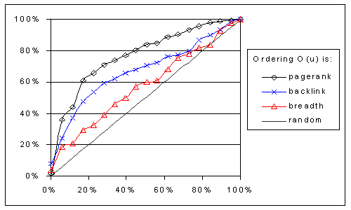
Test Result: 179,000 pages
Percentage of Stanford Web crawled vs. P_{ST} – the percentage of hot pages visited so far

Slide 26
Google Algorithm (very simplified)
First, compute the page rank of each page on WWW
  Query independent
Then, in response to a query q, return pages that contain q and have highest page ranks
A problem/feature of Google: favors big commercial sites

