Slide 1
Data Mining: Data
Lecture Notes for Chapter 2
Introduction to Data Mining
by
Tan, Steinbach, Kumar
Revised by QY

Slide 2

What is Data?
Collection of data objects and their attributes
An attribute is a property or characteristic of an object
  Examples: eye color of a person, temperature, etc.
  Attribute is also known as variable, field, characteristic, or feature
A collection of attributes describe an object
  Object is also known as record, point, case, sample, entity, or instance
Attributes
Objects

Slide 3
Attribute Values
Attribute values are numbers or symbols assigned to an attribute
  E.g. ‘Student Name’=‘John’
  Attributes are also called ‘variables’, or ‘features’
  Attribute values are also called ‘values’, or ‘feature-values’
Designing Attributes for a data set requires domain knowledge
  Always have an objective in mind (e.g., what is the class attribute?)
  Design a ‘movie’ data set for a movie dataset?
    What is domain knowledge?

Slide 4
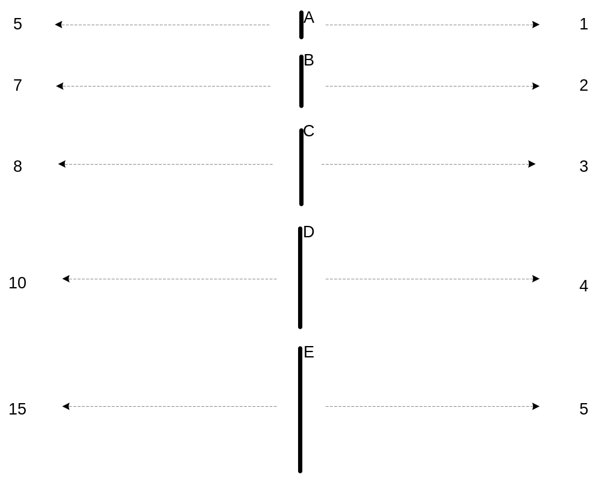
Measurement of Length
Different designs have different attributes properties.

Slide 5
Types of Attributes
There are different types of attributes
  Nominal (Categorical)
    Examples: ID numbers, eye color, zip codes
  Ordinal (Categorical)
    Examples: rankings (e.g., movie ranking scores on a scale from 1-10), grades (A,B,C..), height in {tall, medium, short}
      Binary (0, 1) is a special case
  Continuous
    Example: temperature in Celsius

Slide 6
Record Data
Data consist of a collection of records, each of which consists of a fixed set of attributes
Q: what is a sparse data set?

Slide 7
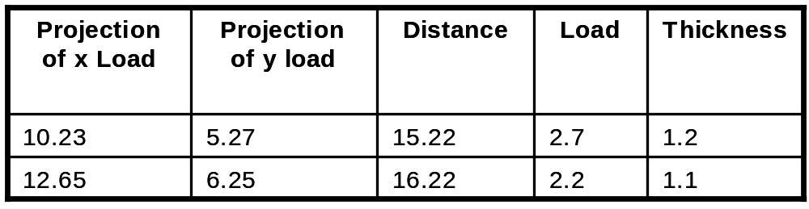
Data Matrix
If data objects have the same fixed set of numeric attributes, then the data objects can be thought of as points in a multi-dimensional space, where each dimension represents an attribute
Such data set can be represented by an m by n matrix, where there are m rows, one for each object, and n columns, one for each attribute
Q: what is a sparse data set?

Slide 8

Document Data
Each document becomes a `term' vector,
  each term is a component (attribute) of the vector,
    Term can be n-grams, phrases, etc.
  the value of each component is the number of times the corresponding term occurs in the document.
Q: what is a sparse data set?

Slide 9

Transaction Data
A special type of record data, where
  each record (transaction) has a set of items.
  For example, consider a grocery store. The set of products purchased by a customer during one shopping trip constitute a transaction, while the individual products that were purchased are the items.
  Set based
Q: class attribute?

Slide 10
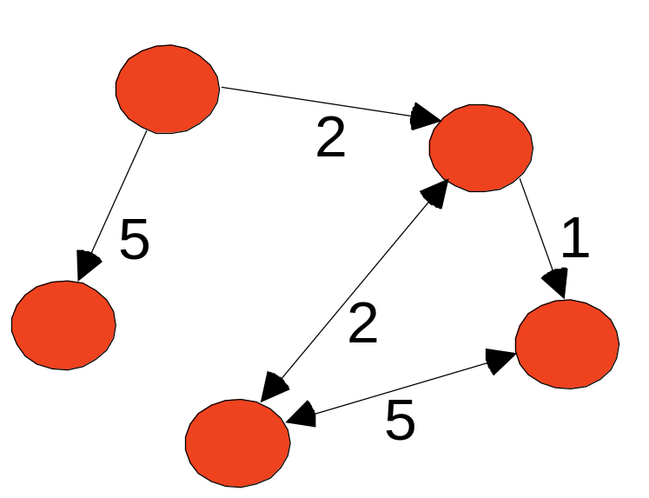
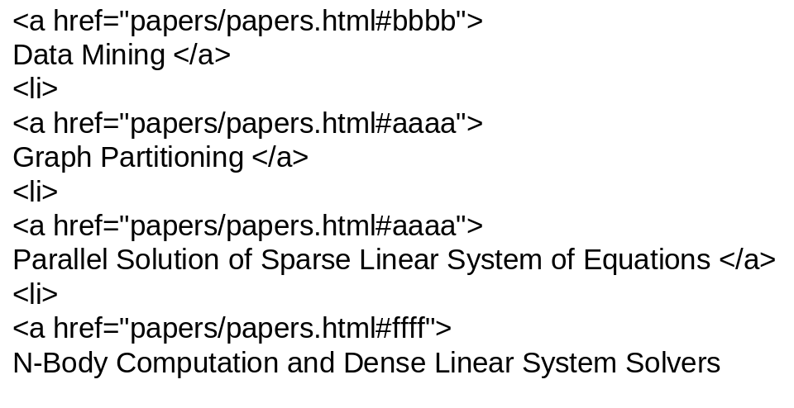
Graph Data
Examples: Directed graph and URL Links
Q: what is a sparse data set?

Slide 11
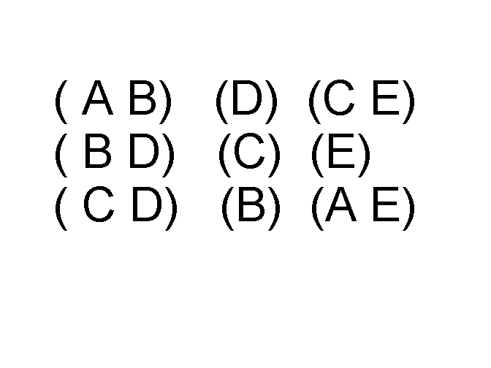
Ordered Data
Sequences of transactions
Items/Events
An element of the sequence

Slide 12
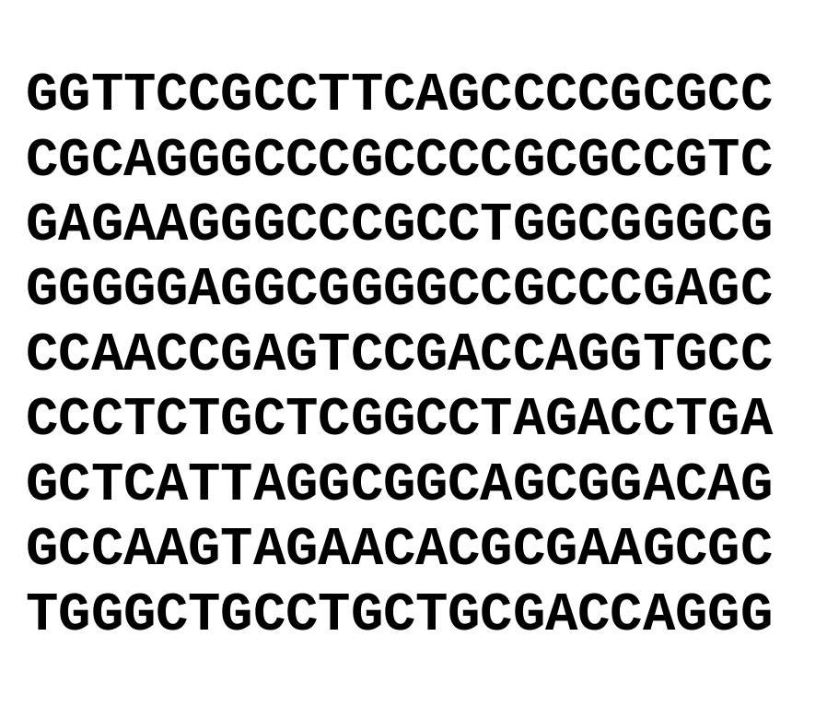
Ordered Data
Genomic sequence data

Slide 13
Data Quality
What kinds of data quality problems?
How can we detect problems with the data?
What can we do about these problems?
Examples of data quality problems:
  Noise and outliers
  missing values
  duplicated data

Slide 14

Outliers
Outliers are data objects with characteristics that are considerably different than most of the other data objects in the data set
  Are they noise points, or meaningful outliers?

Slide 15
Missing Values
Reasons for missing values
  Information is not collected
  (e.g., people decline to give their age and weight)
  Attributes may not be applicable to all cases
  (e.g., annual income is not applicable to children)
Handling missing values
  Eliminate Data Objects
  Estimate Missing Values
  Ignore the Missing Value During Analysis
  Replace with all possible values (weighted by their probabilities)
  Missing as meaningful…

Slide 16
Data Preprocessing
Aggregation and Noise Removal
Sampling
Dimensionality Reduction
Feature subset selection
Feature creation and transformation
Discretization
Q: How much % of the data mining process is data preprocessing?

Slide 17
Aggregation
Combining two or more attributes (or objects) into a single attribute (or object)
Purpose
  Data reduction
    Reduce the number of attributes or objects
  Change of scale
    Cities aggregated into regions, states, countries, etc
  De-noise: more “stable” data
    Aggregated data tends to have less variability

Slide 18
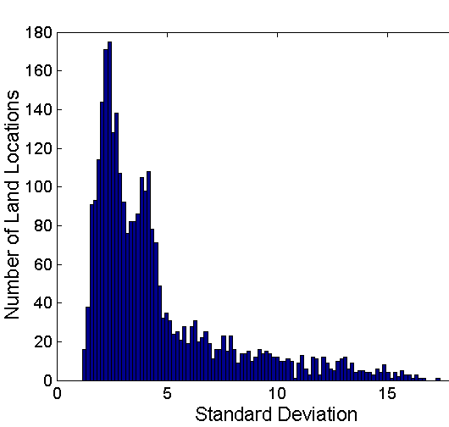
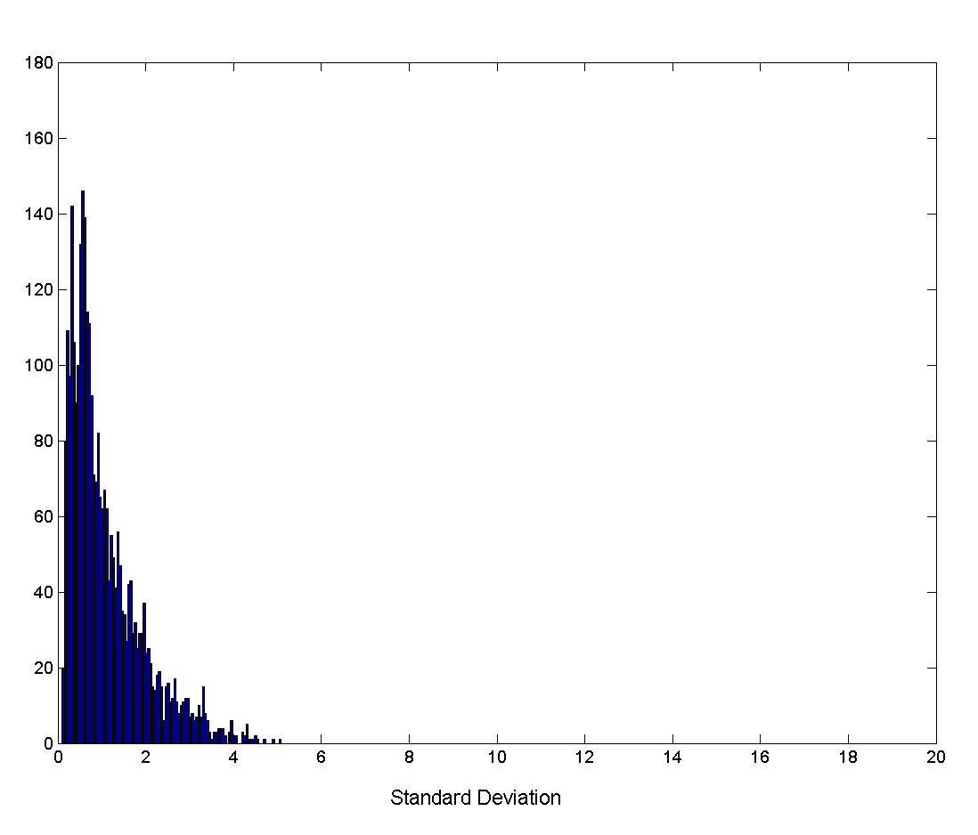
Aggregation
Variation of Precipitation in Australia
Standard Deviation of Average Monthly Precipitation
Standard Deviation of Average Yearly Precipitation

Slide 19
Sampling
Sampling is the main technique employed for data selection.
  It is often used for both the preliminary investigation of the data and the final data analysis.
Reasons:
  too expensive or time consuming to obtain or to process the data.

Slide 20
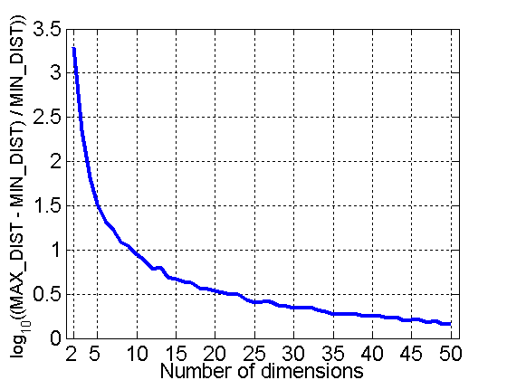
Curse of Dimensionality
When dimensionality increases, data becomes increasingly sparse in the space that it occupies
Definitions of density and distance between points, which is critical for clustering and outlier detection, become less meaningful
Thus, harder and harder to classify the data!
Randomly generate 500 points
Compute difference between max and min distance between any pair of points

Slide 21
Dimensionality Reduction
Purpose:
  Avoid curse of dimensionality
  Reduce amount of time and memory required by data mining algorithms
  Allow data to be more easily visualized
  May help to eliminate irrelevant features or reduce noise
Techniques (supervised and unsupervised methods)
  Principle Component Analysis
  Singular Value Decomposition
  Others: supervised and non-linear techniques

Slide 22
Dimensionality Reduction: PCA
Goal is to find a projection that captures the largest amount of variation in data
  Supervised or unsupervised?
x₂
e
x₁

Slide 23
Dimensionality Reduction: PCA
Find the eigenvectors of the covariance matrix
The eigenvectors define the new space
  How many eigenvectors here?
x₂
e
x₁

Slide 24
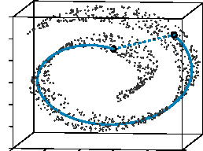
Dimensionality Reduction: ISOMAP
By: Tenenbaum, de Silva, Langford (2000)
Construct a neighbourhood graph
For each pair of points in the graph, compute the shortest path distances – geodesic distances

Slide 25
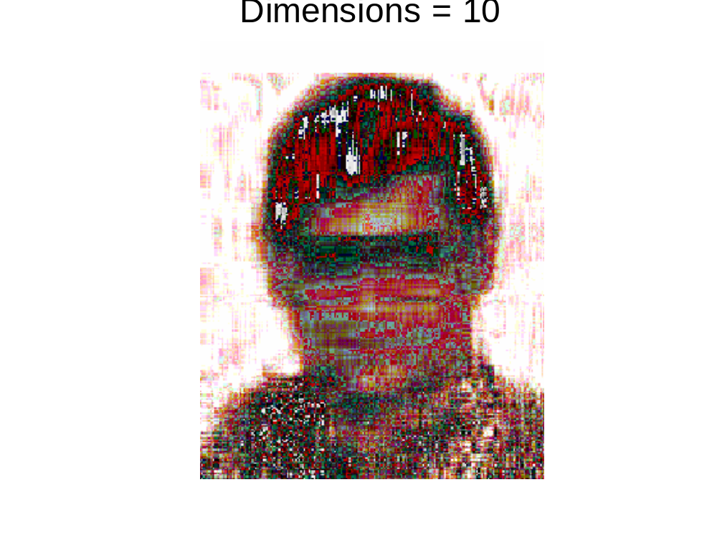
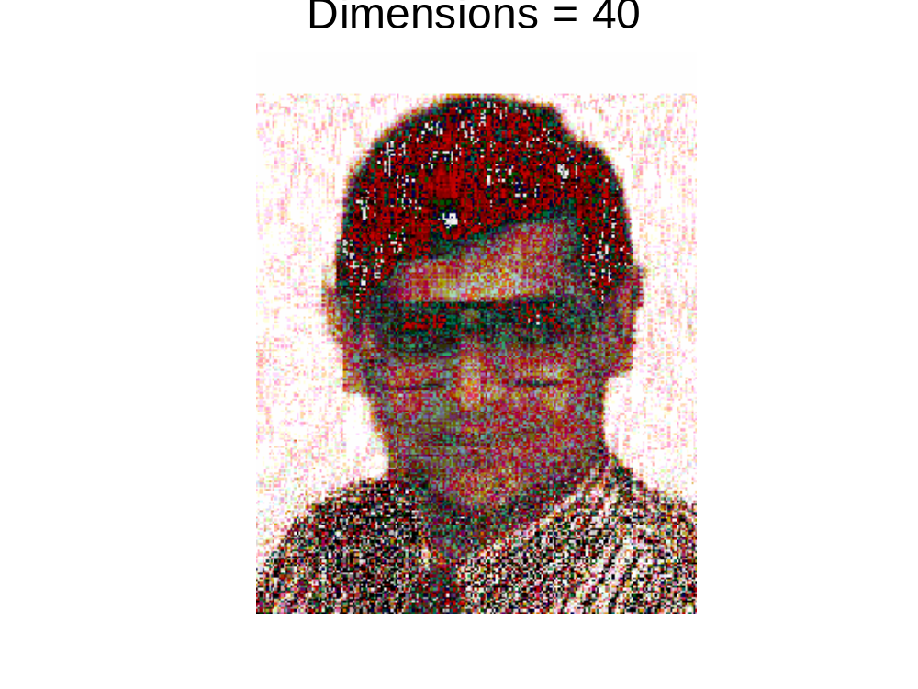
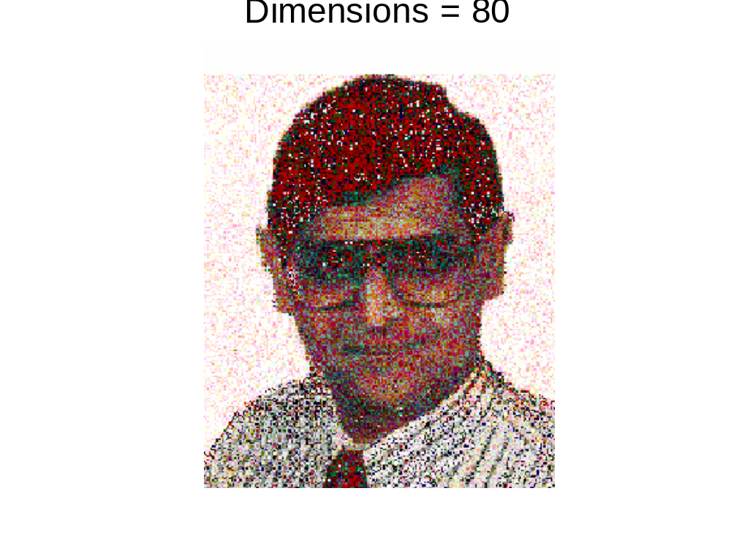
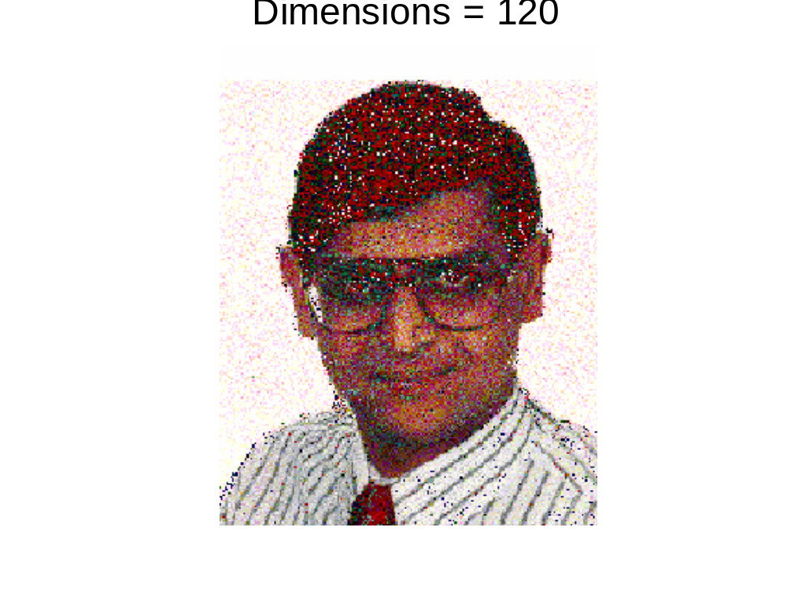
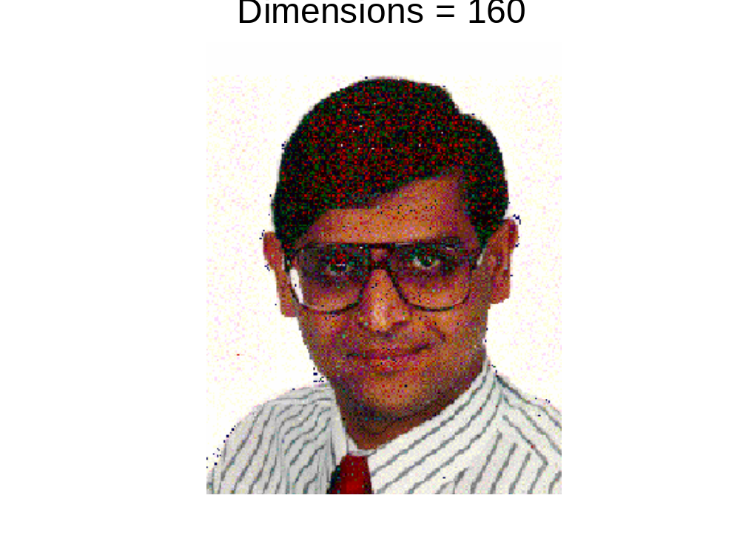
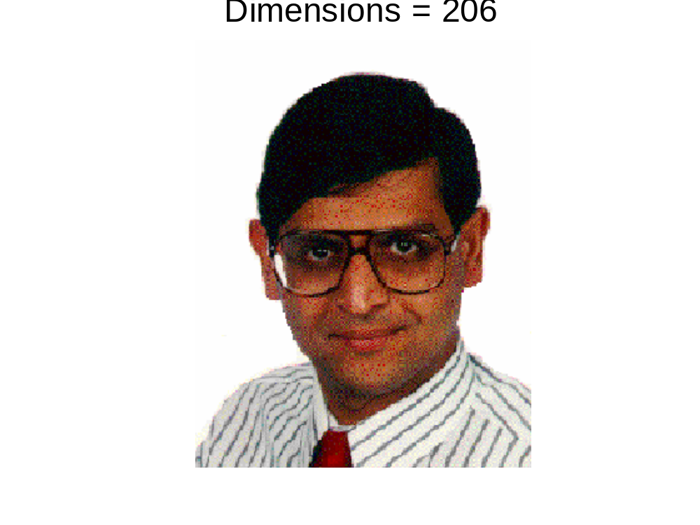
Dimensionality Reduction: PCA

Slide 26
Question
What is the difference between sampling and dimensionality reduction?
  Thining vs. shortening of data

Slide 27
Discretization
Three types of attributes:
  Nominal — values from an unordered set
    Example: attribute “outlook” from weather data
      Values: “sunny”,”overcast”, and “rainy”
  Ordinal — values from an ordered set
    Example: attribute “temperature” in weather data
      Values: “hot” > “mild” > “cool”
  Continuous — real numbers
Discretization:
  divide the range of a continuous attribute into intervals
  Some classification algorithms only accept categorical attributes.
  Reduce data size by discretization
  Supervised (entropy) vs. Unsupervised (binning)

Slide 28
Simple Discretization Methods: Binning
Equal-width (distance) partitioning:
  It divides the range into N intervals of equal size: uniform grid
  if A and B are the lowest and highest values of the attribute, the width of intervals will be: W = (B –A)/N.
    The most straightforward
    But outliers may dominate presentation: Skewed data is not handled well.
Equal-depth (frequency) partitioning:
  It divides the range into N intervals, each containing approximately same number of samples
  Good data scaling
  Managing categorical attributes can be tricky.

Slide 29
Transforming Ordinal to Boolean
Simple transformation allows to code ordinal attribute with n values using n-1 boolean attributes
Example: attribute “temperature”
Why? Not introducing distance concept between different colors: “Red” vs. “Blue” vs. “Green”.
Temperature
Cold
Medium
Hot
Temperature > cold | Temperature > medium
False | False
True | False
True | True
Original data
Transformed data

Slide 30

Visually Evaluating Correlation
Scatter plots showing the similarity from –1 to 1.

