Slide 1
Data Mining Classification: Basic Concepts, Decision Trees, and Model Evaluation
Lecture Notes for Chapter 4
Part I
Introduction to Data Mining
by
Tan, Steinbach, Kumar
Adapted by Qiang Yang (2010)
© Tan,Steinbach, Kumar Introduction to Data Mining 4/18/2004 1

Slide 2
Classification: Definition
Given a collection of records (training set )
Each record contains a set of attributes, one of the attributes is the class.
Find a model for class attribute as a function of the values of other attributes.
Goal: previously unseen records should be assigned a class as accurately as possible.
A test set is used to determine the accuracy of the model. Usually, the given data set is divided into training and test sets, with training set used to build the model and test set used to validate it.

Slide 3
Illustrating Classification Task

Slide 4

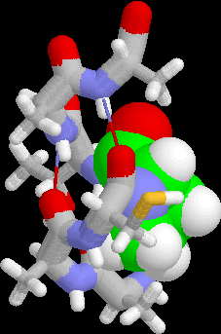
Examples of Classification Task
Predicting tumor cells as benign or malignant
Classifying credit card transactions as legitimate or fraudulent
Classifying secondary structures of protein as alpha-helix, beta-sheet, or random coil
Categorizing news stories as finance, weather, entertainment, sports, etc

Slide 5
Classification Techniques
Decision Tree based Methods
Rule-based Methods
Memory based reasoning
Neural Networks
Naïve Bayes and Bayesian Belief Networks
Support Vector Machines

Slide 6
Example of a Decision Tree
categorical
categorical
continuous
class
Splitting Attributes
Refund
Yes
No
NO
MarSt
Single, Divorced
Married
TaxInc
NO
< 80K
> 80K
NO
YES
Training Data
Model: Decision Tree

Slide 7
Another Example of Decision Tree
categorical
categorical
continuous
class
MarSt
Single, Divorced
Married
NO
Refund
Yes
No
NO
TaxInc
< 80K
> 80K
NO
YES
There could be more than one tree that fits the same data!

Slide 8
Decision Tree Classification Task
Decision Tree

Slide 9
Apply Model to Test Data
Test Data
Start from the root of tree.
Refund
Yes
No
NO
MarSt
Single, Divorced
Married
TaxInc
NO
< 80K
> 80K
NO
YES

Slide 10
Apply Model to Test Data
Test Data
Refund
Yes
No
NO
MarSt
Single, Divorced
Married
TaxInc
NO
< 80K
> 80K
NO
YES

Slide 11
Apply Model to Test Data
Test Data
Refund
Yes
No
NO
MarSt
Single, Divorced
Married
TaxInc
NO
< 80K
> 80K
NO
YES

Slide 12
Apply Model to Test Data
Test Data
Refund
Yes
No
NO
MarSt
Single, Divorced
Married
TaxInc
NO
< 80K
> 80K
NO
YES

Slide 13
Apply Model to Test Data
Test Data
Refund
Yes
No
NO
MarSt
Single, Divorced
Married
TaxInc
NO
< 80K
> 80K
NO
YES

Slide 14
Apply Model to Test Data
Test Data
Refund
Yes
No
NO
MarSt
Single, Divorced
Married
Assign Cheat to “No”
TaxInc
NO
< 80K
> 80K
NO
YES

Slide 15
Decision Trees as a Computer Program
Rewrite the previous decision trees as a If-then-else statement

Slide 16
Decision Boundary
Border line between two neighboring regions of different classes is known as decision boundary
Decision boundary is parallel to axes because test condition involves a single attribute at-a-time

Slide 17
Interpretation of a Node in a Tree
As a subset of a training data set

Slide 18
Tree Evaluation
Test set
Ground truth, data labeling, mechanical Turk
Confusion Matrix and cost matrix
True positive, true negative, false positive, false negative
Accuracy
Error rates

Slide 19
Decision Tree Classification Task
Decision Tree

Slide 20
Decision Tree Induction
Many Algorithms:
CART (Classification and Regression Trees)
ID3, C4.5, C5.0
Other more scalable algorithms

Slide 21
Tree Induction
Greedy strategy.
Split the records based on an attribute test that optimizes certain criterion.
Issues
Determine how to split the records
How to specify the attribute test condition?
How to determine the best split?
Determine when to stop splitting
Determine how to cut back if tree is too deep
What is wrong with a tree that is too deep?

Slide 22
How to Specify Test Condition?
Depends on attribute types
Nominal
Ordinal
Continuous
Depends on number of ways to split
2-way split
Multi-way split
Based on the number of discrete values

Slide 23
Entropy Based Evaluation and Splitting
Entropy at a given node t:
(NOTE: p( j | t) is the relative frequency of class j at node t).
Measures impurity of a node:
Maximum (log n_{c})
when records are equally distributed among all classes: implying least information, where n_{c} =the number of classes.
Minimum (0):
when all records belong to one class, implying most information

Slide 24
Examples for computing Entropy
P(C1) = 0/6 = 0 P(C2) = 6/6 = 1
Entropy = – 0 log 0 – 1 log 1 = – 0 – 0 = 0
P(C1) = 1/6 P(C2) = 5/6
Entropy = – (1/6) log₂ (1/6) – (5/6) log₂ (1/6) = 0.65
P(C1) = 2/6 P(C2) = 4/6
Entropy = – (2/6) log₂ (2/6) – (4/6) log₂ (4/6) = 0.92

Slide 25
Splitting Based on INFO...
Information Gain:
Parent Node, p is split into k partitions;
n_{i} is number of records in partition i
Measures Reduction in Entropy achieved because of the split. Choose the split that achieves most reduction (maximizes GAIN)
Used in ID3 and C4.5
Disadvantage: Tends to prefer splits that result in large number of partitions, each being small but pure.

Slide 26
Splitting Based on INFO...
Gain Ratio:
Parent Node, p is split into k partitions
n_{i} is the number of records in partition i
Adjusts Information Gain by the entropy of the partitioning (SplitINFO). Higher entropy partitioning (large number of small partitions) is penalized!
Used in C4.5
Designed to overcome the disadvantage of Information Gain

Slide 27
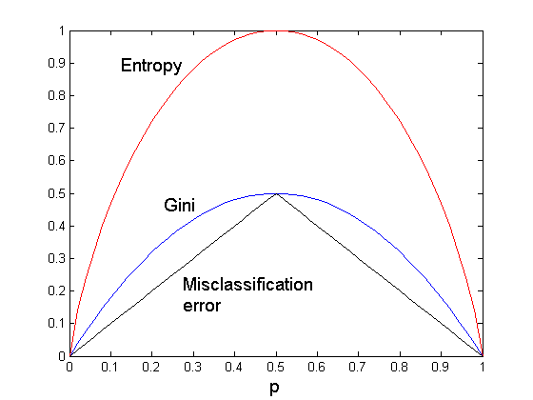
Comparison among Splitting Criteria
For a 2-class problem:

Slide 28
Example: Build a Decision Tree

