Slide 1
Data Mining
Classification: Alternative Techniques
Lecture Notes for Chapter 5
Introduction to Data Mining
by
Tan, Steinbach, Kumar
© Tan,Steinbach, Kumar Introduction to Data Mining 4/18/2004 <number>

Slide 2
Rule Based Method: See new lecture notes

Slide 3
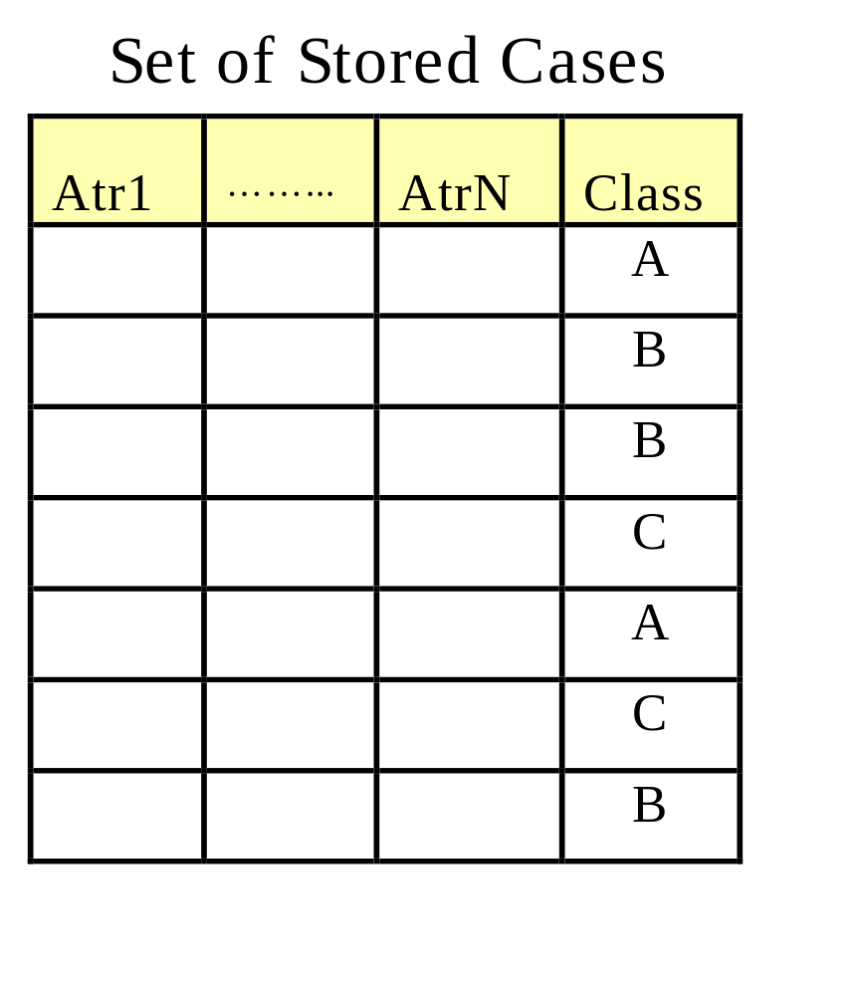
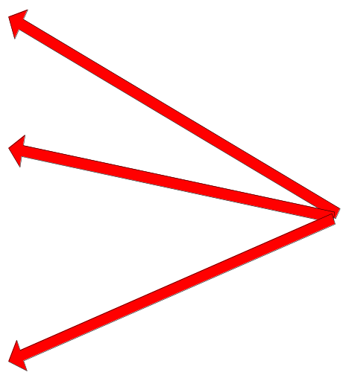
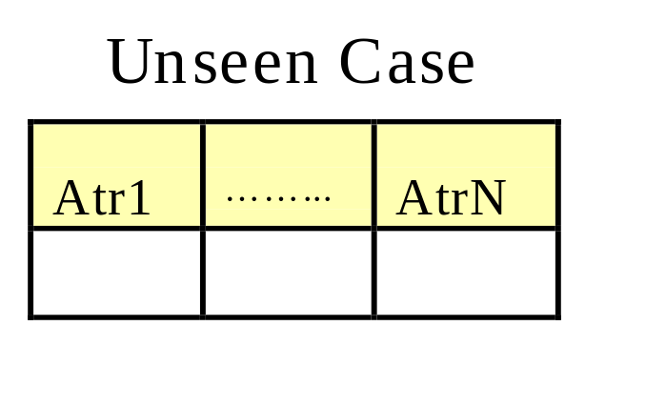
Instance-Based Classifiers
Store the training records
Use training records to
predict the class label of
unseen cases

Slide 4
Instance Based Classifiers
Examples:
  Rote-learner
    Memorizes entire training data and performs classification only if attributes of record match one of the training examples exactly
  Nearest neighbor
    Uses k “closest” points (nearest neighbors) for performing classification

Slide 5






Nearest Neighbor Classifiers
Basic idea:
  If it walks like a duck, quacks like a duck, then it’s probably a duck
Compute Distance
Test Record
Training Records
Choose k of the “nearest” records

Slide 6
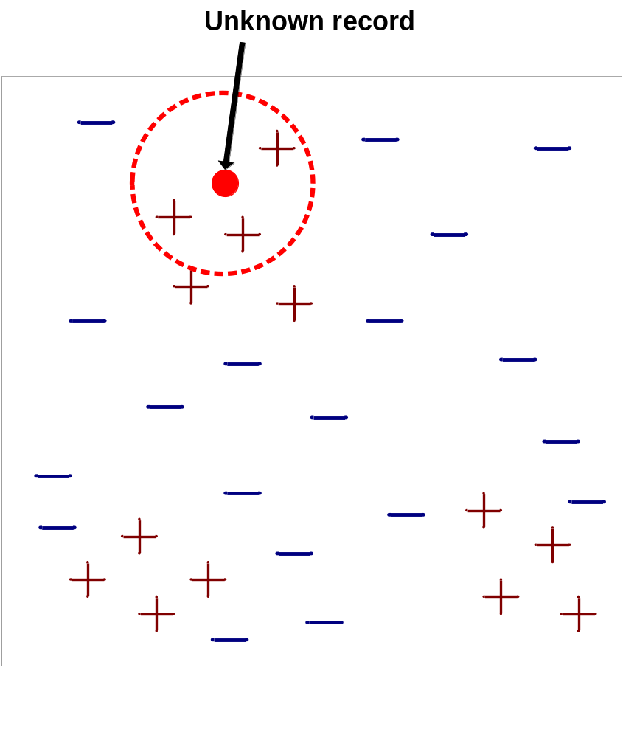
Nearest-Neighbor Classifiers
Requires three things
  The set of stored records
  Distance Metric to compute distance between records
  The value of k, the number of nearest neighbors to retrieve
To classify an unknown record:
  Compute distance to other training records
  Identify k nearest neighbors
  Use class labels of nearest neighbors to determine the class label of unknown record (e.g., by taking majority vote)

Slide 7

Definition of Nearest Neighbor
K-nearest neighbors of a record x are data points that have the k smallest distance to x

Slide 8
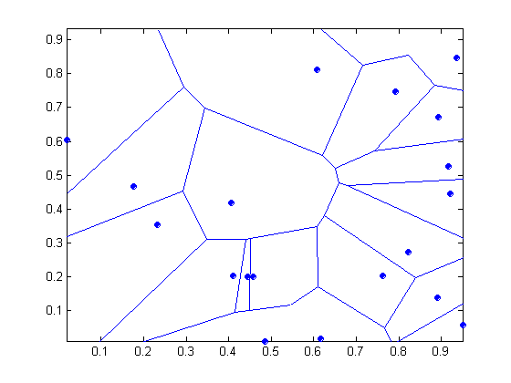
1 nearest-neighbor
Voronoi Diagram

Slide 9
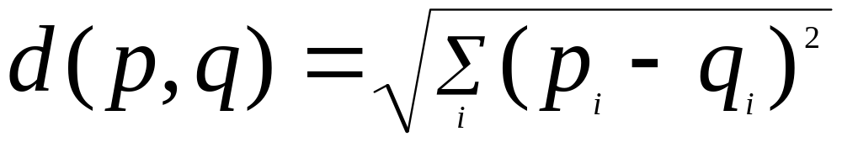
Nearest Neighbor Classification
Compute distance between two points:
  Euclidean distance
Determine the class from nearest neighbor list
  take the majority vote of class labels among the k-nearest neighbors
  Weigh the vote according to distance
    weight factor, w = 1/d²

Slide 10
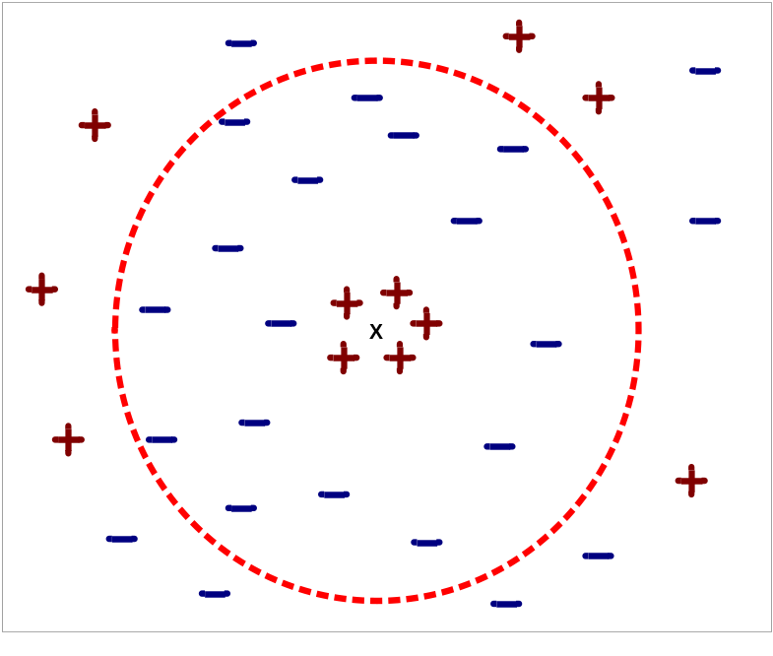
Nearest Neighbor Classification…
Choosing the value of k:
  If k is too small, sensitive to noise points
  If k is too large, neighborhood may include points from other classes

Slide 11
Nearest Neighbor Classification…
Scaling issues
  Attributes may have to be scaled to prevent distance measures from being dominated by one of the attributes
  Example:
    height of a person may vary from 1.5m to 1.8m
    weight of a person may vary from 90lb to 300lb
    income of a person may vary from $10K to $1M

Slide 12
Nearest Neighbor Classification…
Problem with Euclidean measure:
  High dimensional data
    curse of dimensionality
  Can produce counter-intuitive results
1 1 1 1 1 1 1 1 1 1 1 0
1 0 0 0 0 0 0 0 0 0 0 0
vs
0 1 1 1 1 1 1 1 1 1 1 1
0 0 0 0 0 0 0 0 0 0 0 1
d = 1.4142
d = 1.4142
    Solution: Normalize the vectors to unit length

Slide 13
Nearest neighbor Classification…
k-NN classifiers are lazy learners
  It does not build models explicitly
  Unlike eager learners such as decision tree induction and rule-based systems
  Classifying unknown records are relatively expensive

Slide 14
Example: PEBLS
PEBLS: Parallel Examplar-Based Learning System (Cost & Salzberg)
  Works with both continuous and nominal features
    For nominal features, distance between two nominal values is computed using modified value difference metric (MVDM)
  Each record is assigned a weight factor
  Number of nearest neighbor, k = 1

Slide 15

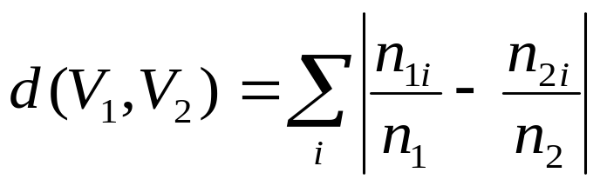
Example: PEBLS
Distance between nominal attribute values:
d(Single,Married)
= | 2/4 – 0/4 | + | 2/4 – 4/4 | = 1
d(Single,Divorced)
= | 2/4 – 1/2 | + | 2/4 – 1/2 | = 0
d(Married,Divorced)
= | 0/4 – 1/2 | + | 4/4 – 1/2 | = 1
d(Refund=Yes,Refund=No)
= | 0/3 – 3/7 | + | 3/3 – 4/7 | = 6/7
Class | Marital Status
 | Single | Married | Divorced
Yes | 2 | 0 | 1
No | 2 | 4 | 1
Class | Refund
 | Yes | No
Yes | 0 | 3
No | 3 | 4

Slide 16
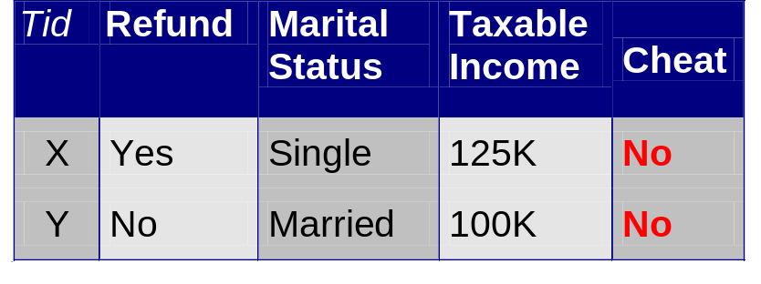
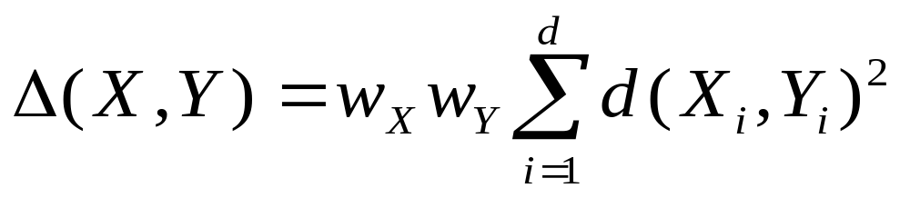
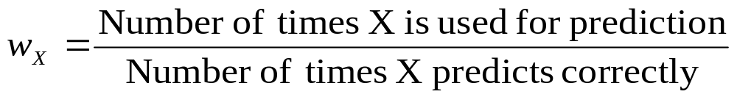
Example: PEBLS
Note: When X is a test data,
We should have a weight
Wx=1, since for the test data,
we do not have the class label.
For a training data Y, W_{Y} is large
when Y is an outlier.
Distance between record X and record Y:
where:
w_{X} ≅ 1 if X makes accurate prediction most of the time
w_{X} > 1 if X is not reliable for making predictions

Slide 17
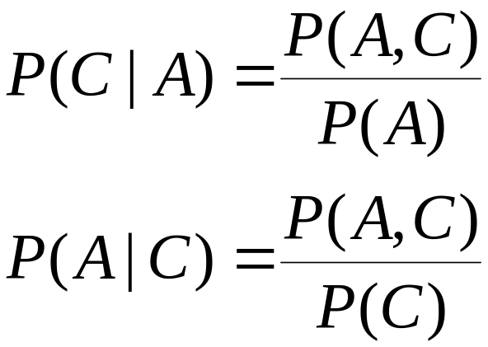
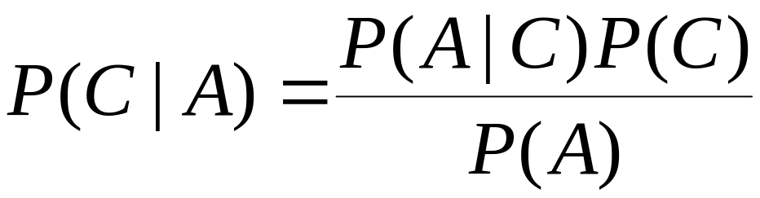
Bayes Classifier
A probabilistic framework for solving classification problems
Conditional Probability:
Bayes theorem:

Slide 18
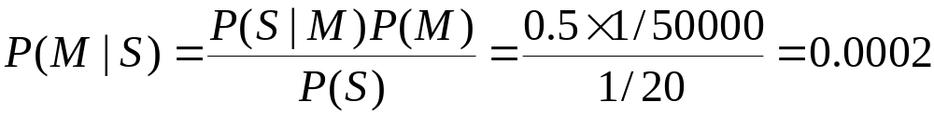
Example of Bayes Theorem
Given:
  A doctor knows that meningitis causes stiff neck 50% of the time
  Prior probability of any patient having meningitis is 1/50,000
  Prior probability of any patient having stiff neck is 1/20
If a patient has stiff neck, what’s the probability he/she has meningitis?

Slide 19
Bayesian Classifiers
Consider each attribute and class label as random variables
Given a record with attributes (A₁, A₂,…,A_{n})
  Goal is to predict class C
  Specifically, we want to find the value of C that maximizes P(C| A₁, A₂,…,A_{n} )
Can we estimate P(C| A₁, A₂,…,A_{n} ) directly from data?

Slide 20
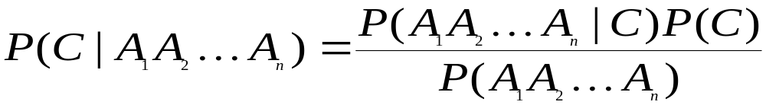
Bayesian Classifiers
Approach:
  compute the posterior probability P(C | A₁, A₂, …, A_{n}) for all values of C using the Bayes theorem
  Choose value of C that maximizes
  P(C | A₁, A₂, …, A_{n})
  Equivalent to choosing value of C that maximizes
  P(A₁, A₂, …, A_{n}|C) P(C)
How to estimate P(A₁, A₂, …, A_{n} | C )?

Slide 21
Naïve Bayes Classifier
Assume independence among attributes A_{i} when class is given:
  P(A₁, A₂, …, A_{n} |C) = P(A₁| C_{j}) P(A₂| C_{j})… P(A_{n}| C_{j})
  Can estimate P(A_{i}| C_{j}) for all A_{i} and C_{j}.
  New point is classified to C_{j} if P(C_{j}) Π P(A_{i}| C_{j}) is maximal.

Slide 22
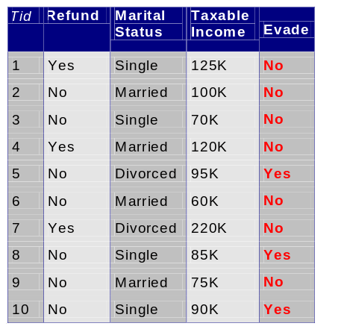
How to Estimate Probabilities from Data?
Class: P(C) = N_{c}/N
  e.g., P(No) = 7/10,
  P(Yes) = 3/10
For discrete attributes:
P(A_{i} | C_{k}) = |A_{ik}|/ N_{c}
  where |A_{ik}| is number of instances having attribute A_{i} and belongs to class C_{k}
  Examples:
  P(Status=Married|No) = 4/7
  P(Refund=Yes|Yes)=0
k

Slide 23
How to Estimate Probabilities from Data?
For continuous attributes:
  Discretize the range into bins
    one ordinal attribute per bin
    violates independence assumption
  Two-way split: (A < v) or (A > v)
    choose only one of the two splits as new attribute
  Probability density estimation:
    Assume attribute follows a normal distribution
    Use data to estimate parameters of distribution
    (e.g., mean and standard deviation)
    Once probability distribution is known, can use it to estimate the conditional probability P(A_{i}|c)
k

Slide 24
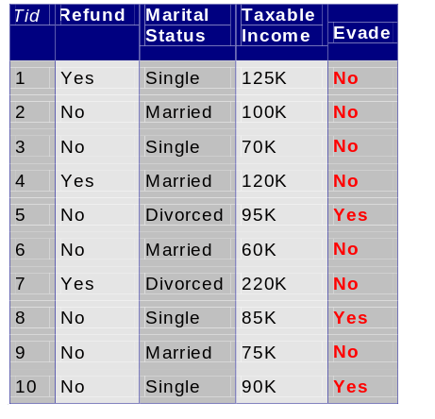
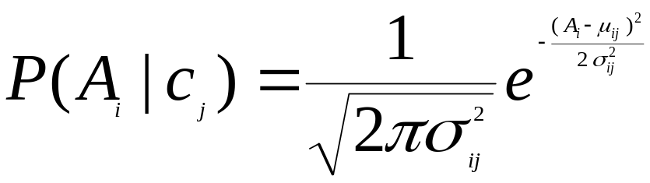
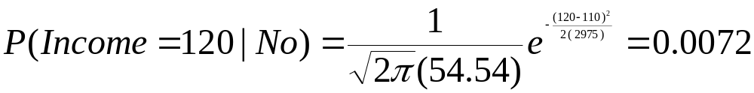
How to Estimate Probabilities from Data?
Normal distribution:
  One for each (A_{i},c_{i}) pair
For (Income, Class=No):
  If Class=No
    sample mean = 110
    sample variance = 2975

Slide 25
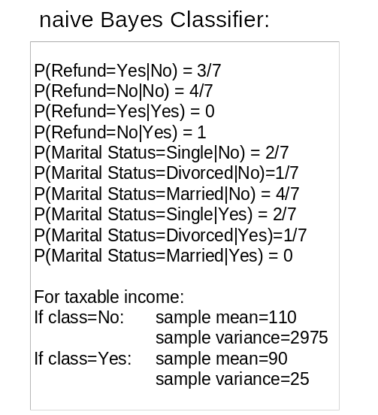
Example of Naïve Bayes Classifier
Given a Test Record:
P(X|Class=No) = P(Refund=No|Class=No)
× P(Married| Class=No)
× P(Income=120K| Class=No)
= 4/7 × 4/7 × 0.0072 = 0.0024
P(X|Class=Yes) = P(Refund=No| Class=Yes)
× P(Married| Class=Yes)
× P(Income=120K| Class=Yes)
= 1 × 0 × 1.2 × 10⁻⁹ = 0
Since P(X|No)P(No) > P(X|Yes)P(Yes)
Therefore P(No|X) > P(Yes|X)
=> Class = No

Slide 26
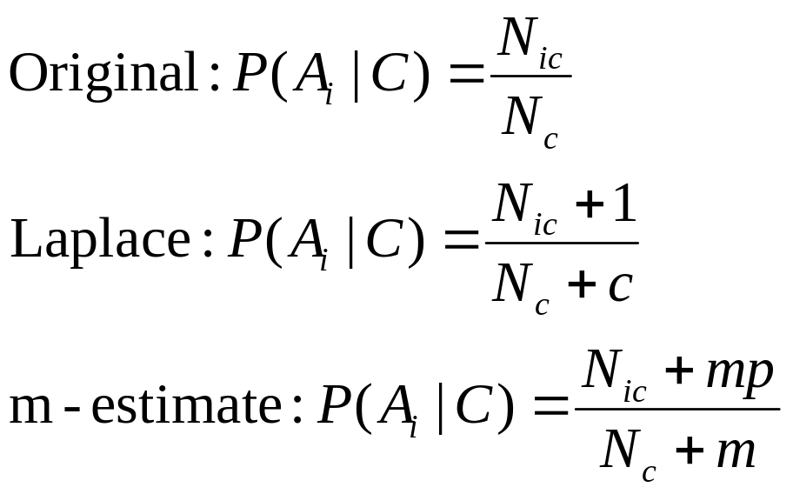
Naïve Bayes Classifier
If one of the conditional probability is zero, then the entire expression becomes zero
Probability estimation:
c: number of values for attribute A (eg, for Outlook, c=3)
p: prior probability set by user
m: parameter set by user
Note: when N_{c} =0, P(A_{i}|C)=p.

Slide 27
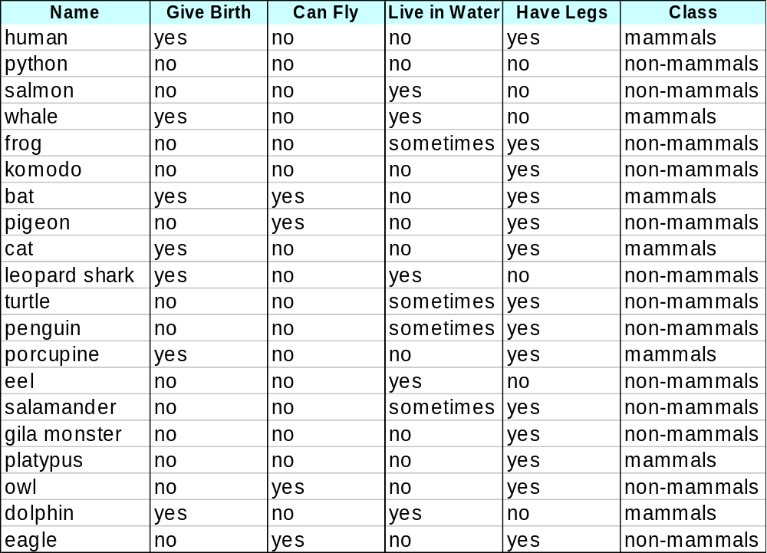
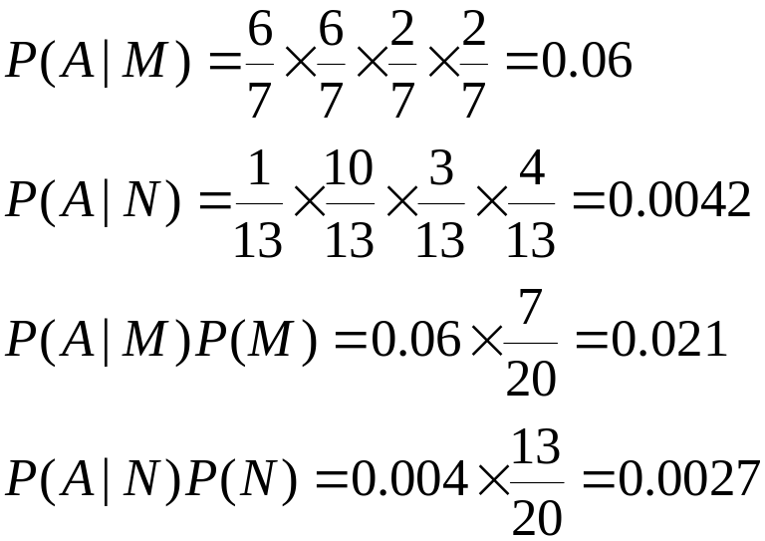
Example of Naïve Bayes Classifier
A: attributes
M: mammals
N: non-mammals
P(A|M)P(M) > P(A|N)P(N)
=> Mammals

Slide 28
Naïve Bayes (Summary)
Robust to isolated noise points
Handle missing values by ignoring the instance during probability estimate calculations
Robust to irrelevant attributes
Independence assumption may not hold for some attributes
  Use other techniques such as Bayesian Belief Networks (BBN)

Slide 29
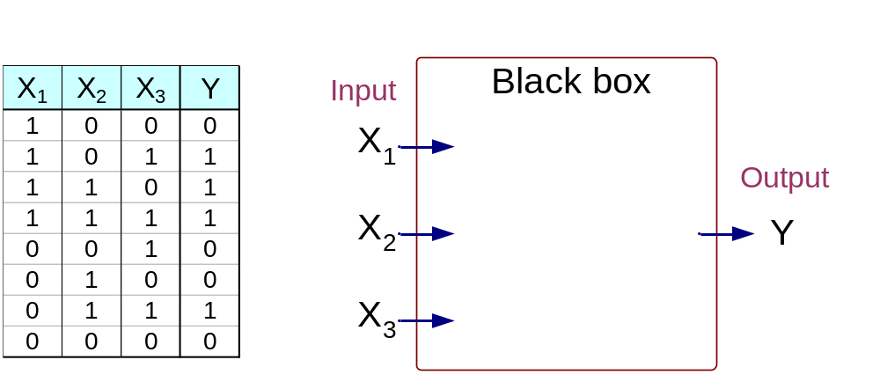
Artificial Neural Networks (ANN)
Output Y is 1 if at least two of the three inputs are equal to 1.

Slide 30
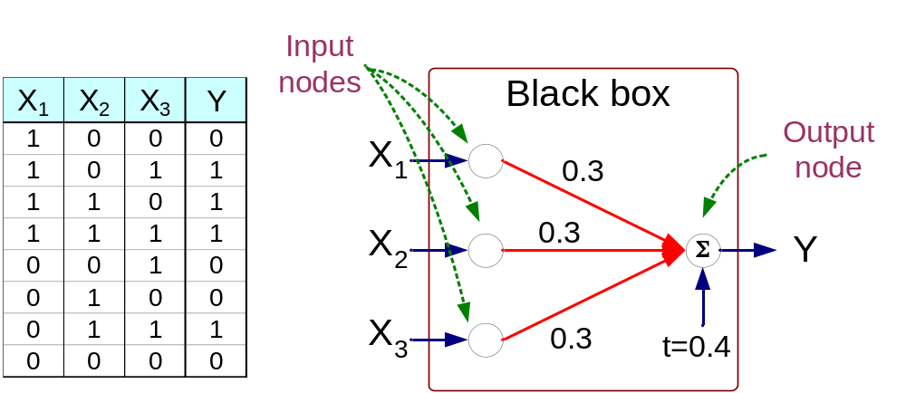
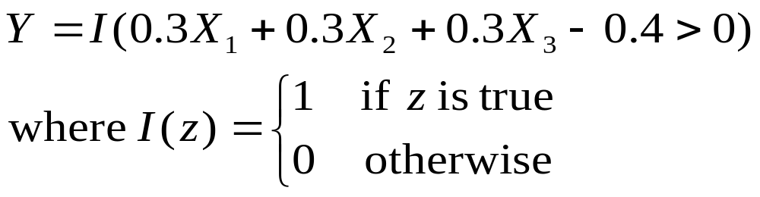
Artificial Neural Networks (ANN)

Slide 31
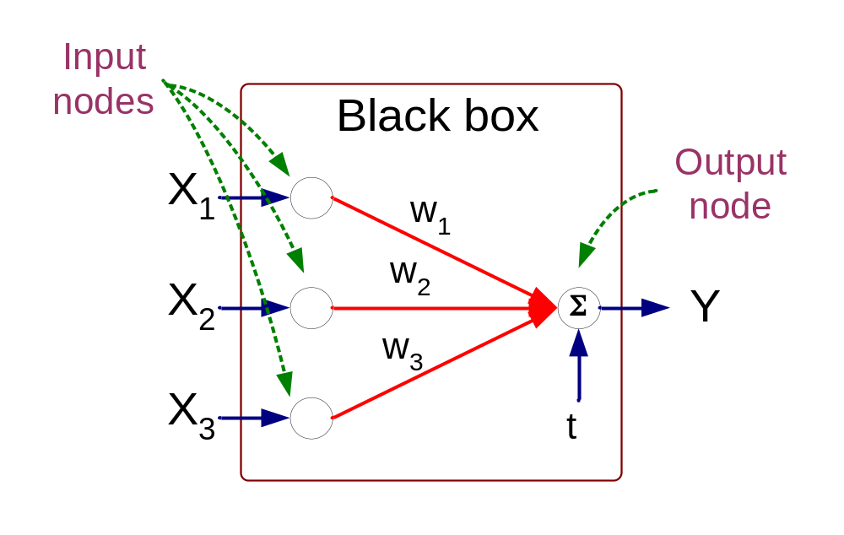
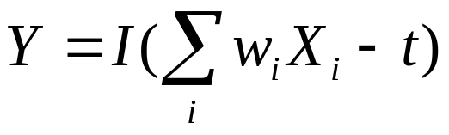
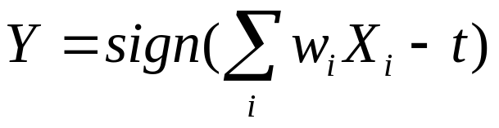
Artificial Neural Networks (ANN)
Model is an assembly of inter-connected nodes and weighted links
Output node sums up each of its input value according to the weights of its links
Compare output node against some threshold t
Perceptron Model
or

Slide 32
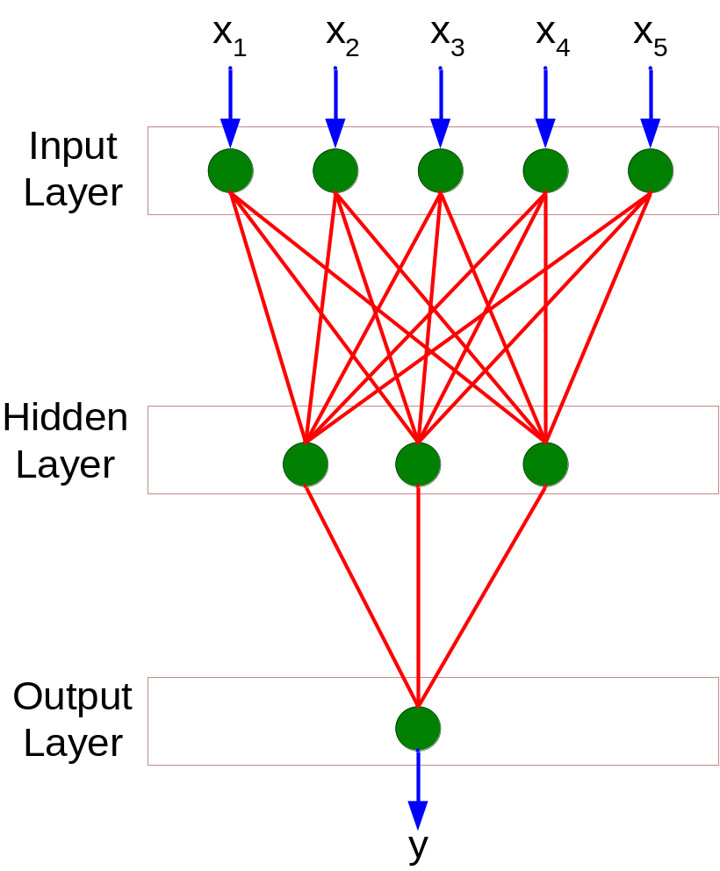
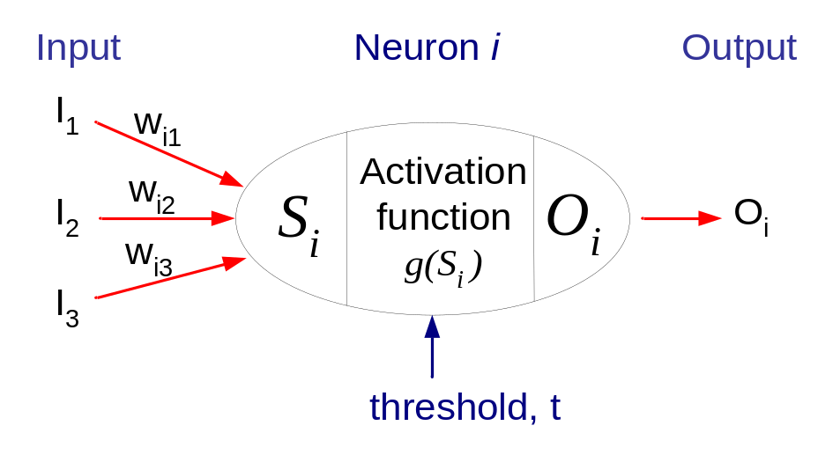
General Structure of ANN
Training ANN means learning the weights of the neurons

Slide 33
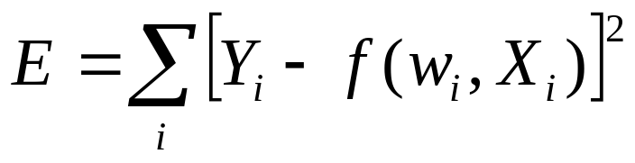
Algorithm for learning ANN
Initialize the weights (w₀, w₁, …, w_{k})
Adjust the weights in such a way that the output of ANN is consistent with class labels of training examples
  Objective function:
  Find the weights w_{i}’s that minimize the above objective function
    e.g., backpropagation algorithm (see lecture notes)

Slide 34
More on Neural Networks: see additional notes

Slide 35
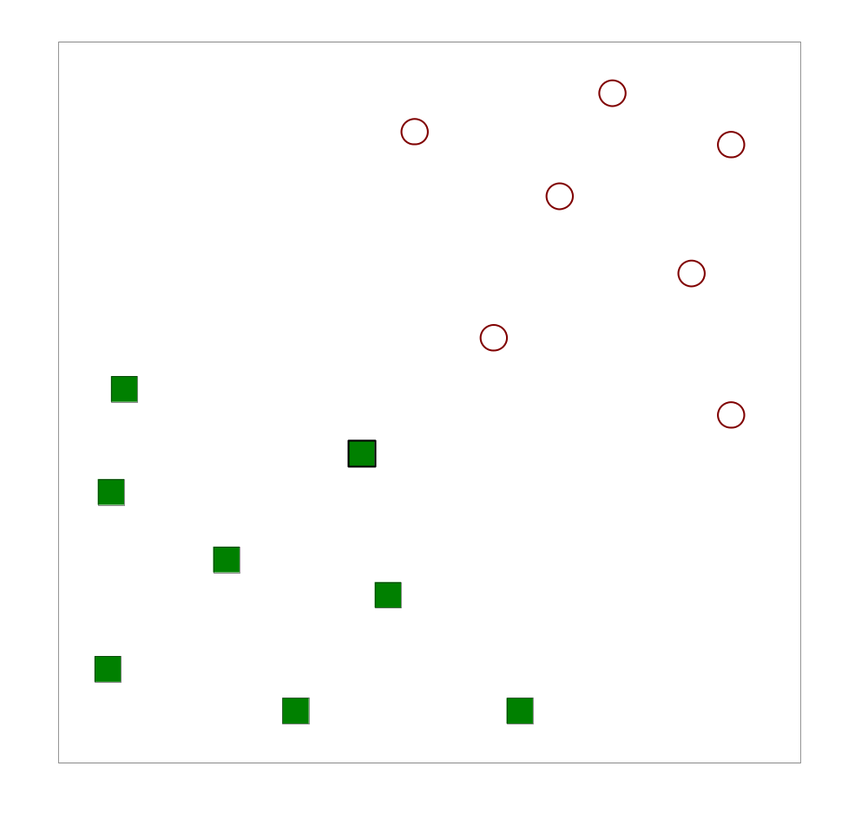
Support Vector Machines
Find a linear hyperplane (decision boundary) that will separate the data

Slide 36
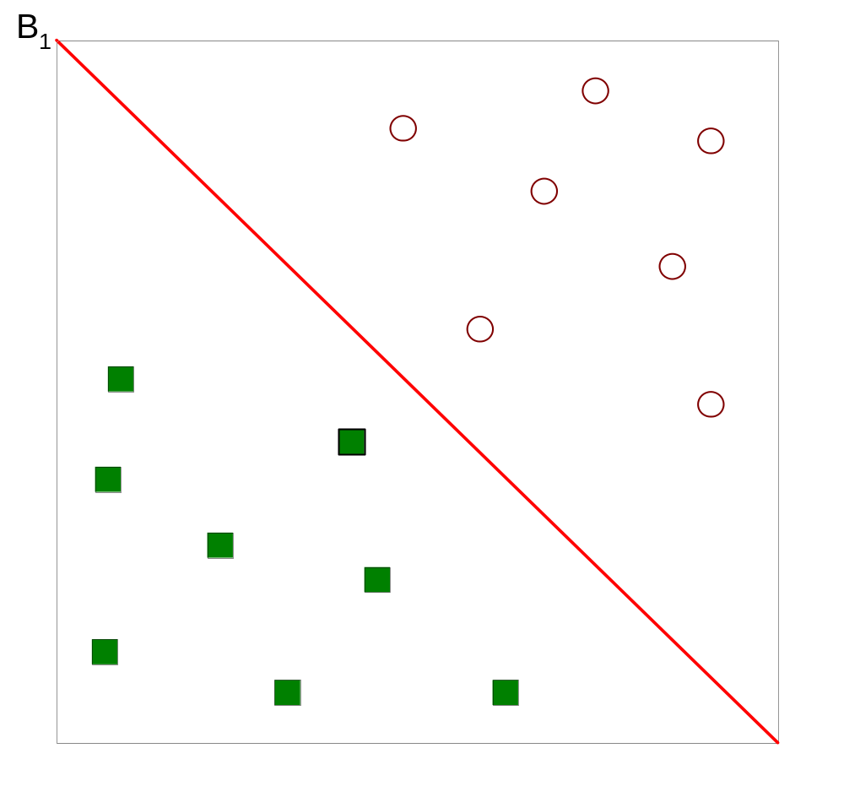
Support Vector Machines
One Possible Solution

Slide 37
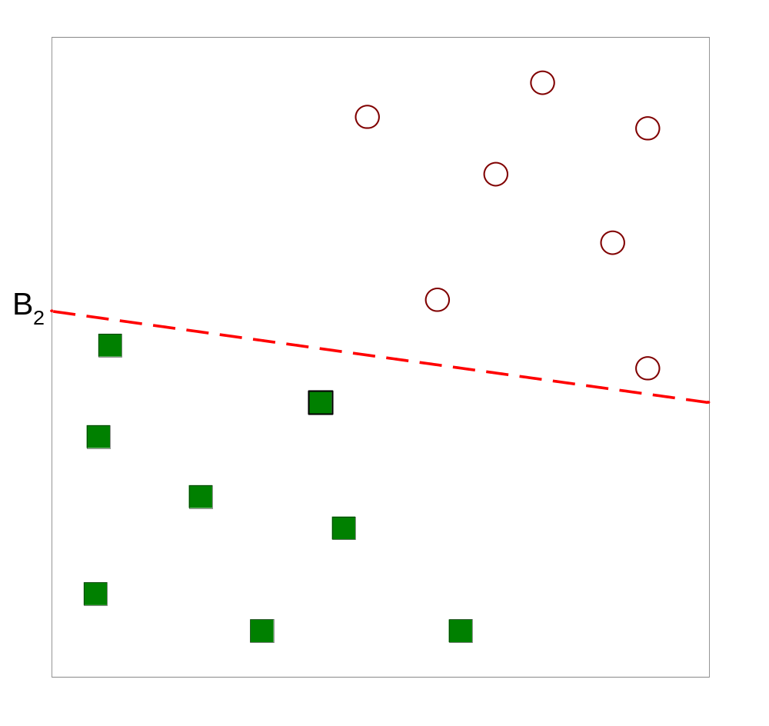
Support Vector Machines
Another possible solution

Slide 38
Support Vector Machines
Other possible solutions

Slide 39
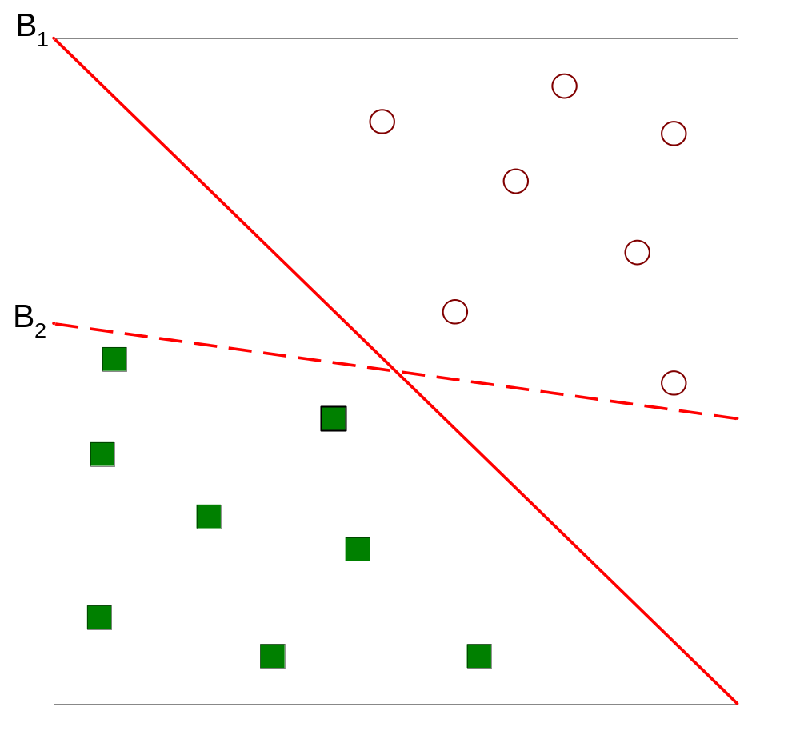
Support Vector Machines
Which one is better? B1 or B2?
How do you define better?

Slide 40
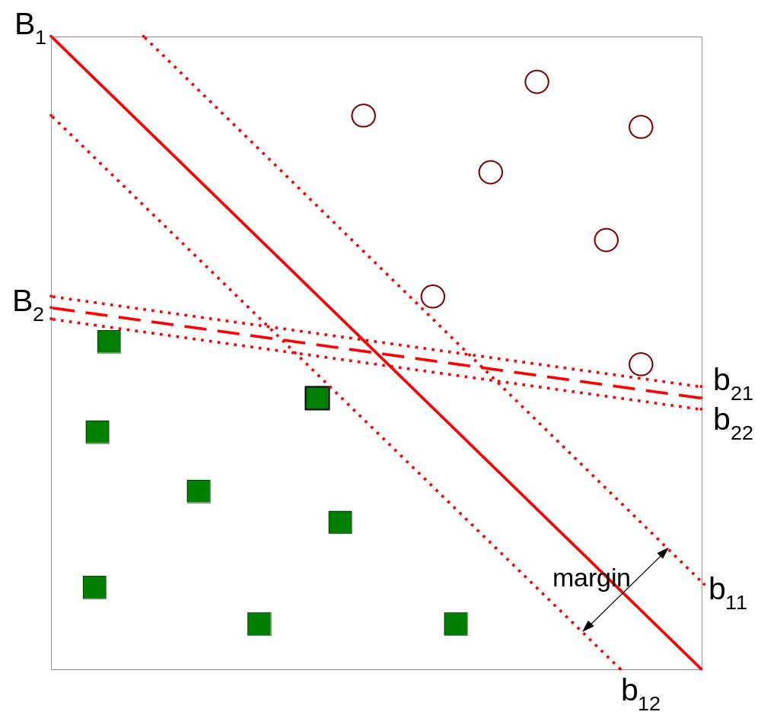
Support Vector Machines
Find hyperplane maximizes the margin => B1 is better than B2

Slide 41
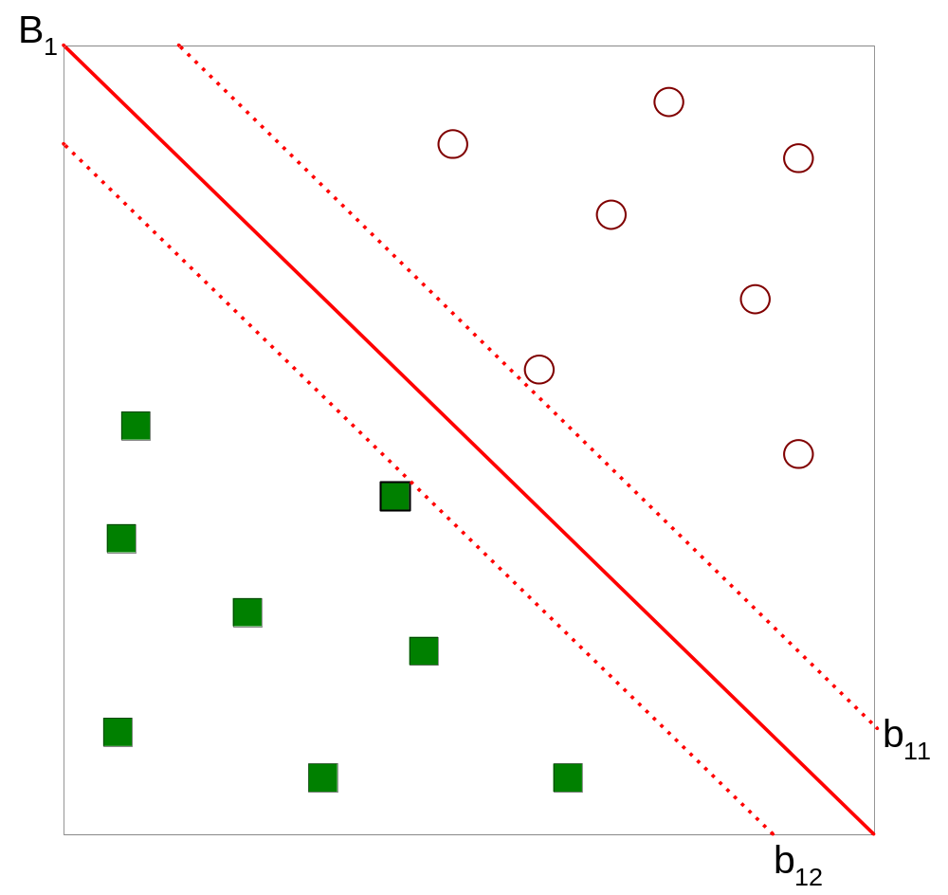



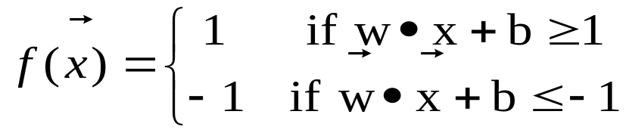
Support Vector Machines
Margin =2/||W||

Slide 42
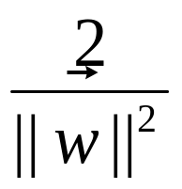
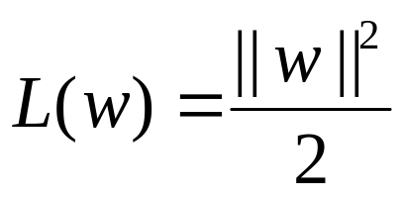
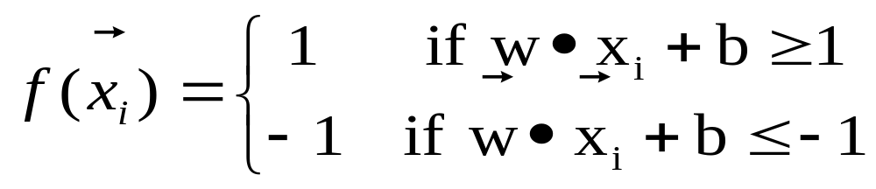
Support Vector Machines
We want to maximize:
  Which is equivalent to minimizing:
  But subjected to the following constraints:
    This is a constrained optimization problem
      Numerical approaches to solve it (e.g., quadratic programming)

Slide 43
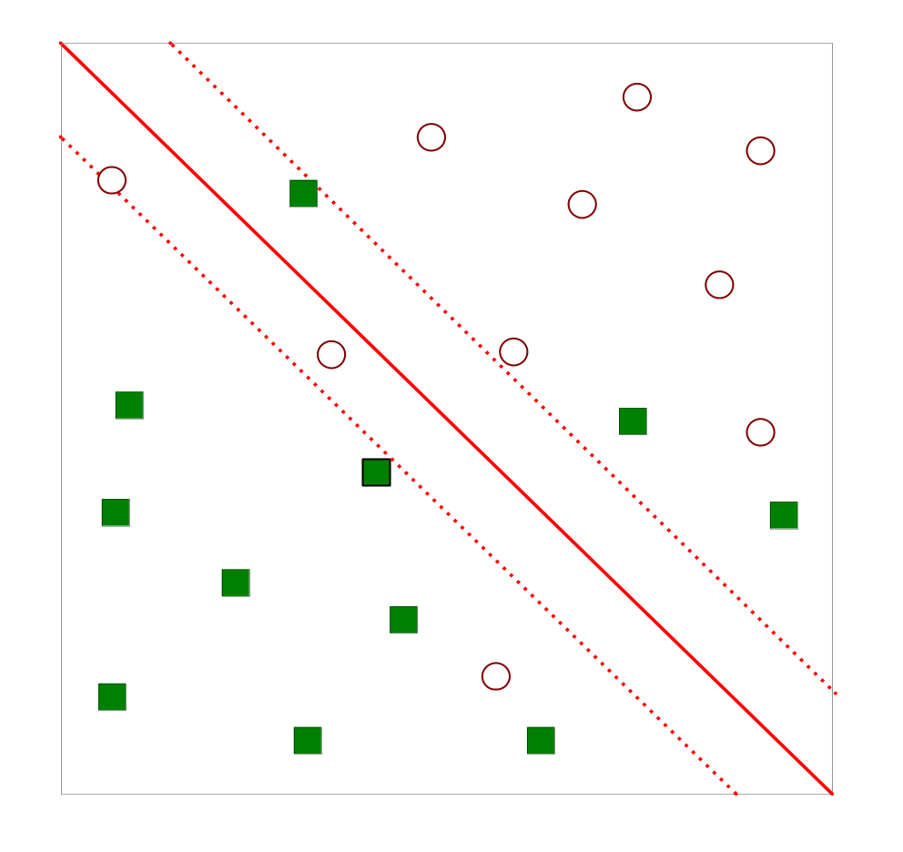
Support Vector Machines
What if the problem is not linearly separable?

Slide 44
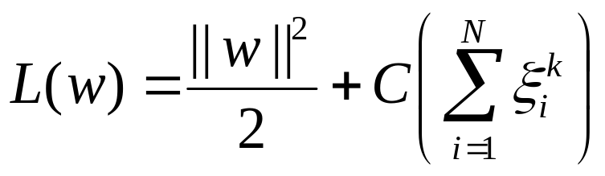
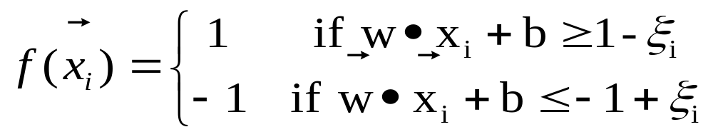
Support Vector Machines
What if the problem is not linearly separable?
  Introduce slack variables
    Need to minimize:
    Subject to:

Slide 45
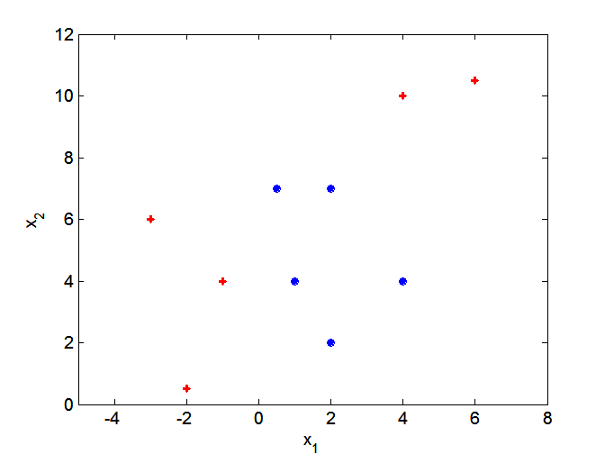
Nonlinear Support Vector Machines
What if decision boundary is not linear?

Slide 46
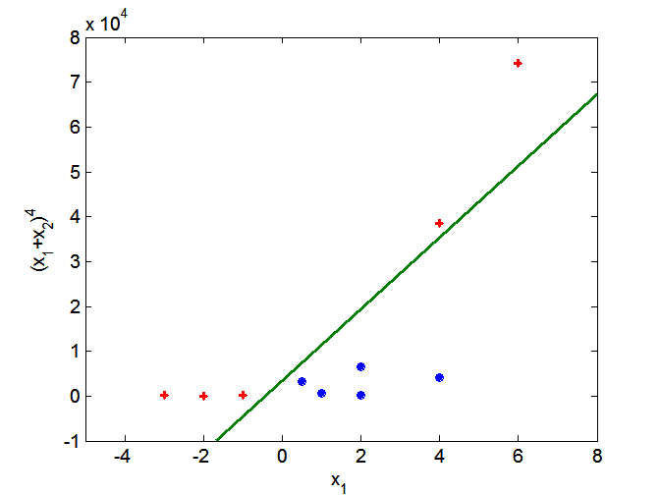
Nonlinear Support Vector Machines
Transform data into higher dimensional space

Slide 47
Ensemble Methods:
Construct a set of classifiers from the training data
Predict class label of previously unseen records by aggregating predictions made by multiple classifiers
See additional Notes

