Slide 1
Prediction with Regression Analysis (HK: Chapter 7.8)
Qiang Yang
HKUST

Slide 2
Goal
To predict numerical values
Many software packages support this
  SAS
  SPSS
  S-Plus
  Weka
  Poly-Analyst

Slide 3
Linear Regression (HK 7.8.1)
Table 7.7
Given one variable
Goal: Predict Y
Example:
  Given Years of Experience
  Predict Salary
Questions:
  When X=10, what is Y?
  When X=25, what is Y?
  This is known as regression
X (years) | Y (salary, $1,000)
3 | 30
8 | 57
9 | 64
13 | 72
3 | 36
6 | 43
11 | 59
21 | 90
1 | 20

Slide 4
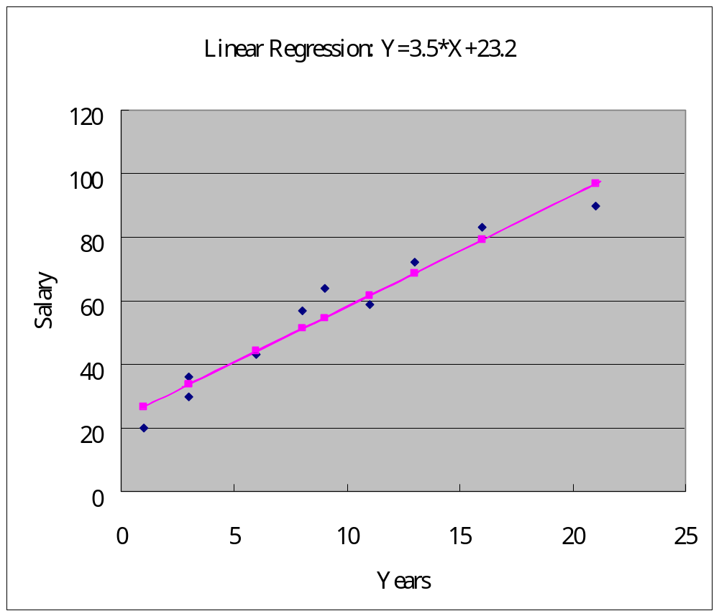
Linear Regression Example

Slide 5
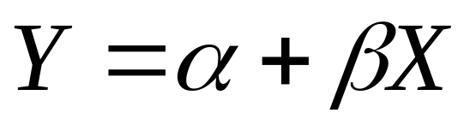
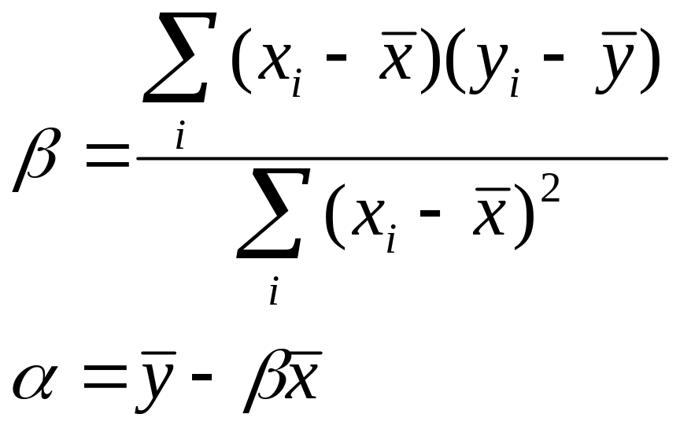
Basic Idea (Equations 7.23, 7.24)
Learn a linear equation
  To be learned:

Slide 6
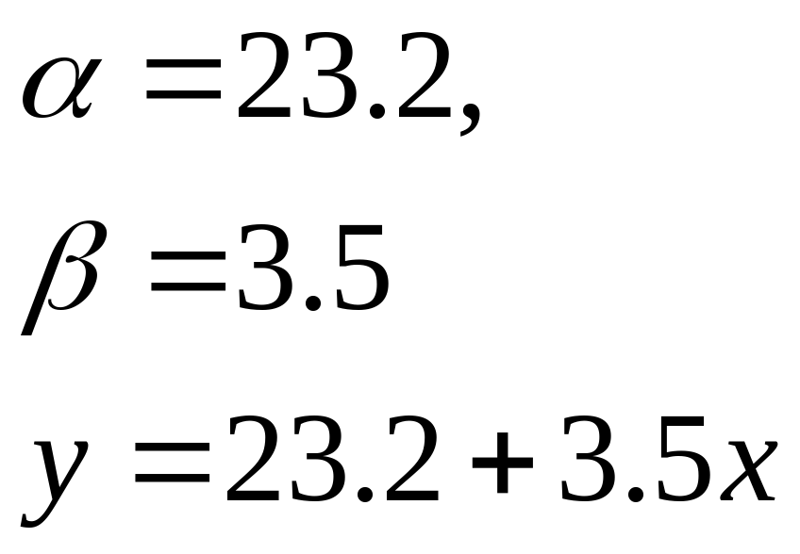
For the example data
Thus, when x=10 years, prediction of y (salary)
is: 23.2+35=58.2 K dollars/year.

Slide 7
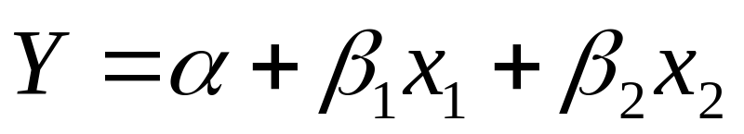
More than one prediction attribute
X1, X2
For example,
  X1=‘years of experience’
  X2=‘age’
  Y=‘salary’
Equation:
The coefficients are more complicated, but can be calculated with
  Vector ß = (X^{T}X) ⁻¹ X^{T}Y
  X=(x₁, x₂)^{T}, β = (β₁, β₂)^{Τ}
  We will not worry about the actual calculation with this equation, but refer to software packages such as Excel

Slide 8
How to predict categorical (7.8.3)?
Say we wish to predict “Accept” for job application, based on “Years of experience”
  Y=Accept, with value = {true, false}
  X=“Years of experience, value = real value
Can we use linear regression to do this?

Slide 9
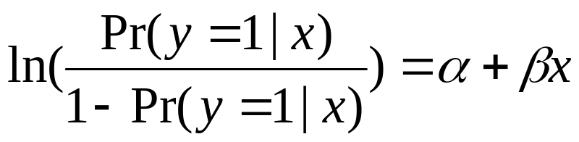
Logit function
The answer is yes
  Even through y is not continuous, the probability of y=True, given X, is continuous!
  Thus, we can model Pr(y=True|X)

Slide 10
In MS Excel, use linest()
Use linest(y-range, x-range, true, true)
  For example, if x1, x2 are in cells A1:B10,
  If Y range is in C1:C10
  Then, linest(C1:C10, A1:B10, true, true) returns the β2
To get elect a highlight area,
  Hold Control-Shift, hit Enter → a matrix
  The first row shows the coefficients and constant term: (β_{n}, β_{n−1}, ... β₁, α) in that order
  The rest of the rows show statistics → refer to Excel Help
Y=α+β1X1+β2X2

Slide 11
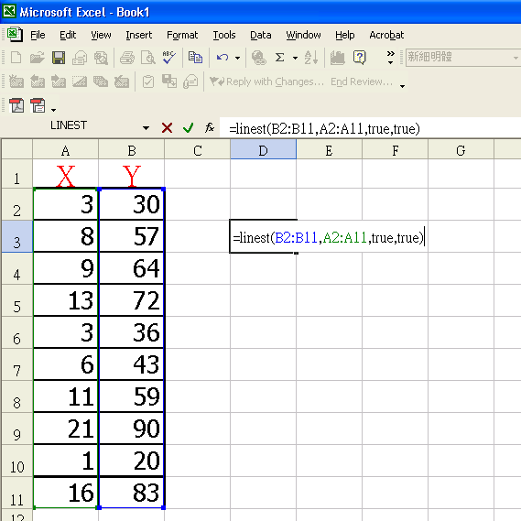

Slide 12
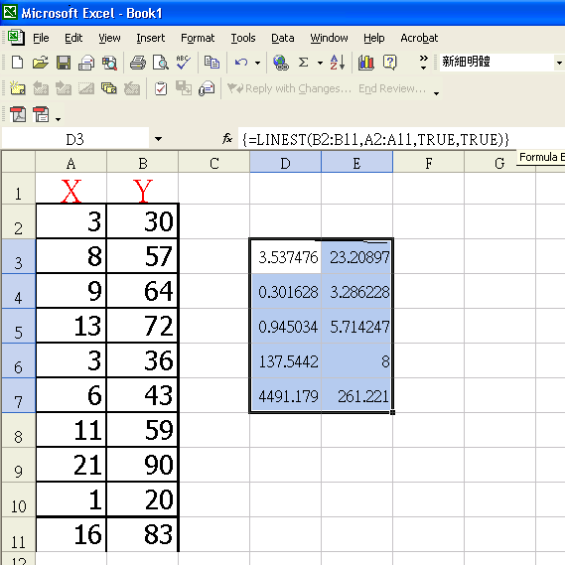
β
α

Slide 14
Linear Regression and Decision Trees
Can combine linear regression and decision trees
Each attribute can be a numerical attribute
Each leaf node can be a regression formula
Try it on Weather data, assuming that the TEMP and HUMIDITY are both numerical, and that Play is replaced by #Wins (Number of wins if you played tennis on that day).

Slide 15
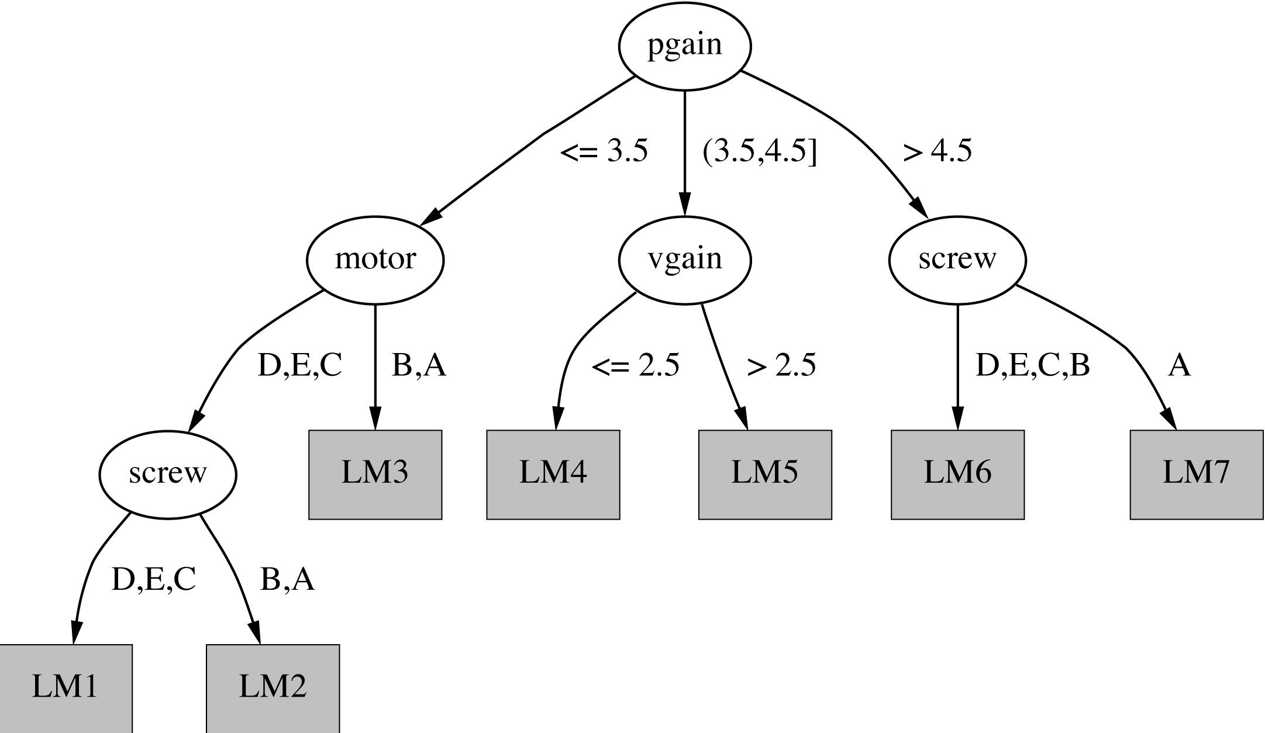
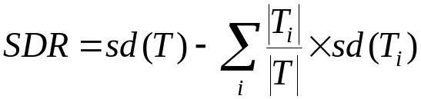
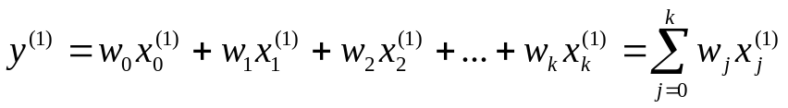
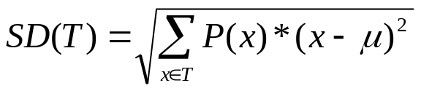

Continuous Case:
The CART Algorithm

Slide 16

Building the tree
Splitting criterion: standard deviation reduction
Termination criteria (important when building trees for numeric prediction):
  Standard deviation becomes smaller than certain fraction of sd for full training set (e.g. 5%)
  Too few instances remain (e.g. less than four)

Slide 17
Model tree for servo data

Slide 18
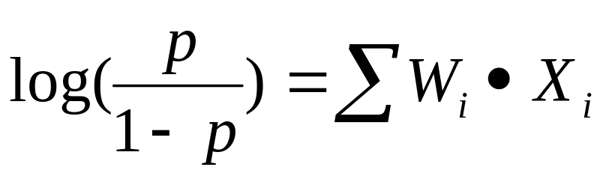
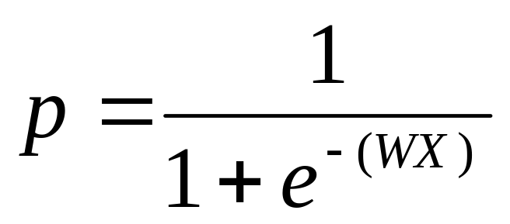
Variations of CART
Applying Logistic Regression
  predict probability of “True” or “False” instead of making a numerical valued prediction
  predict a probability value (p) rather than the outcome itself
  Probability= odds ratio

Slide 19
Conclusions
Linear Regression is a powerful tool for numerical predictions
The idea is to fit a straight line through data points
Can extend to multiple dimensions
Can be used to predict discrete classes also

