Slide 1
Rule based Methods: revised part
Lecture Notes for Chapter 5
Introduction to Data Mining
by
Tan, Steinbach, Kumar
© Tan,Steinbach, Kumar Introduction to Data Mining 4/18/2004 <number>

Slide 2
Rule-Based Classifier
Classify records by using a collection of “if…then…” rules
Rule: (Condition) → y
  where
    Condition is a conjunctions of attributes
    y is the class label
  LHS: rule antecedent or condition
  RHS: rule consequent
  Examples of classification rules:
    (Blood Type=Warm) ∧ (Lay Eggs=Yes) → Birds
    (Taxable Income < 50K) ∧ (Refund=Yes) → Evade=No

Slide 3
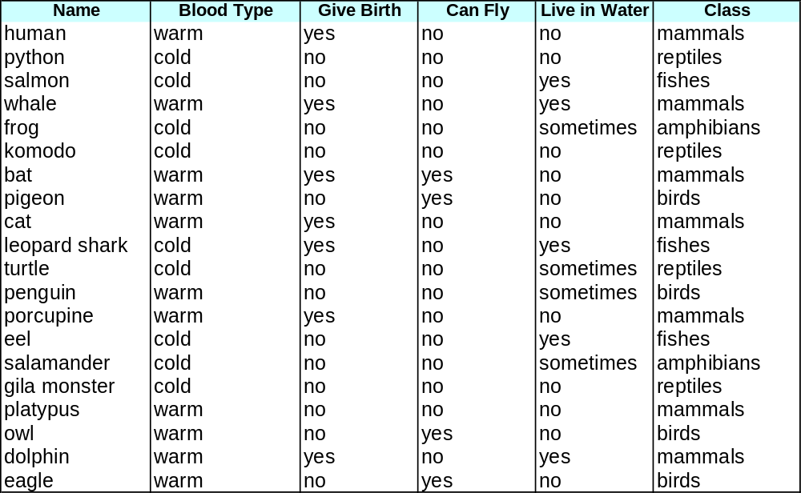
Rule-based Classifier (Example)
R1: (Give Birth = no) ∧ (Can Fly = yes) → Birds
R2: (Give Birth = no) ∧ (Live in Water = yes) → Fishes
R3: (Give Birth = yes) ∧ (Blood Type = warm) → Mammals
R4: (Give Birth = no) ∧ (Can Fly = no) → Reptiles
R5: (Live in Water = sometimes) → Amphibians

Slide 4
Application of Rule-Based Classifier
A rule r covers an instance x if the attributes of the instance satisfy the condition of the rule
R1: (Give Birth = no) ∧ (Can Fly = yes) → Birds
R2: (Give Birth = no) ∧ (Live in Water = yes) → Fishes
R3: (Give Birth = yes) ∧ (Blood Type = warm) → Mammals
R4: (Give Birth = no) ∧ (Can Fly = no) → Reptiles
R5: (Live in Water = sometimes) → Amphibians
The rule R1 covers a hawk => Bird
The rule R3 covers the grizzly bear => Mammal

Slide 5
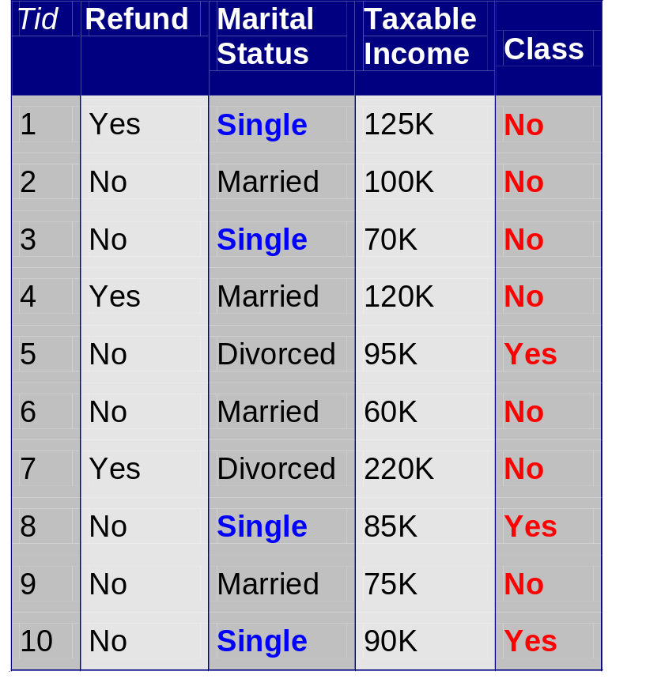
Rule Coverage and Accuracy
Coverage of a rule:
  Fraction of records that satisfy the antecedent of a rule
Accuracy of a rule:
  Fraction of records that satisfy both the antecedent and consequent of a rule
(Status=Single) → No
Coverage = 40%, Accuracy = 50%

Slide 6
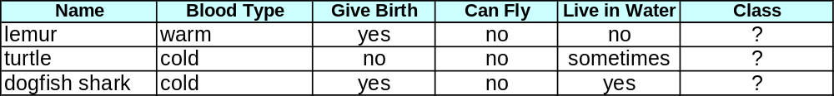
How does Rule-based Classifier Work?
R1: (Give Birth = no) ∧ (Can Fly = yes) → Birds
R2: (Give Birth = no) ∧ (Live in Water = yes) → Fishes
R3: (Give Birth = yes) ∧ (Blood Type = warm) → Mammals
R4: (Give Birth = no) ∧ (Can Fly = no) → Reptiles
R5: (Live in Water = sometimes) → Amphibians
A lemur triggers rule R3, so it is classified as a mammal
A turtle triggers both R4 and R5
A dogfish shark triggers none of the rules

Slide 7
Characteristics of Rule-Based Classifier
Mutually exclusive rules
  Classifier contains mutually exclusive rules if the rules are independent of each other
  Every record is covered by at most one rule
Exhaustive rules
  Classifier has exhaustive coverage if it accounts for every possible combination of attribute values
  Each record is covered by at least one rule

Slide 8
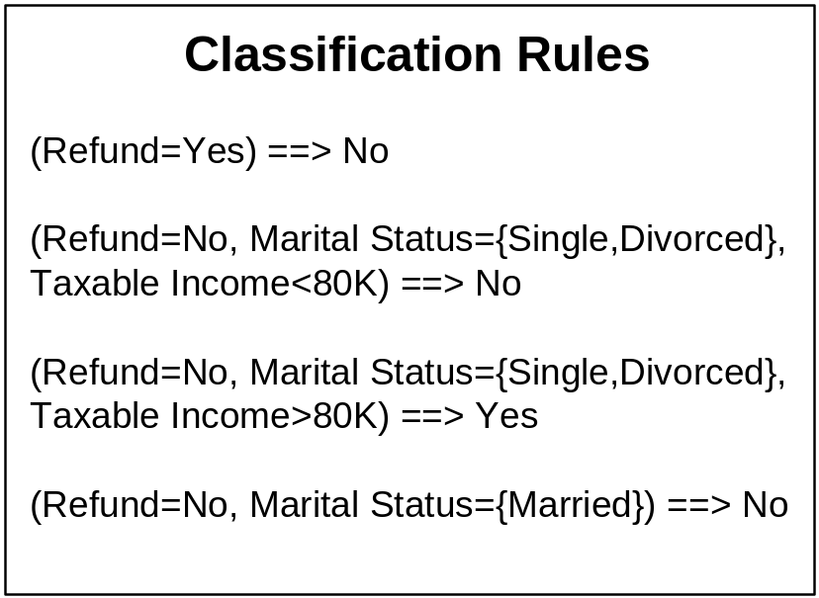
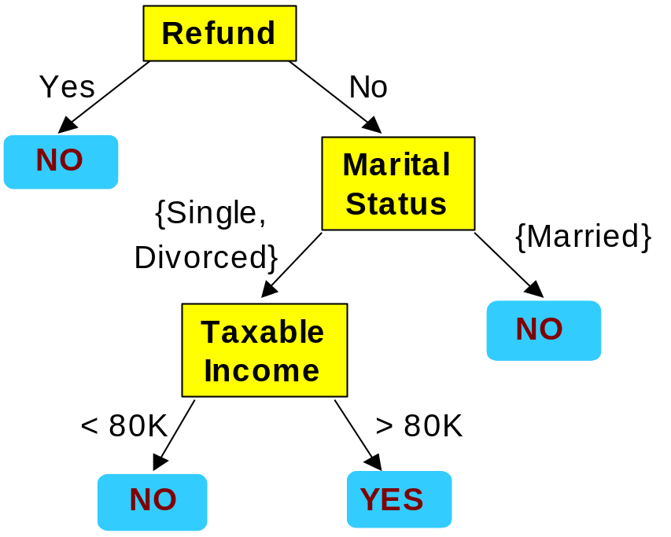
From Decision Trees To Rules
Rules are mutually exclusive and exhaustive
Rule set contains as much information as the tree

Slide 9
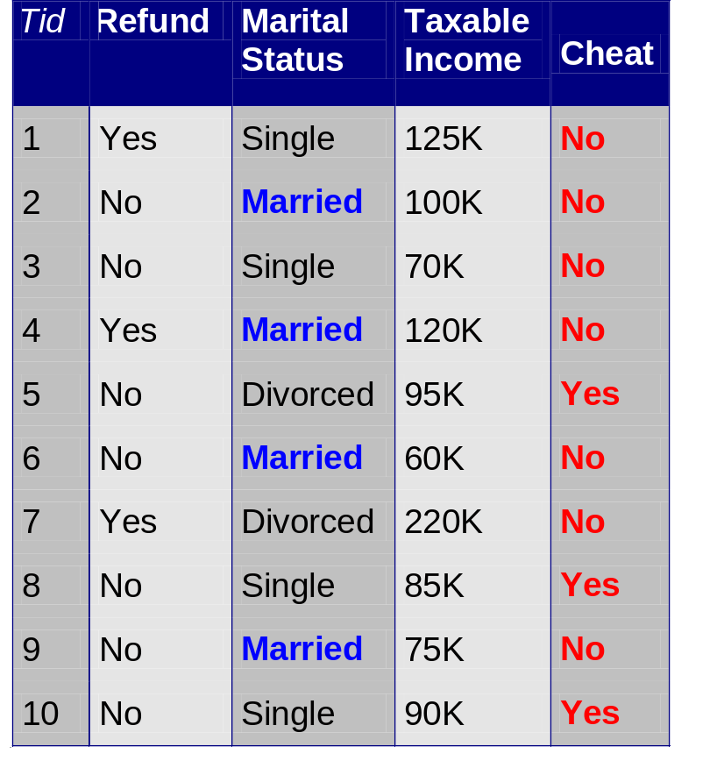
Rules Can Be Simplified
Initial Rule: (Refund=No) ∧ (Status=Married) → No
Simplified Rule: (Status=Married) → No

Slide 10
Effect of Rule Simplification
Rules are no longer mutually exclusive
  A record may trigger more than one rule
  Solution?
    Ordered rule set
    Unordered rule set – use voting schemes
Rules are no longer exhaustive
  A record may not trigger any rules
  Solution?
    Use a default class

Slide 11
Ordered Rule Set
Rules are rank ordered according to their priority
  An ordered rule set is known as a decision list
When a test record is presented to the classifier
  It is assigned to the class label of the highest ranked rule it has triggered
  If none of the rules fired, it is assigned to the default class
R1: (Give Birth = no) ∧ (Can Fly = yes) → Birds
R2: (Give Birth = no) ∧ (Live in Water = yes) → Fishes
R3: (Give Birth = yes) ∧ (Blood Type = warm) → Mammals
R4: (Give Birth = no) ∧ (Can Fly = no) → Reptiles
R5: (Live in Water = sometimes) → Amphibians
R6: Default=mammals

Slide 12
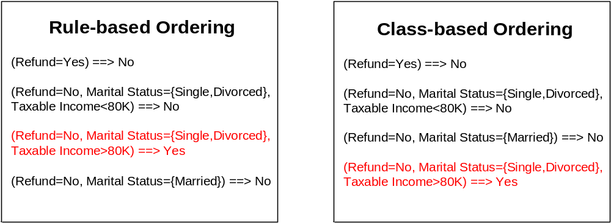
Rule Ordering Schemes
Rule-based ordering
  Individual rules are ranked based on their quality
Class-based ordering
  Rules that belong to the same class appear together
proportion of class

Slide 13
Building Classification Rules
Direct Method:
    Extract rules directly from data
    e.g.: RIPPER, CN2, Holte’s 1R
Indirect Method:
    Extract rules from other classification models (e.g.
    decision trees, neural networks, etc).
    e.g: C4.5rules

Slide 14
Holte’s 1R method
Holte’s 1R method
  For each attribute,
    For each value of the attribute
      Form a rule: choose the value that maximize the accuracy
    Calculate the average training error of the attribute
  Select the Attribute with the maximum accuracy (or minimum error)
Example: For Outlook, Temp, Humidity, Windy,
  Outlook= Sunny, choose class=N, error=2/5
  Outlook=Overcast, choose class=P, error=0
  …
  Outlook’s average error=5/14*2/5+0+5/14*2/5=4/14

Slide 15
Direct Method: Sequential Covering
Start from an empty rule
Grow a rule using the Learn-One-Rule function
Remove training records covered by the rule
Repeat Step (2) and (3) until stopping criterion is met

Slide 16
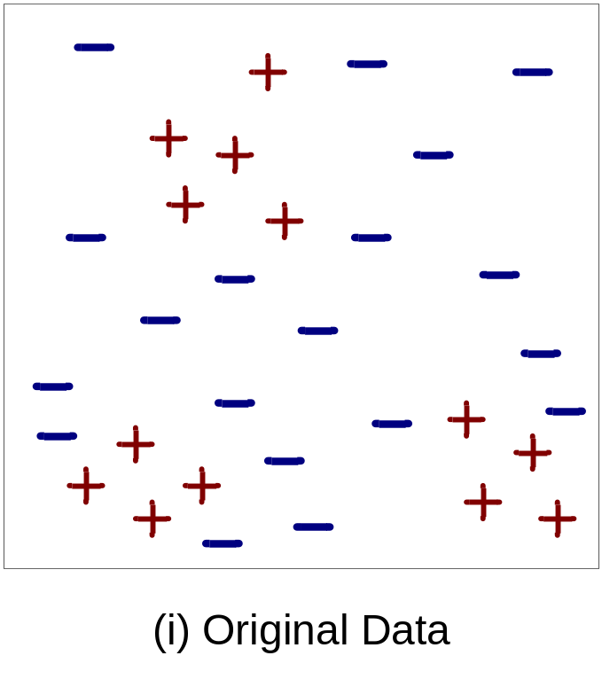
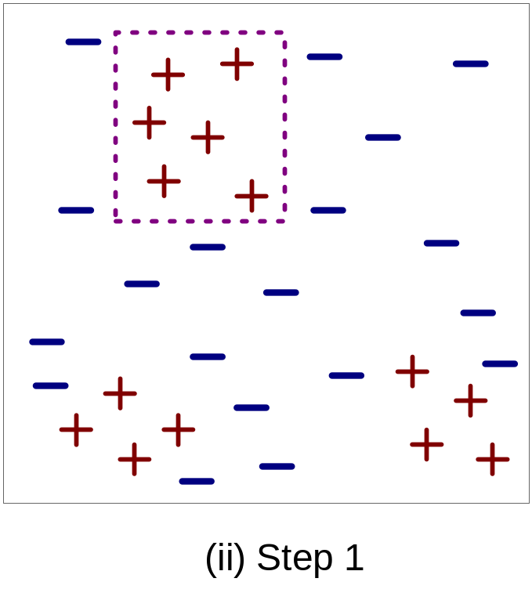
Example of Sequential Covering

Slide 17
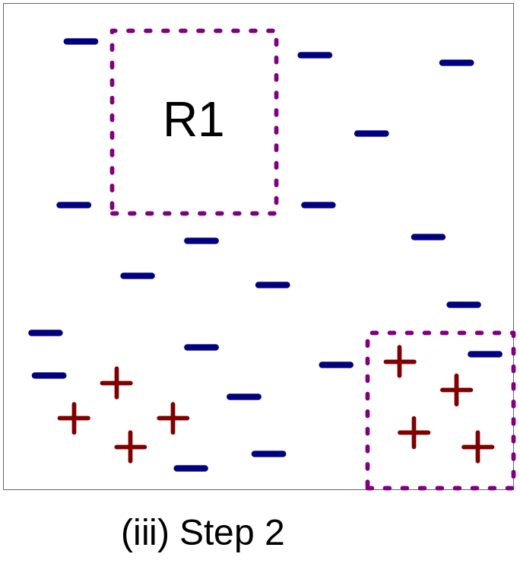
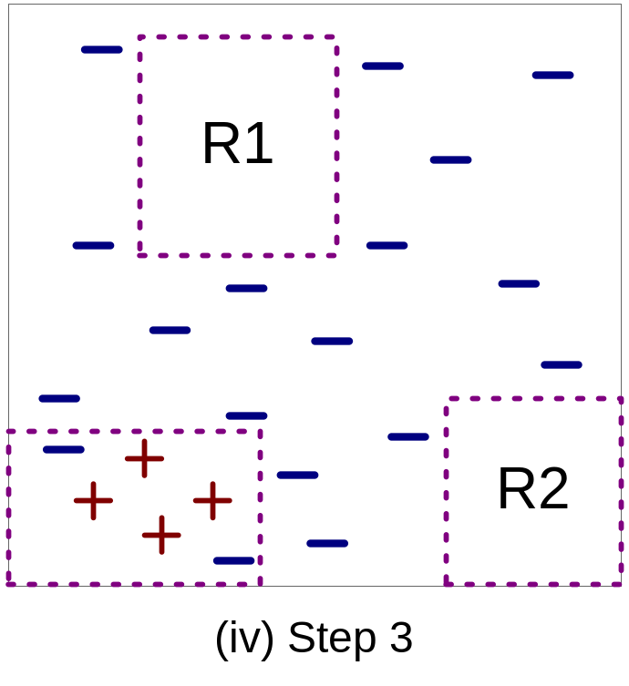
Example of Sequential Covering…

Slide 18
Aspects of Sequential Covering
Rule Growing
Instance Elimination
Rule Evaluation
Stopping Criterion
Rule Pruning

Slide 19
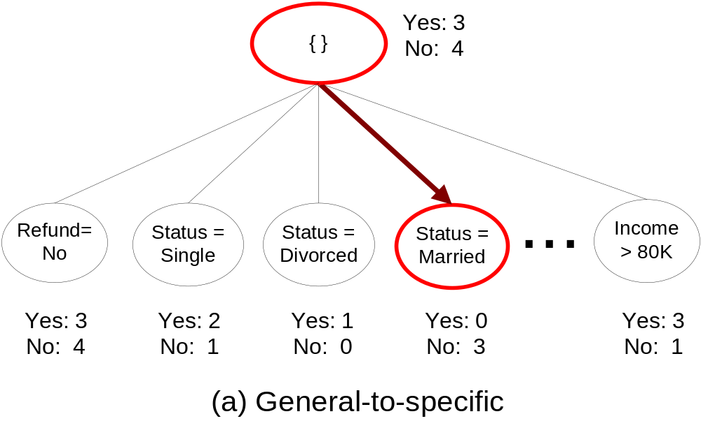
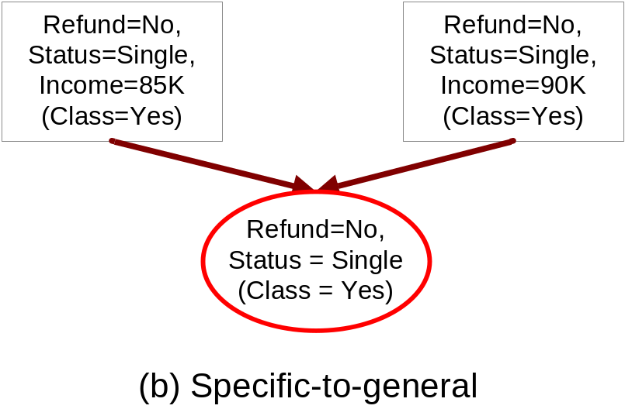
Rule Growing
Two common strategies

Slide 20
Rule Growing (Examples)
RIPPER Algorithm:
  Start from an empty rule: {} => class
  Add conjuncts that maximizes FOIL’s information gain measure:
    R0: {} => class (initial rule)
    R1: {A} => class (rule after adding conjunct)
    Gain(R0, R1) = p1 [ log (p1/(p1+n1)) – log (p0/(p0 + n0)) ]
    where p0: number of positive instances covered by R0
    n0: number of negative instances covered by R0
    p1: number of positive instances covered by R1
    n1: number of negative instances covered by R1

Slide 21
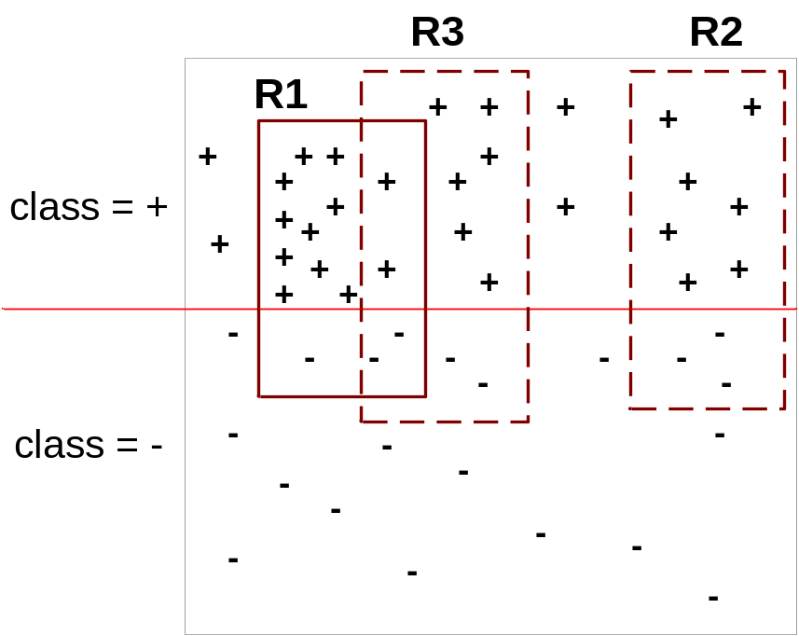
Instance Elimination
Why do we need to eliminate instances?
  Otherwise, the next rule is identical to previous rule
  Suppose R1 is generated first
    We remove all instances of R1
Why do we remove positive instances?
  Ensure that the next rule is different
  Prevent overestimating R3
Why do we remove negative instances?
  Prevent underestimating accuracy of rule R3
  Compare rules R2 and R3 in the diagram
After removing R1 instances,
Accuracy of R3 = 6/8=0.75
Accuracy of R2 = 7/10=0.7

Slide 22
Stopping Criterion and Rule Pruning
Stopping criterion
  Compute the gain
  If gain is not significant (less than a theta), discard the new rule
Rule Pruning: to see if we can remove a condition of a rule, while improving the generalization error
  Similar to post-pruning of decision trees
Reduced Error Pruning: assume we have a validation data set.
  Remove one of the conjuncts in the rule
  Compare error rate on validation set before and after prunin
    If error decreases, prune the conjunct
    Measure for pruning: v = (p-n)/(p+n)
    p: number of positive examples covered by the rule in
    a validation set
    n: number of negative examples covered by the rule in
    a validation set

Slide 23
Summary of Direct Method
Grow a single rule
Remove Instances from rule
Prune the rule (if necessary)
Add rule to Current Rule Set
Repeat

Slide 24
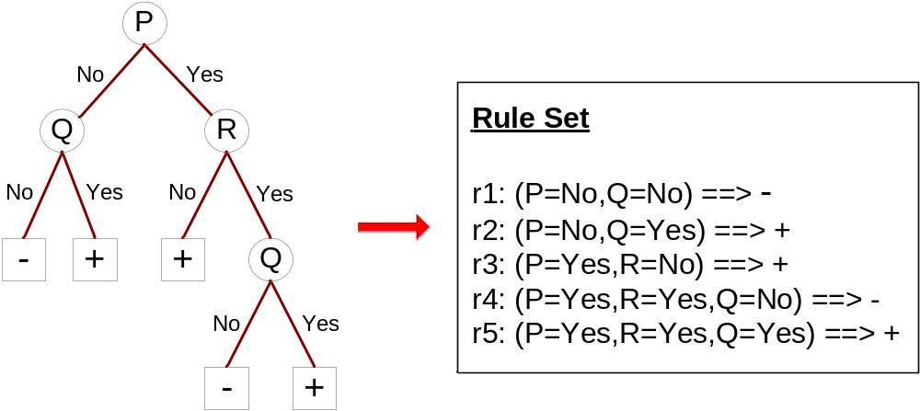
Indirect Methods

Slide 25
Indirect Method: C4.5rules
Extract rules from an unpruned decision tree
For each rule, r: A → y,
  consider an alternative rule r’: A’ → y where A’ is obtained by removing one of the conjuncts in A
  Compare the pessimistic error rate for r against all r’s
  Prune if one of the r’s has lower pessimistic error rate
  Repeat until we can no longer improve generalization error

Slide 26
Indirect Method: C4.5rules
Instead of ordering the rules, order subsets of rules (class ordering)
  Each subset is a collection of rules with the same rule consequent (class)
  Compute description length of each subset
    Description length = L(error) + g L(model)
    g is a parameter that takes into account the presence of redundant attributes in a rule set
    (default value = 0.5)

Slide 27
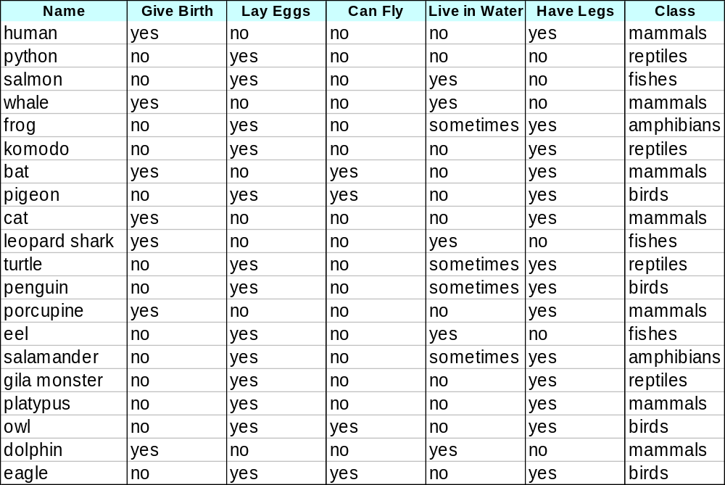
Example

Slide 28
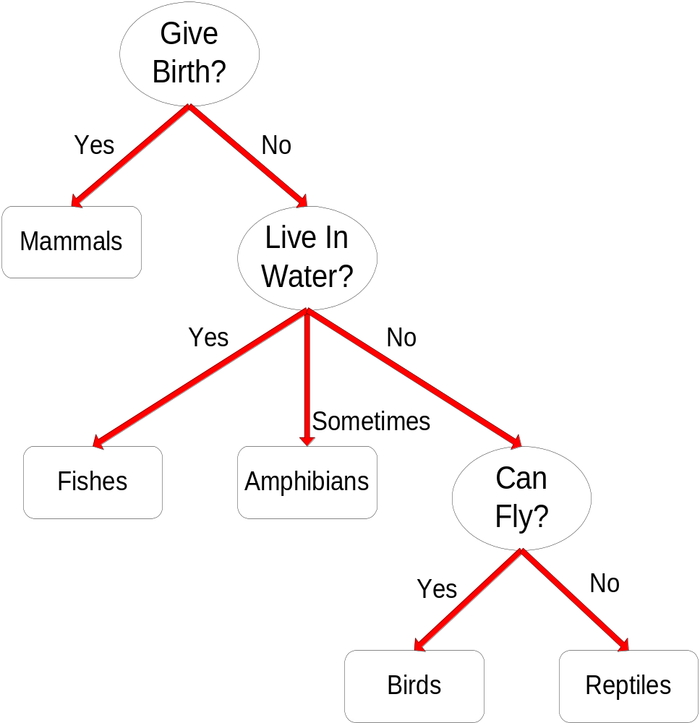
C4.5 versus C4.5rules versus RIPPER
C4.5rules:
(Give Birth=No, Can Fly=Yes) → Birds
(Give Birth=No, Live in Water=Yes) → Fishes
(Give Birth=Yes) → Mammals
(Give Birth=No, Can Fly=No, Live in Water=No) → Reptiles
( ) → Amphibians
RIPPER:
(Live in Water=Yes) → Fishes
(Have Legs=No) → Reptiles
(Give Birth=No, Can Fly=No, Live In Water=No)
→ Reptiles
(Can Fly=Yes,Give Birth=No) → Birds
() → Mammals

Slide 29
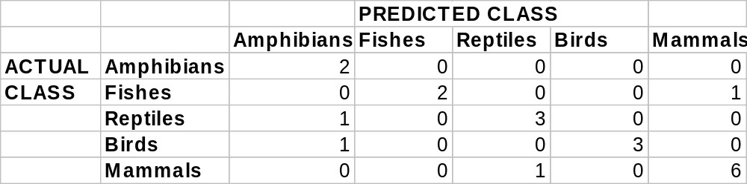
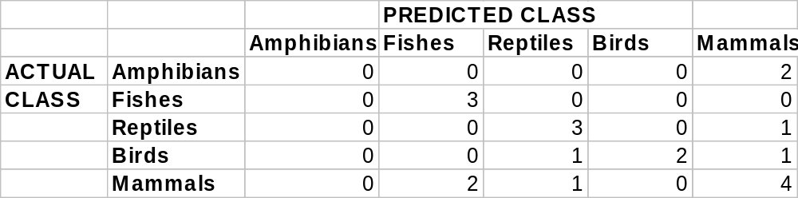
C4.5 versus C4.5rules versus RIPPER
C4.5 and C4.5rules:
RIPPER:

Slide 30
Advantages of Rule-Based Classifiers
As highly expressive as decision trees
Easy to interpret
Easy to generate
Can classify new instances rapidly
Performance comparable to decision trees

