Slide 1
COMP2611: Computer Organization
Building Sequential Logics with Logisim
COMP2611 Spring 2015

Slide 2
Overview
You will learn the following in this lab:
  Logisim auto-build feature,
  building a SR latch on Logisim,
  building a D latch on Logisim,
  building a D flip-flop from D latches,
  building a 2-bit register with two D flip-flops.
Logisim

Slide 3
Quick review of Logisim operations
If you have problem with any of the following operations, do let me know so that I can show you again.
  select and drag a logic component onto the canvas of Logisim,
  draw input/output wires to/from the component and connect them correctly,
  change the data width of a component,
  poke to change the input values.
If you have any other problems related to Logisim please also feel free to ask me.
Logisim

Slide 4
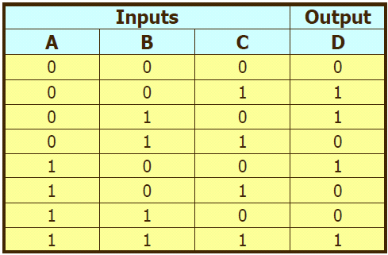
Auto build feature of Logisim 1/2
Just for your interest, Logisim can auto-build a circuit according to the logic expression supplied by you.
For example, to implement a circuit for the following truth table:
You just need to find the sum-of-product representation for the inputs and the output:
D= (~A·~B·C) + (~A·B·~C) + (A·~B·~C) + (A·B·C)
Enter the expression to Logisim and let Logisim build the circuit automatically.
Logisim

Slide 5
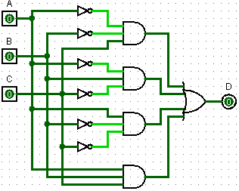
Auto build feature of Logisim 2/2
To do that, click “Project”, “Analyze Circuit”,
then click the “Inputs” tab, enter “A”, “B”, “C” separately as the inputs,
now click the “Outputs” tab, enter “D” as the output,
click the “Expression” tab and type the expression as follows (replace every AND operator with a space):
(~A ~B C) + (~A B ~C) + (A ~B ~C) + (A B C)
now click “Enter” tab at the lower right corner, finally click “Build Circuit” at the bottom, Logisim will build the circuit. You can poke to check its correctness.
THIS IS JUST FOR YOUR INTEREST ONLY, DON’T USE IT TO CHEAT! THIS TOOL WILL NOT BE AVAILABLE ON THE DATES OF THE EXAMINATIONS!
Logisim

Slide 6
Quick sequential logics review
Do Let me know if you have problem to recall the following terms.
  A clock,
  Clock cycles,
  Rising/falling edge of a clock cycle,
  Edge triggered clocking,
  Clocked/unclocked elements,
  State elements.
Logisim

Slide 7
The S-R Latch 1
A Set-Reset latch is the simplest form of storage element. It is an unclocked element (what does that mean?).
Two inputs:
  - S for storing the value “1” to the latch
  - R for storing the value “0” to the latch
Two outputs
  - Q for outputting the value stored in the latch
  -~Q the complement of Q.
The following table details the values of the two inputs and the effects on the output value Q.
S | R | Action on Q
0 | 0 | Nothing changed
0 | 1 | Q=0
1 | 0 | Q=1
1 | 1 | forbidden
Logisim

Slide 8
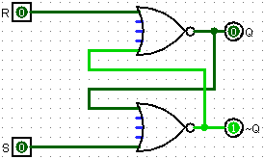
The S-R Latch 2
Start Logisim and build the S-R latch as shown below. (make sure you label the inputs and the outputs)
Poke the inputs and verify your circuit is correct by referring to the table on the previous slide. Save the latch as “sr-latch.circ” for future use.
Logisim

Slide 9
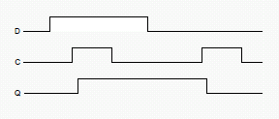
The D-Latch 1
A D-latch is a clocked storage element.
The value stored in a D-latch can be updated iff the clock is asserted (i.e. Hi).
Two inputs
  - D, the value to be stored
  - a clock signal (that alternates between Hi and Lo regularly)
Two outputs
  - Q for outputting the value stored in the latch
  -~Q the complement of Q.
The following table details the values of the two inputs and the effects on the output value Q.
C (Clock) | D | Action on Q
0 | 0 | Nothing changed
0 | 1 | Nothing changed
1 | 0 | Q=0
1 | 1 | Q=1
Logisim

Slide 10
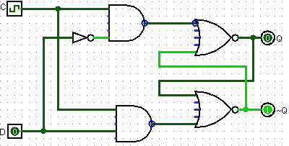
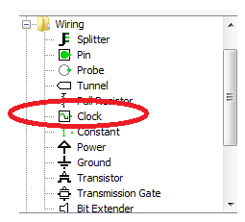
The D-Latch 2
Build the D-latch as shown below. (make sure you label the inputs and the outputs)
You can find the clock element in the wiring folder of the “Explorer pane”
Logisim

Slide 11
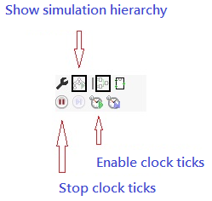
The D-Latch 3
Click “Simulate”, “Tick Frequency”, “1 Hz” so that the clock will alternate at the frequency of 1Hz.
Now click “Show simulation Hierachy” button on the toolbar, and then click the “Enable clock ticks” button to start the clock.
Once the clock is running you can poke the input D to store value to the latch. Take some time to observe the way the input is being stored.
Store the latch as “d-latch.circ”.
Logisim

Slide 12
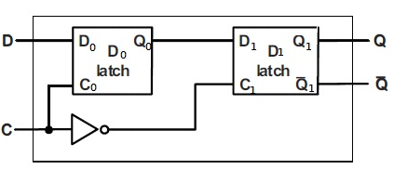
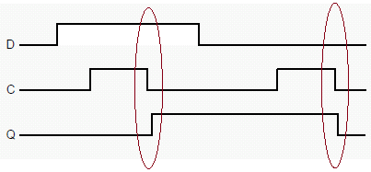
The D Flip-Flop 1
A D flip-flop is an edge triggered device. Its value can only be changed on a clock edge (a much shorter duration than that of the D latch).
The D flip-flop can be made from two D latches:
The timing diagram for the D flip-flop is shown below, note that changes of the flip-flop value occur only at the falling edge of the clock (circled by the two red ovals)
C (Clock) | D | Action on Q
Falling edge | 0 | 0
Falling edge | 1 | 1
Non-falling edge | X (don’t care) | Nothing changed
Logisim

Slide 13
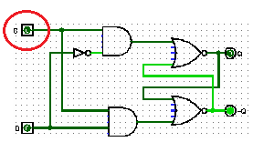
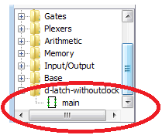
The D Flip Flop 2
Load “d-latch.circ” and replace the clock with an input named “C”. Store it as “d-latch-withoutclock.circ”.
Start a new project (by pressing “Ctrl+N”) in Logisim. Load the D latch built by clicking “Project”, ”Load Library”, “Logisim library…” and select “d-latch-withoutclock.circ”. Now you should be able to find the d-latch in the “Explore pane”.
Logisim

Slide 14

The D Flip Flop 3
Click on “main” and drag the D latch to the canvas to draw the D Flip flop.
Mind that locations of the C and D on the D latch (i.e. they are different from that of slide 12).
Your finished flip-flop should be similar to the following:
Enable the clock as discussed on slide 11, and poke the input “D” to see the changes of the output at Q and ~Q.
Save the flip-flop as “D-flip-flop.circ”.
Now remove the clock from the D flip-flop and replace it by an input “C” just like before. Save this version as “D-flip-flop-withoutclock.circ”. We will use it to build a register.
Logisim

Slide 15
Building a 2-bit register with the D Flip Flops 1
We can build a simple register that holds 2 bits with the D flip-flop(you can use the D flip-flop to build register of any size, we build a 2-bit register here for simplicity).
Basically, the idea is to use two D flip-flops in the circuit, each of which holds a single bit.
The input will be 2-bit in width. We need to separate the individual bits by using a “splitter” and direct the bits to the corresponding D flip-flops.
Logisim

Slide 16
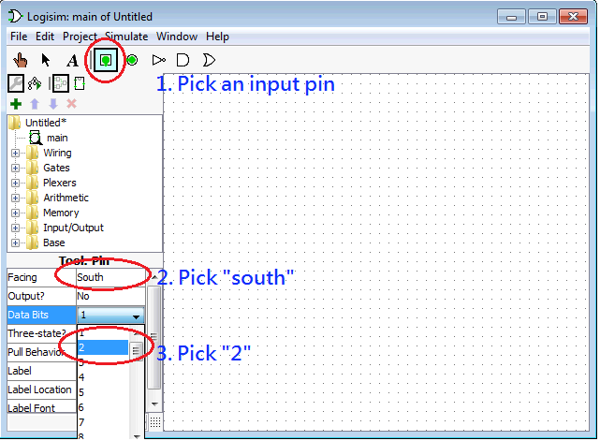

Building a 2-bit register with the D Flip Flops 2
To have 2-bit inputs, you need to follow the 3 steps below to set up the input pin.
When you pick “south” for “Facing” in step 2, wires can be drawn from the bottom (south) of the input pin. It is up to you whether you want to choose “south”.
After the 3 steps you drag the pin to the canvas and you will have this 2-bit input pin on the canvas (values have been initialized to 0,0).
Logisim

Slide 17
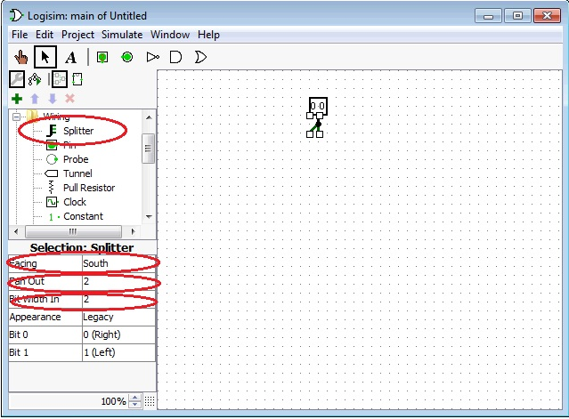
Building a 2-bit register with the D Flip Flops 3
Select a 2-bit splitter from the “wiring” folder of the “Explore pane”.
Make sure you have set the “Fan-Out” (number of output legs) and “Bit Width In” both to be 2. So that each leg carries 1 bit of data.
Logisim

Slide 18
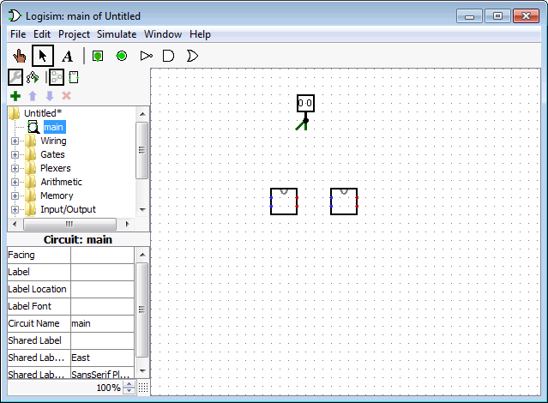
Building a 2-bit register with the D Flip Flops 4
Now load the “D-flip-flop-withoutclock.circ” as a library and use it as a component of the register. You can load it by clicking “Project”, ”Load Library”, “Logisim library…” and select “D-flip-flop-withoutclock.circ”.
Drag two D flip-flops from the “Explorer pane”.
Note the two input dots (in blue) on the left of the flip-flop and the two output dots (in red) on the right.
The upper input dot is C (Clock), the lower input dot is D (Data).
The upper output dot is Q and the lower output dot is ~Q.
Logisim

Slide 19
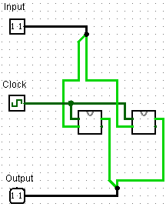
Building a 2-bit register with the D Flip Flops 5
To store 2 bits into the flip-flops, you need to forward the bits from the splitter to the corresponding D flip-flops.
You also need to connect a clock signal to both of the D flip-flops.
Don’t forget to retrieve the output from the flip-flops (using an output pin).
Here is an example circuit for the register:
Logisim

Slide 20
Building a 2-bit register with the D Flip Flops 6
Some hints:
  The colors of the wires hint you on possible errors, make good use of this information.
  Each of the input/output pins can be connected in one direction only, as determined by the “facing” attribute. Make sure you connect it correctly.
  A splitter splits bits according to their location in the input, the order is preserve on the splitter, (i.e., left-most bit on the left-most split wire and so on)
  Logisim could sometimes have mysterious errors on the wires even though there is no error at all. An easy way to solve this is to copy and paste the whole circuit to a new canvas. This usually solves the problem.
Logisim

Slide 21
Conclusion
We covered the following topics today:
  Logisim auto-build feature,
  building a SR latch on Logisim,
  building a D latch on Logisim,
  building a D flip-flop from D latches,
  building a 2-bit register with two D flip-flops.
Logisim

