Slide 1
COMP2611: Computer Organization
MIPS syscall services
COMP2611 Spring 2015

Slide 2
Overview
You will learn the following in this lab:
  how to perform a system service using the instruction syscall in a MIPS program.
MIPS syscall services

Slide 3
MIPS syscall services
A MIPS instruction syscall is defined to perform a system service, e.g., Console Input/Output.
Run the example program printString.s which uses the syscall to print the string "Hello World" to the console.
Before executing the syscall instruction, you need to:
  store the system call code (an integer) in the register v0, and the service performed by the syscall is determined by this register value (at the moment of executing the syscall instruction) .
  pass any argument(s) for the syscall service via some particular register(s), e.g., passing the output value in the register a0 for printing an integer to the console.
MIPS syscall services

Slide 4
Common syscall services
  Some common syscall services (you must know the yellow ones):
Service | System Call Code ($v0) | Arguments | Result | Example
print_int | 1 | $a0=integer |  | li $v0, 1 li $a0, 100 syscall
print_float | 2 | $f12=float
print_double | 3 | $f12=double
print_string | 4 | $a0=start address of the string
read_int | 5 |  | integer (in $v0) | li $v0, 5 syscall # $v0 = input value
read_float | 6 |  | float (in $f0)
read_double | 7 |  | double (in $f0)
read_string | 8 | $a0=buffer, $a1=length
sbrk | 9 | $a0=amount | address (in $v0)
exit | 10 |  |  | li $v0, 10 syscall
MIPS syscall services

Slide 5
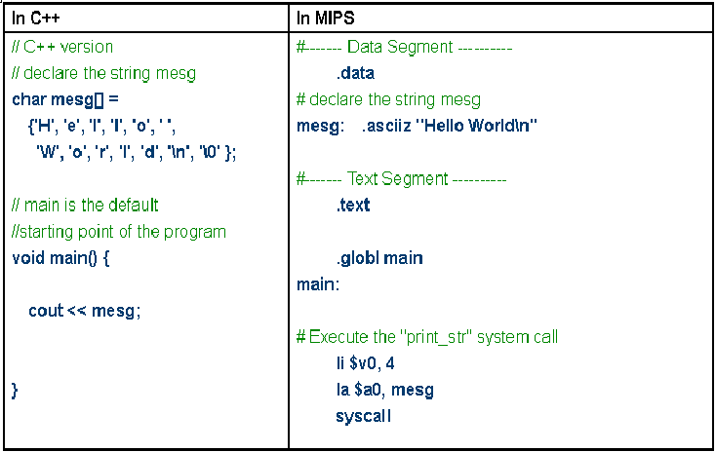
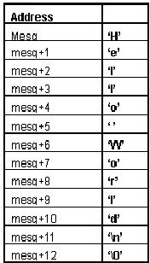
Printing a string to console
MIPS syscall services

Slide 6
Printing a string to console
Setting v0 to 4, the processor knows we need to print a string to the console when executing a syscall.
MIPS syscall services

Slide 7
Printing a string to console
Setting v0 to 4, the processor knows we need to print a string to the console when executing a syscall.
When la $a0, mesg
is executed, the starting address of the string will be assigned to the register a0.
MIPS syscall services

Slide 8
Printing a string to console
e.g., if mesg (character 'H') is located at the 1001-th byte of memory, then a0 = 1001.
Setting v0 to 4, the processor knows we need to print a string to the console when executing a syscall.
When la $a0, mesg
is executed, the starting address of the string will be assigned to the register a0.
MIPS syscall services

Slide 9
Printing a string to console
e.g., if mesg (character 'H') is located at the 1001-th byte of memory, then a0 = 1001.
Setting v0 to 4, the processor knows we need to print a string to the console when executing a syscall.
When la $a0, mesg
is executed, the starting address of the string will be assigned to the register a0.
After executing syscall, the processor reads the memory byte by byte from the address in a0 (e.g. 1001--> 1002 --> 1003 ... and so on). The corresponding character will be displayed one by one until the end of string character ('\0') is read.
MIPS syscall services

Slide 10
Example programs
Try the following example programs:
  printString.s (for Printing a string to the console).
  printInt.s (for Printing an integer to the console).
  readInt.s (for Reading an integer from the console).
MIPS syscall services

Slide 11
Syscall service "exit"
The syscall service "exit" terminates the program immediately after this syscall instruction is executed.
# starting main program
.text
.globl __start
__start:
addi $t0, $zero, 5
addi $t1, $t0, -2
li $v0, 10
syscall # the program is terminated after executing this syscall
# the codes below will never be executed
addi $t1, $t1, 1
add $t1, $t0, $t1
  Try the example programs exitExample1.s and exitExample2.s.
MIPS syscall services

Slide 12
Example program
  Try the example program combinedSyscalls.s:
    It demonstrates the use of various syscall services together.
    It prompts the user to enter two numbers on the console, reads the input numbers and prints their sum to the console.
MIPS syscall services

Slide 13
Exercise
By using the syscall services you have learnt:
  write a MIPS program that prompts the user for two integer inputs,
  and displays the sum of the two integers,
  the program should be able to exit using the syscall service after displaying the sum,
  you do not need to verify the correctness of the input integers.

Slide 14
Conclusion
You have learnt:
  how to perform a system service using the instruction syscall in a MIPS program.
MIPS syscall services

