Slide 1
Programs and Numbers
COMP2611: Computer Organization

Slide 2
Overview
You will learn the following in this tutorial:
  the compilation process of computer programs into machine instructions.
  the conversion between binary, decimal and hexadecimal numbers.
  the computer numerical unit prefix.
Programs and Numbers

Slide 3
Programs and Numbers
Computer programs
- the compilation process
Number bases
- the introduction of different bases
Conversion between binary and decimal
- conversion methods and exercises
Conversion between binary and hexadecimal
- conversion methods and exercises
Computer numerical unit prefix
Exercises
Programs and Numbers

Slide 4
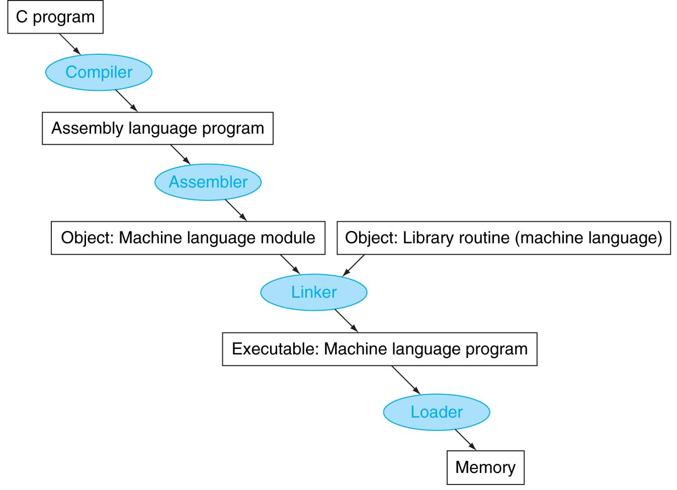
Computer programs
Programs and Numbers

Slide 5
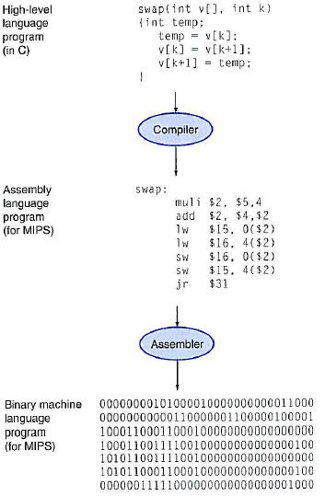
Programs for MIPS processor
Programs and Numbers

Slide 6
Programs and Numbers
Computer programs
- the compilation process
Number bases
- the introduction of different bases
Conversion between binary and decimal
- conversion methods and exercises
Conversion between binary and hexadecimal
- conversion methods and exercises
Computer numerical unit prefix
Exercises
Programs and Numbers

Slide 7
Number bases
Numbers can be represented using various bases.
  i.e. base 2, base 10, base 16, etc.
Decimal numbers are of base 10.
  For example, 174₍₁₀₎ = (1x10²) + (7x10¹) + (4x10⁰)
Binary representation (base 2) is the basis of digital data.
  For example, 18₍₁₀₎ = 10010₍₂₎
If a number is represented using the base x, each digit of the number can only be one of the values 0, 1, 2, …, x – 1.
For example, a digit of a binary number (called a bit) is either 0 or 1.
Programs and Numbers

Slide 8
Programs and Numbers
Computer programs
- the compilation process
Number bases
- the introduction of different bases
Conversion between binary and decimal
- conversion methods and exercises
Conversion between binary and hexadecimal
- conversion methods and exercises
Computer numerical unit prefix
Exercises
Programs and Numbers

Slide 9
Converting positive decimal integer to binary
We keep on dividing the decimal integer by 2 until the quotient is 0. The remainder at each step corresponds to a digit of the integer in base 2, from the Least Significant Digit (LSD) to the Most Significant Digit (MSD).
Programs and Numbers

Slide 10
Exercises
Question 1: Convert 37₍₁₀₎ to the binary format.
Programs and Numbers

Slide 11
Converting positive binary integer to decimal
The value represented by the i-th bit d of a positive binary integer is in fact d x 2^{i}. Note that the Least Significant bit is the 0-th bit.
Take the integer ABCD₍₂₎ as an example, it effectively corresponds to:
ABCD₍₂₎ = (Ax2³) + (Bx2²) + (Cx2¹) + (Dx2⁰)
2’s power | 2¹ | 2² | 2³ | 2⁴ | 2⁵ | 2⁶ | 2⁷ | 2⁸ | 2⁹ | 2¹⁰
value | 2 | 4 | 8 | 16 | 32 | 64 | 128 | 256 | 512 | 1024
Programs and Numbers

Slide 12
Exercises
  Question 1: Convert the positive integer 10 1001₍₂₎ to the decimal format.
Programs and Numbers

Slide 13
Converting positive binary integer to decimal
A positive integer of the base t can be represented by a polynomial of t: the i-th digit d of the integer is in fact d x t^{i}.
Take the integer ABCD_{(t)} as an example, it effectively corresponds to:
  ABCD_{(t)} = (A x t³) + (B x t²) + (C x t¹) + (D x t⁰)
Programs and Numbers

Slide 14
Programs and Numbers
Computer programs
- the compilation process
Number bases
- the introduction of different bases
Conversion between binary and decimal
- conversion methods and exercises
Conversion between binary and hexadecimal
- conversion methods and exercises
Computer numerical unit prefix
Exercises
Programs and Numbers

Slide 15
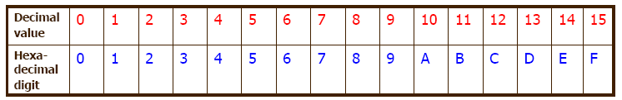
Hexadecimal format
The binary number system is verbose in that even small numerical values could require long strings of bits to represent.
Hexadecimal number system is a number system that has a base of 16 (instead of 2).
Under the hexadecimal system, there are 16 possible values for each digit, as shown in the table.
Programs and Numbers

Slide 16
Converting binary number to hexadecimal
We just group the binary number into groups of 4 bits, and then each group represents one digit of the corresponding hexadecimal number.
The conversion can be made immediately by eye inspection.
Programs and Numbers

Slide 17
Exercises
  Question 1: Convert 0011 0010₍₂₎ to the hexadecimal format.
Programs and Numbers

Slide 18
Converting hexadecimal number to binary
We just expand each digit of the hexadecimal number into 4 bits, and then the resulting bits from all the digits represent the corresponding binary number.
Again, the conversion can be made immediately by eye inspection.
Programs and Numbers

Slide 19
Exercises
  Question 1: Convert A7₍₁₆₎ to the binary format.
Programs and Numbers

Slide 20
Programs and Numbers
Computer programs
- the compilation process
Number bases
- the introduction of different bases
Conversion between binary and decimal
- conversion methods and exercises
Conversion between binary and hexadecimal
- conversion methods and exercises
Computer numerical unit prefix
Exercises
Programs and Numbers

Slide 21
Computer numerical unit prefix
For representing a number of bits or bytes in computers, the unit prefix Kilo is often used to represent 2¹⁰ (equal to 1024) not 1000.
For examples, 1 kilobytes = 1024 bytes and 1 kilobits = 1024 bits.
Similarly, we have the following table for the common prefixes used for bytes and bits:
Unit prefix | Value
Kilo | 2¹⁰ (or 1024)
Mega | 2²⁰ (or 2¹⁰ Kilo)
Giga | 2³⁰ (or 2¹⁰ Mega)
Tera | 2⁴⁰ (or 2¹⁰ Giga)
Programs and Numbers

Slide 22
Programs and Numbers
Computer programs
- the compilation process
Number bases
- the introduction of different bases
Conversion between binary and decimal
- conversion methods and exercises
Conversion between binary and hexadecimal
- conversion methods and exercises
Computer numerical unit prefix
Exercises
Programs and Numbers

Slide 23
Exercises
Question 1: Convert 176₍₁₀₎ to the binary format.
Programs and Numbers

Slide 24
Exercises
  Question 2: Convert the positive integer 11 0100 1001₍₂₎ to the decimal format.

Slide 25
Exercises
  Question 3: Convert 1010 0011 1001 0111 0100₍₂₎ to the hexadecimal format.

Slide 26
Exercises
  Question 4: Convert B12A3F01₍₁₆₎ to the binary format.

Slide 27
Conclusion
You have learnt:
  the compilation process of computer programs into machine instructions.
  the conversion between binary, decimal and hexadecimal numbers.
  the computer numerical unit prefix.
Programs and Numbers

