Slide 1
Introduction to
Combinational Logic
COMP2611: Computer Organization

Slide 2
Overview
You will learn about the combinational logic circuits
  Do not have internal states (i.e. memoryless),
  The output is solely determined by the present input and the circuit,
  Can be specified with a truth table or a logic equation (in Boolean algebra expression).
Vs Sequential Logic circuits (the next tutorial)
  Have memory,
  The output depends on both the current input and the value stored in the memory of the circuits (called state).
Combinational Logic

Slide 3
Combinational logic
Boolean algebra
- review of the Boolean algebra
- the Sum of Product (SoP) representation
- from Boolean algebra to circuit
- PLA implementation
- K-Maps
Exercises
Combinational Logic

Slide 4
Why Boolean Algebra?
The Input-Output relationship of any combinational logic circuit can be completely specified using either
  a truth table,
  or a Boolean algebra expression.
When there are N inputs, the truth table would require as many as 2^{N} entries.
The Boolean algebra expression does not have this “cardinality explosion” problem.
Combinational Logic
Notes:
The truth table is more straightforward, yet when there are N inputs, the truth table would require as many as 2^{N} entries.
For N=15, truth table requires as many as 2¹⁵~=32k entries!.
The Boolean algebra expression does not have this “cardinality explosion” problem and is more suitable for describing the input-output relationships having large number of inputs.

Slide 5

Review of Boolean Algebra 1
Boolean algebra consists of
  Boolean variables (with values equal to either ‘0’ or ‘1’ ),
  and binary operators AND (‘ ’), OR (‘+’), NOT (‘ ’) or (‘ ’ ’).
The AND, OR, and NOT operations form a functionally complete set, as they can specify any logic function.
Combinational Logic
Notes:
can specify any logic function=>(i.e. can specify all possible truth tables)

Slide 6



Review of Boolean Algebra 2
Identity laws:
Annihilator (or Zero and one) laws:
Complement laws:
Commutativity laws:
Associativity laws:
Distributivity laws:
Combinational Logic

Slide 7
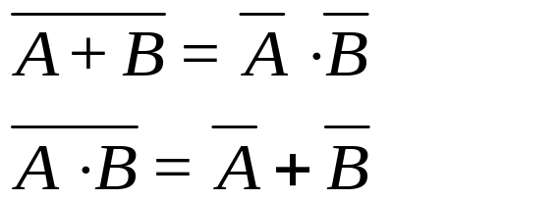
Review of Boolean Algebra 3
Idempotence:
Absorption laws:
De Morgan Laws:
Combinational Logic

Slide 8
Truth table to Boolean representation 1
Any logic function can be expressed as a two-level representation, either as
  the Sum-of-Products (SoP) representation,
  or as the Product-of-Sums (PoS) representation.
Example: Assume the truth table for a circuit is given as:
Express the truth table using SoP representations in Boolean Algebra.
Inputs |  | Outputs
In0 | In1 | Out0 | Out1
0 | 0 | 1 | 0
0 | 1 | 1 | 1
1 | 0 | 0 | 1
1 | 1 | 0 | 0
Combinational Logic

Slide 9




Truth table to Boolean representation 2
For each output (Out0, Out1),
  Observe the rows that the output has a value of ‘1’.
    For Out0, the 1’s are at the 1st and the 2nd rows.
  Write the minterms for the inputs such that the minterms will give 1’s for the input patterns in the same rows.
    For Out0, the two 1’s correspond to the input patterns (in0=0,in1=0) and (in0=0,in1=1). The two minterms that will give 1’s are and
  Write the outputs as the OR operation of the minterms found in step two. For Out0, we have
Combinational Logic

Slide 10

Truth table to Boolean representation 3
By following the above steps. The required expressions for the two outputs (Out0, Out1) are and
respectively.
Could the expressions for Out0 and Out1 be further simplified using the laws on slide 6?
Combinational Logic
Notes:
Yes for out0
by first applying the distributivity law out0 = ~ln0 (~ln1+ln1), where ~ is the negation operator,
by applying the complement law we have out0=~ln0(1),
by applying the identity law we have out0=~ln0.
We can not simplify out1

Slide 11

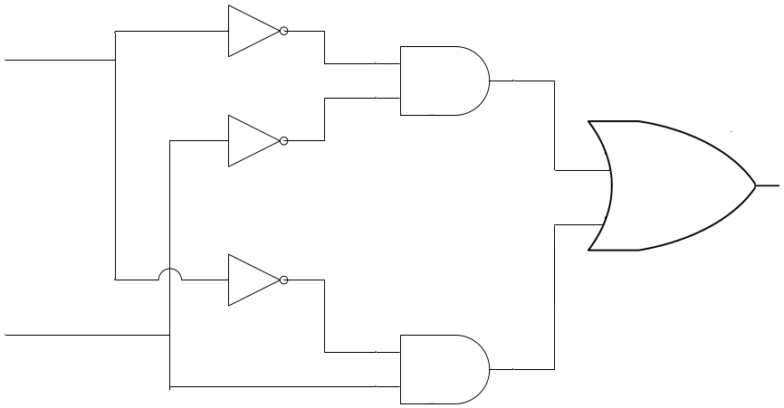
Reducing a Boolean expression to a circuit 1
The expression can be viewed as performing the OR operation on two ANDed minterms and .
The circuit is as follows. Mind the two AND gates that correspond to the AND expressions and the single OR gate that corresponds to the OR expression.
What will be the impact on the circuit if we use the simplified expression (mentioned in the last slide) to build the circuit.
in0
Out0
in1
Combinational Logic
Notes:
If we use the simplified expression, we just need a NOT gate ( can save all the other AND gates and NOT gates), which reduces the number of logic components required (also in turn reduces the number of transistors used to physically implement the circuit)

Slide 12

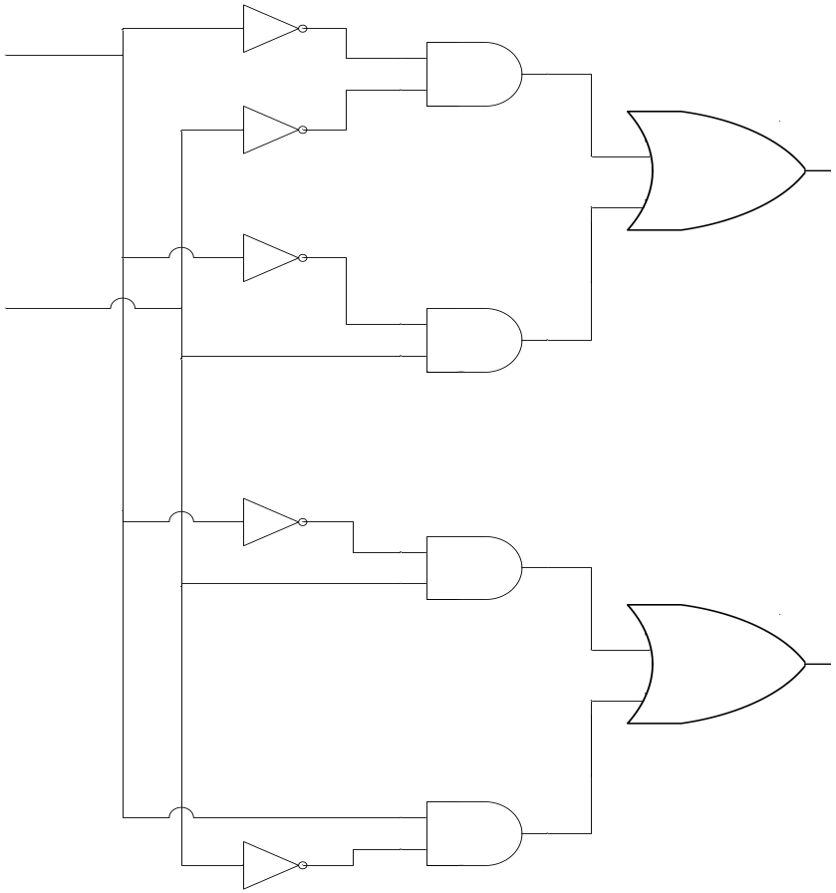
Reducing a Boolean expression to a circuit 2
Using the same approach, the expression can also be drawn. Combine it with the previous figure we have the overall circuit:
in0
Out0
in1
Out1
Combinational Logic

Slide 13

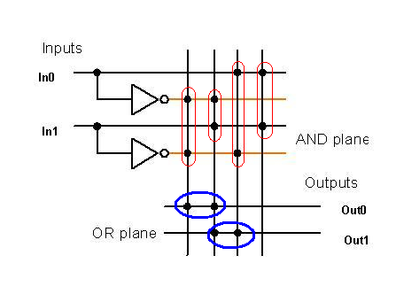





PLA implementation of a Boolean expression
The same circuit can be equivalently represented by a programmable logic array (PLA) circuit.
Combinational Logic
Notes:
A programmable logic array (PLA) is a gate-level implementation of the two-level representation for any set of logic functions, which corresponds to a truth table with multiple output columns.
e.g. the outputs of AND plane to inputs of OR plane corresponds to the sum-of-products representation.

Slide 14
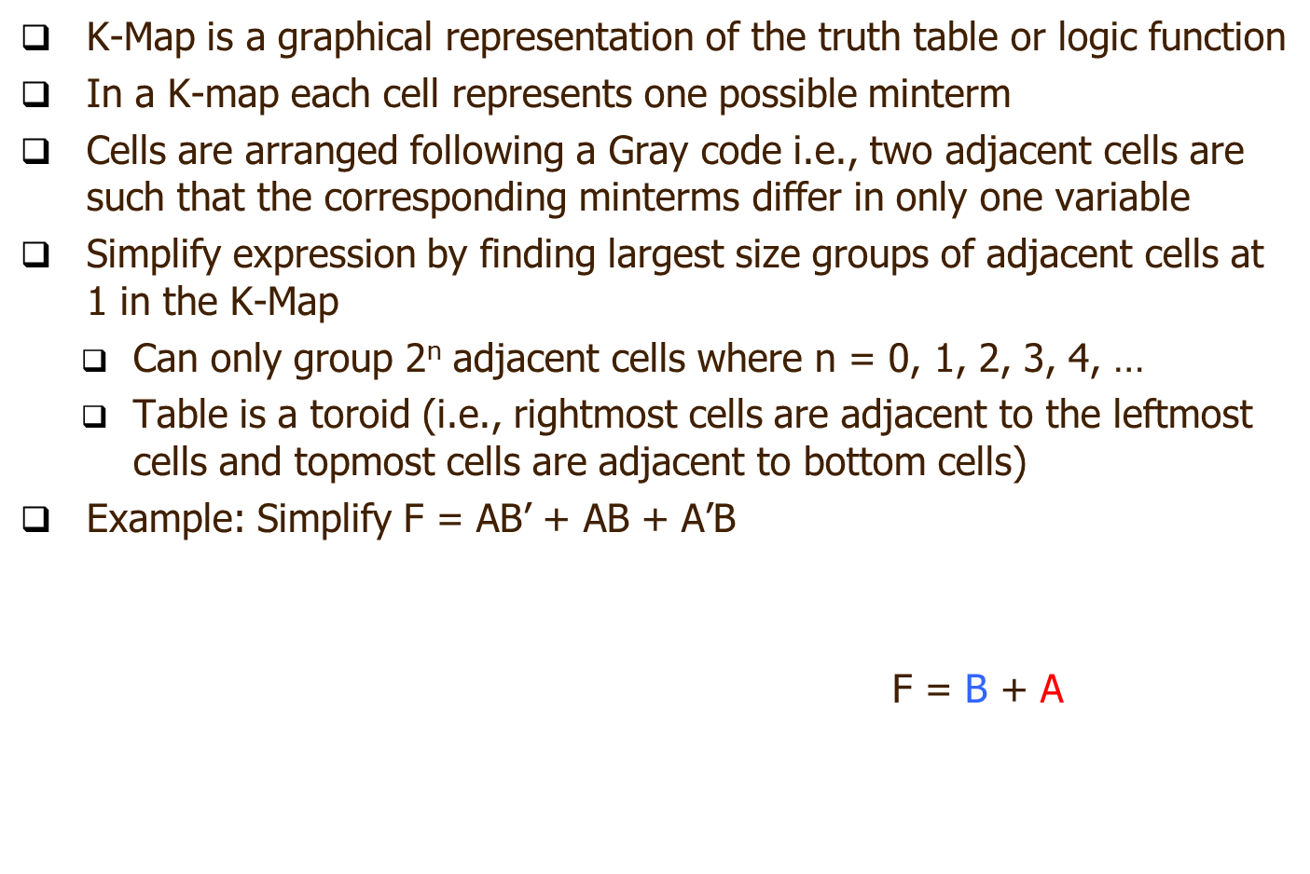
K-Maps
B A | 0 | 1
0 | A’B’ | A’B
1 | AB’ | AB
B A | 0 | 1
0 | 0 | 1
1 | 1 | 1
Combinational Logic
Notes:
As shown in previous slid, simplifying boolean expressions leads to simpler and cheaper circuits.
Karnaugh-Maps (K-maps) is one such method for simplying boolean expressions by hand.

Slide 15
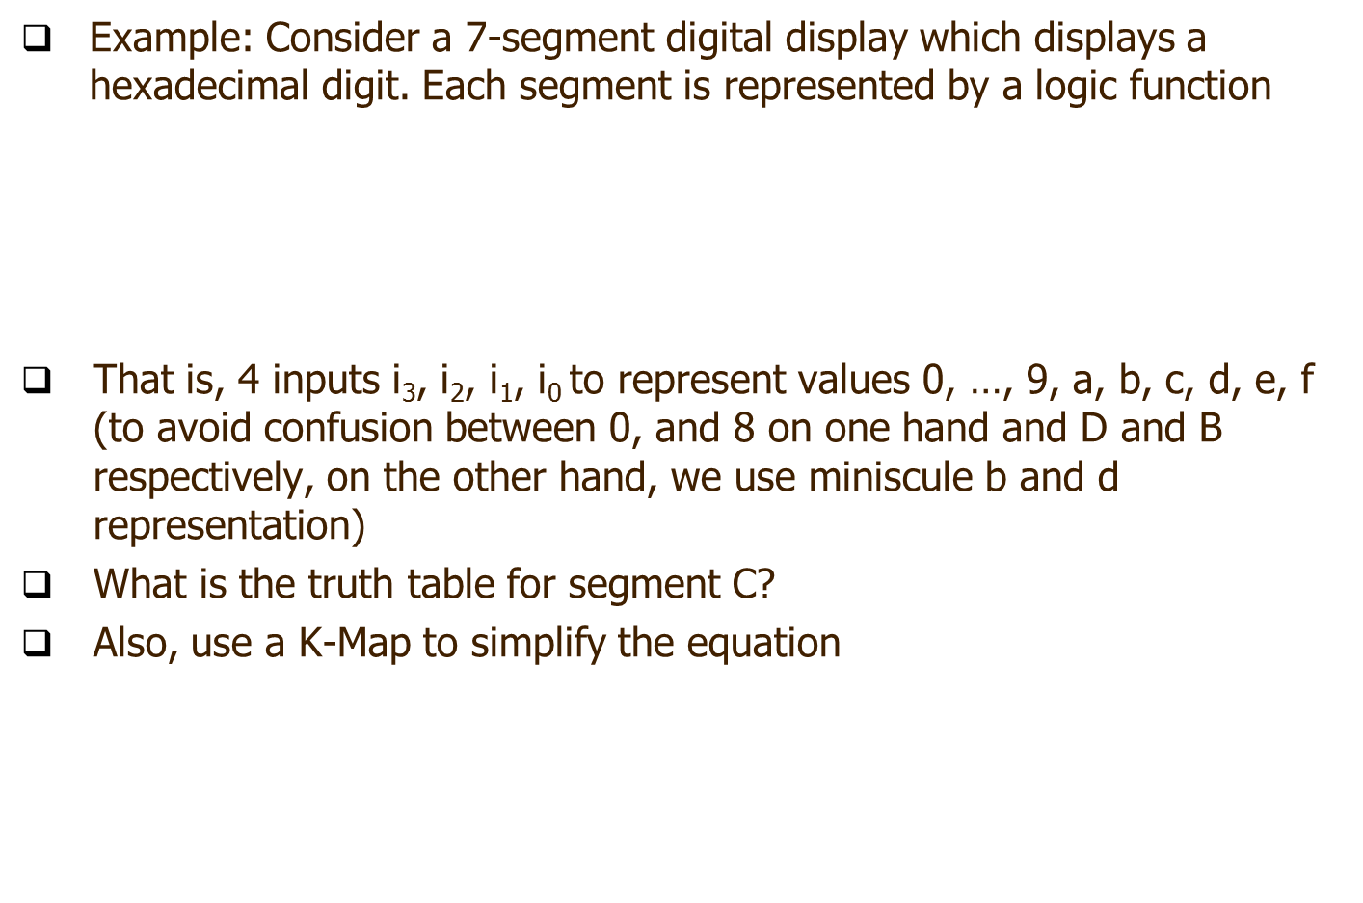
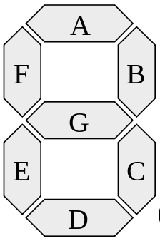
K-Maps
Combinational Logic

Slide 16
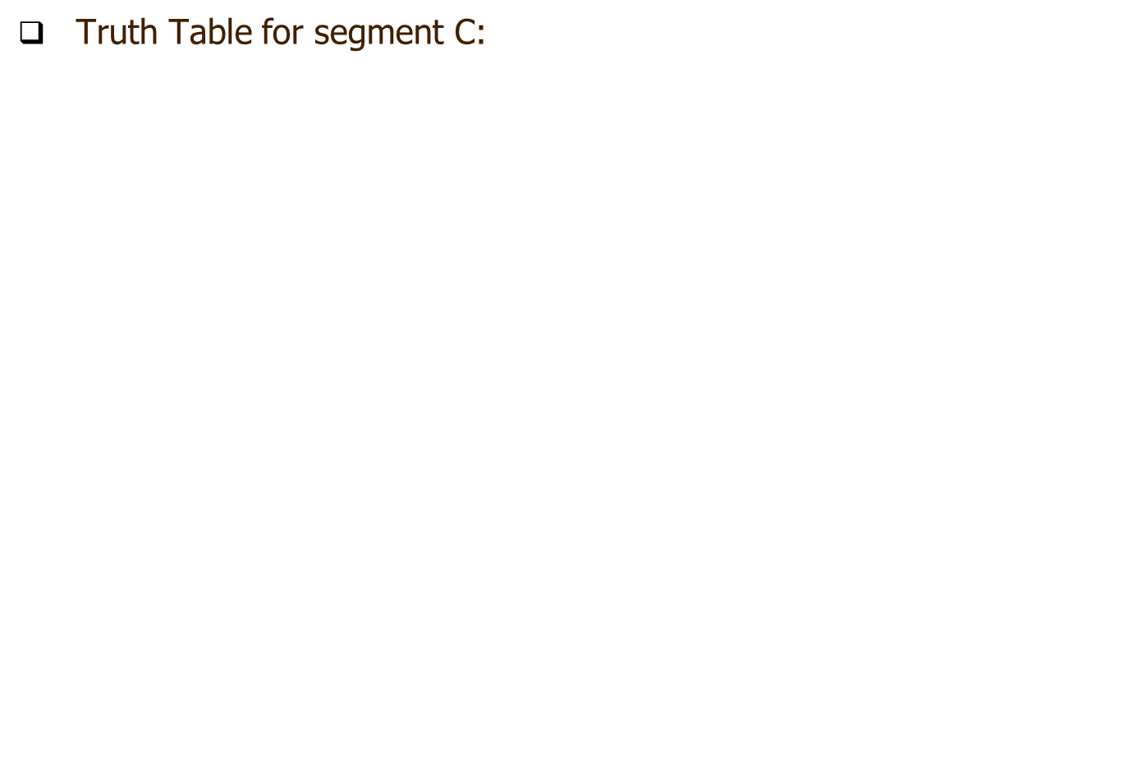
K-Maps
 | Inputs |  |  |  | Output
Hexadecimal Digit | i₃ | i₂ | i₁ | i₀ | C
 | 0 | 0 | 0 | 0 | 1
 | 0 | 0 | 0 | 1 | 1
 | 0 | 0 | 1 | 0 | 0
 | 0 | 0 | 1 | 1 | 1
 | 0 | 1 | 0 | 0 | 1
 | 0 | 1 | 0 | 1 | 1
 | 0 | 1 | 1 | 0 | 1
 | 0 | 1 | 1 | 1 | 1
 | 1 | 0 | 0 | 0 | 1
 | 1 | 0 | 0 | 1 | 1
 | 1 | 0 | 1 | 0 | 1
 | 1 | 0 | 1 | 1 | 1
 | 1 | 1 | 0 | 0 | 0
 | 1 | 1 | 0 | 1 | 1
 | 1 | 1 | 1 | 0 | 0
 | 1 | 1 | 1 | 1 | 0
Combinational Logic

Slide 17
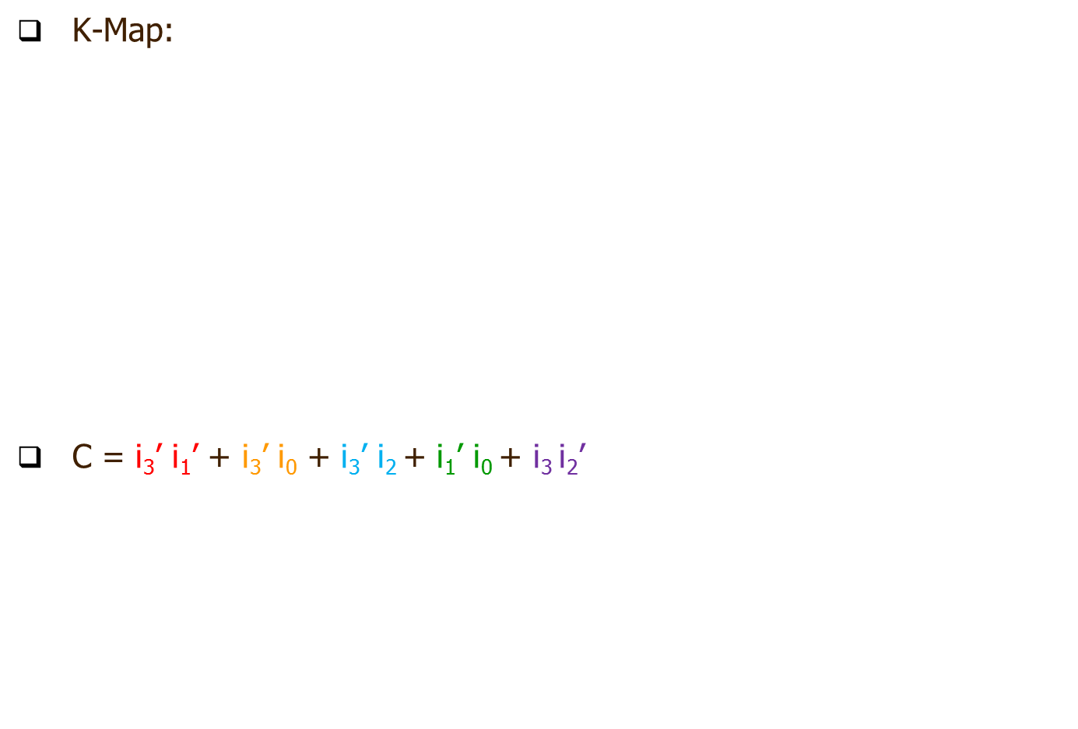
K-Maps
i₁i₀ i₃i₂ | 00 | 01 | 11 | 10
00 | 1 | 1 | 1 | 0
01 | 1 | 1 | 1 | 1
11 | 0 | 1 | 0 | 0
10 | 1 | 1 | 1 | 1
Combinational Logic

Slide 18
Combinational logic
Boolean algebra
- review of the Boolean algebra
- the Sum of Product (SoP) representation
- from Boolean algebra to circuit
- PLA implementation
- K-maps
Exercises
Combinational Logic

Slide 19
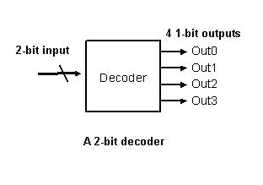
Exercises
Question 1: A decoder takes a single N-bit input and outputs 2^{N} 1-bit signals. The 1-bit output corresponds to the N-bit input bit pattern is true while all other outputs are false. The following figure shows a block diagram for a 2-to-4 decoder.
Combinational Logic

Slide 20
Exercises
- Why a 2-bit input can generate 4 outputs in the decoder?
- If the input bits are 11, what will happen to the outputs of the decoder?
- Is it possible to have more than one outputs asserted?
- Name two potential uses of the decoder.
- Implement the decoder using Logisim
Combinational Logic

Slide 21
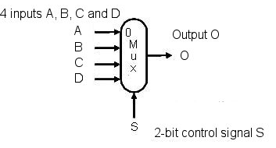
Exercises
Question 2: A multiplexor is a devices that given the control signal, selects one of the inputs to be forwarded to the output. The following figure shows a 4-input multiplexor.
Combinational Logic

Slide 22
Exercises
- If the inputs A/B are 32-bit in width, what is the data width of the Output O?
- What is the maximum number of inputs if the control signal is 10-bit in width?
- What is the bit-width of the control signal for the multiplexor if there are 9 inputs?

Slide 23
Conclusion
Today we have reviewed:
  simple Boolean algebra and the related laws,
  reducing truth table to the canonical Sum-of-Products form,
  converting simple Boolean algebra expressions to circuits,
  simple combinational logic circuits,
  K-maps.
Combinational Logic

