Slide 1
Arithmetic Logic Unit
COMP2611: Computer Organization

Slide 2
Overview
You will learn the following in this tutorial:
  the structure of 1-bit MIPS ALUs,
  overflow detecting mechanism in the MSB 1-bit ALU,
  building a simple 32-bit ALU for the MIPS arithmetic,
  implementing the SLT instruction in a 32-bit MIPS ALU.
ALU

Slide 3
Arithmetic Logic Unit
Review of the 1-bit ALU
- 1-bit ALU
- 1-bit ALU for the MSB
- Overflow detection
An extended 32-bit ALU
- Ripple carry Add/Sub
- SLT implementation
Exercises
ALU

Slide 4
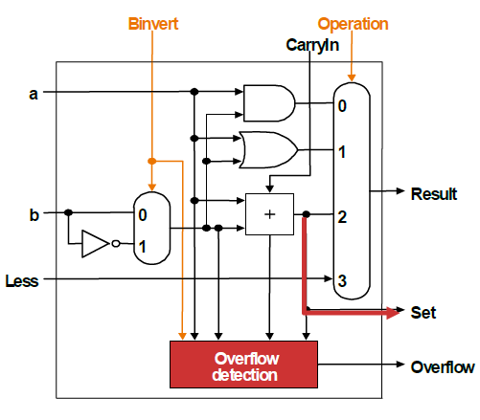
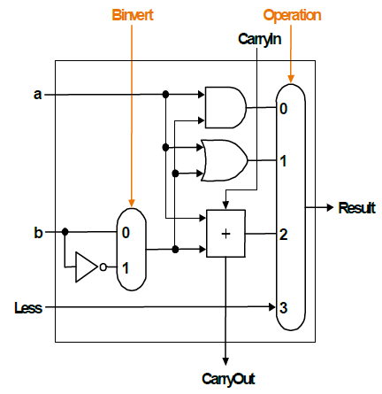
1-bit ALU0-ALU30 V.S. 1-bit ALU31
A 32-bit ALU can be constructed using the following 1-bit ALUs
1-bit ALU for bits 0 to 30
1-bit ALU for the Most Significant Bit (MSB): ALU31
Overflow conditions
Operation | Sign Bit of A | Sign bit of B | Sign bit of Result
A + B | 0 | 0 | 1
A + B | 1 | 1 | 0
A - B | 0 | 1 | 1
A - B | 1 | 0 | 0
ALU

Slide 5
Arithmetic Logic Unit
Review of the 1-bit ALU
- 1-bit ALU
- ALU for the MSB
- Overflow detection
An extended 32-bit ALU
- Ripple carry Add/Sub
- SLT implementation
Exercises
ALU

Slide 6
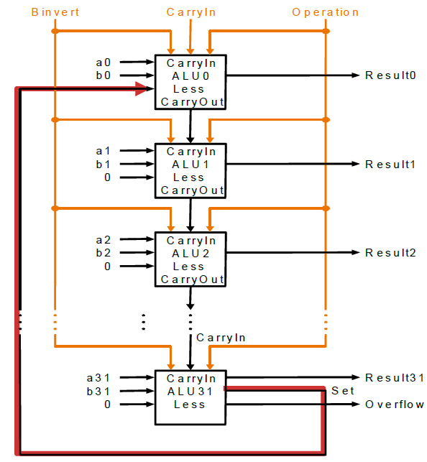
A 32-bit ALU that supports ADD, SUB, AND, OR, SLT
An extended 32-bit ALU (supports SLT) can be formed by connecting 32 1-bit ALUs as follows. Note the 0’s at the “Less” input for ALU1-ALU31, note also the set signal from ALU31 to ALU0.
Set
0
ALU

Slide 7
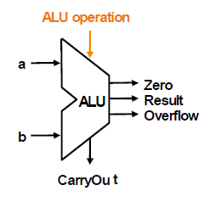
ALU Control Signals /Control Lines
 | Binvert | CarryIn | Operation
AND | 0 | X | 00
OR | 0 | X | 01
ADD | 0 | 0 | 10
SUB | 1 | 1 | 10
SLT | 1 | 1 | 11
Control signals to ALU0
Bnegate (combine Binvert and CarryIn)
Operation | ALU Control Lines
AND | 000
OR | 001
ADD | 010
SUB | 110
SLT | 111
Final ALU control lines
ALU

Slide 8
Arithmetic Logic Unit
Review of the 1-bit ALU
- 1-bit ALU
- ALU for the MSB
- Overflow detection
An extended 32-bit ALU
- Ripple carry Add/Sub
- SLT implementation
Exercises
ALU

Slide 9
Exercises
Question 1: Some argue that the control signals Binvert and CarryIn of the bit-0 ALU can be combined into one control signal. Justify this claim (refer to the ALU diagrams on slides 4 and 6 whenever necessary).
ALU

Slide 10
Exercises
Question 2: By referring to slides 4 and 6, explain how SLT operation can be performed. State the values for the control signals Binvert, CarryIn and Operation.
ALU

Slide 11
Exercises
Question 3: By referring to slides 4 and 6, derive the logic expression in the Sum of Product form (SoP) for overflow conditions based on a 4-bit ALU.
ALU
Notes:
set = result31

Slide 12
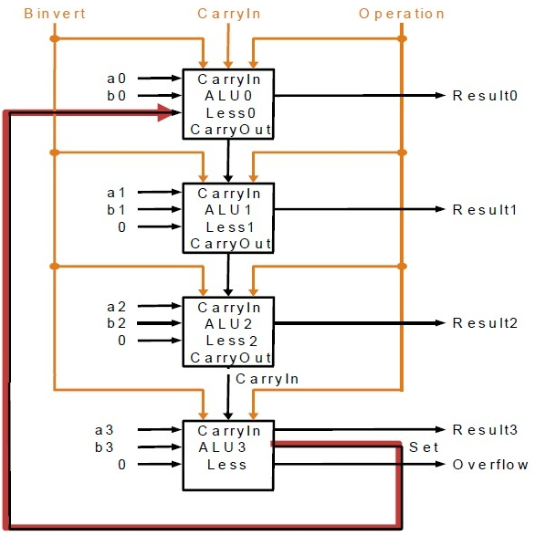
Exercises
Question 4: By referring to the 4-bit ALU below, and by filling into the blanks in the table on the next slide, show how the SLT operation is performed. Assume A is 4-bit and is equal to -3, B is also 4-bit and equals to 2.
ALU

Slide 13
Exercises
Solution:
ALU0
Result of Operation
a0
b0
CarryIn
Binvert
CarryOut
0
1
2
3
ALU1
Result of Operation
a1
b1
CarryIn
Binvert
CarryOut
0
1
2
3
ALU2
Result of Operation
a2
b2
CarryIn
Binvert
CarryOut
0
1
2
3
ALU3
Result of Operation
a3
b3
CarryIn
Binvert
CarryOut
0
1
2
3
ALU

Slide 14
Exercises
Question 5: The SLT operation depends on the result of A-B, and set whenever the sign bit of the operation is asserted. Describe a scenario such that this approach does not work correctly.
ALU

Slide 15
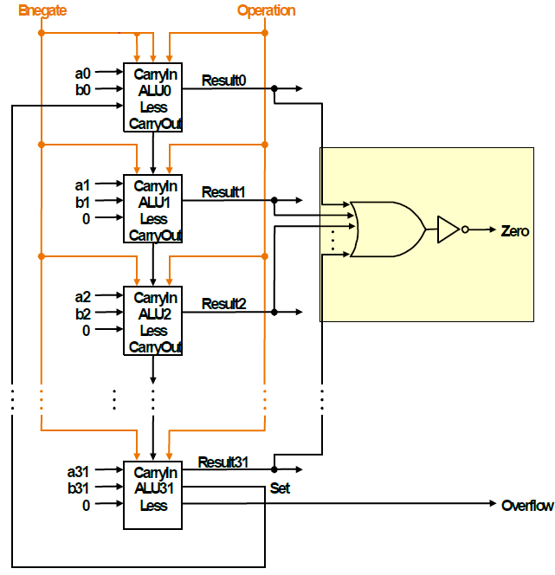
Exercises
Question 6: By referring to the modified 32-bit ALU below, explain how the condition A==B is detected. State the values for the control signals Bnegate and Operation.
ALU

Slide 16
Conclusion
Today we have reviewed:
  the structure of 1-bit MIPS ALUs,
  overflow detecting mechanism in the MSB 1-bit ALU,
  a simple 32-bit ALU for the MIPS arithmetic,
  implementing the SLT instruction in a 32-bit MIPS ALU,
  implementing the “zero” testing in a 32-bit ALU.
ALU

