Slide 1
COMP2611: Computer Organization
Multi-cycle Datapath
Multi-cycle datapath

Slide 2
Overview
You will learn the following in this tutorial:
  how an instruction is executed through the guidance of the control signals.
  how the registers of the datapath change in each clock cycle as an instruction is executing.
Multi-cycle datapath

Slide 3
Multi-cycle Datapath
Datapath implementation
- the updating of the datapath registers in each
execution cycle
- the standard setting of the control signals
- exercise
Exercises
Multi-cycle datapath

Slide 4
Datapath implementation
  The clock cycle of the single-cycle datapath is often very long, leading to a low efficiency
  To improve efficiency, the multi-cycle datapath breaks an instruction execution into a series of steps (cycles):
    Instruction fetch
    Instruction decode and register reads
    ALU operation
    Memory access (when necessary)
    Write data back (to a register)
  In each cycle of the execution, the execution results are always produced at the input of a register.
  The value of a register is not updated to its input in the current cycle until the next cycle starts (as it is often built using clock edge-trigger flip-flops).
Multi-cycle datapath

Slide 5
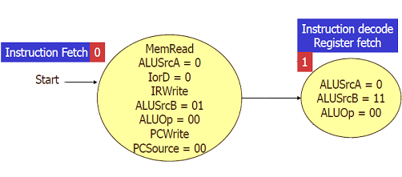
Control signals
  In the standard setting, the first two states of the control signals in the multi-cycle datapath are always these:
Multi-cycle datapath

Slide 6
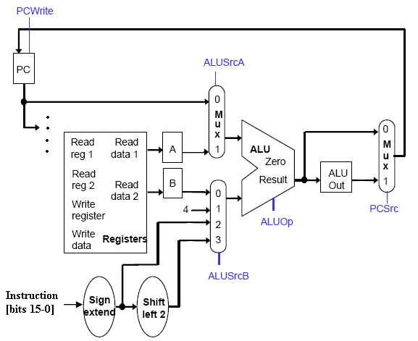
State 0
  In state 0, the addition PC + 4 is done and the result is put in the input of PC. Again, the value of PC is updated to it when the next cycle starts.
Multi-cycle datapath

Slide 7
State 1
  Then, in state 1, PC has the original address in PC plus 4.
  The sign-extended and shifted version of the least significant 16 bits (bit 0 to bit 15) of the instruction is added to the current value of PC.
  If the instruction is a "branch" instruction, the result is used to update PC (in the next cycle). Otherwise, the result is not used (by setting the control signals accordingly).
Multi-cycle datapath

Slide 8
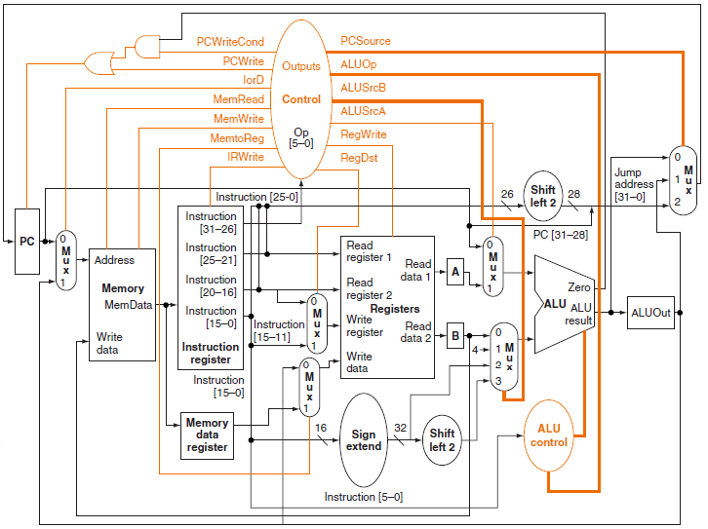
Exercises
Question 1: Consider the following multi-cycle datapath for the instruction “jr”.
Multi-cycle datapath

Slide 9
Exercise
(a) Draw the third and fourth states of the control signals for the execution of the following instruction:
Assembly code (jr $reg) | jr $t0
Machine code: | 000000 01000 00000 00000 00000 001000 OpCode Rs Rt Rd Shift function
Multi-cycle datapath

Slide 10
Exercise
(b) Fill in the table below with the values (in hex. format) of the registers in the beginning of each execution cycle of “jr $t0”, based on the values given in the first cycle. The value of $t0 is 0x000004F1. If a value is unknown, write down "x" instead.
Solution:
1st cycle | PC = 001f0000, IR = x, A = x, B = x, ALUOut = x, MDR (Memory Data Register) = x
2nd cycle
3rd cycle
4th cycle
After 4th cycle | PC = 000004f1
Multi-cycle datapath

Slide 11
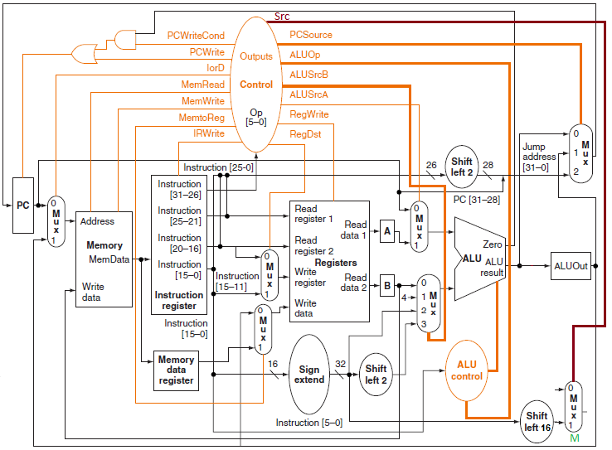
Exercises
Question 2: Consider the following partial implementation of the multi-cycle datapath for the instruction “lui”.
Multi-cycle datapath

Slide 12
Exercises
(a) Complete the datapath to implement the instruction “lui” by making only the following changes:
1. Break up one of the existing data paths,
2. connect one of the two broken ends to the input 0 of the multiplexor M, and
3. connect the other broken end to the output of M.
Also, the standard setting of the control signals in the first two cycles (learnt from the lecture) must not have to be modified for your answer. The new signal Src for M must be set to 1 in only the third cycle of the execution.
Multi-cycle datapath

Slide 13
Exercises
(b) Fill in the table below with the control signals in each execution cycle of “lui”. Your answer in this part must be in accord with that in part (a). If different values of a signal in a particular cycle do not change the execution in that cycle, write down "x" for it.
 | PCWriteCond | PCWrite | IorD | MemRead | MemWrite | MemToReg | IRWrite
3rd cycle
4th cycle
5th cycle
 | Src | PCSource | ALUOp | ALUSrcB | ALUSrcA | RegWrite | RegDst
3rd cycle
4th cycle
5th cycle
Multi-cycle datapath

Slide 14
Exercises
(c) Draw all the states, after the state 0 and state 1, of the control signals according to your answer in part (a) only.
Solution:
Multi-cycle datapath

Slide 15
Multi-cycle Datapath
Datapath implementation
- the updating of the datapath registers in each
execution cycle
- the standard setting of the control signals
- exercises
Exercise
Multi-cycle datapath

Slide 16
Exercises
Question 1: Redo all the parts of Question 2 of the previous exercise with this change: in part (a) the signal Src must be set to 1 in only the second cycle of the execution. The standard setting of the control signals in the first two cycles are still used.
Multi-cycle datapath

Slide 17
Conclusion
You have learnt:
  how an instruction is executed through the guidance of the control signals.
  how the registers of the datapath change in each clock cycle as an instruction is executing.
Multi-cycle datapath

