Slide 1
Comp 3311 Database Management Systems
3. Relational Data Model
Exercises

Slide 2
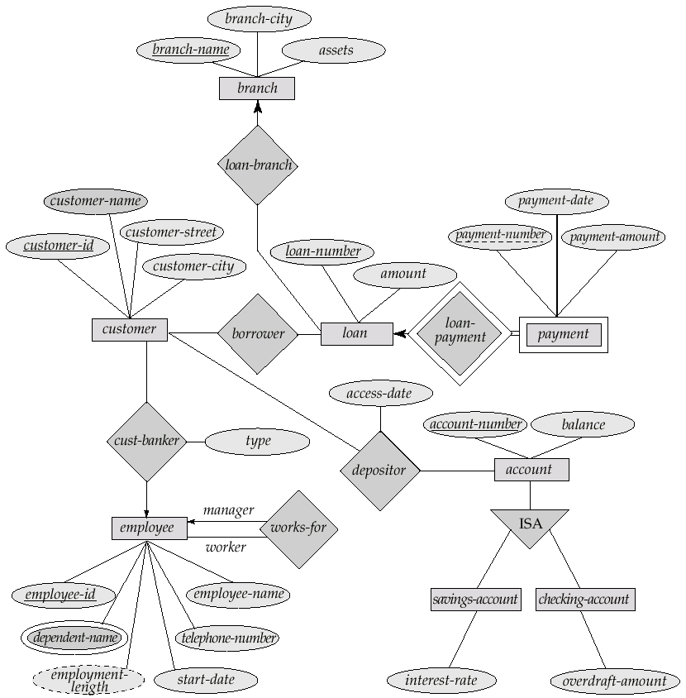
E-R Diagram for a Banking Enterprise

Slide 3
Tables for ER diagram
Entities
Branch (branch-name, branch-city, assets)
Customer (customer-id, customer-name, customer-street, customer-city)
Loan (loan-number, amount)
Employee (employee-id, employee-name, telephone-number, start-date)
Account (account-number, balance)
Savings-account (account-number, interest-rate)
Checking-account (account-number, overdraft-amount)

Slide 4
Tables for ER diagram
Weak Entity
Payment (loan-number, payment-number, payment-date, payment-amount)
Multi-valued attribute
Dependent (employee-id, dependent-name)

Slide 5
Tables for ER diagram
Many-to-many relationships
Borrower (customer-id, loan-number)
Depositor (customer-id, account-number, access-date)
One-to-many relationships
Loan-branch is represented in Loan (loan-number, amount, branch-name)
Cust-banker is represented in Customer (customer-id, customer-name, customer-street, customer-city, employee-id, type)
Works-for is represented in Employee (employee-id, employee-name, telephone-number, start-date, manager-id)

Slide 6
ER to Tables
Convert the ER diagram into tables.

Slide 7
Tables for ER diagram
Entities
Route (number, departure, destination)
Driver (id, name, phone)
Bus (license, capacity)
Weak Entity
Schedule (number, departure-time)
Relationships
Drives (number, departure-time, id)
Bus-in-use (license, number, departure-time)

Slide 8
Example
Let the following relational schema:
B(X,W),
C(P,Q,X) where X is defined as NOT NULL,
D(P,X,R)
Give an ER diagram for the above relational schema.

Slide 9
Solution

