Slide 1
Comp 3311 Database Management Systems
13. Introduction to Indexing
Exercises

Slide 2
Indexing Problem 1
Assume a movie database with the following sizes of each attribute:
Film (Title : 40 bytes, Director Name: 20 bytes, Year: 4 bytes, Company: 20 bytes)
Actor (ID: 4 bytes, Name: 20 bytes, Date_of_Birth: 4 bytes)
There exist 30,000 films in the database and 100,000 actors. Each page is 512 bytes and each pointer is 6 bytes. The blocking factor of a file (bfr) is the number of records that fit in a page.
1] What is the blocking factor for Film relation bfrF and bfrA for Actor relation?
bfrF =⎣512/84⎦ = 6, bfrA = ⎣ 512/28 ⎦ =18
2] Assuming that the Film relation is sorted on the Title and there is no index what is the cost (in terms of page reads) for:
2a] finding the film with title "Titanic":
The file is stored in 30,000/6=5,000 pages. Cost of binary search: ⎡log₂5000⎤=13
2b] finding all the films directed by director “John Woo":
We need sequential scan since sorting is not based on director (5000 pages)

Slide 3
Indexing Problem 1 (cont)
3] Assume that the Actor relation is sorted on the name and you want to create an ordered index on ID (each index entry has the form <ID, pointer>).
3a] What is the blocking factor for the index (single-level):
bfr_{Aindex}= 512/(4+6)=51
3b] How many index entries you need:
100,000 we need dense index because sorting is according to name (not ID).
3c] How many pages are required for these entries:
100,000/51=1961
3d] What is the cost of retrieval based on a single id using this organization (e.g., “Find actor with id=100”).
⎡ log₂1961 ⎤ +1=12

Slide 4
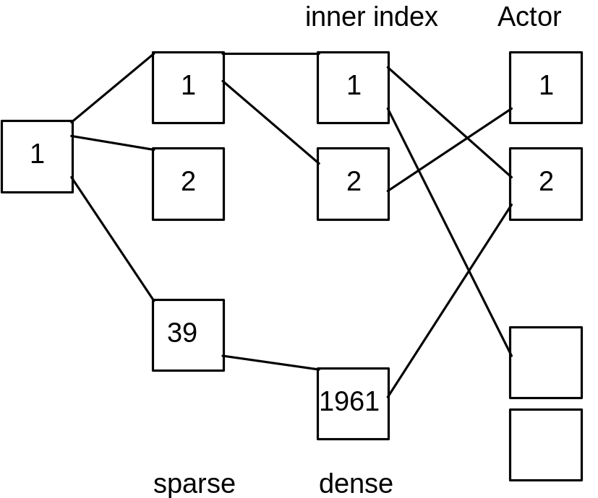
Indexing Problem 1 (cont)
3e] If you convert the above index in multiple-level index, how many levels you need (assuming full pages)?
At the next level we index 1961 pages – i.e., index contains 1961/51=39 pages. We need an additional top level with 1 page
3f] What is the cost of answering the query “Find actor with id=100”?
4 page accesses

Slide 5
Indexing Problem 2
Assume that a big company keeps a file with the records of its employees: Employee (eid: 6 bytes, ename: 10 bytes, did: 4 bytes) , where did is the id of the department where the employee works.
There exist 100,000 employee records and 1,000 departments (each department has 100 employees). A page is 1,000 bytes and a pointer is 4 bytes.
1] Assume that the employee file is sorted sequentially (no pointers between leaf pages) on did and there is no index. What is the cost (in terms of page reads) for retrieving the records of all employees working in a department with a given id (for instance, in department number 64):
Answer :
record size = 20 bytes, 50 records per page, 2,000 pages.
Finding the first record requires log₂2000 + 1 more page to search the remaining records (each dept has 100 employees which are distributed in 2 pages).
The answer log₂2000 + 2 is also considered correct (e.g., the first page contains 25 records – the second one 50 – and the third one 25).

Slide 6
Indexing Problem 2 (cont)
2] Assume that we add a single-level ordered index on eid on the above file (each entry has the form <eid, pointer> - the number of pointers is the same as the number of search keys).
2a] How many index entries you need (explain briefly):
100,000 entries – the index must be dense since the file is sorted on a different attribute
2b] How many pages are required for these entries, and what is the cost of retrieving the record of an employee with a given eid:
index entry size = 10 bytes, 100 entries per page, 1,000 pages for the index, cost: log₂1000+1

Slide 7
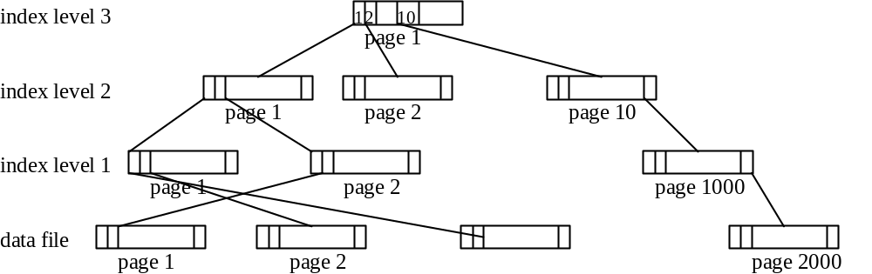
Indexing Problem 2 (cont)
2c] If you convert the above index in multiple-level index, how many levels you need (assuming full pages)?

Slide 8
Indexing Problem 2 (cont)
3] Assume that instead of an ordered index, we want to build a hash index on eid on the above file (each entry has again the form <eid, pointer>).
3a] How many index entries you need:
100,000 entries – the index must be dense since a hash index is always secondary.
3b] How many pages are required for these entries, and what is the cost of retrieving the record of an employee with a given eid:
index entry size = 10 bytes, 100 entries per page, 1,000 pages for the index.
Assuming no overflow buckets the cost is 2.

