Slide 1
Comp 3311 Database Management Systems
14. B+-trees and Dynamic Hashing
Exercises

Slide 2
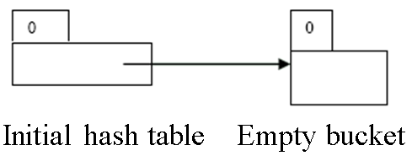
Hashing Problem 1
Suppose that we are using extendable hashing index that contains the following search-key values K: 17, 20, 25, 30, 22, 23, 37. Assuming the search-key values arrive in the given order (i.e. 17 being the first coming key and 37 being the last one). Show the extendable hash structure for each insertion of the above key values file if the hash function is h(x) = x mod 8 and buckets can hold two keys. You should follow the convention used by lecture slides: binary hash indices starting from the least significant bit. The initial configuration of the structure should be used as the given diagram below. (I.e. time stamps start from 0.)

Slide 3
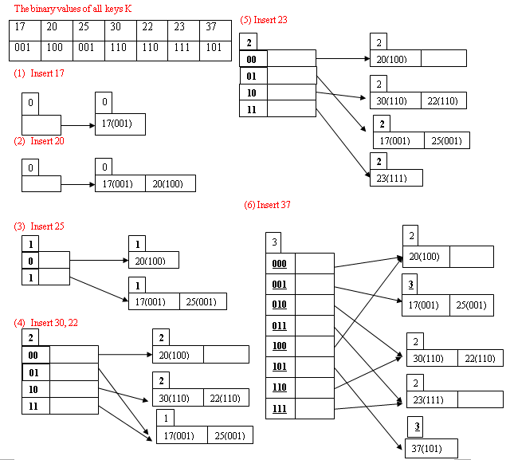
Hashing Problem 1

